Slide 1

Functions and Procedures
ALMAARIF UNIVERSITY
CET/
Advanced Digital Electronics
Lecture 9

Slide 2
Outlines
Introduction
FUNCTION
Function Location
PROCEDURE
Procedure Location
FUNCTION versus PROCEDURE Summary
ASSERT

Slide 3
Introduction
FUNCTIONS and PROCEDURES are subprograms. They are very similar to a PROCESS, for they are the only pieces of sequential VHDL code, and thus employ the same sequential statements seen there (IF, CASE, and LOOP; WAIT is not allowed).
There is a fundamental difference between a PROCESS and a FUNCTION or PROCEDURE. While the first is intended for immediate use in the main code, the others are intended mainly for LIBRARY allocation, that is, their purpose is to store commonly used pieces of code, so they can be reused or shared by other projects. Nevertheless, if desired, a FUNCTION or
PROCEDURE can also be installed in the main code itself.

Slide 4
FUNCTION
A FUNCTION is a section of sequential code. Its purpose is to create new functions to deal with commonly encountered problems, like data type conversions, logical operations, arithmetic computations, and new operators and attributes. By writing such code as a FUNCTION, it can be shared and reused, also propitiating the main code to be shorter and easier to understand.
To construct and use a function, two parts are necessary: the function itself (function body) and a call to the function. Their syntaxes are shown next.

Slide 5
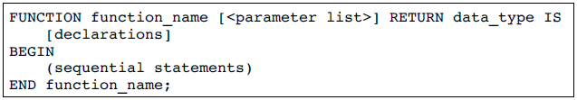
FUNCTION Body
parameter list specifies the function’s input parameters:
<parameter list>:[CONSTANT] constant_name: constant_type; or
<parameter list>: SIGNAL signal_name: signal_type;
There can be any number of such parameters (even zero), which, can only be CONSTANT (default) or SIGNAL (VARIABLES are not allowed).
Their types can be any of the synthesizable data types

Slide 6

FUNCTION
Example: The function below, named f1, receives three parameters (a, b, and c).
a and b are CONSTANTS (notice that the word CONSTANT can be omitted, for it is the default object), while c is a SIGNAL.
a and b are of type INTEGER, while c is of type STD_LOGIC_VECTOR. Notice that neither RANGE nor DOWNTO was specified.
The output parameter (there can be only one) is of type BOOLEAN.

Slide 7

FUNCTION Call
A function is called as part of an expression. The expression can obviously appear by itself or associated to a statement (either concurrent or sequential).
Examples of function calls:

Slide 8
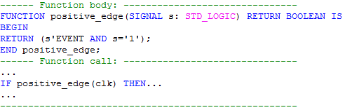
Example 1: Function positive_edge( )
The FUNCTION below detects a positive (rising) clock edge. It is similar to the IF(clk’EVENT and clk= ‘1’) statement. This function could be used, for example, in the implementation of a DFF.

Slide 9
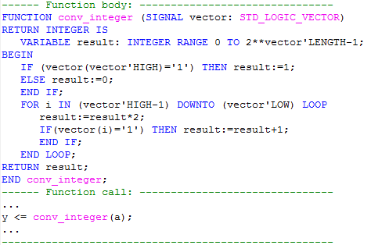
Example 2: Function conv_integer ( )
The FUNCTION presented next converts a parameter of type STD_LOGIC_VECTOR into an INTEGER. Notice that the code is generic, that is, it works for any range or order (TO/DOWNTO) of the input STD_LOGIC_VECTOR parameter.

Slide 10
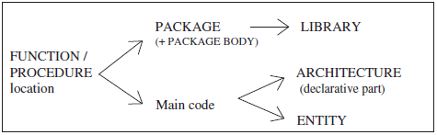
FUNCTION Location
The typical locations of a FUNCTION (or PROCEDURE) are shown in figure below. Though a FUNCTION is usually placed in a PACKAGE or in the main code. When placed in a PACKAGE, then a PACKAGE BODY is necessary, which must contain the body of each FUNCTION (or PROCEDURE) declared in the declarative part of the PACKAGE.

Slide 11
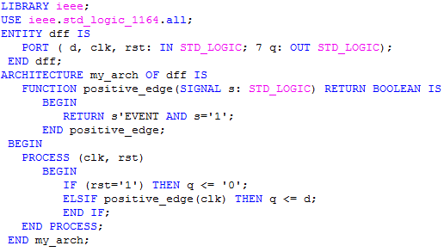
Example 3: Function located in Main code
Function in example1, if installed in main code, can be located either in the ENTITY or the declarative part of the ARCHITECTURE. here, the function appears in the latter, and used to construct a DFF.

Slide 12
Example 4: Function located a Package
This example is similar to example 3, with the only difference being that the FUNCTION located in a PACKAGE can now be reused and shared by other projects.
Notice that, when placed in a PACKAGE, the function is indeed declared in the PACKAGE, but described in the PACKAGE BODY.
Below two VHDL codes are presented, being one relative to the construction of the FUNCTION / PACKAGE, while the other is an example where a call to the FUNCTION is made.
The two codes can be compiled as two separate files, or can be compiled as a single file (saved as dff.vhd, which is the ENTITY’s name). Notice the inclusion of ‘‘USE work.my_package.all;’’ in the main code.

Slide 13
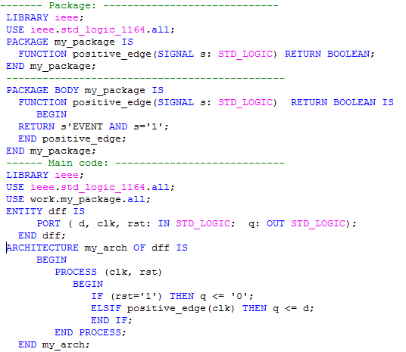

Slide 14
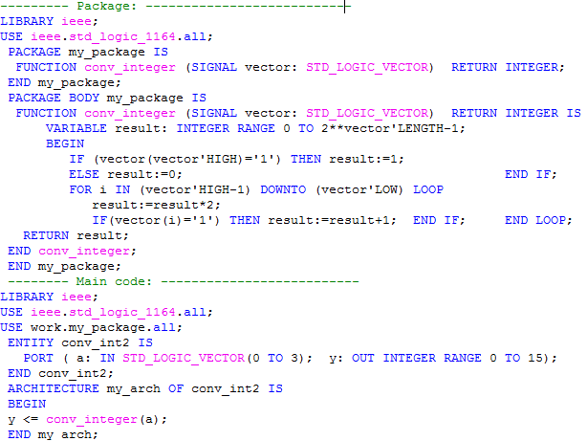
Example 5: Function conv_integer()

Slide 15
Example 6: Function “+” Operator
The function shown below, called ‘‘+‏’’, overloads the pre-defined ‘‘‏+’’ (addition) operator. Recall that the latter accepts only INTEGER, SIGNED, or UNSIGNED values. However, we are interested in writing a function which should allow the sum of STD_LOGIC_VECTOR values as well (thus overloading the ‘‘+‏’’ operator). The function shown below was placed in a PACKAGE (plus PACKAGE BODY).
An example utilizing this function is also presented in the main code that follows the function implementation. Notice that the two parameters passed to the function, as well as the return value, are all of type STD_LOGIC_VECTOR. We assume that they all have the same number of bits.

Slide 16
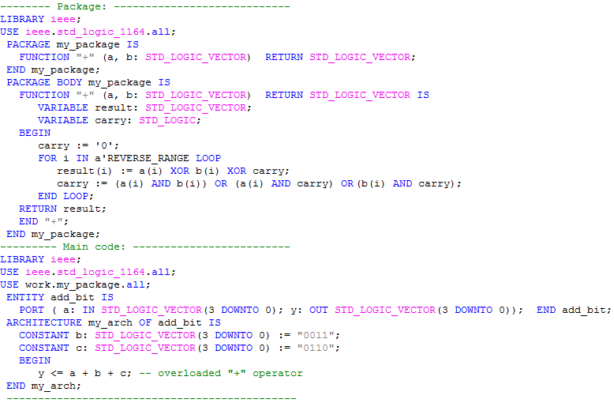

Slide 17
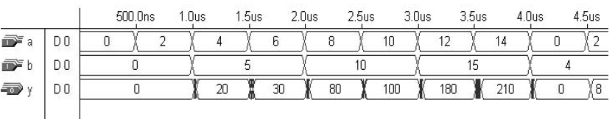
Example 7: Multiplier
Here, a function called mult( ) is presented. It multiplies two UNSIGNED values, returning their UNSIGNED product. The parameters passed to the function do not need to have the same number of bits, and their order (TO/DOWNTO) can be any. The function was installed in a package called pack. An application example (main code) is also presented. Simulation results are :

Slide 18
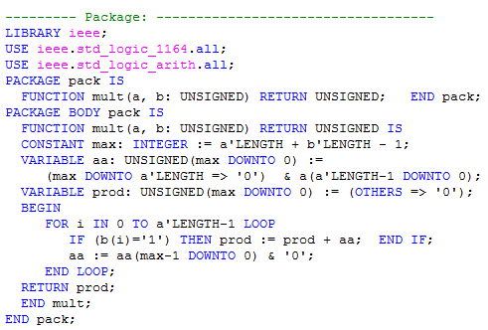
Example 7: Multiplier

Slide 19
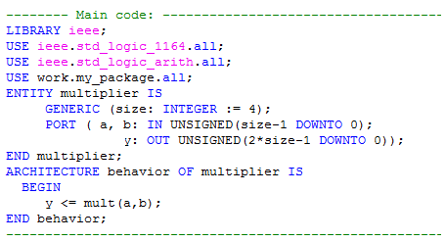
Example 7: Multiplier

Slide 20
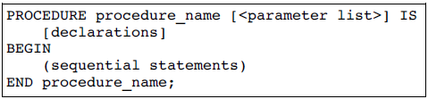
Procedures / Procedure Body
A PROCEDURE is very similar to a FUNCTION But a procedure can return more than one value. Also, two parts are necessary to construct and use a PROCEDURE: the procedure itself (procedure body) and a procedure call. the Procedure Body :
In the syntax above, <parameter list> specifies the procedure’s input and output :
<parameter list> = [CONSTANT] constant_name: mode type;
<parameter list> = SIGNAL signal_name: mode type; or
<parameter list> = VARIABLE variable_name: mode type;

Slide 21

Procedures
A PROCEDURE can have any number of in, out, or inout parameters, which can be SIGNALS, VARIABLES, or CONSTANTS.
Inputs default is CONSTANT, outputs default is VARIABLE.
WAIT, SIGNAL declarations, and COMPONENTS are not synthesizable when used in a FUNCTION or a PROCEDURE.
Example: The PROCEDURE next has three inputs, a, b, and c.
A CONSTANT of type BIT, while b and c are SIGNALS, also of type BIT. Notice that the word CONSTANT can be omitted for input parameters, for it is the default object (for outputs the default object is VARIABLE). There are also two return signals, x and y type INTEGER.

Slide 22

Procedures Call
Contrary to a FUNCTION, which is called as part of an expression, a PROCEDURE call is a statement on its own. It can appear by itself or associated to a statement (either concurrent or sequential).
Examples of procedure calls:

Slide 23
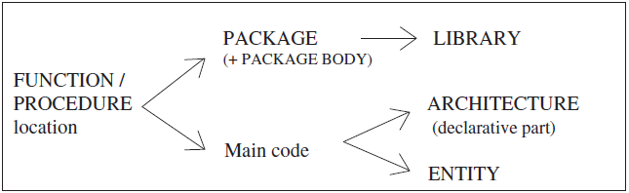
Procedures Location
The typical locations of a PROCEDURE are the same as those of a FUNCTION. Again, though it is usually placed in a PACKAGE, it can also be located in the main code (either in the ENTITY or in the declarative part of the ARCHITECTURE). When placed in a PACKAGE, a PACKAGE BODY is then necessary, which must contain the body of each PROCEDURE declared in the declarative part of the PACKAGE.

Slide 24
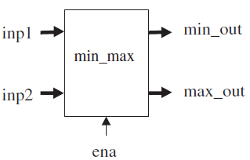
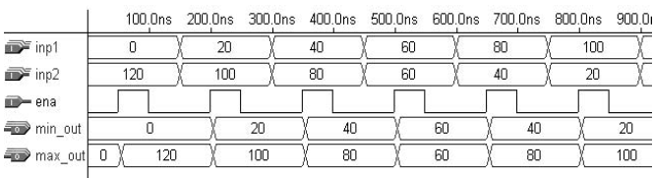
Example 8: PROCEDURE Located in Main Code
The min_max code below takes two 8-bit unsigned integers inputs (inp1, inp2), sorts them, then outputs the smaller value at min_out and the higher value at max_out. The PROCEDURE sort is located in the declarative part of the ARCHITECTURE (main code). Simulation results are shown in figure:

Slide 25
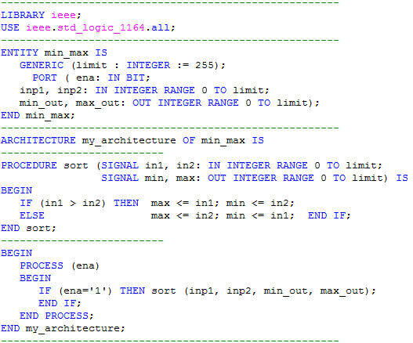
Example 8: PROCEDURE Located in Main Code

Slide 26
Example 9:
PROCEDURE Located in a Package
This example is similar to example 8, with the only difference being that now the PROCEDURE (called sort) is placed in a PACKAGE (called my_package). Thus the PROCEDURE can now be reused and shared with other designs. The code below can be compiled as two separate files, or can be compiled as a single file (called min_max.vhd, which is the ENTITY’s name).

Slide 27
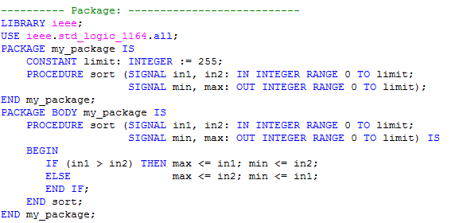
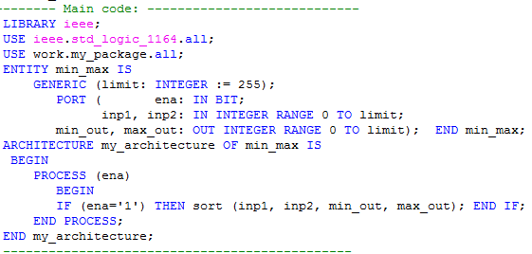

Slide 28
FUNCTION versus PROCEDURE Summary
A FUNCTION has zero or more input parameters and a single return value. The input parameters can only be CONSTANTS (default) or SIGNALS (VARIABLES are not allowed).
A PROCEDURE can have any number of IN, OUT, and INOUT parameters, which can be SIGNALS, VARIABLES, or CONSTANTS. For input parameters (mode IN) the default is CONSTANT, whereas for output parameters (mode OUT or INOUT) the default is VARIABLE.
A FUNCTION is called as part of an expression, while a PROCEDURE is a statement on its own.
In both, WAIT and COMPONENTS are not synthesizable.
The possible locations of FUNCTIONS and PROCEDURES are the same. They are usually placed in PACKAGES (for code partitioning, sharing, and reuse purposes), they can also be located in the main code (either inside the ARCHITECTURE or inside the ENTITY). When placed in a PACKAGE, then a PACKAGE BODY is necessary, which should contain the body of each FUNCTION and/or PROCEDURE declared in the PACKAGE.

Slide 29
Home work:
Arithmetic Shift Function
Write a function which arithmetically shifts a STD_LOGIC_VECTOR value to the left. Two arguments should be passed to the function: arg1 and arg2. The first is the vector to be shifted, while the second specifies the amount of shift. Make your function totally generic; that is, it works for any size (number of bits) or order (TO/DOWNTO) of the input vector. the function should located in the main code instead of in a package.

Slide 30

Questions?

