Slide 1


Packages & Components
Advanced Digital Electronics
Lecture 8

Slide 2
Outlines
Introduction
PACKAGE
COMPONENT
PORT MAP
GENERIC MAP

Slide 3
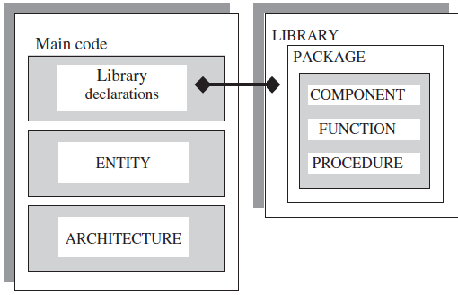
Introduction
In this lecture and the next one a new building blocks will added to the material already presented. These new building blocks are intended mainly for library allocation, as shown in figure: Packages, Components, Functions, and Procedures.
These new units can be located in the main code itself, but it is more usual to place them in a LIBRARY. This also leads to code partitioning, which is helpful when dealing with long codes.

Slide 4
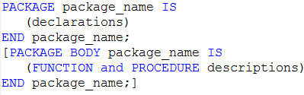
PACKAGE
A frequently used pieces of VHDL code are usually written in the form of COMPONENTS, FUNCTIONS, or PROCEDURES. Such codes are then placed inside a PACKAGE and compiled into the destination LIBRARY. The importance of this technique is that it allows code partitioning, code sharing, and reuse. Its syntax is:

Slide 5
PACKAGE
The syntax is composed of two parts: PACKAGE and PACKAGE BODY.
The first part contains all declarations, while the second part is necessary only when one or more subprograms (FUNCTION or PROCEDURE) are declared in the upper part, in which case it must contain the descriptions (bodies) of the subprograms. PACKAGE and PACKAGE BODY must have the same name.
The declarations list can contain the following: COMPONENT, FUNCTION, PROCEDURE, TYPE, CONSTANT, etc.

Slide 6
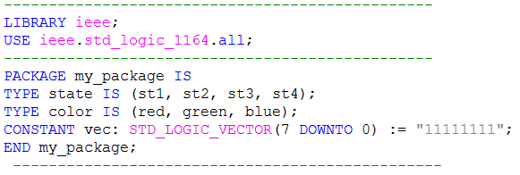
Example 1: Simple Package
The example below shows a PACKAGE called my_package. It contains only TYPE and CONSTANT declarations, so a PACKAGE BODY is not necessary.

Slide 7
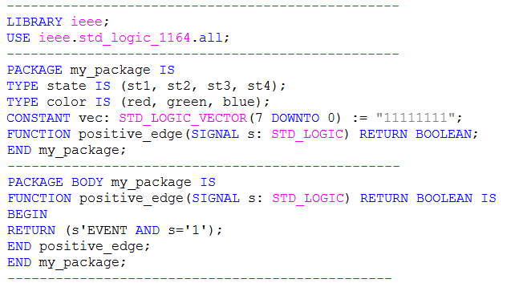
Example 2: Package with a Function
This example contains, TYPE and CONSTANT declarations, and FUNCTION. Therefore, a PACKAGE BODY is now needed. This function returns TRUE when a positive edge occurs on clk.

Slide 8
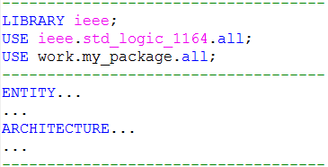
PACKAGE
Any of the PACKAGES above (example 1 or example 2) can now be compiled, becoming then part of our work LIBRARY (or any other). To make use of it in a VHDL code, we have to add a new USE clause to the main code (USE work.my_package.all), as shown below.

Slide 9
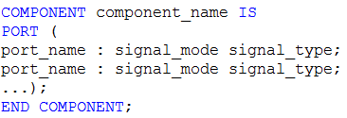
COMPONENT
A COMPONENT is simply a piece of code, by declaring such code as a COMPONENT, it can then be used within another circuit for hierarchical designs. A COMPONENT is also another way of partitioning a code and providing code sharing and code reuse. Commonly used circuits, like flip-flops, multiplexers, adders, basic gates, etc., can be placed in a LIBRARY, so any project can make use of them without rewrite such codes. its syntaxes: COMPONENT declaration:
COMPONENT instantiation:

Slide 10
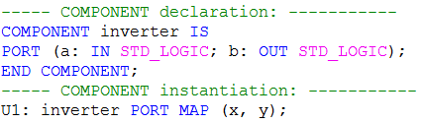
COMPONENT
Consider an inverter, which has been previously designed (inverter.vhd) and compiled into the work library. We can make use of it by means of the code shown below. The label chosen for this component was U1. The names of the ports in the actual circuit are x and y, which are being assigned to a and b, respectively, of the pre-designed inverter (this is called positional mapping, for the first signal in one corresponds to the first signal in the other, the second in one to the second in the other, and so on).

Slide 11
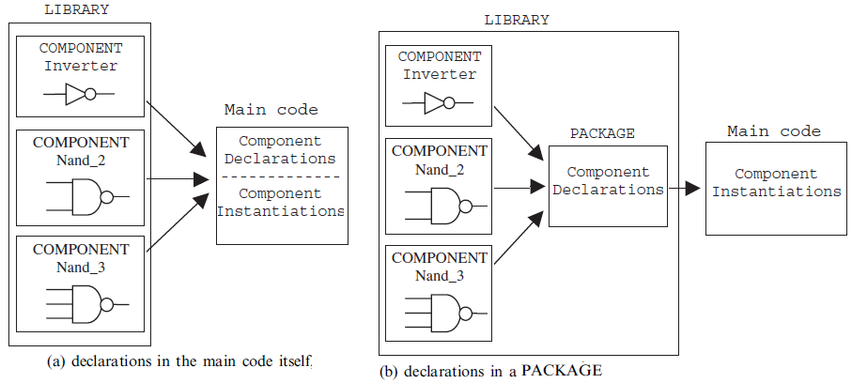
COMPONENT
There are two basic ways to declare a COMPONENT. Once we have designed it and placed it in the destination LIBRARY, then declare it in the main code itself, figure (a), or we can declare it using a PACKAGE, figure (b), which avoids the repetition of the declaration every time the COMPONENT is instantiated.

Slide 12
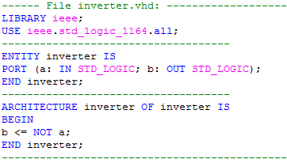
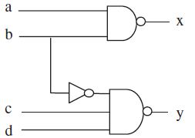
Example 3: Components Declared in the Main Code
To implement the circuit of figure below using COMPONENTS (inverter, nand_2, and nand_3), but without creating a specific PACKAGE to declare them. Then four pieces of VHDL code are needed: one for each component, plus one for the project (main code). All four files are shown below:

Slide 13
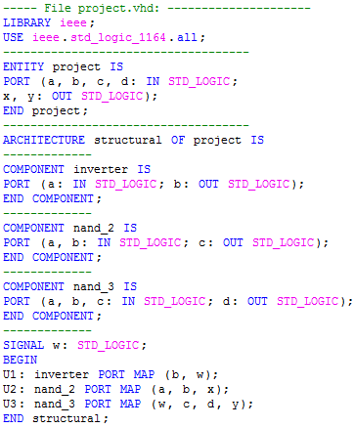
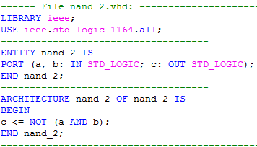
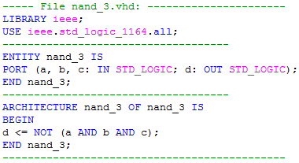
Example 3: Components Declared in the Main Code

Slide 14
Example 4:Components Declared in a Package
To implement the same project of the previous example a PACKAGE for all COMPONENTS (inverter, nand_2, and nand_3) will be declared. Thus now five pieces of VHDL code are needed: one for each component, one for the PACKAGE, and finally one for the project. Despite having an extra file (PACKAGE), such extra file needs to be created only once, thus avoiding the need to declare the components in the main code every time they are instantiated.
extra USE clause
(USE work.my_components.all) is now necessary, in order to make the PACKAGE my_components visible to the design.

Slide 15
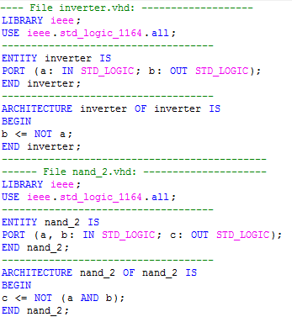
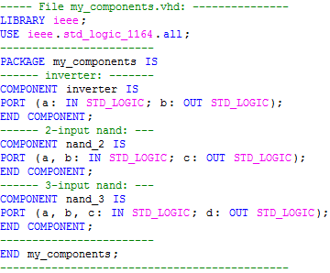
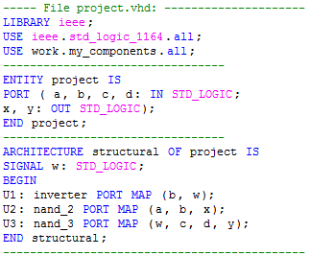
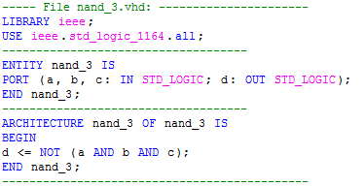

Slide 16

PORT MAP
There are two ways to map the PORTS of a COMPONENT during its instantiation: positional mapping and nominal mapping. example:
here, the mapping is positional; that is, PORTS x and y correspond to a and b, respectively. On the other hand, a nominal mapping would be the following:
Positional mapping is easier to write, but nominal mapping is less error. Ports can also be left unconnected (using the keyword OPEN). For example:

Slide 17
GENERIC MAP
GENERIC can be instantiated. In that case, a GENERIC MAP must be used in the COMPONENT instantiation to pass information to the GENERIC parameters. The new syntax is shown below.
The only differences from the syntax already presented are the inclusion of the word GENERIC and of a parameter list. The purpose is to inform that those parameters are to be considered as generic. The usage of GENERIC MAP is illustrated in the next example.

Slide 18

Example 5:Instantiating a Generic Component
Consider the generic parity generator of example which adds one bit to the input vector (on its left-hand side). Such bit must be a ‘0’ if the number of ‘1’s in the input vector is even, or a ‘1’ if it is odd, such that the resulting vector will always contain an even number of ‘1’s. The code presented next slide is generic (that is, works for any positive integer n). Two files are shown: one relative to the COMPONENT (par_generator, which, indeed,
we can assume as previously designed and available in the work library), and one relative to the project itself (main code), where the component par_generator is instantiated.

Slide 19
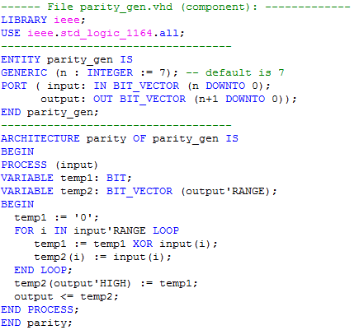
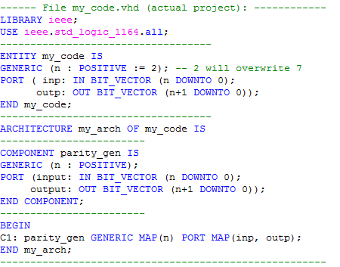
Example 5:Instantiating a Generic Component

Slide 20
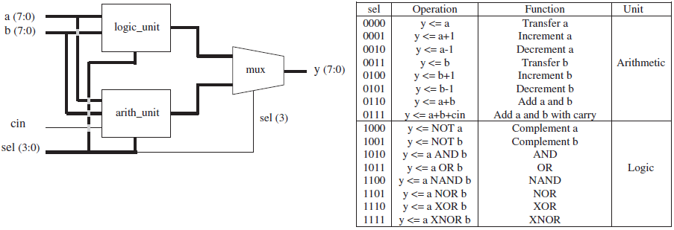
Example 6: ALU made of Component
An ALU (Arithmetic Logic Unit) in figure. Can be design with component assume that our library contains the three components (logic_unit, arith_unit, and mux) with which the ALU can be constructed.

Slide 21
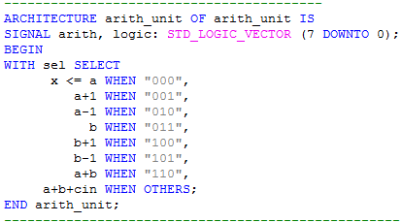
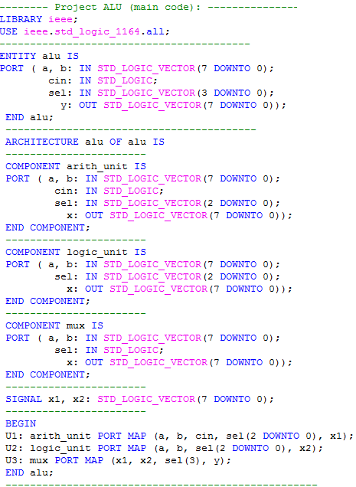
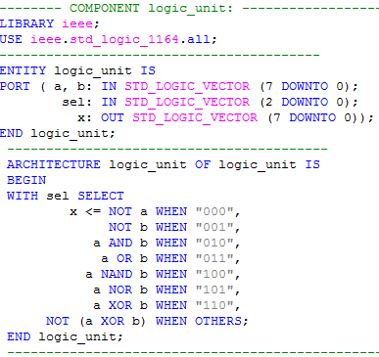
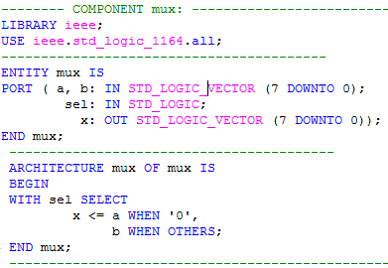

Slide 22
Home work:
ALU with Components Declared in a Package
Redo example 6. This time, create a PACKAGE containing all COMPONENT declarations. Then make the changes needed in the main code and recompile it.

Slide 23

Questions?

