Slide 1


State Machines
Advanced Digital Electronics
Lecture 7

Slide 2
  Outlines
Introduction
Design Style #1
Design Style #2 (Stored Output)
Moore and Mealy machines
Encoding Style: From Binary to OneHot

Slide 3
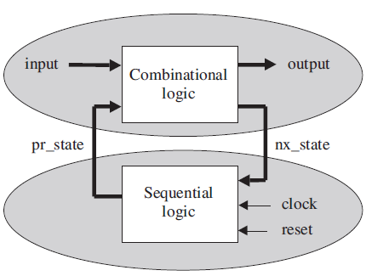
Introduction
Finite state machines (FSM) constitute a special modeling technique for sequential logic circuits. Figure shows the block diagram of a single-phase state machine. As indicated in the figure, the lower section contains the sequential logic (flip-flops), while the upper section contains the combinational logic.
The combinational (upper) section has two inputs, pr_state (present state) and the external input. It has two outputs, nx_state (next state) and the external output.
The sequential (lower) section has three inputs (clock, reset, and nx_state), and one output (pr_state).

Slide 4
Introduction
If the output of the machine depends not only on the present state but also on the current input, then it is called a Mealy machine. Otherwise, if it depends only on the current state, it is called a Moore machine.
The separation of the circuit into two sections allows the design to be broken into two parts as well. It is clear that the lower part sequential, will require a PROCESS, while the upper part combinational, will not. However, sequential code can implement both types of logic, combinational as well as sequential. i.e. the upper part can also be implemented using a PROCESS. When reset is asserted, pr_state will be set to the system’s initial state. Otherwise, at the proper clock edge the flip-flops will store nx_state, thus transferring it to the lower section’s output (pr_state).

Slide 5
Design Style #1
Several approaches can be conceived to design a FSM. In this lecture we will describe in detail one style that is well structured and easily applicable. In it, the design of the lower section of the state machine is completely separated from that of the upper section.
All states of the machine are always explicitly declared using an enumerated data type. After introducing such a design style, we will examine it from a data storage perspective, in order to further understand and refine its construction, which
will lead to design style #2.

Slide 6
Design Style #1:
Design of the Lower (Sequential) Section
A typical design template for the lower section is the following:
PROCESS (reset, clock)
BEGIN
IF (reset='1') THEN pr_state <= state0;
ELSIF (clock'EVENT AND clock='1') THEN
pr_state <= nx_state;
END IF;
END PROCESS;

Slide 7
Design Style #1:
Design of the Lower (Sequential) Section
The code shown above is very simple consisting an asynchronous reset, which determines the initial state of the system (state0), followed by the synchronous storage of nx_state (at the positive transition of clock), which will produce pr_state at the lower section’s output. One good thing about this approach is that the design of the lower section is basically standard. Another advantage of this design style is that the number of registers is minimum. The number of flip-flops inferred from the code above is simply equal to the number of bits needed to encode all states of the FSM (because the only signal to which a value is assigned at the transition of another signal is pr_state).

Slide 8
Design Style #1:
Design of the Upper (Combinational) Section
The upper section is fully combinational, so its code does not need to be sequential; concurrent code can be used as well. In next template sequential code CASE statement playing the central role, recall that rules 1 and 2 of section (Using Sequential Code to Design Combinational Circuits) must be observed.
The code is also very simple, and does two things: (a) it assigns the output value and (b) it establishes the next state. Notice also that it complies with rules 1 and 2 relative to the design of combinational circuits using sequential statements, for all input signals are present in the sensitivity list and all input/output combinations are specified. Finally, observe that no signal assignment is made at the transition of another signal, so no flip-flops will be inferred.

Slide 9
Design Style #1:
Design of the Upper (Combinational) Section
PROCESS (input, pr_state)
BEGIN
CASE pr_state IS
WHEN state0 => IF (input = ...) THEN
output <= <value>;
nx_state <= state1;
ELSE ...
END IF;
WHEN state1 => IF (input = ...) THEN
output <= <value>;
nx_state <= state2;
ELSE ...
END IF;
WHEN state2 => IF (input = ...) THEN
output <= <value>;
nx_state <= state3;
ELSE ...
END IF;
...
END CASE;
END PROCESS;

Slide 10
State Machine Template for Design Style #1
LIBRARY ieee;
USE ieee.std_logic_1164.all;
-----------------------------------------------------
ENTITY <entity_name> IS
PORT ( input : IN <data_type>;
reset, clock: IN STD_LOGIC;
output : OUT <data_type>); END <entity_name>;
-----------------------------------------------------
ARCHITECTURE <arch_name> OF <entity_name> IS
TYPE state IS (state0, state1, state2, state3, ...);
SIGNAL pr_state, nx_state: state;
BEGIN
---------- Lower section: ------------------------
PROCESS (reset, clock)
BEGIN
IF (reset='1') THEN pr_state <= state0;
ELSIF (clock'EVENT AND clock='1') THEN pr_state <= nx_state;
END IF; END PROCESS;
---------- Upper section: ------------------------
PROCESS (input, pr_state)
BEGIN
CASE pr_state IS
WHEN state0 => IF (input = ...) THEN output <= <value>;
nx_state <= state1;
ELSE ... END IF;
WHEN state1 => IF (input = ...) THEN output <= <value>;
nx_state <= state2;
ELSE ... END IF;
WHEN state2 => IF (input = ...) THEN output <= <value>;
nx_state <= state3;
ELSE ... END IF;
            ...
END CASE; END PROCESS; END <arch_name>;

Slide 11
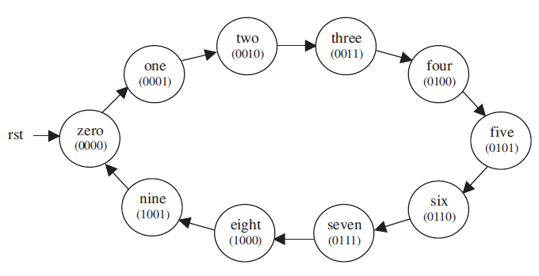
Example 1: BCD Counter
A counter is an example of Moore machine, for the output depends only on the stored (present) state. It can be easily implemented using conventional or FSM type. The state diagram of a 0-to-9 circular counter is shown in figure below. The states were called zero, one, . . . , nine, each name corresponding to the decimal value of the output.

Slide 12
LIBRARY ieee;
USE ieee.std_logic_1164.all;
ENTITY counter IS
PORT ( clk, rst: IN STD_LOGIC;
count: OUT STD_LOGIC_VECTOR (3 DOWNTO 0));
END counter;
ARCHITECTURE state_machine OF counter IS
TYPE state IS (zero, one, two, three, four, five, six, seven, eight, nine);
SIGNAL pr_state, nx_state: state;
BEGIN
------------- Lower section: -----------------
PROCESS (rst, clk)
BEGIN
IF (rst='1') THEN pr_state <= zero;
ELSIF (clk'EVENT AND clk='1') THEN pr_state <= nx_state;
END IF;
END PROCESS;
------------- Upper section: -----------------
PROCESS (pr_state)
BEGIN
CASE pr_state IS
WHEN zero => count <= "0000"; nx_state <= one;
WHEN one => count <= "0001"; nx_state <= two;
WHEN two => count <= "0010"; nx_state <= three;
WHEN three => count <= "0011"; nx_state <= four;
WHEN four => count <= "0100"; nx_state <= five;
WHEN five => count <= "0101"; nx_state <= six;
WHEN six => count <= "0110"; nx_state <= seven;
WHEN seven => count <= "0111"; nx_state <= eight;
WHEN eight => count <= "1000"; nx_state <= nine;
WHEN nine => count <= "1001"; nx_state <= zero;
END CASE;
END PROCESS;
END state_machine;

Slide 13
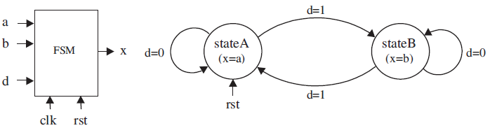
Example 2: Simple FSM #1
Figure below shows the states diagram of a very simple FSM. The system has two states (stateA and stateB), and must change from one to the other every time d = ‘1’ is received. The desired output is x = a when the machine is in stateA, or x = b when in stateB. The initial (reset) state is stateA.
A VHDL code for this circuit, employing design style #1, next:

Slide 14
ENTITY simple_fsm IS
PORT ( a, b, d, clk, rst: IN BIT;
x: OUT BIT);
END simple_fsm;
ARCHITECTURE simple_fsm OF simple_fsm IS
TYPE state IS (stateA, stateB);
SIGNAL pr_state, nx_state: state;
BEGIN
----- Lower section: ----------------------
PROCESS (rst, clk)
BEGIN
IF (rst='1') THEN pr_state <= stateA;
ELSIF (clk'EVENT AND clk='1') THEN pr_state <= nx_state;
END IF;
END PROCESS;
---------- Upper section: -----------------
PROCESS (a, b, d, pr_state)
BEGIN
CASE pr_state IS
WHEN stateA => x <= a;
IF (d='1') THEN nx_state <= stateB;
ELSE nx_state <= stateA; END IF;
WHEN stateB => x <= b;
IF(d='1') THEN nx_state <= stateA;
ELSE nx_state <= stateB; END IF;
END CASE;
END PROCESS;
END simple_fsm;

Slide 15
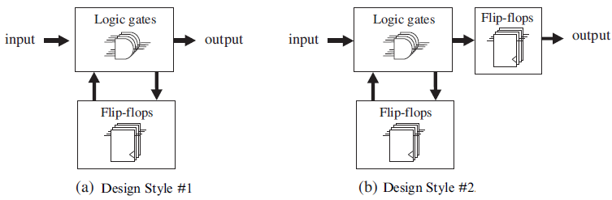
Design Style #2 (Stored Output)
In design style #1 only pr_state is stored as in figure(a). If it is a Mealy machine (one whose output is dependent on the current input), the output might change when the input changes (asynchronous output), To make Mealy machines synchronous, the output must be stored as well, as shown in figure (b). To implement this new structure, very few modifications are needed. These modifications are shown in template next:

Slide 16
LIBRARY ieee;
USE ieee.std_logic_1164.all;
-------------------------------------------------------
ENTITY <ent_name> IS
PORT ( input: IN <data_type>;
reset, clock: IN STD_LOGIC;
output: OUT <data_type>); END <ent_name>;
-------------------------------------------------------
ARCHITECTURE <arch_name> OF <ent_name> IS
TYPE states IS (state0, state1, state2, state3, ...);
SIGNAL pr_state, nx_state: states;
SIGNAL temp: <data_type>;
BEGIN
---------- Lower section: --------------------------
PROCESS (reset, clock)
BEGIN
IF (reset='1') THEN pr_state <= state0;
ELSIF (clock'EVENT AND clock='1') THEN
output <= temp; pr_state <= nx_state; END IF;
END PROCESS;
---------- Upper section: --------------------------
PROCESS (pr_state)
BEGIN
CASE pr_state IS
WHEN state0 => temp <= <value>;
IF (condition) THEN nx_state <= state1;
... END IF;
WHEN state1 => temp <= <value>;
IF (condition) THEN nx_state <= state2;
... END IF;
WHEN state2 => temp <= <value>;
IF (condition) THEN nx_state <= state3;
... END IF;
      ...
END CASE;
PROCESS;
END <arch_name>;

Slide 17
Example 3: Simple FSM #2
Consider the design of example 2 once again, now we want the output to be synchronous Since this is a Mealy machine, design style #2 is required.

Slide 18
ENTITY simple_fsm IS
PORT ( a, b, d, clk, rst : IN BIT;
x : OUT BIT);
END simple_fsm;
------------------------------------------------------------
ARCHITECTURE simple_fsm OF simple_fsm IS
TYPE state IS (stateA, stateB);
SIGNAL pr_state, nx_state: state;
SIGNAL temp: BIT;
BEGIN
------------- Lower section: -------------------------------
PROCESS (rst, clk)
BEGIN
IF (rst='1') THEN pr_state <= stateA;
ELSIF (clk'EVENT AND clk='1') THEN x <= temp;
pr_state <= nx_state;
END IF;
END PROCESS;
------------- Upper section: --------------------------------
PROCESS (a, b, d, pr_state)
BEGIN
CASE pr_state IS
WHEN stateA => temp <= a;
IF (d='1') THEN nx_state <= stateB;
ELSE nx_state <= stateA;
END IF;
WHEN stateB => temp <= b;
IF (d='1') THEN nx_state <= stateA;
ELSE nx_state <= stateB;
END IF;
END CASE;
END PROCESS;
END simple_fsm;

Slide 19
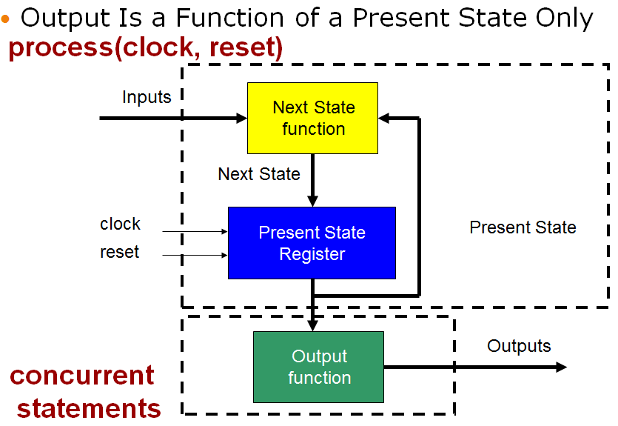
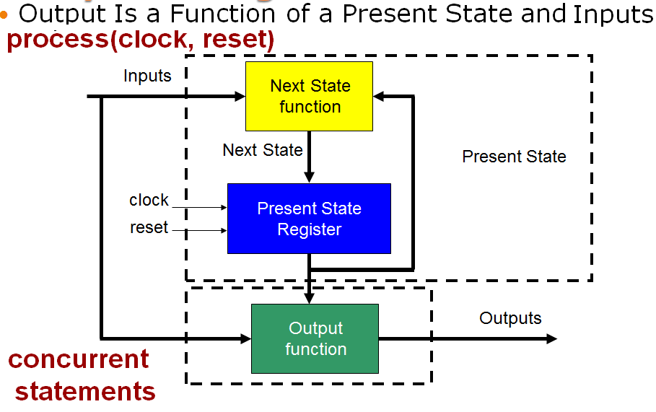
Moore FSM Diagram
Mealy FSM Diagram

Slide 20
Moore FSM – Example : State diagram & table
reset
w
=
1
w
=
0
A
⁄
z
=
0
B
⁄
z
=
0
w
=
0
Present
Next state
Output
w
=
0
w
=
1
state
w
=
0
w
=
1
z
A
A
B
0
C
⁄
z
=
1
B
A
C
0
C
A
C
1
w
=
1

Slide 21
library IEEE;
use IEEE.STD_LOGIC_1164.ALL;
use IEEE.STD_LOGIC_ARITH.ALL;
use IEEE.STD_LOGIC_UNSIGNED.ALL;
entity fsm1 is
Port ( clk, rst, W : in STD_LOGIC;
Z: out STD_LOGIC);
end fsm1;
architecture Behavioral of fsm1 is
type state IS (A,B,C);
signal pr_state, nx_state: state;
Begin
process (rst, clk)
begin
if (rst='1') then pr_state <=A;
elsif (clk'EVENT and clk='1') then pr_state <= nx_state;
end if;
end process;
process (W,pr_state)
begin
case pr_state is
when A => Z <='0';
if (W='1') then nx_state <= B;
else nx_state <= A; end if;
when B => Z <='0';
if (W='1') then nx_state <= C;
else nx_state <= A; end if;
when C => Z <='1';
if (W='0') then nx_state <= A;
else nx_state <= C; end if;
end case;
end process;
end Behavioral;

Slide 22
Mealy FSM – Example : State diagram & table
reset
w
=
1
⁄
z
=
0
w
=
0
⁄
z
=
0
A
B
w
=
1
⁄
z
=
1
w
=
0
⁄
z
=
0
Present
Next state
Output
z
state
w
=
0
w
=
1
w
=
0
w
=
1
A
A
B
0
0
B
A
B
0
1

Slide 23
library IEEE;
use IEEE.STD_LOGIC_1164.ALL;
use IEEE.STD_LOGIC_ARITH.ALL;
use IEEE.STD_LOGIC_UNSIGNED.ALL;
entity fsm2 is
Port ( clk, rst, W : in STD_LOGIC;
Z: out STD_LOGIC);
end fsm2;
architecture Behavioral of fsm2 is
type state IS (A,B);
signal pr_state, nx_state: state;
Begin
process (rst, clk)
begin
if (rst='1') then pr_state <=A;
elsif (clk'EVENT and clk='1') then pr_state <= nx_state;
end if;
end process;
process (W,pr_state)
begin
case pr_state is
when A => if (W='1') then Z <='0'; nx_state <= B;
else Z <='0'; nx_state <= A;
end if;
when B => if (W='1') then Z <='1'; nx_state <= B;
else Z <='0'; nx_state <= A;
end if;
end case;
end process;
end Behavioral;

Slide 24
Encoding Style: From Binary to OneHot
To encode the states of a state machine, we can select one among several available styles. The default style is binary. Its advantage is that it requires the least number of flip-flops. The disadvantage of this encoding scheme is that it requires more logic and is slower than the others.
At the other extreme is the one-hot encoding style, which uses one flip-flop per state. Therefore, it demands the largest number of flip-flops. On the other hand, this approach requires the least amount of extra logic and is the fastest.
An style that is in between the two styles above is the two-hot encoding scheme, which presents two bits active per state.
Example, say that our state machine has eight states. Then the encoding would be that shown in next table:

Slide 25
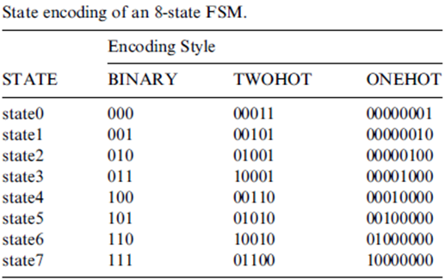
Encoding Style: From Binary to OneHot
The number of flip-flops required in each case is three (for binary), five (two-hot), or eight (one-hot)

Slide 26
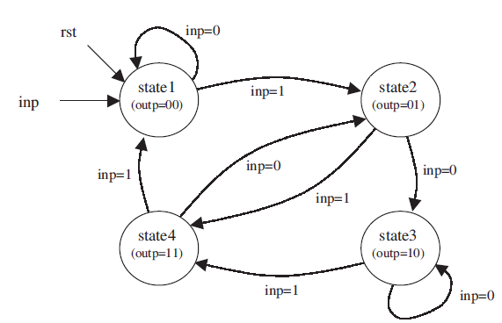
Home work:
Write a VHDL code that implements the FSM described by the states diagram of figure below.

Slide 27

Questions?

