Slide 1

Sequential Code
ALMAARIF UNIVERSITY
CET/
Advanced Digital Electronics
Lecture 5

Slide 2
  Outlines
PROCESS
Signals and Variables
IF
WAIT
CASE
LOOP
CASE versus IF
CASE versus WHEN
Using Sequential Code to Design Combinational Circuits
Examples

Slide 3
Introduction
One important aspect of sequential code is that it is not limited to sequential logic. Indeed, with it we can build sequential circuits as well as combinational circuits. Sequential code is also called behavioral code.
The statements discussed in this lecture are all sequential, that is, allowed only inside PROCESSES, FUNCTIONS, or PROCEDURES. They are:
IF, WAIT, CASE, and LOOP.
VARIABLES are also restricted to be used in sequential code only (that is, inside a PROCESS, FUNCTION, or PROCEDURE). Thus, contrary to a SIGNAL, a VARIABLE can never be global.

Slide 4
PROCESS
A PROCESS is a sequential section of VHDL code. It is characterized by the presence of IF, WAIT, CASE, or LOOP, and by a sensitivity list (except when WAIT is used). A PROCESS must be installed in the main code, and is executed every time a signal in the sensitivity list changes (or the condition related to WAIT is fulfilled). Its syntax is shown below.
[label:] PROCESS (sensitivity list)
[VARIABLE name type [range] [:= initial_value;]]
BEGIN
(sequential code)
END PROCESS [label];

Slide 5
PROCESS
VARIABLES are optional. If used, they must be declared in the declarative part of the PROCESS (before the word BEGIN, as indicated in the syntax above). The initial value is not synthesizable, being only taken into consideration in simulations. The use of a label is also optional. Its purpose is to improve code readability. The label can be any word, except VHDL reserved words.
To construct a synchronous circuit, monitoring a signal (clock, for example) is necessary. A common way of detecting a signal change is by means of the EVENT attribute. For instance, if clk is a signal to be monitored, then clk’EVENT returns TRUE when a change on clk occurs (rising or falling edge). An example, illustrating the use of EVENT and PROCESS, is shown next.

Slide 6
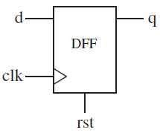
Example 1: DFF with Asynchronous Reset #1
A D-type flip-flop is the most basic building block in sequential logic circuits. In it, the output must copy the input at either the positive or negative transition of the clock signal (rising or falling edge).
In the code presented below, we make use of the IF statement to design a DFF with asynchronous reset. If rst = ‘1’, then the output must be q = ‘0’ ,regardless of the status of clk. Otherwise, the output must copy the input (that is, q = d) at the positive edge of clk . The EVENT attribute is used to detect a clock transition. The PROCESS is run every time any of the signals that appear in its sensitivity list (clk and rst) changes.

Slide 7
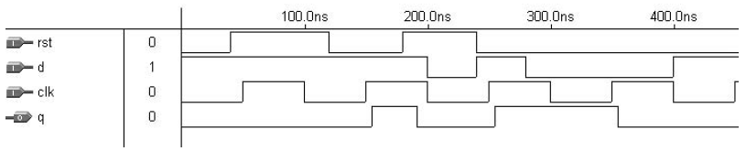
Example 1: DFF with Asynchronous Reset #1
Simulation results, confirming the functionality of the synthesized circuit, are presented in figure below:

Slide 8
Example 1: DFF with Asynchronous Reset #1
LIBRARY ieee;
USE ieee.std_logic_1164.all;
--------------------------------------
ENTITY dff IS
PORT (d, clk, rst: IN STD_LOGIC;
q: OUT STD_LOGIC);
END dff;
--------------------------------------
ARCHITECTURE behavior OF dff IS
BEGIN
PROCESS (clk, rst)
BEGIN
IF (rst='1') THEN q <= '0';
ELSIF (clk'EVENT AND clk='1') THEN q <= d;
END IF;
END PROCESS;
END behavior;

Slide 9
Signals and Variables
VHDL has two ways of passing non-static values around: by means of a SIGNAL or by means of a VARIABLE.
A SIGNAL can be declared in a PACKAGE, ENTITY or ARCHITECTURE (in its declarative part), while a VARIABLE can only be declared inside a piece of sequential code (in a PROCESS, for example). Therefore, while the value of the former can be global, the latter is always local. The value of a VARIABLE can never be passed out of the PROCESS directly; if necessary, then it must be assigned to a SIGNAL. On the other hand, the update of a VARIABLE is immediate, that is, we can promptly count on its new value in the next line of code. That is not the case with a SIGNAL (when used in a PROCESS).

Slide 10
IF
As mentioned earlier, IF, WAIT, CASE, and LOOP are the statements intended for sequential code. Therefore, they can only be used inside a PROCESS, FUNCTION, or PROCEDURE.
The natural tendency is for people to use IF more than any other statement. Though this could, in principle, have a negative consequence ,the synthesizer will optimize the structure and avoid the extra hardware. The syntax of IF is shown below.
IF conditions THEN assignments;
ELSIF conditions THEN assignments;
...
ELSE assignments;
END IF;
Example: IF (x<y) THEN temp:="11111111";
ELSIF (x=y AND w='0') THEN temp:="11110000";
ELSE temp:=(OTHERS =>'0');

Slide 11
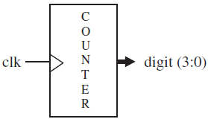
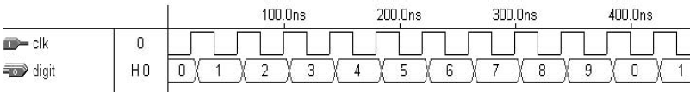
Example 2: One-digit Counter #1
The code below implements a progressive 1-digit decimal counter (0 → 9 → 0). A top-level diagram of the circuit is shown in figure. It contains a single-bit input (clk) and a 4-bit output (digit). The IF statement is used in this example. A variable, temp, was employed to create the four flip-flops necessary to store the 4-bit output signal. Simulation results, confirming the correct operation of the synthesized circuit.

Slide 12
Example 2: One-digit Counter #1
LIBRARY ieee;
USE ieee.std_logic_1164.all;
---------------------------------------------
ENTITY counter IS
PORT ( clk : IN STD_LOGIC;
digit : OUT INTEGER RANGE 0 TO 9);
END counter;
---------------------------------------------
ARCHITECTURE counter OF counter IS
BEGIN
count: PROCESS(clk)
VARIABLE temp : INTEGER RANGE 0 TO 10;
BEGIN
IF (clk'EVENT AND clk='1') THEN temp :=temp+1;
IF (temp=10) THEN temp := 0;
END IF;
END IF;
digit <= temp;
END PROCESS count;
END counter;

Slide 13
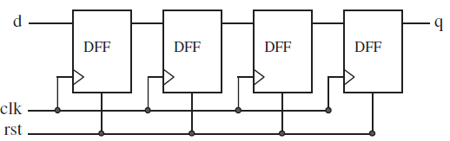
Example 3: Shift Register
Figure below shows a 4-bit shift register. The output bit (q) must be four positive clock edges behind the input bit (d). It also contains an asynchronous reset, which must force all flip-flop outputs to ‘0’ when asserted. In this example, the IF statement is again employed.

Slide 14
Example 3: Shift Register
LIBRARY ieee;
USE ieee.std_logic_1164.all;
ENTITY shiftreg IS
GENERIC (n: INTEGER := 4); -- # of stages
PORT (d, clk, rst: IN STD_LOGIC;
q: OUT STD_LOGIC);
END shiftreg;
ARCHITECTURE behavior OF shiftreg IS
SIGNAL internal: STD_LOGIC_VECTOR (n-1 DOWNTO 0);
BEGIN
PROCESS (clk, rst)
BEGIN
IF (rst='1') THEN
internal <= (OTHERS => '0');
ELSIF (clk'EVENT AND clk='1') THEN
internal<=d&internal(internal'LEFT DOWNTO 1);
END IF;
END PROCESS;
q <= internal(0);
END behavior;

Slide 15
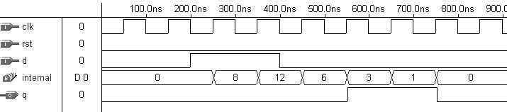
Example 3: Shift Register
Simulation results are shown in figure. q is indeed four positive clock edges behind d.

Slide 16
WAIT
The operation of WAIT is sometimes similar to that of IF. However, more than one form of WAIT is available. Moreover, contrary to when IF, CASE, or LOOP are used, the PROCESS cannot have a sensitivity list when WAIT is employed. Its syntax
(there are three forms of WAIT) is shown below:
WAIT UNTIL signal_condition;
WAIT ON signal1 [, signal2, ... ];
WAIT FOR time;
WAIT FOR is intended for simulation only (waveform generation for testbenches). Example: WAIT FOR 5ns;
The WAIT UNTIL statement accepts only one signal, thus being more appropriate for synchronous code than asynchronous. Since the PROCESS has no sensitivity list in this case, WAIT UNTIL must be the first statement in the PROCESS. The PROCESS will be executed every time the condition is met.

Slide 17
WAIT
Example: 8-bit register with synchronous reset:
PROCESS -- no sensitivity list
BEGIN
WAIT UNTIL (clk'EVENT AND clk='1');
IF (rst='1') THEN output <= "00000000";
ELSIF(clk'EVENT AND clk='1')THEN output<= input;
END IF;
END PROCESS;
WAIT ON, on the other hand, accepts multiple signals. The PROCESS is put on hold until any of the signals listed changes. In the example below, the PROCESS will continue execution whenever a change in rst or clk occurs.
Example: 8-bit register with asynchronous reset:
PROCESS
BEGIN
WAIT ON clk, rst;
IF (rst='1') THEN output <= "00000000";
ELSIF (clk'EVENT AND clk='1') THEN output <= input;
END IF;
END PROCESS;

Slide 18
Example 4: DFF with Asynchronous Reset #2
The code below implements the same DFF of example 1, here WAIT ON is used instead of IF only.
LIBRARY ieee;
USE ieee.std_logic_1164.all;
ENTITY dff IS
PORT (d, clk, rst: IN STD_LOGIC;
q: OUT STD_LOGIC);
END dff;
ARCHITECTURE dff OF dff IS
BEGIN
PROCESS
BEGIN
WAIT ON rst, clk;
IF (rst='1') THEN q <= '0';
ELSIF (clk'EVENT AND clk='1') THEN q <= d;
END IF;
END PROCESS;
END dff;

Slide 19
Example 5: One-digit Counter #2
Code below implements the same progressive 1-digit decimal counter of example 2, WAIT UNTIL was used instead of IF only.
LIBRARY ieee;
USE ieee.std_logic_1164.all;
ENTITY counter IS
PORT ( clk : IN STD_LOGIC;
digit : OUT INTEGER RANGE 0 TO 9);
END counter;
ARCHITECTURE counter OF counter IS
BEGIN
PROCESS -- no sensitivity list
VARIABLE temp : INTEGER RANGE 0 TO 10;
BEGIN
WAIT UNTIL (clk'EVENT AND clk='1');
temp := temp + 1;
IF (temp=10) THEN temp := 0;
END IF;
digit <= temp;
END PROCESS;
END counter;

Slide 20
CASE
CASE is another statement intended exclusively for sequential code (along with IF, LOOP, and WAIT). Its syntax is shown below:
CASE identifier IS
WHEN value => assignments;
WHEN value => assignments;
...
END CASE;
Example:
CASE control IS
WHEN "00" => x<=a; y<=b;
WHEN "01" => x<=b; y<=c;
WHEN OTHERS => x<="0000"; y<="ZZZZ";
END CASE;

Slide 21
CASE
The CASE statement (sequential) is very similar to WHEN (combinational). Here too all permutations must be tested, so the keyword OTHERS is often helpful. Another important keyword is NULL (the counterpart of UNAFFECTED), which should be used when no action is to take place. For example, WHEN OTHERS => NULL;
CASE allows multiple assignments for each test condition (as shown in the example above), while WHEN allows only one.
Like in the case of WHEN, here too ‘‘WHEN value’’ can take up three forms:
WHEN value -- single value
WHEN value1 to value2 -- range, for enumerated data -- types only
WHEN value1 | value2 |... -- value1 or value2 or ...

Slide 22
Example 6: DFF with Asynchronous Reset #3
The code below implements the same DFF of example 1 here CASE was used instead of IF only. Notice that a few unnecessary declarations were intentionally included in the code to illustrate their usage.
LIBRARY ieee; -- Unnecessary declaration, because
-- BIT was used instead of STD_LOGIC
USE ieee.std_logic_1164.all;
ENTITY dff IS
PORT (d, clk, rst: IN BIT; q: OUT BIT);
END dff;
ARCHITECTURE dff3 OF dff IS
BEGIN
PROCESS (clk, rst)
BEGIN
CASE rst IS
WHEN '1'=> q<='0';
WHEN '0'=> IF(clk'EVENT AND clk='1')THEN q<= d;
END IF;
WHEN OTHERS => NULL;--Unnecessary ,rst is BIT
END CASE;
END PROCESS;
END dff3;

Slide 23
LOOP
As the name says, LOOP is useful when a piece of code must be instantiated several times. Like IF, WAIT, and CASE, LOOP is intended exclusively for sequential code, so it too can only be used inside a PROCESS, FUNCTION, or PROCEDURE.
There are several ways of using LOOP, as shown in the syntaxes:
FOR / LOOP: The loop is repeated a fixed number of times.
[label:] FOR identifier IN range LOOP
(sequential statements)
END LOOP [label];
WHILE / LOOP: The loop is repeated until a condition no longer holds.
[label:] WHILE condition LOOP
(sequential statements)
END LOOP [label];
EXIT: Used for ending the loop.
[label:] EXIT [label] [WHEN condition];
NEXT: Used for skipping loop steps.
[label:] NEXT [loop_label] [WHEN condition];

Slide 24
LOOP: Examples
Example:
-- the loop will be repeated unconditionally until i --- reaches 5 (that is, six times).
FOR i IN 0 TO 5 LOOP -- the range must be static
x(i) <= enable AND w(i+2);
    y(0, i) <= w(i);
END LOOP;
Example
--LOOP will keep repeating while i < 10.
WHILE (i < 10) LOOP
WAIT UNTIL clk'EVENT AND clk='1';
(other statements)
END LOOP;

Slide 25
LOOP: Examples
Example
-- the loop will end as soon as a value different from ‘0’ is found in the data vector.
FOR i IN data'RANGE LOOP
CASE data(i) IS
WHEN '0' => count:=count+1;
WHEN OTHERS => EXIT;
END CASE;
END LOOP;
Example
--NEXT causes LOOP to skip one iteration when i=skip
FOR i IN 0 TO 15 LOOP
NEXT WHEN i=skip; -- jumps to next iteration
(...)
END LOOP;

Slide 26
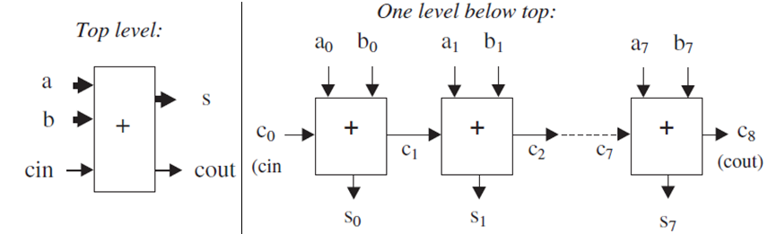
Example 7: Carry Ripple Adders
Figure below shows an 8-bit unsigned carry ripple adder. The top-level diagram shows the inputs and outputs of the circuit: a and b are the input vectors to be added, c_{in} is the carry-in bit, s is the sum vector, and c_{out} is the carry-out bit. The one-level below-top diagram shows how the carry bits propagate (ripple).
Each section of the latter diagram is a full-adder unit. Thus its outputs: s_{j} = a_{j} XOR b_{j} XOR c_{j}
c_{j+‏1} = (a_{j} AND b_{j})OR(a_{j} AND c_{j})OR(b_{j} AND c_{j})

Slide 27
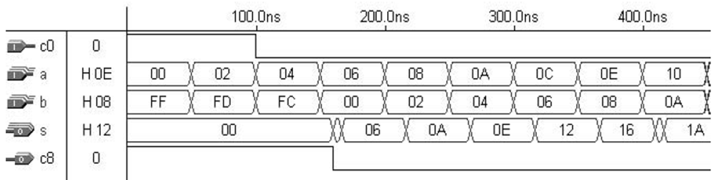
Example 7: Carry Ripple Adders
Two solutions are presented, being one generic (that is, for any number of bits) and the other specific for 8-bit numbers. Also the use of vectors and FOR/LOOP is shown in the first solution, and of integers and IF in the second. Simulation results from either solution are shown below.

Slide 28
Example 7: Carry Ripple Adders
----- Solution 1: Generic, with VECTORS --------
LIBRARY ieee;
USE ieee.std_logic_1164.all;
ENTITY adder IS
GENERIC (length : INTEGER := 8);
PORT (a, b: IN STD_LOGIC_VECTOR (length-1 DOWNTO 0);
cin: IN STD_LOGIC;
s: OUT STD_LOGIC_VECTOR (length-1 DOWNTO 0);
cout: OUT STD_LOGIC);
END adder;
ARCHITECTURE adder OF adder IS
BEGIN
PROCESS (a, b, cin)
VARIABLE carry : STD_LOGIC_VECTOR (length DOWNTO 0);
BEGIN
carry(0) := cin;
FOR i IN 0 TO length-1 LOOP
s(i) <= a(i) XOR b(i) XOR carry(i);
carry(i+1):=(a(i) AND b(i))OR
(a(i) AND carry(i))OR
(b(i) AND carry(i));
END LOOP;
cout <= carry(length);
END PROCESS;
END adder;

Slide 29
Example 7: Carry Ripple Adders
---- Solution 2: non-generic, with INTEGERS ----
LIBRARY ieee;
USE ieee.std_logic_1164.all;
ENTITY adder IS
PORT ( a, b: IN INTEGER RANGE 0 TO 255;
c0: IN STD_LOGIC;
s: OUT INTEGER RANGE 0 TO 255;
c8: OUT STD_LOGIC);
END adder;
ARCHITECTURE adder OF adder IS
BEGIN
PROCESS (a, b, c0)
VARIABLE temp : INTEGER RANGE 0 TO 511;
BEGIN
IF (c0='1') THEN temp:=1;
ELSE temp:=0;
END IF;
temp := a + b + temp;
IF (temp > 255) THEN c8 <= '1'; temp := temp---256;
ELSE c8 <= '0';
END IF;
s <= temp;
END PROCESS;
END adder;

Slide 30
CASE versus IF
The presence of ELSE in the IF/ELSE statement might infer the implementation of a priority decoder (which would never occur with CASE), when IF (a sequential statement) is used to implement a fully combinational circuit, a multiplexer might be inferred instead. Therefore, after optimization, a circuit synthesized from a VHDL code based on IF not to differ from that based on CASE.
--Codes below implement same physical multiplexer circuit.
---- With IF: --------------
IF (sel="00") THEN x<=a;
ELSIF (sel="01") THEN x<=b;
ELSIF (sel="10") THEN x<=c;
ELSE x<=d;
---- With CASE: ------------
CASE sel IS
WHEN "00" => x<=a;
WHEN "01" => x<=b;
WHEN "10" => x<=c;
WHEN OTHERS => x<=d;
END CASE;

Slide 31
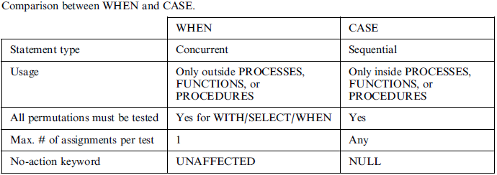
CASE versus WHEN
CASE and WHEN are very similar. However, while one is concurrent (WHEN), the other is sequential (CASE). Their main similarities and differences are summarized in table:

Slide 32
CASE versus WHEN
--From a functional point of view, the two codes --below are equivalent.
---- With WHEN: ----------------
WITH sel SELECT
x <= a WHEN "000",
b WHEN "001",
c WHEN "010",
UNAFFECTED WHEN OTHERS;
---- With CASE: ----------------
CASE sel IS
WHEN "000" => x<=a;
WHEN "001" => x<=b;
WHEN "010" => x<=c;
WHEN OTHERS => NULL;
END CASE;
--------------------------------

Slide 33
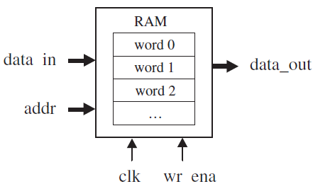
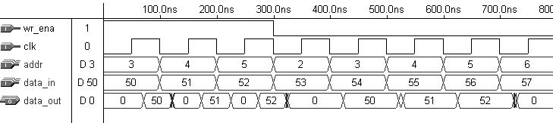
Example 8: RAM
example below shows the implementation of a RAM (random access memory), the circuit has a data input bus (data_in), a data output bus (data_out), an address bus (addr), plus clock (clk) and write enable (wr_ena) pins.
Simulation results:

Slide 34
Example 8: RAM
ENTITY ram IS
GENERIC ( bits: INTEGER := 8; -- # of bits per word
words: INTEGER:= 16); -- # of words in the memory
PORT ( wr_ena, clk:IN STD_LOGIC;
addr:IN INTEGER RANGE 0 TO words-1;
data_in:IN STD_LOGIC_VECTOR (bits-1 DOWNTO 0);
data_out:OUT STD_LOGIC_VECTOR (bits-1 DOWNTO 0));
END ram;
---------------------------------------------------
ARCHITECTURE ram OF ram IS
TYPE v_ary IS ARRAY(0 TO words-1)OF STD_LOGIC_VECTOR(bits-1 DOWNTO 0);
SIGNAL memory: v_ary;
BEGIN
PROCESS (clk, wr_ena)
BEGIN
IF (wr_ena='1') THEN
IF(clk'EVENT AND clk='1')THEN memory(addr) <= data_in;
END IF;
END IF;
END PROCESS;
data_out <= memory(addr);
END ram;

Slide 35
Using Sequential Code to Design Combinational Circuits
The sequential code can be used to implement either sequential or combinational circuits. the following rules should be observed:
Rule 1: Make sure that all input signals used (read) in the PROCESS appear in its sensitivity list.
Rule 2: Make sure that all combinations of the input/output signals are included in the code; that is, make sure that, by looking at the code, the circuit’s complete truth-table can be obtained (indeed, this is true for both sequential as well as concurrent code).

Slide 36
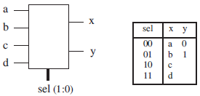
Example 9: Bad Combinational Design
ENTITY example IS
PORT (a, b, c, d: IN STD_LOGIC;
sel: IN INTEGER RANGE 0 TO 3;
x, y: OUT STD_LOGIC);
END example;
--------------------------------------
ARCHITECTURE example OF example IS
BEGIN
PROCESS (a, b, c, d, sel)
BEGIN
IF (sel=0) THEN x<=a; y<='0';
ELSIF (sel=1) THEN x<=b; y<='1';
ELSIF (sel=2) THEN x<=c;
ELSE x<=d;
END IF;
END PROCESS;
END example;

Slide 37
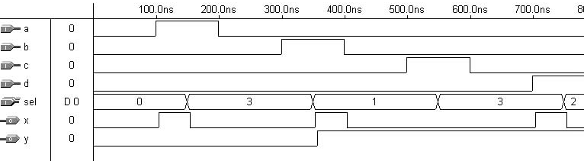
Example 9: Bad Combinational Design
After compiling, the report files show that no flip-flops were inferred (as expected). but, when we look at the simulation results :
we notice something peculiar about y. Observe that, for the same value of the input (sel = ‘‘11’’), two different results are obtained for y). To avoid the extra logic required by the latch, the specifications of should be used (‘X’ should be used for all unknown or ‘‘don’t care’’ values). Thus the line y<='X'; must be included after the indicated lines.

Slide 38

Home work:
Use WHEN to design a 3-state buffer of figure below output=input when ena (enable) is low, or output = ‘‘ZZZZZZZZ’’ (high impedance) otherwise.

Slide 39

Questions?

