Slide 1

Concurrent Code
ALMAARIF UNIVERSITY
CET/
Advanced Digital Electronics Lecture 4

Slide 2
Outlines
Concurrent versus Sequential
Using Operators
WHEN (Simple and Selected)
GENERATE
BLOCK
Examples

Slide 3
Concurrent versus Sequential
We start by reviewing the fundamental differences between combinational logic and sequential logic, and by contrasting them with the differences between concurrent code and sequential code.
In combinational logic the output of the circuit depends on the current inputs, the system requires no memory and can be implemented using conventional logic gates.
In sequential logic the output does depend on previous inputs, storage elements are required, which are connected to the combinational logic block through a feedback loop, such that now the stored states (created by previous inputs) will also affect the output of the circuit.

Slide 4
Concurrent versus Sequential Code
VHDL code is inherently concurrent (parallel). Only statements placed inside a PROCESS, FUNCTION, or PROCEDURE are sequential. Still, though within these blocks the execution is sequential, the block, as a whole, is concurrent with any other (external) statements. Concurrent code is also called dataflow code.
let us consider a code with three concurrent statements (stat1, stat2, stat3). Then any of the alternatives below will render the same physical circuit:
stat1 stat3 stat1
Stat2 Ξ stat2 Ξ stat3
stat3 stat1 stat2

Slide 5
Concurrent versus Sequential Code
concurrent code, the statements that can only be used outside PROCESSES, FUNCTIONS, or PROCEDURES are:
Operators;
The WHEN statement (WHEN/ELSE or WITH/SELECT/WHEN);
The GENERATE statement;
The BLOCK statement..

Slide 6
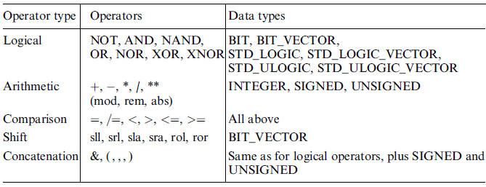
Concurrent Code Using Operators
This is the most basic way of creating concurrent code. Operators as shown in table below:

Slide 7
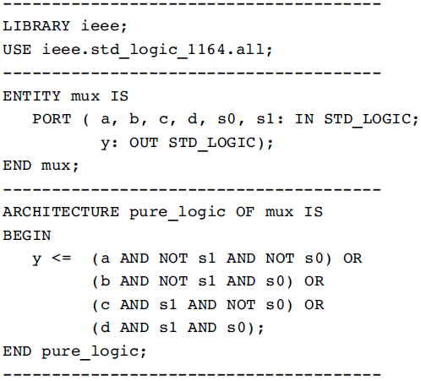
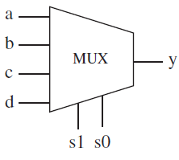
Example: Multiplexer #1
Figure shows a 4:1 multiplexer. The output must be equal to the input selected by the selection bits, s1-s0. Its implementation, using only logical operators, can be done as follows:

Slide 8
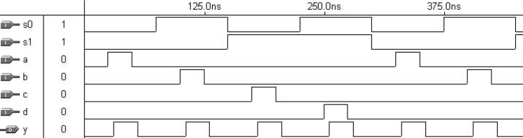
Example: Multiplexer #1
Simulation results of the circuit, are shown in figure below:

Slide 9
WHEN (Simple and Selected)
WHEN is one of the fundamental concurrent statements (along with operators and GENERATE). It appears in two forms: WHEN / ELSE (simple WHEN) and WITH / SELECT / WHEN (selected WHEN). Its syntax is shown below.
WHEN / ELSE:
assignment WHEN condition ELSE
assignment WHEN condition ELSE
.....;
WITH / SELECT / WHEN:
WITH identifier SELECT
assignment WHEN value,
assignment WHEN value,
.....;
Whenever WITH / SELECT / WHEN is used, all permutations must be tested, so the keyword OTHERS is often useful.

Slide 10
WHEN (Simple and Selected)
Example:
------ with WHEN/ELSE -------------------------
outp <= "000" WHEN (inp='0' OR reset='1') ELSE
"001" WHEN ctl='1' ELSE
"010“ ;
---- With WITH/SELECT/WHEN --------------------
WITH control SELECT
output <= "000" WHEN reset,
"111" WHEN set,
UNAFFECTED WHEN OTHERS;
-----------------------------------------------

Slide 11
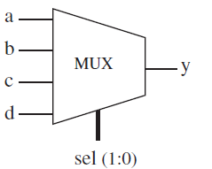
Example : Multiplexer #2
This example shows the implementation of the same multiplexer of previous example , but with a slightly different representation for the sel input. However, in it WHEN was employed instead of logical operators. Two solutions are presented: one using WHEN/ELSE (simple WHEN) and the other with WITH/SELECT/WHEN (selected WHEN). The experimental results are obviously similar to those obtained
in previous example.

Slide 12
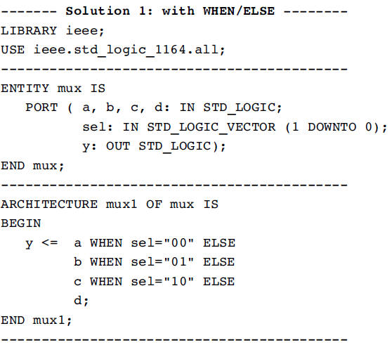
Example : Multiplexer #2

Slide 13
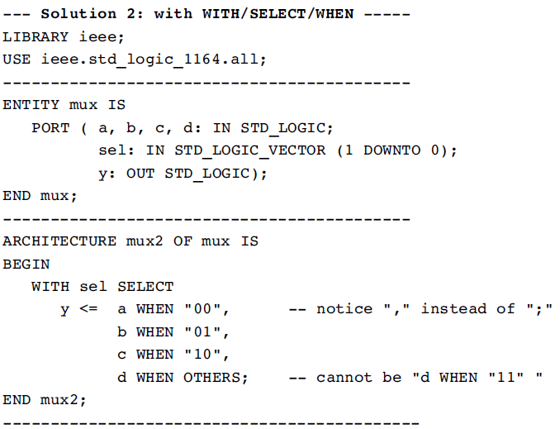
Example : Multiplexer #2

Slide 14
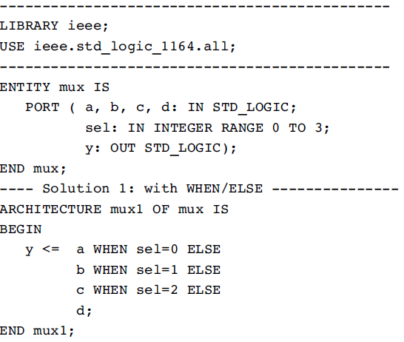
Example : Multiplexer #2
In the solutions above, sel could have been declared as an INTEGER, in which case the code would be the following:

Slide 15
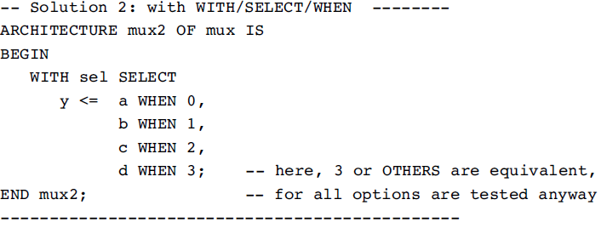
Example : Multiplexer #2

Slide 16
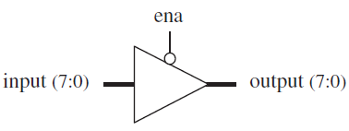
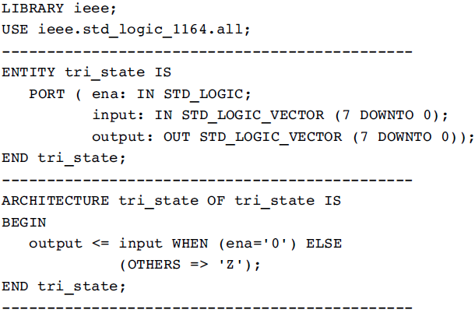
Example : Tri-state Buffer
The 3-state buffer in figure must provide output=input when ena=low, or output =‘‘ZZZZZZZZ’’(high impedance) otherwise.

Slide 17
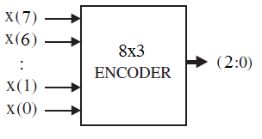
Example : Encoder
The top-level diagram of an n-by-m encoder is shown in figure. Two solutions are presented, one using WHEN / ELSE, and the other with WITH / SELECT / WHEN.

Slide 18
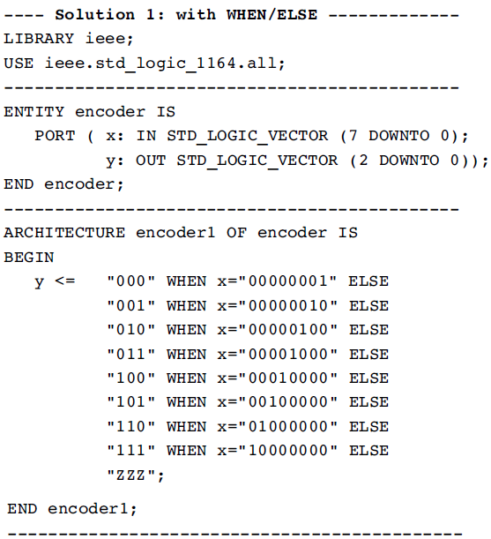
Example : Encoder

Slide 19
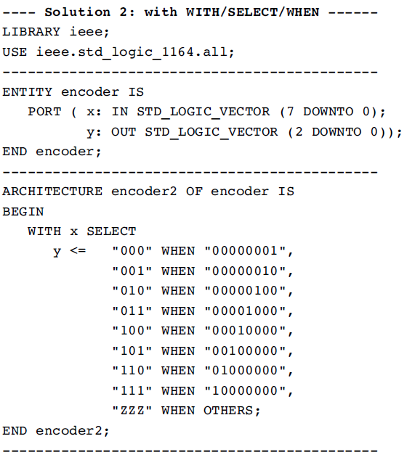
Example : Encoder

Slide 20
GENERATE
GENERATE is another concurrent statement (along with operators and WHEN). It is equivalent to the sequential statement LOOP in the sense that it allows a section of code to be repeated a number of times, thus creating several instances of the same assignments. Its regular form is the FOR / GENERATE construct, with the syntax shown below. Notice that GENERATE must be labeled.
FOR / GENERATE:
label: FOR identifier IN range GENERATE
(concurrent assignments)
END GENERATE;

Slide 21
GENERATE
Another form is also available, which uses IF/GENERATE (Here ELSE is not allowed). In the same way that IF/GENERATE can be nested inside FOR/ GENERATE (syntax below), the opposite can also be done.
IF / GENERATE nested inside FOR / GENERATE:
label1: FOR identifier IN range GENERATE
...
label2: IF condition GENERATE
(concurrent assignments)
END GENERATE;
...
END GENERATE;

Slide 22
GENERATE
Example:
SIGNAL x: BIT_VECTOR (7 DOWNTO 0);
SIGNAL y: BIT_VECTOR (15 DOWNTO 0);
SIGNAL z: BIT_VECTOR (7 DOWNTO 0);
...
G1: FOR i IN x'RANGE GENERATE
z(i) <= x(i) AND y(i+8);
END GENERATE;
One important remark about GENERATE is that the range must be static. As an example, let us consider the code below this kind of code is generally not synthesizable.
NotOK: FOR i IN 0 TO choice GENERATE
(concurrent statements)
END GENERATE;

Slide 23
BLOCK
There are two kinds of BLOCK statements: Simple and Guarded.
Simple BLOCK
The BLOCK statement, in its simple form, represents only a way of locally partitioning the code. It allows a set of concurrent statements to be clustered into a BLOCK, with the purpose of turning the overall code more readable and more manageable (which might be helpful when dealing with long codes). Its syntax is shown below.
label: BLOCK
[declarative part]
BEGIN
(concurrent statements)
END BLOCK label;

Slide 24
BLOCK: Simple BLOCK
Therefore, the overall aspect of a ‘‘blocked’’ code is the following:
ARCHITECTURE example ...
BEGIN
...
block1: BLOCK
BEGIN
...
END BLOCK block1
...
block2: BLOCK
BEGIN
...
END BLOCK block2;
...
END example;
Example:
b1: BLOCK
SIGNAL a: STD_LOGIC;
BEGIN
a <= input_sig WHEN ena='1' ELSE 'Z';
END BLOCK b1;

Slide 25
BLOCK: Simple BLOCK
A BLOCK (simple or guarded) can be nested inside another BLOCK. The corresponding syntax is shown below.
label1: BLOCK
[declarative part of top block]
BEGIN
[concurrent statements of top block]
label2: BLOCK
[declarative part nested block]
BEGIN
(concurrent statements of nested block)
END BLOCK label2;
[more concurrent statements of top block]
END BLOCK label1;

Slide 26
BLOCK: Guarded BLOCK
A guarded BLOCK is a special kind of BLOCK, which includes an additional expression, called guard expression. A guarded statement in a guarded BLOCK is executed only when the guard expression is TRUE.
Guarded BLOCK:
label: BLOCK (guard expression)
[declarative part]
BEGIN
(concurrent guarded and unguarded statements)
END BLOCK label;
As the examples below illustrate, even though only concurrent statements can be written within a BLOCK, with a guarded BLOCK even sequential circuits can be constructed. This, however, is not a usual design approach.

Slide 27
Example: DFF with a Guarded BLOCK
Here, a positive-edge sensitive D-type flip-flop, with synchronous reset, is designed. clk'EVENT AND clk='1' is the guard expression, while q <= GUARDED '0'WHEN rst='1' is a guarded statement. Therefore, q<='0' will occur when the guard expression is true and rst is ‘1’.
LIBRARY ieee;
USE ieee.std_logic_1164.all;
ENTITY dff IS
PORT ( d, clk, rst: IN STD_LOGIC;
q: OUT STD_LOGIC);
END dff;
ARCHITECTURE dff OF dff IS
BEGIN
b1: BLOCK (clk'EVENT AND clk='1')
BEGIN
q <= GUARDED '0' WHEN rst='1' ELSE d;
END BLOCK b1;
END dff;

Slide 28
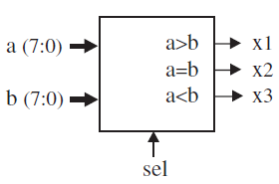
Home work:
Construct a circuit capable of comparing two 8-bit vectors, a and b. A selection pin (sel) should determine whether the comparison is signed (sel = ‘1’) or unsigned (sel = ‘0’). The circuit must have three outputs, x1, x2, and x3, corresponding to a > b, a = b, and a < b, respectively

Slide 29

Questions?

