Slide 1

Operators and Attributes
ALMAARIF UNIVERSITY
CET/
Advanced Digital Electronics Lecture 3

Slide 2
Outlines
Operators
Attributes
User-Defined Attributes
Operator Overloading
GENERIC
Examples
Summary

Slide 3
Operators
VHDL provides several kinds of pre-defined operators:
Assignment operators
Logical operators
Arithmetic operators
Relational operators
Shift operators
Concatenation operators

Slide 4
Operators: Assignment Operators
To assign values to signals, variables, and constants. They are:
<= Used to assign a value to a Signal.
:= Used to assign a value to a Variable, Constant, or Generic. Used also for establishing initial values.
=>Used to assign values to individual vector elements or with Others.
Example: Consider following signal and variable declarations:
SIGNAL x: STD_LOGIC;
VARIABLE y: STD_LOGIC_VECTOR(3 DOWNTO 0);
SIGNAL w: STD_LOGIC_VECTOR(0 TO 7);
Then the following assignments are legal:
x <='1'; --'1' is assigned to SIGNAL x using <=
y :="0000"; --"0000" is assigned to VARIABLE y using :=
w <="10000000"; -- LSB is '1', the others are '0'
w <=(0 =>'1', OTHERS =>'0');
-- LSB is '1',the others are '0'

Slide 5
Operators: Logical Operators
Used to perform logical operations. The data must be of type BIT, STD_LOGIC, or STD_ULOGIC (or, their respective extensions, BIT_VECTOR, STD_LOGIC_VECTOR, or STD_ULOGIC_VECTOR). The logical operators are:
NOT
AND
OR
NAND
NOR
XOR
XNOR
Notes: The NOT operator has precedence over the others. The XNOR operator was introduced in VHDL93.
Examples:
y <= NOT a AND b; -- (a'.b)
y <= NOT (a AND b); -- (a.b)'
y <= a NAND b; -- (a.b)'

Slide 6
Operators: Arithmetic Operators
Used to perform arithmetic operations. The data can be of type INTEGER, SIGNED, UNSIGNED, or REAL (recall that the last cannot be synthesized directly). Also, if the std_logic_signed or the std_logic_unsigned package of the ieee library is used, then STD_LOGIC_VECTOR can also be employed directly in addition
and subtraction operations.
‏ + Addition
- Subtraction
* Multiplication
/ Division
** Exponentiation
MOD Modulus ymodx returns the remainder of y/x with the signal of x
REM Remainder yremx returns the remainder of y/x with the signal of y
ABS Absolute value

Slide 7
Operators: Comparison Operators
Used for making comparisons. The data can be of any of the types listed above. The relational (comparison) operators are:
= Equal to
/= Not equal to
< Less than
> Greater than
<= Less than or equal to
>= Greater than or equal to

Slide 8
Operators: Shift Operators
Used for shifting data. They were introduced in VHDL93. Their syntax is the following:
<left operand> <shift operation> <right operand>. The left operand must be of type BIT_VECTOR, while the right operand must be an INTEGER (‏ + or – in front of it is accepted). Some shift operators are:
sll Shift left logic – positions on the right are filled with ‘0’s
srl Shift right logic – positions on the left are filled with ‘0’s

Slide 9
Attributes: Data Attributes
The pre-defined, synthesizable data attributes are the following:
d’LOW: Returns lower array index
d’HIGH: Returns upper array index
d’LEFT: Returns leftmost array index
d’RIGHT: Returns rightmost array index
d’LENGTH: Returns vector size
d’RANGE: Returns vector range
d’REVERSE_RANGE: Returns vector range in reverse order
Example: Consider the following signal:
SIGNAL d : STD_LOGIC_VECTOR (7 DOWNTO 0);
Then:
d'LOW=0, d'HIGH=7, d'LEFT=7, d'RIGHT=0,d'LENGTH=8,
d'RANGE=(7 downto 0), d'REVERSE_RANGE=(0 to 7).

Slide 10
Attributes: Data Attributes
Example: Consider the following signal:
SIGNAL x: STD_LOGIC_VECTOR (0 TO 7);
Then all four LOOP statements below are synthesizable and equivalent.
FOR i IN RANGE (0 TO 7) LOOP ...
FOR i IN x'RANGE LOOP ...
FOR i IN RANGE (x'LOW TO x'HIGH) LOOP ...
FOR i IN RANGE (0 TO x'LENGTH-1) LOOP ...
If the signal is of enumerated type, then:
d’VAL(pos) : Returns value in the position specified
d’POS(value) : Returns position of the value specified
d’LEFTOF(value): Returns value in the position to the left of the value specified
d’VAL(row, column):Returns value in the position specified; etc.
There is little or no synthesis support for enumerated data type attributes.

Slide 11
Attributes: Signal Attributes
Let us consider a signal s. Then:
s’EVENT: Returns true when an event occurs on s
s’STABLE: Returns true if no event has occurred on s
s’ACTIVE: Returns true if s=‘1’
s’QUIET<time>:Returns true if no event has occurred during the time specified
s’LAST_EVENT: Returns the time elapsed since last event
s’LAST_ACTIVE:Returns the time elapsed since last s=‘1’
s’LAST_VALUE:Returns the value of s before the last event
Though most signal attributes are for simulation purposes only, the first two in the list above are synthesizable, s’EVENT being the most often used of them all.

Slide 12
Attributes: Signal Attributes
Example:
All four assignments shown below are synthesizable and equivalent. They return TRUE when an event (a change) occurs on clk, AND if such event is upward
(in other words, when a rising edge occurs on clk).
-- EVENT attribute used with IF
IF(clk'EVENT AND clk='1')...
-- STABLE attribute used with IF
IF(NOT clk'STABLE AND clk='1')...
-- EVENT attribute used with WAIT
WAIT UNTIL (clk'EVENT AND clk='1');
-- call to a function
IF RISING_EDGE(clk)...

Slide 13
Attributes: User-Defined Attributes
We saw above attributes of the type HIGH, RANGE, EVENT, etc. Those are all pre-defined in VHDL. However, VHDL also allows the construction of user defined attributes.
To employ a user-defined attribute, it must be declared and specified. The syntax is the following:
Attribute declaration:
Attribute specification:
where:
attribute_type: any data type (BIT, INTEGER, STD_LOGIC_VECTOR, etc.)
class: TYPE, SIGNAL, FUNCTION, etc.
value: ‘0’, 27, ‘‘00 11 10 01’’, etc.

Slide 14
Attributes: User-Defined Attributes
Example:
-- declaration
ATTRIBUTE number_of_inputs: INTEGER;
-- specification
ATTRIBUTE number_of_inputs OF nand3: SIGNAL IS 3;
...
...
-- attribute call, returns 3
inputs <= nand3'number_of_pins;

Slide 15
Attributes: User-Defined Attributes
Example: Enumerated encoding.
A popular user-defined attribute, which is provided by synthesis tool vendors, is the enum_encoding attribute. By default, enumerated data types are encoded sequentially. Thus, if we consider the enumerated data type color shown below:
TYPE color IS (red, green, blue, white);
its states will be encoded as red = ‘‘00’’, green = ‘‘01’’, blue = ‘‘10’’, and white =‘‘11’’. Enum_encoding allows the default encoding (sequential) to be changed. Thus the following encoding scheme could be employed, for example:
ATTRIBUTE enum_encoding OF color:TYPE IS "11 00 10 01";
A user-defined attribute can be declared anywhere, except in a PACKAGE BODY. When not recognized by the synthesis tool, it is simply ignored, or a warning is issued.

Slide 16
Operator Overloading
We have just seen that attributes can be user-defined. The same is true for operators. As an example, let us consider the pre-defined arithmetic operators(‏+,-,*,/,etc.). They specify arithmetic operations between data of certain types (INTEGER, for example). For instance, the pre-defined ‘‘+‏’’ operator does not allow addition between data of type BIT.
We can define our own operators, using the same name as the pre-defined ones. For example, we could use ‘‘+‏’’ to indicate a new kind of addition, this time between values of type BIT_VECTOR. This technique is called operator overloading.

Slide 17
Operator Overloading
Example:
Consider that we want to add an integer to a binary 1-bit number. Then the following FUNCTION could be used :
FUNCTION "+" (a: INTEGER, b: BIT) RETURN INTEGER IS
BEGIN
IF (b='1') THEN RETURN a+1;
ELSE RETURN a;
END IF;
END "+";
A call to the function above could thus be the following:
SIGNAL inp1, outp: INTEGER RANGE 0 TO 15;
SIGNAL inp2: BIT;
(...)
outp <= 3 + inp1 + inp2;
(...)
In ‘‘outp<=3+inp1+inp2;’’, the first ‘‘+’’ is the pre-defined addition operator (adds two integers), while the second is the overloaded user-defined addition operator (adds an integer and a bit).

Slide 18
GENERIC
As the name suggests, GENERIC is a way of specifying a generic parameter (that is, a static parameter that can be easily modified and adapted to different applications). The purpose is to confer the code more flexibility and reusability.
A GENERIC statement, when employed, must be declared in the ENTITY. The specified parameter will then be truly global (that is, visible to the whole design, including the ENTITY itself ). Its syntax is shown below.

Slide 19
GENERIC
Example: The GENERIC statement below specifies a parameter called n, of type INTEGER, whose default value is 8. Therefore, whenever n is found in the ENTITY itself or in the ARCHITECTURE (one or more) that follows, its value will be assumed to be 8.
ENTITY my_entity IS
GENERIC (n : INTEGER := 8);
PORT (...);
END my_entity;
ARCHITECTURE my_architecture OF my_entity IS
...
END my_architecture:
More than one GENERIC parameter can be specified in an ENTITY. For example:
GENERIC(n:INTEGER:=8;vector:BIT_VECTOR:="00001111");
Complete design examples, further illustrating the use of GENERIC and other attributes and operators, are presented next.

Slide 20
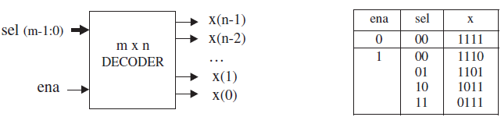
Example1: Generic Decoder
Figure below shows the top-level diagram of a generic m-by-n decoder. The circuit has two inputs, sel (m bits) and ena (single bit), and one output, x (n bits). Assume that n is a power of two, so m = log2n. If ena = ‘0’, then all bits of x should be high; otherwise, the output bit selected by sel should be low, as illustrated in the truth table of same figure.

Slide 21
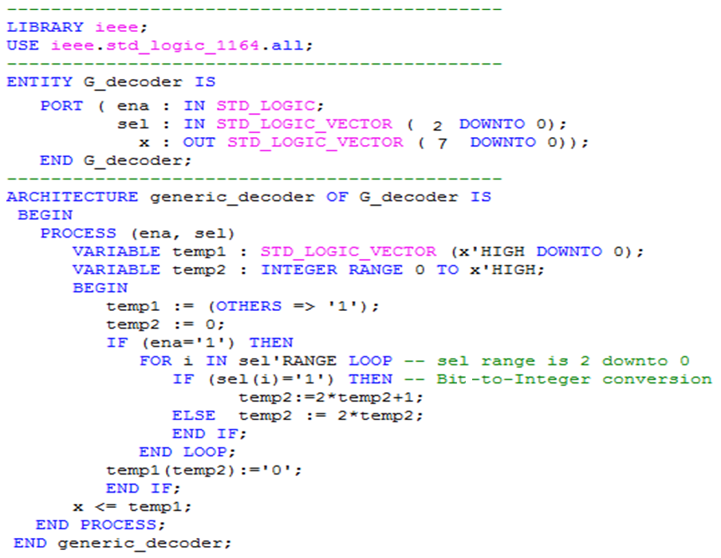

Slide 22
Example1: Generic Decoder
The ARCHITECTURE above is totally generic, for the only changes needed to operate with different values of m and n are in the ENTITY (through sel, and x, respectively). In this example, we have used m = 3 and n = 8. However, though this works fine, the use of GENERIC would have made it clearer that m and n are indeed generic parameters.
Notice in the code the use of the following operators: *‏,+,:=,<= and =>.
Notice also the use of the following attributes: HIGH and RANGE

Slide 23
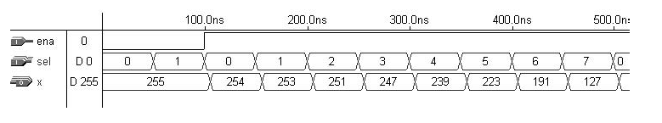
Example1: Generic Decoder
The functionality of the encoder above can be verified in the simulation results of figure below. As can be seen, all outputs are high, that is, x = ‘‘11111111’’ (decimal 255), when ena = ‘0’. After ena has been asserted, only one output bit (that selected
by sel) is turned low. For example,
when sel = ‘‘000’’ (decimal 0), x = ‘‘11111110’’(decimal 254); when sel = ‘‘001’’ (decimal 1), x = ‘‘11111101’’ (decimal 253); when sel = ‘‘010’’ (decimal 2), x = ‘‘11111011’’ (decimal 251); and so on.

Slide 24
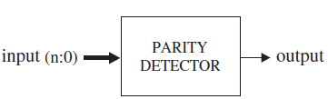
Example2: Generic Parity Detector
Figure below shows the top-level diagram of a parity detector. The circuit must provide output = ‘0’ when the number of ‘1’s in the input vector is even, or output = ‘1’ otherwise. Notice in the VHDL code below that the ENTITY contains a GENERIC statement, which defines n as 7. This code would work for any other vector size, being only necessary to change the value of n in that line. You are invited to highlight the operators and attributes that appear in this design.

Slide 25
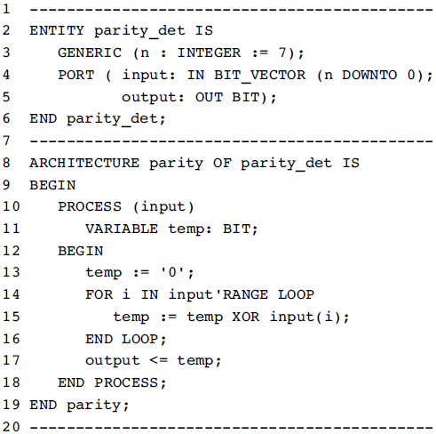
Example2: Generic Parity Detector

Slide 26
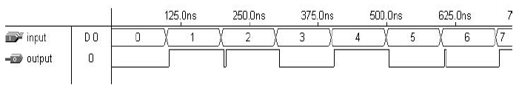
Example2: Generic Parity Detector
Simulation results from the circuit synthesized with the code above are shown in figure below. Notice that when input = ‘‘00000000’’ (decimal 0), the output is ‘0’, because the number of ‘1’s is even; when input = ‘‘00000001’’ (decimal 1), the output is ‘1’, because the number of ‘1’s is odd; and so on.

Slide 27
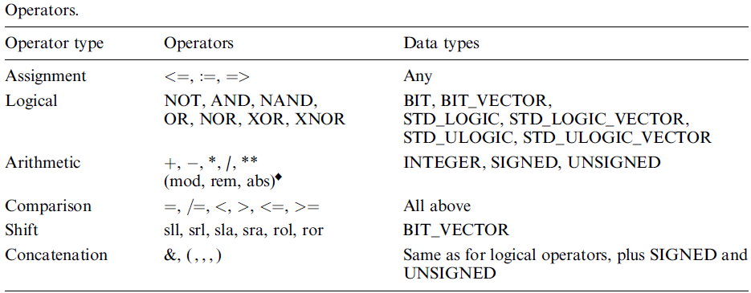
Summary
A summary of VHDL operators and attributes is presented in tables below. The constructs that are not synthesizable (or have little synthesis support) are marked with the ‘‘ ’’ symbol.

Slide 28
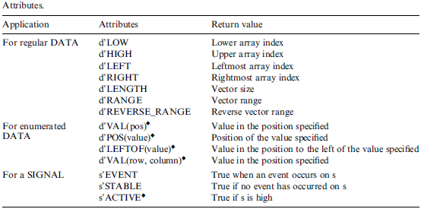
Summary

Slide 29
Exercise 1
SIGNAL a : BIT := '1';
SIGNAL b : BIT_VECTOR (3 DOWNTO 0) := "1100";
SIGNAL c : BIT_VECTOR (3 DOWNTO 0) := "0010";
SIGNAL d : BIT_VECTOR (7 DOWNTO 0);
SIGNAL e : INTEGER RANGE 0 TO 255;
SIGNAL f : INTEGER RANGE -128 TO 127;
-- Operators (fill in the blanks)
x1 <= a & c; -> x1 <= ________
x2 <= c & b; -> x2 <= ________
x3 <= b XOR c; -> x3 <= ________
x4 <= a NOR b(3); -> x4 <= ________
x5 <= b sll 2; -> x5 <= ________
x6 <= b sla 2; -> x6 <= ________
x7 <= b rol 2; -> x7 <= ________
x8 <= a AND NOT b(0) AND NOT c(1); -> x8 <= ________
d <= (5=>'0', OTHERS=>'1'); -> d<= ________

Slide 30
Exercise 2
SIGNAL a : BIT := '1';
SIGNAL b : BIT_VECTOR (3 DOWNTO 0) := "1100";
SIGNAL c : BIT_VECTOR (3 DOWNTO 0) := "0010";
SIGNAL d : BIT_VECTOR (7 DOWNTO 0);
SIGNAL e : INTEGER RANGE 0 TO 255;
SIGNAL f : INTEGER RANGE -128 TO 127;
-- Attributes (fill in the blanks)
c'LOW -> ______
d'HIGH -> ______
c'LEFT -> ______
d'RIGHT -> ______
c'RANGE -> ______
d'LENGTH -> ______
c'REVERSE_RANGE -> ______

Slide 31
Home work:
SIGNAL a : BIT := '1';
SIGNAL b : BIT_VECTOR (3 DOWNTO 0) := "1100";
SIGNAL c : BIT_VECTOR (3 DOWNTO 0) := "0010";
SIGNAL d : BIT_VECTOR (7 DOWNTO 0);
SIGNAL e : INTEGER RANGE 0 TO 255;
SIGNAL f : INTEGER RANGE -128 TO 127;
--legal or illegal?
b(0) AND a
a + d(7)
NOT b XNOR c
c + d
e - f
IF (b<c) ...
IF (b>=a) ...
IF (f/=e) ...
IF (e>d) ...
b sra 1
c srl -2
f ror 3
e*3
5**5
f/4
e/3
d <= c
d(6 DOWNTO 3) := b
e <= d
f := 100
Notes:
b(0) AND a
a + d(7) -- x bit + ?
NOT b XNOR c
c + d -- x +
e - f
IF (b<c) ...
IF (b>=a) ... -- X different size
IF (f/=e) ...
IF (e>d) ...
b sra 1
c srl -2
f ror 3 -- X ror with int
e*3
5**5
f/4
e/3
d <= c -- X
d(6 DOWNTO 3) := b -- X:=
e <= d --X type
f := 100 -- X:=

Slide 32

Questions?

