Slide 1

VHDL Data Types
ALMAARIF UNIVERSITY
CET/
Advanced Digital Electronics
Lecture 2--DAWAH

Slide 2
  Outlines
Pre-defined data types
User-defined data types
Subtypes
Arrays
Port Array
Records
Signed and Unsigned Data Types
Data Conversion
Examples

Slide 3
Introduction
In order to write VHDL code efficiently, it is essential to know what data types are allowed, and how to specify and use them. In this lecture, all fundamental data types are described, with special emphasis on those that are synthesizable.
VHDL is a strongly typed language, which means that an object must have a data type and only the defined values and operations can be applied to the object.

Slide 4
Pre-defined data types
VHDL contains a series of pre-defined data types, specified through the IEEE 1076 and IEEE 1164 standards. More specifically, such data type definitions can be found
in the following packages / libraries:
Package standard of library std: Defines BIT, BOOLEAN, INTEGER, and REAL data types.
Package std_logic_1164 of library ieee: Defines STD_LOGIC and STD_ULOGIC data types.
Package std_logic_arith of library ieee: Defines SIGNED and UNSIGNED data types, plus several data conversion functions
Packages std_logic_signed and std_logic_unsigned of library ieee: Contain functions that allow operations with STD_LOGIC_VECTOR data if the data SIGNED or UNSIGNED.

Slide 5
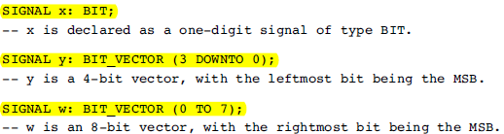
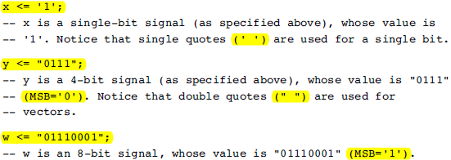
Pre-defined data types
BIT (and BIT_VECTOR): 2-level logic (‘0’, ‘1’). Examples:

Slide 6
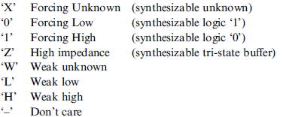
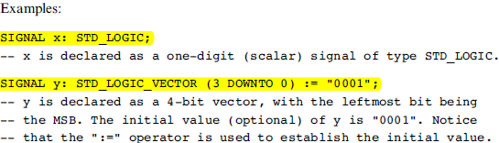
Pre-defined data types
STD_LOGIC (and STD_LOGIC_VECTOR): 8-valued logic system introduced in the IEEE 1164 standard.

Slide 7
Pre-defined data types
BOOLEAN: True, False.
INTEGER:32-bit integers (from -2,147,483,647 to ‏+2,147,483,647).
NATURAL: Non-negative integers (from 0 to ‏+2,147,483,647).
REAL: Real numbers ranging from -1.0E38 to ‏+1.0E38. Not synthesizable.
Physical literals: Used to inform physical quantities, like time, voltage, etc. Useful in simulations. Not synthesizable.
Character literals: Single ASCII character or a string of such characters. Not synthesizable.
SIGNED and UNSIGNED: data types defined in the std_logic_arith package of the ieee library. They have the appearance of STD_LOGIC_VECTOR, but accept arithmetic operations, which are typical of INTEGER data types (SIGNED and UNSIGNED).

Slide 8
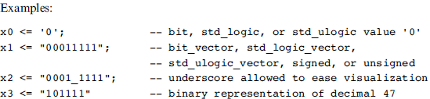
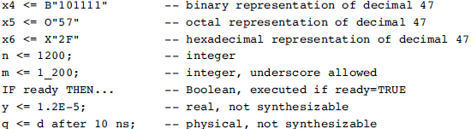
Pre-defined data types

Slide 9
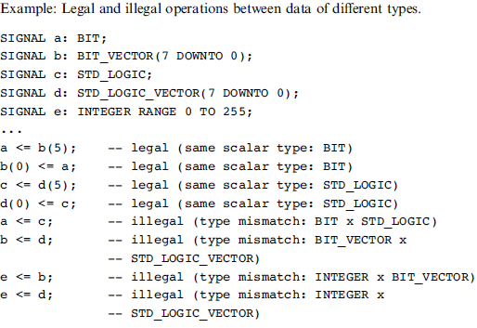
Pre-defined data types

Slide 10


User-defined data types
VHDL also allows the user to define his/her own data types. Two categories of user defined data types are shown below: integer and enumerated.
User-defined integer types:

Slide 11
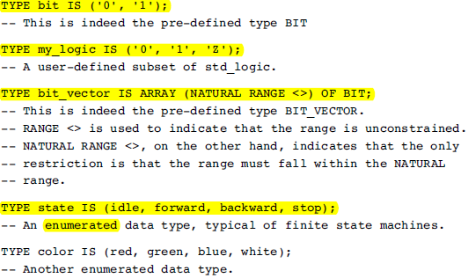
User-defined data types
User-defined enumerated types:

Slide 12
User-defined data types
The encoding of enumerated types is done sequentially and automatically (unless specified otherwise by a user-defined attribute.
For example, for the type color above, two bits are necessary (there are four states), being ‘‘00’’ assigned to the first state (red), ‘‘01’’ to the second (green), ‘‘10’’ to the next
(blue), and finally ‘‘11’’ to the last state (white).

Slide 13
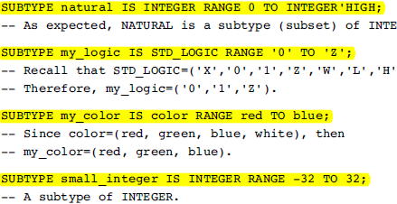
Subtypes
A SUBTYPE is a TYPE with a constraint. The main reason for using a subtype rather than specifying a new type is that, though operations between data of different types are not allowed, they are allowed between a subtype and its corresponding base type. Examples:

Slide 14
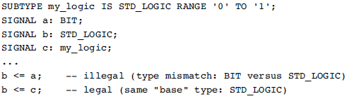
Subtypes
Example:
Legal and illegal operations between types and subtypes.

Slide 15
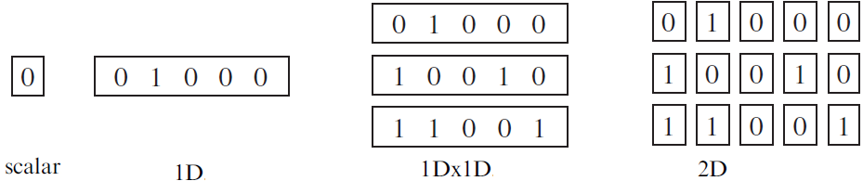
Arrays
Arrays are collections of objects of the same type. They can be one-dimensional (1D), two-dimensional (2D), or one-dimensional-by-one-dimensional (1Dx1D). They can also be of higher dimensions, but then they are generally not synthesizable.
the pre-defined VHDL data types include only the scalar (single bit) and vector (one-dimensional array of bits) categories..

Slide 16

Arrays
The predefined synthesizable types in each of these categories are the following:
There are no pre-defined 2D or 1Dx1D arrays, which, when necessary, must be first defined by the user using type, then the new signal, variable, or constant can be declared using that data type.
To make use of the new array type:

Slide 17

Example: 1Dx1D Array
If we want to build an array containing four vectors, each of size eight bits. This is then an 1Dx1D array. Let us call each vector by row, and the complete array by matrix. Additionally, say that we want the leftmost bit of each vector to be its MSB (most significant bit), and that we want the top row to be row 0. Then the array implementation would be the following (notice that a signal, called x, of type matrix, was declared as an example):
Another way of constructing the 1Dx1D array:

Slide 18
Example: : 2D array
The array below is truly two-dimensional. Notice that its construction is not based on vectors, but rather entirely on scalars.
Array initialization Example :
... :="0001"; -- for 1D array
... :=('0','0','0','1') -- for 1D array
... :=(('0','1','1','1'), ('1','1','1','0')); -- for 1Dx1D or 2D array

Slide 19
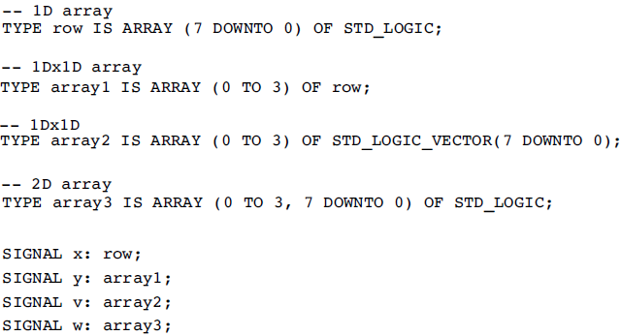
Example: : Legal and illegal array assignments
The assignments in this example are based on the following type definitions and signal declarations:

Slide 20
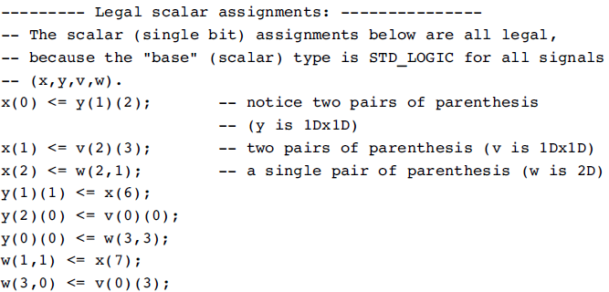
Example: : Legal and illegal array assignments

Slide 21
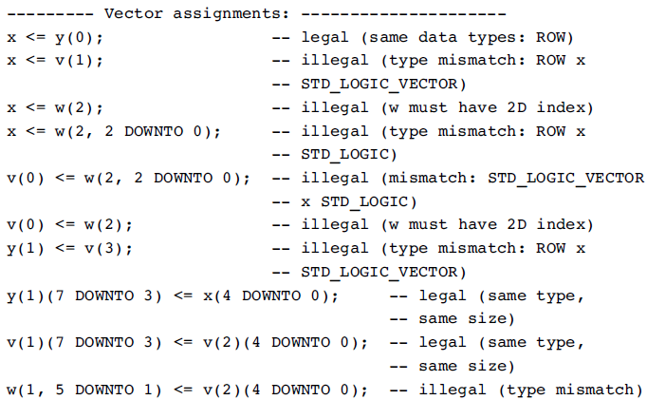
Example: : Legal and illegal array assignments

Slide 22
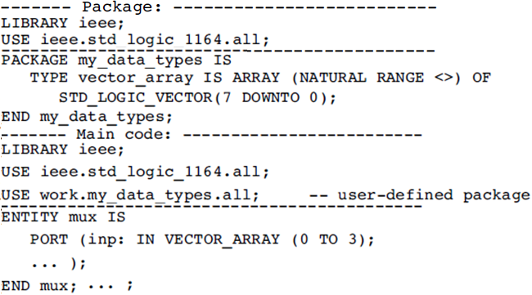
Port Array
Sometimes we might need to specify the ports as arrays of vectors. Since TYPE declarations are not allowed in an ENTITY, we must use a PACKAGE, which will then be visible to the whole design (thus including the ENTITY). An example is shown below.

Slide 23
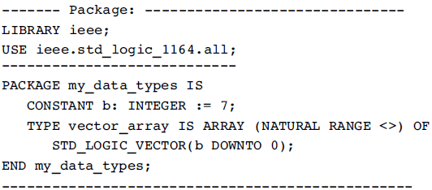
Port Array
Another option for the previous PACKAGE shown below, where a
CONSTANT declaration is included:

Slide 24
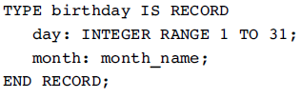
Records
Records are similar to arrays, with the only difference that they contain objects of different types.
Example:

Slide 25

Signed and Unsigned Data Types
These types are defined in the std_logic_arith package of the ieee library. Their syntax is illustrated in the examples below:
Their syntax is similar to that of STD_LOGIC_VECTOR, not like that of an INTEGER, as one might have expected.
An UNSIGNED value is a number never lower than zero. For example, ‘‘0101’’ represents the decimal 5, while ‘‘1101’’ signifies 13.

Slide 26
Signed and Unsigned Data Types
If type SIGNED is used instead, the value can be positive or negative (in two’s complement format). Therefore, ‘‘0101’’ would represent the decimal 5, while ‘‘1101’’ would mean -3. To use SIGNED or UNSIGNED data types, the std_logic_arith package, of the ieee library, must be declared. Despite their syntax, SIGNED and UNSIGNED data types are intended mainly for arithmetic operations, that is, contrary to STD_LOGIC_VECTOR, they accept arithmetic operations. On the other hand, logical operations are not allowed. With respect to relational (comparison) operations,
there are no restrictions.

Slide 27
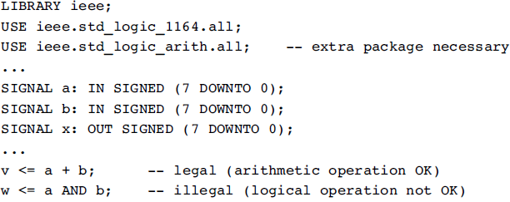
Signed and Unsigned Data Types
Legal and illegal operations with signed/unsigned data types:

Slide 28
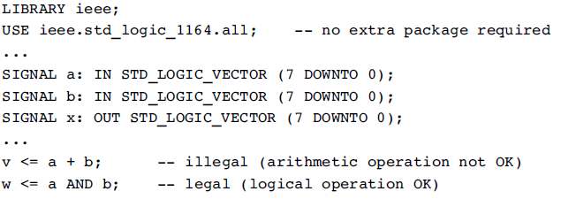
Signed and Unsigned Data Types
Legal and illegal operations with std_logic_vector:

Slide 29
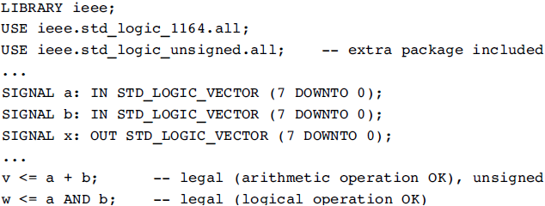
Signed and Unsigned Data Types
There is a simple way of allowing data of type STD_LOGIC_VECTOR to participate directly in arithmetic operations, using two packages, std_logic_signed and std_logic_unsigned.
Example: Arithmetic operations with std_logic_vector.

Slide 30
Data Conversion
VHDL does not allow direct operations (arithmetic, logical, etc.) between data of different types. Therefore, it is often necessary to convert data from one type to another. This can be done in basically two ways: or we write a piece of VHDL code for that, or we invoke a FUNCTION from a pre-defined PACKAGE which is capable of doing it for us.
If the data are closely related (that is, both operands have the same base type, despite being declared as belonging to two different type classes), then the std_logic_1164 of the ieee library provides straightforward conversion functions. An example is shown in the next slide.

Slide 31
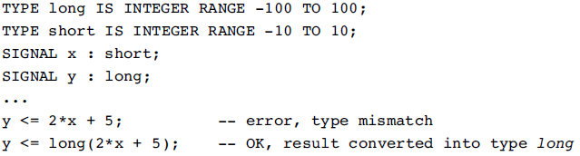
Data Conversion
Legal and illegal operations with subsets.

Slide 32
Data Conversion
Several data conversion functions can be found in the std_logic_arith package of the ieee library. They are:
conv_integer(p) : Converts a parameter p of type INTEGER, UNSIGNED, SIGNED, or STD_ULOGIC to an INTEGER value. Notice that STD_LOGIC_VECTOR is not included.
conv_unsigned(p, b): Converts a parameter p of type INTEGER, UNSIGNED, SIGNED, or STD_ULOGIC to an UNSIGNED value with size b bits.
conv_signed(p, b): Converts a parameter p of type INTEGER, UNSIGNED, SIGNED, or STD_ULOGIC to a SIGNED value with size b bits.
conv_std_logic_vector(p, b): Converts a parameter p of type INTEGER, UNSIGNED, SIGNED, or STD_LOGIC to a STD_LOGIC_VECTOR value with size b bits.

Slide 33
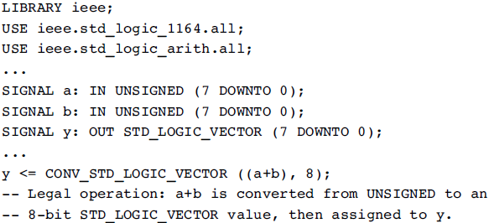
Data Conversion
Another functions are available using the std_logic_signed or the std_logic_unsigned package from the ieee library. Besides the data conversion functions described above, several others are often offered by synthesis tool vendors.

Slide 34
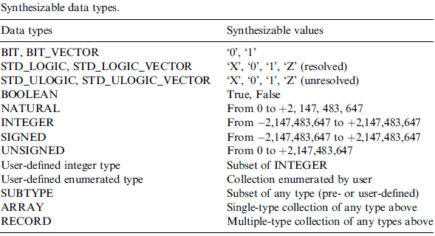
Data Types
The fundamental synthesizable VHDL data types are summarized in table below:

Slide 35
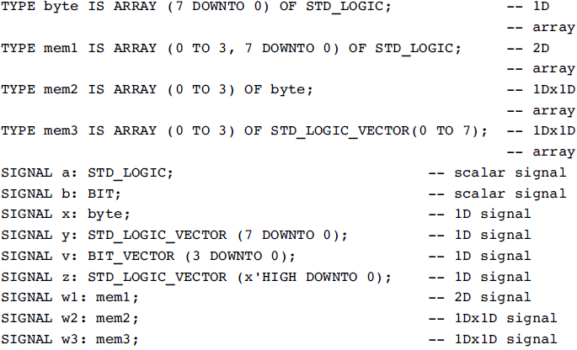
Example 1: Dealing with Data Types

Slide 36
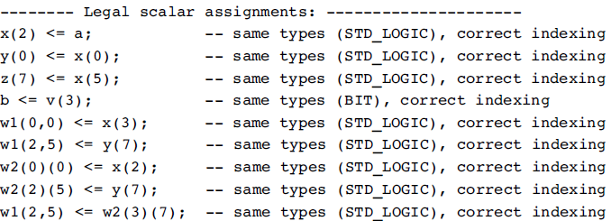

Example 1: Dealing with Data Types

Slide 37
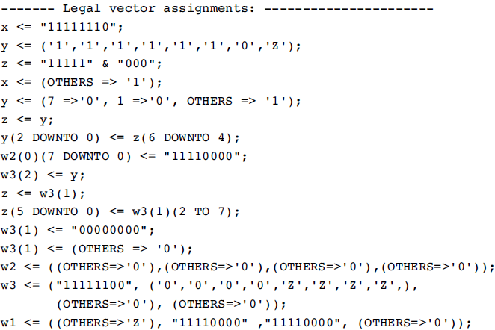
Example 1: Dealing with Data Types

Slide 38
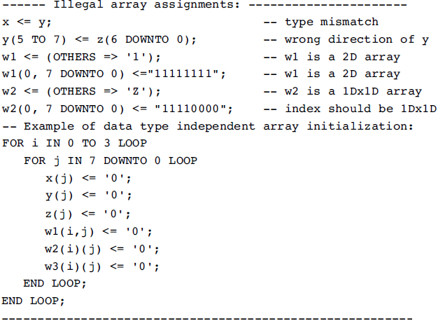
Example 1: Dealing with Data Types

Slide 39
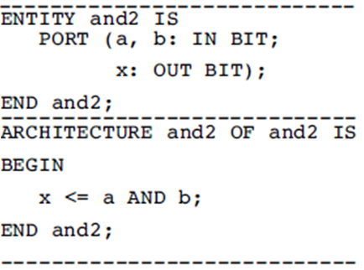

Example 2: Single Bit Versus Bit Vector
This example illustrates the difference between a single bit assignment and a bit vector assignment.
Two VHDL codes are presented. Both perform the AND operation between the input signals and assign the result to the output signal. The only difference between them is the number of bits in the input and output ports (1 bit in the first, 4 bits in the second). The circuits inferred from these codes are shown in next slides.

Slide 40
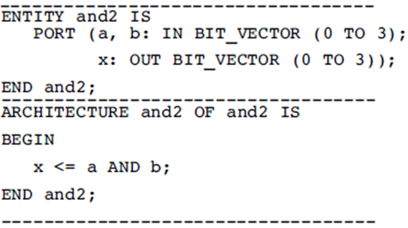
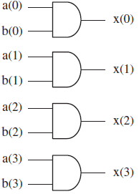
Example 2: Single Bit Versus Bit Vector

Slide 41
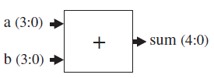
Example 3: Adder
The 4-bit adder shown below has two inputs (a, b) and one output (sum).
The first solutions, all signals are of type SIGNED, while in the second the output is of type INTEGER.
Notice in solution 2 that a conversion function was used in line 13, for the type of a ‏ b does not match that of sum. Notice also the inclusion of the std_logic_arith package (line 4 of each solution), which specifies the SIGNED data type. Recall that a SIGNED value is represented like a vector; that is, similar to STD_LOGIC_VECTOR, not like an INTEGER.

Slide 42
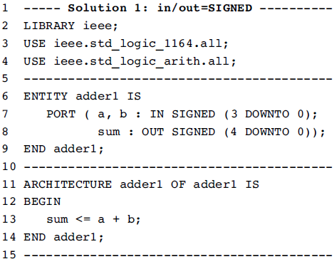
Example 3: Adder

Slide 43
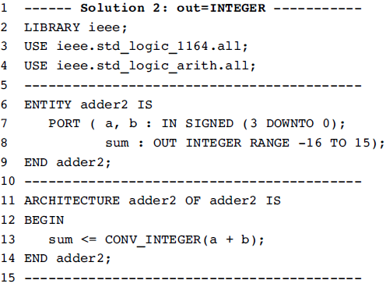
Example 3: Adder

Slide 44
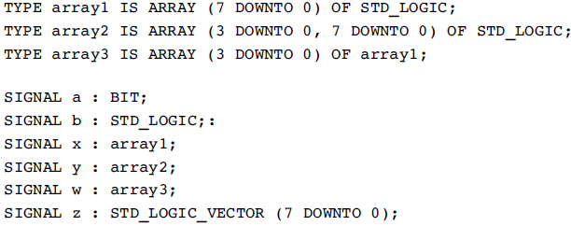
Home work:
The problems below are based on the following TYPE definitions and SIGNAL declarations:
Determine the dimensionality (scalar, 1D, 2D, or 1Dx1D) of the signals given. Also, write down a numeric example for each signal.

Slide 45

Questions?

