Slide 1

Introduction to VHDL
ALMAARIF UNIVERSITY
CET
DAWAH
Advanced Digital Electronics
Lecture 1

Slide 2
Outlines
Introduction to VHDL
Fundamental VHDL Units
Library
Entity
Architecture
Examples

Slide 3
Introduction to VHDL
VHDL is a hardware description language. It describes the behavior of an electronic circuit or system, from which the physical circuit or system can then be implemented.
VHDL stands for VHSIC Hardware Description Language. VHSIC is itself an abbreviation for Very High Speed Integrated Circuits. VHDL is intended for circuit synthesis as well as circuit simulation.
A fundamental motivation to use VHDL is that is a standard, technology independent language, and is therefore portable and reusable. The two main immediate applications of VHDL are in the field of Programmable Logic Devices (CPLDs and FPGAs) and for ASICs (Application Specific Integrated Circuits).

Slide 4
Introduction to VHDL
A note regarding VHDL is that, contrary to regular computer programs which are sequential, its statements are inherently concurrent (parallel). For that reason, VHDL is usually referred to as a code rather than a program. In VHDL, only statements placed inside a PROCESS, FUNCTION, or PROCEDURE are executed sequentially.

Slide 5
Design Flow
The design is started by writing the VHDL code, which is saved in a file with the extension .vhd and the same name as its ENTITY’s name. The first step in the synthesis process is compilation. Compilation is the conversion of the high-level VHDL language, which describes the circuit at the Register Transfer Level (RTL), into a netlist at the gate level. The second step is optimization, which is performed on the gate-level netlist for speed or for area. At this stage, the design can be simulated. Finally, a place and route (fitter) software will generate the physical layout for a PLD/FPGA chip or will generate the masks for an ASIC.

Slide 6

Specification
Circuit or system design is entered into the design application software using text-based entry (VHDL), graphic entry (Schematic), or state diagram description.
libraries
HDL
Schematic Capture
Synthesis
netlist
Verification
Design is simulated by software to
confirm that logic circuit functions as expected. Using waveforms
Design Flow
Simulation
100
001
11
test vector
Implementation
Logic structures are mapped into the actual structure of the specific device using fitting or place and route and results in an output called a bit-stream, which is device dependent.
Translate
Fitting
Place & Route
Timing Analyzer
Back Annotation
Download Program
device
System Debug
downloaded bit-stream to implement the software design in hardware.
printed circuit board

Slide 7
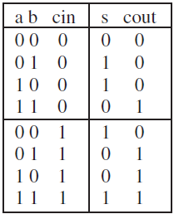
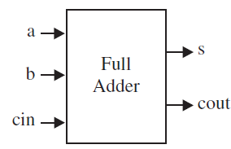
VHDL Code Circuit
for a full-adder unit, a and b represent the input bits to be added, c_{in} is the carry-in bit, s is the sum bit, and c_{out} the carry-out bit. As shown in the truth table, s must be high whenever the number of inputs that are high is odd, while c_{out} must be high when two or more inputs are high.

Slide 8
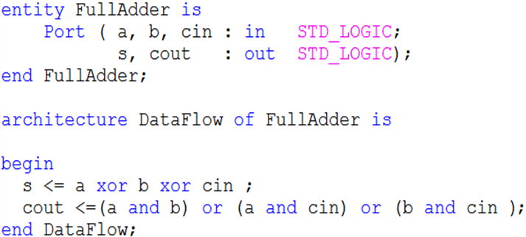
VHDL Code Circuit
A VHDL code for the full adder consists of an ENTITY, which is a description of the pins (PORTS) of the circuit, and of an ARCHITECTURE, which describes how the circuit should function.

Slide 9
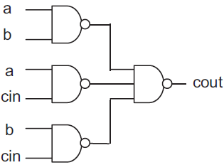

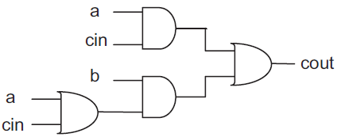
VHDL Code Circuit
there are several ways of implementing the equations described in the previous ARCHITECTURE, so the actual circuit will depend on the compiler/optimizer being used and,
more importantly, on the target technology, if our target is a programmable logic device (PLD or FPGA), then the possible results (among many others) are illustrated below

Slide 10
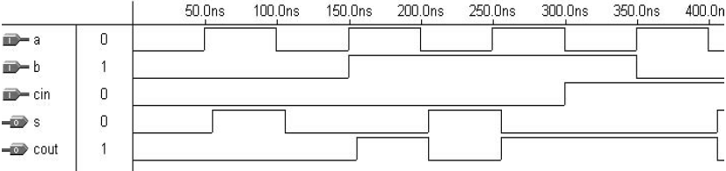
VHDL Code Circuit
After testing, the following waveforms will be displayed by the simulator. Indeed, The simulation results from the circuit
synthesized with the VHDL code , which implements the full-adder unit can be seen, the input pins (characterized by an inward arrow with an I marked inside) and the output pins (characterized by an outward arrow with an O marked inside) are those listed in the ENTITY. As can be observed, the outputs do behave as expected.

Slide 11
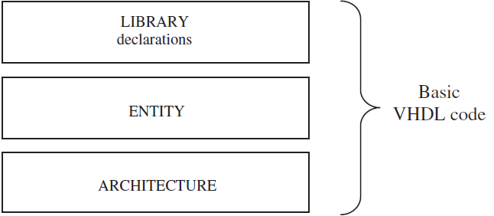
Fundamental VHDL Units
A VHDL code is composed of at least three fundamental sections:
LIBRARY declarations: Contains a list of all libraries to be used in the design. For example: ieee, std, work, etc.
ENTITY: Specifies the I/O pins of the circuit.
ARCHITECTURE: Contains the VHDL code proper, which describes how the circuit should behave (function).

Slide 12

Library
To declare a LIBRARY (that is, to make it visible to the design) two lines of code are needed, one containing the name of the library, and the other a use clause, as shown in the syntax below.
At least three packages, from three different libraries, are usually needed in a design:
ieee.std_logic_1164 (from the ieee library),
standard (from the std library), and
work (work library).

Slide 13
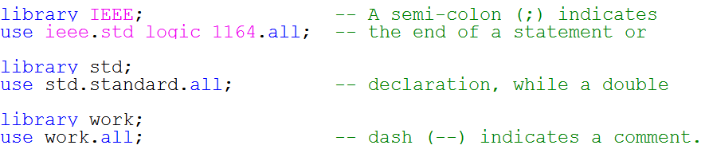
Library
Their declarations are as follows:
The libraries std and work shown above are made visible by default, so there is no need to declare them; only the ieee library must be explicitly written.

Slide 14
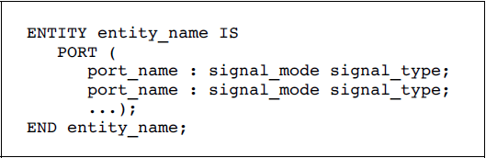
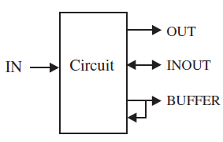
Entity
An ENTITY is a list with specifications of all input and output pins (PORTS) of the circuit. Its syntax is shown below.
The mode of the signal can be IN, OUT, INOUT, or BUFFER. IN and OUT are truly unidirectional pins, while INOUT is bidirectional. BUFFER, on the other hand, is employed when the output signal must be used (read) internally. Finally, the name of the entity can be basically any name, except VHDL reserved words.

Slide 15


Entity
Example: Let us consider the NAND gate shown in figure. Its ENTITY can be specified as:
The meaning of the ENTITY above is the following:
the circuit has three I/O pins, being two inputs (a and b, mode IN) and one output (x, mode OUT). All three signals are of type STD_LOGIC (BIT). The name chosen for the entity was nand_gate.

Slide 16
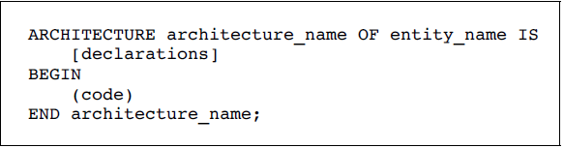
Architecture
The ARCHITECTURE is a description of how the circuit should behave (function). Its syntax is the following:
As shown above, an architecture has two parts: a declarative part (optional), where signals and constants are declared, and the code part (from BEGIN down). Like in the case of an entity, the name of an architecture can be basically any name (except VHDL reserved words), including the same name as the entity’s.

Slide 17
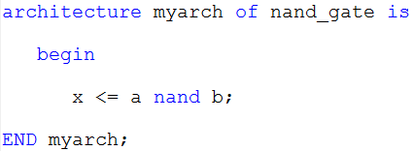
Architecture
Example: Let us consider the previous NAND gate.
The meaning of the ARCHITECTURE above is the following:
the circuit must perform the NAND operation between the two input signals (a, b) and assign (‘‘<=’’)the result to the output pin (x). The name chosen for this architecture was myarch. In this example, there is no declarative part, and the code contains just a single assignment.

Slide 18
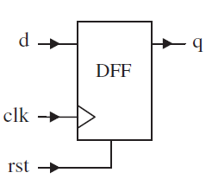
Example 1: DFF with Asynchronous Reset:
A D-type flip-flop (DFF), triggered at the rising edge of the clock signal (clk), and with an asynchronous reset input (rst). When rst =‘1’, the output must be turned low, regardless of clk.
Otherwise, the output must copy the input (that is, q <= d) at the moment when clk changes from ‘0’ to ‘1’ (that is, when an upward event occurs on clk).
There are several ways of implementing this DFF , one being the solution presented next slide. One thing to remember, however, is that VHDL is inherently concurrent (contrary to regular computer programs, which are sequential), so to implement any clocked circuit (flip-flops, for example) we have to ‘‘force’’ VHDL to be sequential. This can be done using a PROCESS, as shown latter.

Slide 19
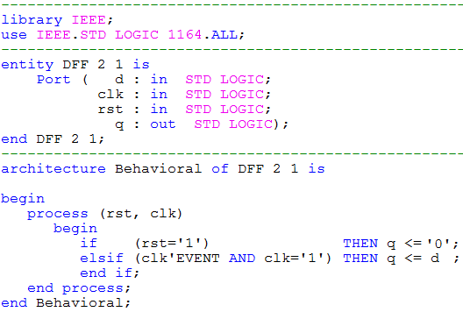
Example 1: DFF with Asynchronous Reset:

Slide 20
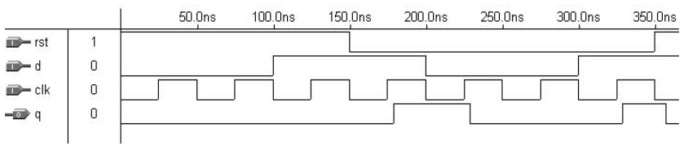
Simulation results for Example 1:
Figure below presents simulation results regarding example 1. The graphs can be easily interpreted. The first column shows the signal names, as defined in the ENTITY. It also shows the mode of the signals. The second column has the value of each signal in the position where the vertical cursor is placed. While the third column shows the simulation proper. The input signals (rst, d, clk) can be chosen freely, and the simulator will determine the corresponding output (q). we notice that our design works properly.

Slide 21
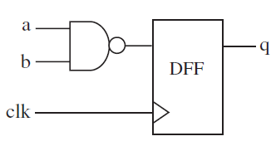
Example 2: DFF plus NAND Gate:
The circuit of shown figure is a mixture of combinational and sequential (without reset). In the solution that follows, we have purposely introduced an unnecessary signal (temp), just to illustrate how a signal should be declared.
Simulation results from the circuit synthesized with the code below are shown in next slide.

Slide 22
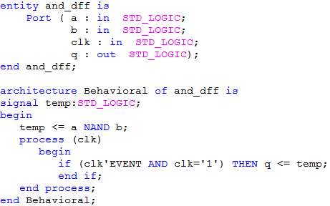
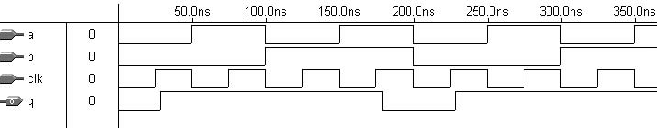
Example 2: DFF plus NAND Gate:

Slide 23
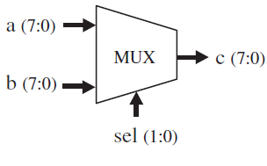
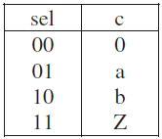
Problem: Multiplexer
For the multiplexer shown in figure:
a) Complete the VHDL code in the next slide.
b) Compile and simulate your solution, checking whether it works as expected.
Note: A solution using IF was employed in the code below, because it is more intuitive. However, as will be seen later, a multiplexer can also be implemented with other statements, like WHEN or CASE.

Slide 24
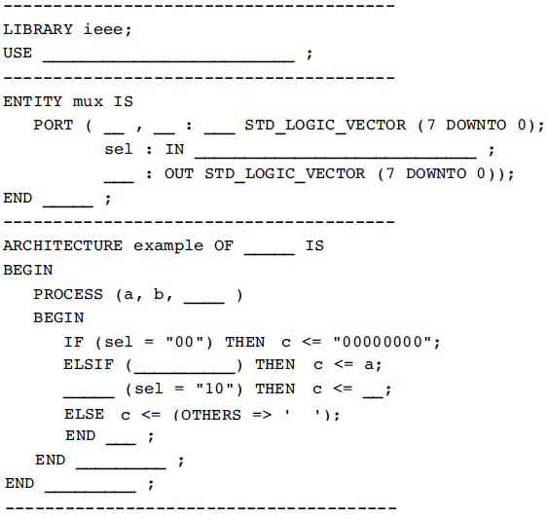
Problem : Multiplexer

Slide 25
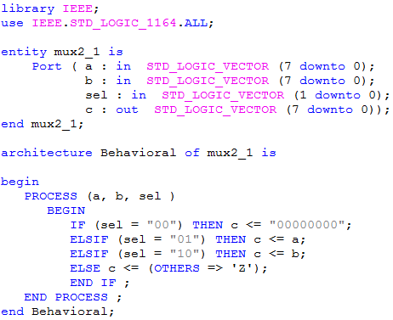
Problem Multiplexer Solution:

Slide 26
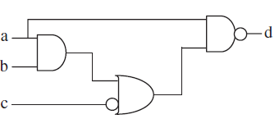
Home work: Logic Gates
a) Write a VHDL code for the circuit of figure below. Notice that it is purely combinational, so a PROCESS is not necessary. Write an expression for d using only logical operators (AND, OR, NAND, NOT, etc.).
b) Synthesize and simulate your circuit. After assuring that it works properly, open the report file and check the actual expression implemented by the compiler. Compare it with your expression.

Slide 27

Questions?

