Slide 1
Al-Maarif University College
Department of Dentistry
Medical Biology Lab
Stage -3-
Medical Parasitology
Lec. 7
A.L :- Zaid Ahmad Hameed

Slide 2
Introduction
Parasitology is the branch of biology concerned with the phenomenon of dependence of one living organism on another. Medical parasitology deals with the parasites which infect man, the diseases they produce, the response generated by him against them, and various methods of diagnosis, prevention and treatment.
Parasitology is the study of invertebrate animals capable of causing disease in humans and other animals. It is concerned with 200 or so species of helminth worms and about 80 species of protozoa that infect humans.

Slide 3
The Parasite
Is an organism that is entirely dependent on another organism, referred to as its host, for all or part of its life cycle and metabolic requirements.
1. Microparasite: small, unicellular and multiplies within its vertebrate host, often inside cells. Protozoa are microparasites.
2. Macroparasite: large, multicellular and has no direct reproduction within its vertebrate host. This category includes helminths.

Slide 4
On the basis of their location, parasites may be divided into:
1. Ectoparasites: which live on the surface of the body, e.g., the human louse, Pediculus humanus. The infection by these parasites is known as infestation. They are important as vectors transmitting pathogenic microorganisms.
2. Endoparasites: which live within the body of the host in the blood, tissues, body cavities, digestive tract and other organs. All protozoan and helminthic parasites of man are endoparasites. The invasion by endoparasites is known as infection.
This group can be further subdivided into the following types:
a. Obligate parasites: organisms that cannot exist without a host (e.g., Toxoplasma gondii).

Slide 5
b. Facultative parasites: organisms that under favorable circumstances may live either a parasitic or free-living existence e.g., Naegleria fowleri
c. Accidental parasites: organisms that attack an unusual host e.g. Echinococcus granulosus in man.
d. Aberrant parasites: organisms that attack a host where they cannot live or develop further e.g. Toxocara canis in man.
e. Free-living: it describes the nonparasitic stages of existence which are live independently of a host, e.g. hookworms have active free-living stages in the soil.

Slide 6
The Vector
An agent, usually an insect transmits the infection from one human host to another. It is of two types:
1. Mechanical vector: the term used to describe a vector which assists in the transfer of parasitic forms between hosts but is not essential in the life cycle of the parasite, e.g. a housefly and Cockroaches in the case of Entamoeba which transfers the cysts of the parasite from the infected feces to food that is eaten by humans.
2. Biological vector: in which the pathogenic organism develops and multiplies before being transmitted to the next host, therefore, it is essential in the life cycle of the parasite.

Slide 7
Host-Parasite relationships
1. Symbiosis: an association in which both host and parasite are so dependent upon each other that one cannot live without the help of the other. Neither of the partners suffers from any harm from this association.
2. Commensalism: an association in which only the parasite derives benefit without causing any injury to the host. A commensal lives on food residues or waste products of the body and is capable of leading an independent life, as in the case of Entamoeba coli in the large intestine of man (One partner benefits, the other is not hurt).
3. Parasitism: Parasitism is a relationship in which a parasite benefits and the host provides the benefit. The host gets nothing in return and always suffers from some injury because the parasite lives on the expense of the host. The degree of dependence of a parasite on its host varies.

Slide 8
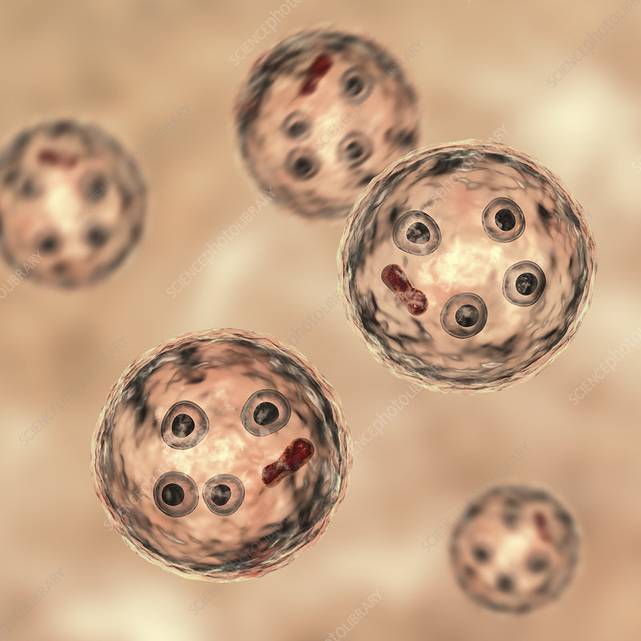
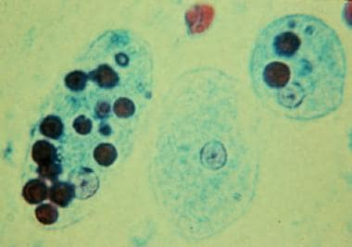
Intestinal Amoeba

Slide 9
General classification of intestinal amoebae:
Pathogenic Intestinal Amoeba
Ex: Entamoebae histolytica
Nonpathogenic Intestinal Amoeba
Ex: Entamoebae coli.
Idomoeba butschlii.
Endolimax nana.

Slide 10
Entamoebae histolytica

Slide 11
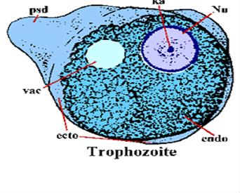
Trophozoite Morphology :
Is also known as growing stage, feeding stage or active vegetative stage. Size of trophozoite is (10-60 µm)but majority are around (15-30 µm).
The trophozoite not has a fixed shape because constantly changing position.They move by pseudopodia which are cytoplasmic protrusions that may be formed at any point on the surface of the organisms. The trophozoites is actively motile, motility is usually progressive and directional rather than aimless as other amoebae.
The cytoplasm is divisible in two portions, a clear translucent ectoplasm and a granular endoplasm. Red blood cells, white blood cells and tissue debris may be occasionally seen inside the cytoplasm.
The trophozoite has one nucleus which is (4-6 µm )in size, spherical in shape and placed centrically. It has a clearly defined nuclear membrane.
The inner surface of which is lined with uniform and closely packed fine granules of chromatin.

Slide 12
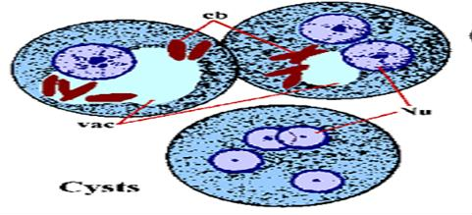
Cyst Morphology:
During encystment the parasite becomes rounded and it surrounded by a smooth, refractive non-staining wall. The size of the cyst various between (12-15 µm ), the nucleus retains the charecters of the trophozoite. Early in development of the cytoplasm of the cyst shows (1-4) chromatin bars which are refractive, oblong bodies with rounded ends which stain black with iron heamatoxylin stain and a glycogen mass which stain brown with iodine. The cyst initially uninuclear but by binary fission soon developed into a binuclear and quadrinuclear body.
As the cyst mature both the glycogen and the chromatdial bars generally disapper. The cyst containing (1-4) nuclei may be passed in the feces.

Slide 13
Life cycle of Entamoeba histolytica

Slide 14
Clinical features of intestinal pathogenic amoebae:
Mild diarrhea to fulminate and fatal dysentery.
The stool are usually loose, have a foul smell and are often flecked with blood.
Abdominal pain, discomfort, flatulence, nausea and vomiting.

Slide 15
laboratory diagnosis :
Examination of stool samples :
Permanent staining
( Trophozoites may be seen in a fresh fecal smear and cyst in an ordinary stool sample ).
PCR
ELISA and culture can also be used.
Treatment
Metronidazole is currently the standard therapy for treating adults and children with invasive amoebiasis, but it may not be sufficient to eliminate amoebic cysts from the intestine.

