Slide 1
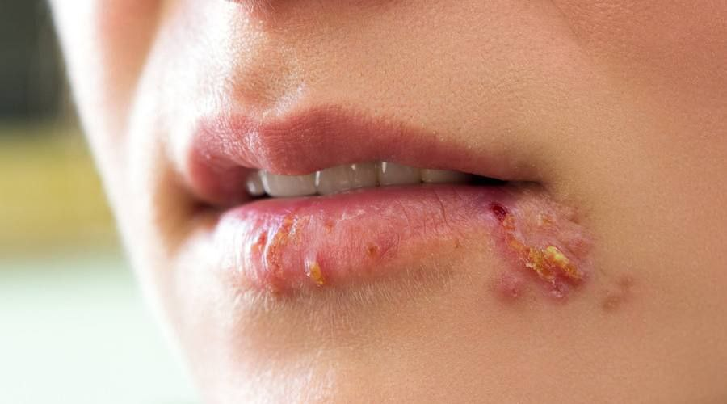
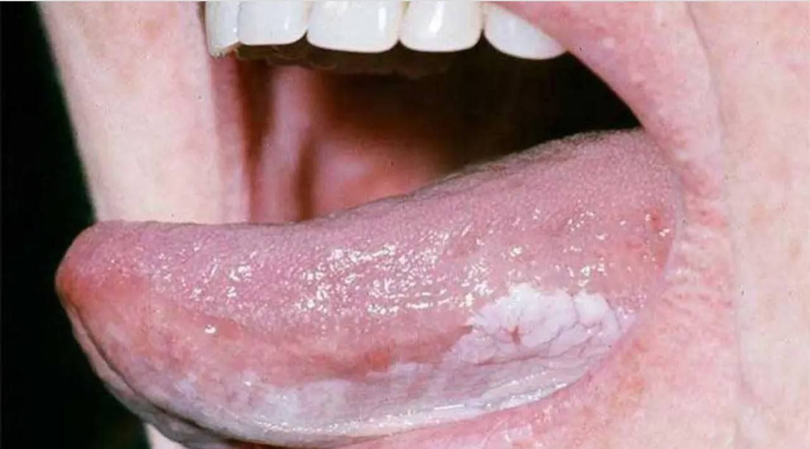
the difference between normal ulcers and cancerous ulcers that effect oral tissues
الفرق بين التقرحات العادية والتقرحات السرطانية التي تصيب أنسجة الفم
Prepared by:
Zaid Ahmed Hameed
2023, University of Mansoura – Egypt (MSc. (cell, tissue and genetics

Slide 2
content list ….
What are normal mouth ulcers
mouth ulcers causes
Treatment of mouth ulcers
What Is cancer ulcers
Cancer treatments that generally cause mouth ulcers
How can we distinguish between normal and cancerous ulcers

Slide 3
What are normal mouth ulcers ?
These are open wounds or small painful blisters that appear in the inner cavity of the mouth or on the gums and also on the lip.
It is caused by erosion of part of the thin tissue (mucosa) that lines the inside of the mouth.

Slide 5
Treatment of mouth ulcers
The ulcers disappear on their own in about 10-14 days. But some treatments can reduce the pain of mouth ulcers and speed up their treatment, such as:
Apply ice to mouth ulcers.
Take nutritional supplements, such as folic acid, vitamin B6, vitamin B12, and zinc.
An antimicrobial mouthwash, such as chlorhexidine mouthwash.
An antibiotic, such as doxycycline.
A topical ointment or gel containing a steroid to relieve pain and swelling.
Corticosteroid ointment, such as hydrocortisone.
Antacids.

Slide 6
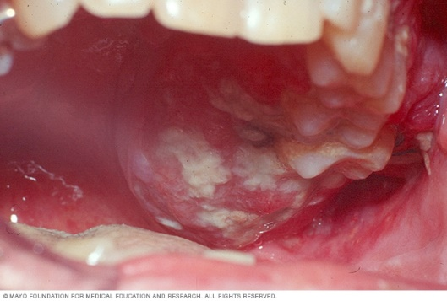
What Is cancer ulcers ?
Cancerous ulcers are one of several types of cancer that are grouped into a category called head and neck cancers. Oral cancer and other head and neck cancers are usually treated similarly.
Oral cancers form when cells on the lips, or in the mouth, develop mutations in their DNA. A cell's DNA contains the instructions that tell the cell what to do. The changes caused by mutations tell cells to continue growing and dividing when healthy cells die.
Accumulating abnormal mouth cancer cells may form a tumor. Over time, it may spread inside the mouth, and to other areas of the head and neck, or other parts of the body.

Slide 7
Cancer treatments that generally cause mouth ulcers
include:
Chemotherapy
Radiation therapy which targeting the head and neck
Bone marrow transplant, also known as stem cell transplant Targeted therapy
Immunotherapy

Slide 8
How can we distinguish between normal and cancerous ulcers?
Normal Mouth ulcers are painful, while mouth cancer spots often do not cause pain.
Mouth ulcers disappear in a relatively short period, while mouth cancer may spread gradually and not disappear without treatment.
Oral cancer spots are rough in texture and difficult to scrape off.
Oral cancer spots are often relatively large red and white areas, and may appear on the tongue, the back of the mouth, the gums, or the inside of the cheeks.
Oral cancer spots chronic problems with swallowing, chewing, and speaking.

Slide 9
Conclusion
There is no sure way to prevent mouth ulcers. However, you can reduce your risk of mouth cancer by doing the following:
Avoid spicy or sour foods.
Brush your teeth twice a day, floss your teeth at least once a day Stop smoking because using tobacco, whether by smoking or chewing, exposes the cells in your mouth to dangerous cancer-causing chemicals.
See your dentist regularly. Ask your dentist to examine your entire mouth as part of routine dental exams, to look for any abnormal areas that may be a sign of oral cancer or pre-cancerous changes.

Slide 10
Homework
Mention the most important diseases and other problems that can lead to the appearance of ulcers in the mouth ?

Slide 11
Thank you for listening

