Slide 1
Al-Maarif University
College of Dentistry
microbiology
Stage -3-
Streptococci
Prepared by:
Assistant Lec. Zaid Ahmad Hameed, MSc. Cancer Bio, BSc. Biology

Slide 2
Bacteria
Gram-Positive
Gram-negative
Staphylococcus
Streptococcus
Two of the most important human pathogens, Staphylococcus aureus and Streptococcus pyogenes.

Slide 3
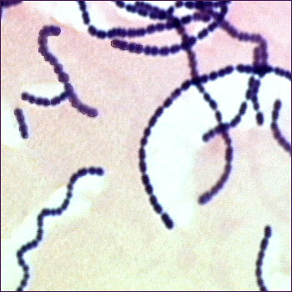
Streptococci
Characters of Streptococci
Gram positive cocci
Size 1µm
Chains or pairs
Non motile
Non spore forming
Facultative anaerobes
Catalase negative
(staphylococci are catalase positive)

Slide 4
Classification of Streptococci
1-Hemolysis on Blood Agar
α-hemolysis
Partial hemolysis
Green discoloration around colonies
e.g. S. pneumoniae & S. viridans
β-hemolysis
Complete hemolysis
Clear zone of hemolysis around colonies
e.g. Lancefield Group A & B (S. pyogenes & S. agalactiae)
γ-hemolysis
No hemolysis
e.g. Group D (Enterococcus sp.)

Slide 5
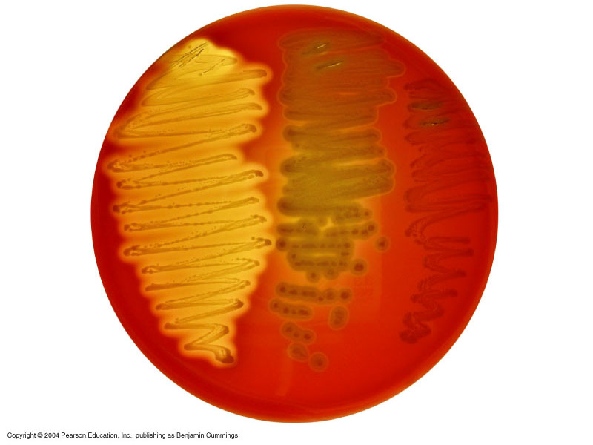
Hemolysis on Blood agar
α-hemolysis
β-hemolysis
γ-hemolysis

Slide 6
2- Lancefield Classification- β hemolytic
Streptococci
Lanciefield classification
Group A
S. pyogenes
Group B
S. agalactiae
Group C
S. equisimitis
Group D
Enterococcus
Other groups
(E-U)
Classification based on C- carbohydrate antigen of cell wall
20 Lancefield groups from A-H & K-V
One or more species per group
Group A- Further subdivided based on M, T, R protein (Griffith typing) in to 80 serotypes

Slide 7
VIRULENCE FACTORS
Capsule: hyaluronic acid , antiphagocytosis.
Group-specific cell wall antigens (Lancefield groups A-V) Specificity is determined by a dimer of N- acetylglucosamine and rhamnose .
T protein: type-specific; function unknown.
M- proteins: binds IgM, IgG and α2-macroglobulin; interfere with phagocytosis.
Lipoteichoic acid: binds to epithelial cells.
F protein: a major adhesin of S. pyogenes, binding with fibronectin.

Slide 8
Enzymes and toxins
Streptokinase (fibrinolysin)
Can lyse blood clots and may be responsible for the rapid spread of the organism.
Used (IV injection) for treatment of pulmonary emboli, coronary artery thrombosis and venous thrombosis.
Streptodornase (DNases A to D)
Decreases viscosity of DNA suspension.
A mixture of this and streptokinase is used in removal of pus and necrotic tissue.
Hyaluronidase (spreading factor)
Destroys connective tissue and aids in spreading infecting bacteria.
C5a peptidase
Prevents streptococci from C5a-mediated activation of phagocytes, and is important for survival of S. pyogenes in tissue and blood.
Streptococcal Toxic Shock Syndrome (STSS)

Slide 9
Disease caused by S. pyogenes
1.Non-Invasive
Pharyngitis - inflammation of the pharynx, tonsillitis, otitis media, mastoiditis, rarely meningitis
Pyoderma- Impetigo - localised pus-producing lesions usually occur on face, arms, or legs
2. Invasive
Erysipelas - diffuse infection of skin, involves superficial lymphatics. well demarcated borders
Cellulitis - infection of skin & subcutaneous tissue, spreading

Slide 10
Laboratory Diagnosis
Smears: useful for soft tissue infections or pyoderma, but not for respiratory infections.
Antigen detection tests: commercial kits for rapid detection of group A streptococcal antigen from throat swabs.
Detection of group A streptococci by molecular methods: PCR assay for pharyngeal specimens.
Culture: Specimens are cultured on blood agar plates in air. 10% CO₂ although speeds hemolysis,
Identification: serological and biochemical tests.
Antibody detection
ASO titration for infections ( rheumatic fever & osteomylitis) .
Anti-DNase B and antihyaluronidase titration for skin infections.

Slide 11
Treatment
Penicillin is the drug of choice in the treatment of S. pyogenes infection. Where a history of hypersensitivity to penicillin exits, erythromycin may be used instead.
Prevention and Control
Most streptococci are normal flora of the human body. Source of S. pyogenes and S. agalactiae is a person harboring these organisms (carrier).
Control:
1. Prompt eradication of streptococci from early infections.
2. Prophylactic antibiotic treatment for rheumatic fever patients.
3. Eradication of S. pyogenes from carriers.
4. Dust control, ventilation, air filtration, UV irradiation and aerosol mists are of doubtful efficacy.
5. Intrapartum penicillin to mother at risk of giving birth to an infant with invasive group B disease.

