Slide 1
Al-Maarif University
College of Dentistry
microbiology
Stage -3-
Staphylococcus
Prepared by:
Assistant Lec. Zaid Ahmad Hameed, MSc. Cancer Bio, BSc. Biology

Slide 2
Bacteria
Gram-Positive
Gram-negative
Staphylococcus
Streptococcus
Two of the most important human pathogens, Staphylococcus aureus and Streptococcus pyogenes.

Slide 3
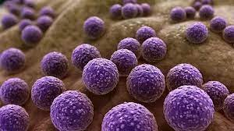
Staphylococcus
Including
S. aureus
S. epidermidis
S. saprophyticus
Gram +Ve
Non Motile
Not Form Spores
Cocci or spherical
Catalase +Ve

Slide 4
1- Staphylococcus aureus
Characteristics:
Gram-positive cocci in clusters. Coagulase and Catalase-positive.
Most isolates produce β-lactamase

Slide 5
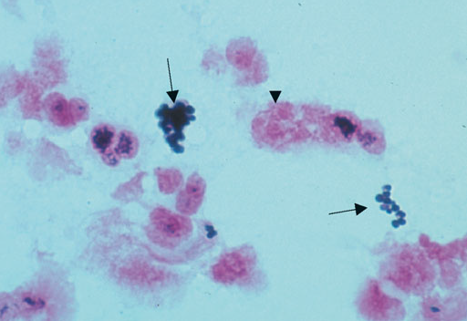
Staphylococcus aureus —Gram stain. Arrows point to two “grapelike” clusters of gram-positive cocci.

Slide 6
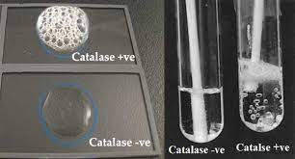
β-lactamase :produced by bacteria that provide multi-resistance to beta- lactam antibiotics such as penicillins, cephalosporins.
Catalase
Staphylococci produce catalase degrades H 2 O 2 into O 2 and H 2 O

Slide 7
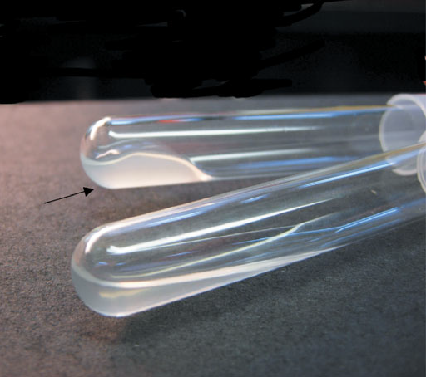
Coagulase test—Upper tube inoculated with Staphylococcus aureus; lower tube inoculated with Staphylococcus epidermidis . Arrow points to clotted plasma formed by coagulase produced by Sta. aureus.

Slide 8
Diseases
Abscess of many organs, endocarditis, osteomyelitis, septic arthritis, and impetigo.
Hospital-acquired pneumonia, surgical wound infections, and sepsis.
exotoxin-mediated diseases such as food poisoning, toxic shock syndrome, and scalded skin syndrome.
Skin infection: Folliculitis , Cellulitis ,and impetigo

Slide 9
Abscess on foot. Note central raised area of whitish pus surrounded by erythema. An abscess is the classic lesion caused by Staphylococcus aureus

Slide 10
Staph.Scalded skin syndrome(SSSS). Caused by an exotoxin produced by Staphylococcus aureus

Slide 11
Folliculitis. Note the multiple, small pustules on the chin and neck. Staphylococcus aureus is the most common cause of folliculitis.

Slide 12
Impetigo. Note vesicular lesions covered with “honey-colored” crust erythema. Impetigo is caused by either Staphylococcus aureus or Streptococcus pyogenes

Slide 13
Habitat and Transmission—Main habitat is human nose; also found on human skin. Transmission is via the hands.

Slide 14
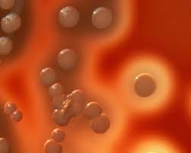
Laboratory Diagnosis
Gram-stained smear and culture.
Yellow or gold colonies on blood agar; colonies often beta hemolytic.
Staphylococcus aureus is coagulase-positive;
Staphylococcus epidermidis is coagulase-negative.
Serologic tests not useful

Slide 15
Treatment
Penicillin G for sensitive isolates; β-lactamase–resistant penicillins such as Nafcillin for resistant isolates; Vancomycin for isolates resistant to Nafcillin.
About 85% are resistant to penicillin G..
Resistance to Nafcillin is caused by changes in binding proteins. Some isolates are tolerant to penicillin.
Rare Vancomycin-resistant strains have emerged.

Slide 16
Prevention—Cefazolin is used to prevent surgical wound infections.
No vaccine is available.
Hand washing reduces spread.

Slide 17
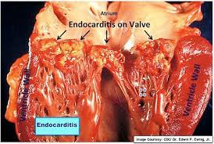
2-Staphylococcus epidermidis
Diseases—Endocarditis on prosthetic heart valves, prosthetic hip infection, intravascular catheter infection, CSF infection, neonatal sepsis.

Slide 18
Characteristics
Gram-positive cocci in clusters.
Coagulase Negative.
Catalase-Positive.

Slide 19
Habitat and Transmission
Normal flora of the human skin and mucous membranes. It is probably the patient’s own strains that cause infection, but transmission from person to person via hands may occur.

Slide 20
Laboratory Diagnosis
Gram-stained smear and culture.
Whitish, non-hemolytic colonies on blood agar. It is coagulase negative.
S. epidermidis is sensitive to novobiocin, whereas the other coagulase-negative staphylococcus, S. saprophyticus, is resistant. Serologic tests are not useful.

Slide 21
Treatment—Vancomycin plus either rifampin or an aminoglycoside.
It produces β-lactamases and is resistant to many antibiotics.
Prevention—There is no drug or vaccine.

Slide 22
3-Staphylococcus Saprophyticus
Gram-positive cocci in clusters. Coagulase-negative. catalase positive
Resistant to Novobiocin in contrast to S.epidermidis, which is sensitive.
Causes community-acquired urinary tract infections in young women (but Escherichia coli is a much more common cause).

