Slide 1
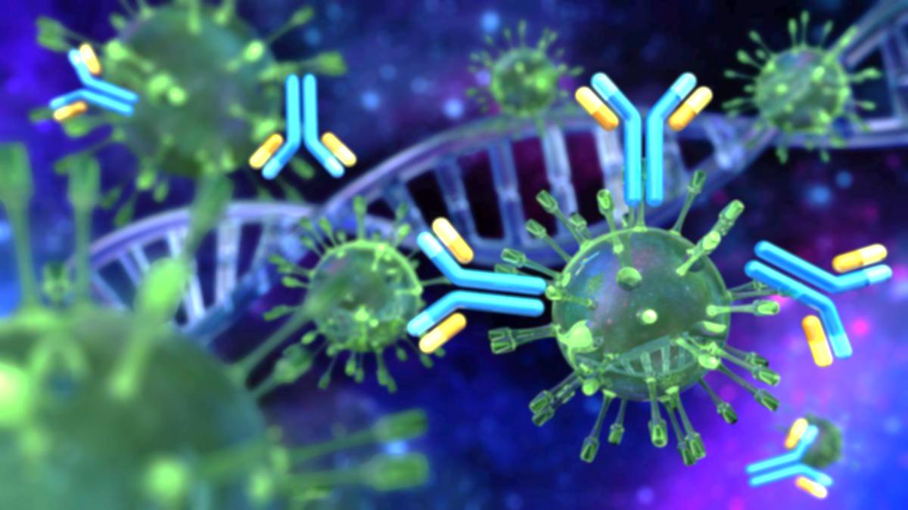


Immunology lab
3rd stage
Lab 6
Natural Antibodies Study
Assistant Lecturer
A’laa Khalaf Bediwi
2024-2025

Slide 2
Introduction to Antibodies
Antibody, also known as immunoglobulins (Ig), are specialized proteins produced by plasma cell, its used by the immune system to identify and neutralize foreign substances, such as bacteria, viruses, and toxins.
The antibody recognizes a unique molecule of harmful agent called antigen via the variable region .

Slide 3
Structure of antibody
All antibodies share basic structure.
Antibody is composed of two identical heavy polypeptide chains and two identical light polypeptide chains bonded via interchain disulphide (s-s) linkages.

Slide 4
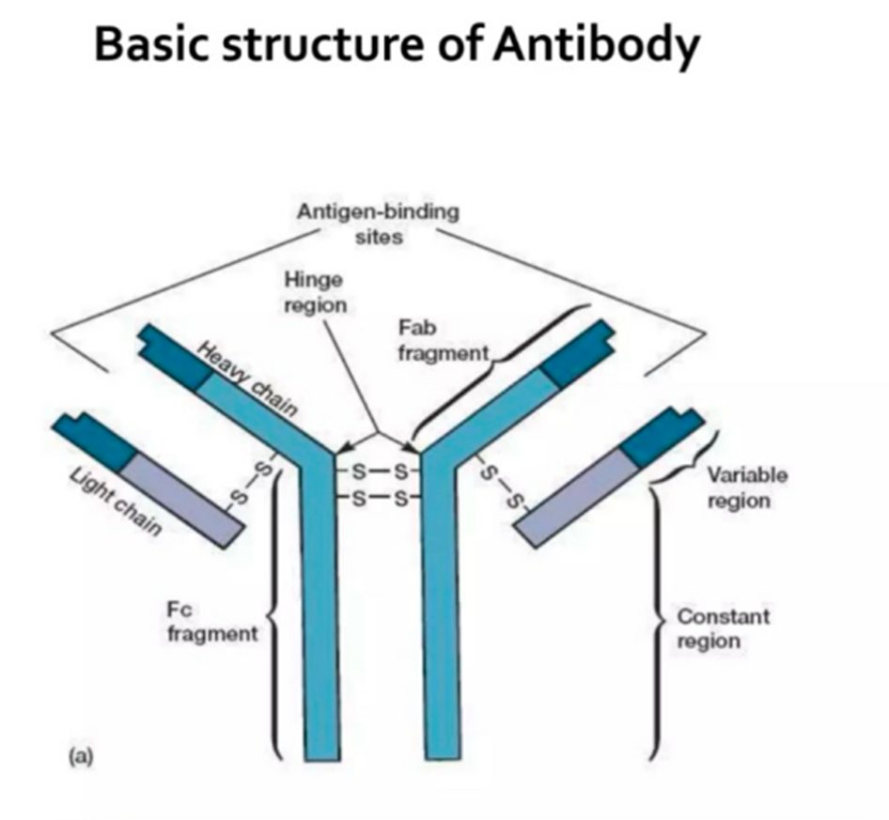

Slide 5
HEAVY CHAINS
Five Types Of Heavy Chains Are Present O They Are;
1) Alpha (A)
2) Gamma (G)
3) Delta (D)
4) Epsilon (E)
5) Mu (M)
Each Heavy Chain Has Two Regions, One Constant Region And One Variable Region.

Slide 6
LIGHT CHAINS
Two types of light chains are present are;
1) kappa
2) lambda
All antibodies have one of the two kinds of light chains.
A light chain has two successive domains, one constant domain and one variable domain.

Slide 7
Different Classes Of Antibodies
There are five classes of antibodies are present They are;
1) lgG
2) lgM
3) lgA
4) lgD
5) lgE
The antibody classes are named as correspond to their heavy chain types .

Slide 8
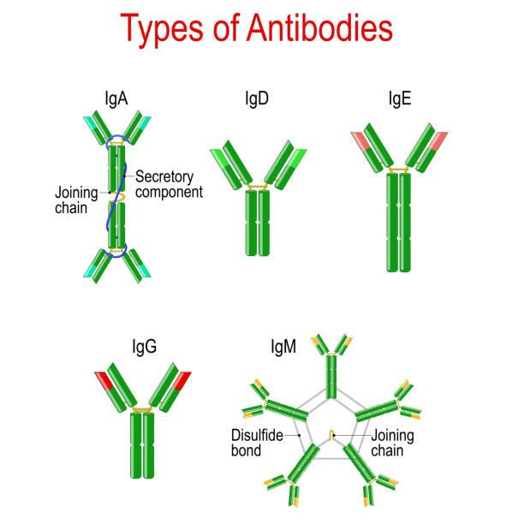

Slide 9
• IgG (Immunoglobulin G): Provides long-term immunity and can cross the placenta to protect the fetus.
• Location: Found in all body fluids.
• IgA (Immunoglobulin A): Protects mucosal surfaces and is the first line of defense in respiratory and gastrointestina
• Location: Primarily in mucous membranes, saliva, tears, and breast milk.
.

Slide 10
• IgM (Immunoglobulin M):First antibody produced in response to infection; forms pentamers for efficient pathogen binding.
• Location: Mainly in blood and lymph fluid
• IgE (Immunoglobulin E): Protects against parasitic infections and plays a role in allergic reactions.
• Location: Found in the lungs, skin, and mucous membranes.
• IgD (Immunoglobulin D):Works mainly as a receptor on B cells, helping initiate the immune response.
• Location: Found in blood and lymphatic tissue

Slide 11
Function antibody
Neutralization: Bind to pathogens, preventing them from infecting cells.
• Opsonization: Tag pathogens for destruction by other immune cells.
• Complement Activation: Trigger the complement system, leading to cell lysis.
• Agglutination: Clump pathogens together for easier removal by immune cells

Slide 12


