Slide 1
The Electroretinogram ERG
By: ENG : Walaa Ahmed

Slide 2
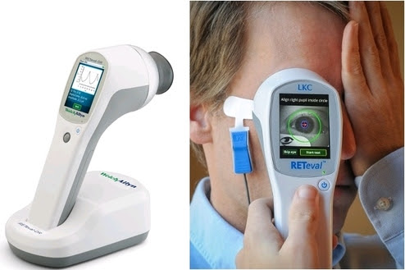
The Electroretinogram ERG
The electroretinogram (ERG) is an electrical response of the eye used globally to assess retinal health in human patients and animal models of retinal disease. It provides objective information on retinal function, allowing researchers and clinicians to analyze ERG waves to understand the integrity of different retinal structures and pinpoint retinal disorders. ERG signals are generated by extracellular currents in response to light stimuli.

Slide 3
Purpose
Electroretinography (ERG) measures the retina's electrical activity, helping assess its function accurately. The retina detects light and images, sending electrical signals to the brain for visual recognition. ERG provides valuable diagnostic information on various retinal disorders, including inherited and acquired conditions, and helps distinguish types of retinal degeneration and dystrophies.

Slide 4
Principle
The retina contains rod and cone cells, with around 120 million rods and 6–7 million cones in the human eye. Cones enable color vision, while rods are more light-sensitive. When stimulated by light, retinal cells generate electrical currents, creating an electric field in and around the eye. The ERG measures the potential difference within this field, depending on retinal function, light stimulus, and other eye structures.

Slide 5
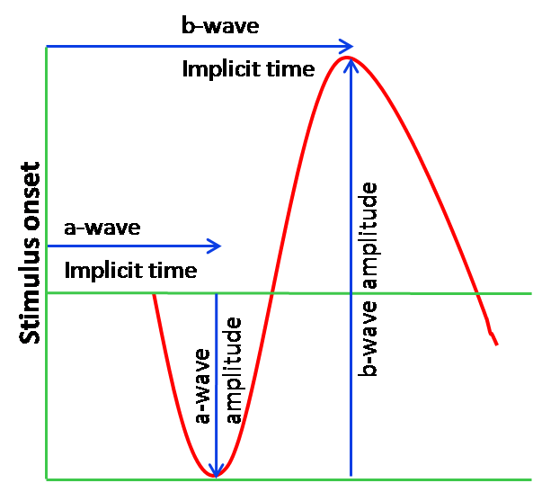
ERG Waveform
This electrical response arises from retinal potentials caused by light-induced transretinal ion flux, mainly of sodium and potassium ions.
ERG amplitudes are small, typically in the microvolt or nanovolt range.The ERG captures electrical potentials from different retinal cell types based on the stimulus.
ERG is recorded by stimulating the eye with a bright flash, often from LEDs or a strobe lamp.
The light flash generates a biphasic waveform, with two main components: the a-wave (first large negative component) and the b-wave (positive, usually larger)

Slide 6
ERG Waveform
The two important characteristics of the ERG waveform are:
(a) Amplitude:
(i) The a-wave amplitude is measured from the baseline to the negative trough of the a-wave.
(ii) The b-wave amplitude is measured from the trough of the a-wave to the following peak of the b-wave.
(b) Time:
Time from flash onset to the trough of the a-wave.
Time from flash onset to the peak of the b-wave.
The ERG signal typically lasts 200 ms, with the first 80 ms being the most important, containing most ERG components.
The short length of the ERG signal presents a challenge for analysis.
The a-wave indicates the condition of the outer retina's photoreceptors, while the b-wave reflects the condition of the inner retinal layers.

Slide 7
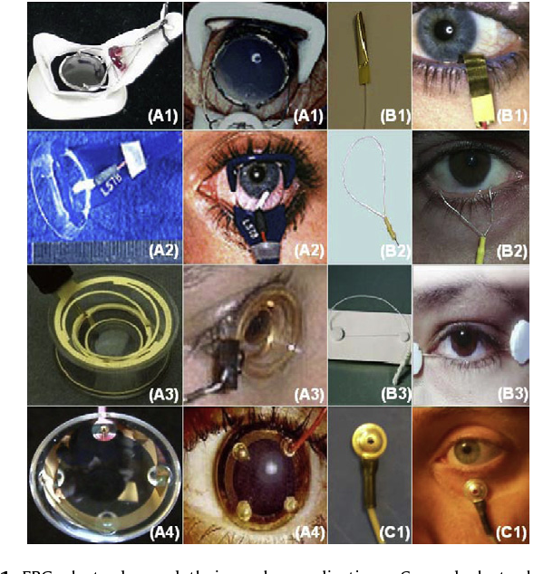
ERG Electrodes
The choice of electrode is crucial in ERG recording, with two main types:
(i) Contact lens electrodes, which touch the cornea.
(ii) Non-contact electrodes, which contact either the cornea or the bulbar conjunctiva.
Small ERG signals are commonly recorded using contact lens electrodes on the corneal surface, allowing for the summation of retinal electrical activity.
Contact lens electrodes, often with a central optical opening and lid holder, provide larger signal amplitudes but are costly and uncomfortable. They can be unipolar (e.g., Jet electrode, some Burian-Allen electrodes) or bipolar (other Burian-Allen types).
Non-contact electrodes include gold foil, H-K loop, DTL fiber, and LVP-Zari electrodes.

Slide 8
System Description
The ERG recording system is similar to ECG and EEG, using electrodes to capture the retinal electrical signal.
This signal is sent to a preamplifier, amplified further, and filtered to reduce noise, with the patient electrically isolated for safety.
A bandpass filter (0.3–300 Hz) removes unwanted frequencies, allowing for clear recording of oscillatory potentials.
The amplified analog signal is digitized by an analog-to-digital converter, then processed in a microprocessor.
A sampling rate of at least 1000 Hz ensures accurate digitization, with the output displayed or stored for further analysis.
The system's software can average multiple responses to improve the signal-to-noise ratio.
The hardware includes a photostimulator for retinal stimulation, with two types of illumination arrangements used for ERG recording.

Slide 9
Block diagram of signal acquisition system in ERG

Slide 10
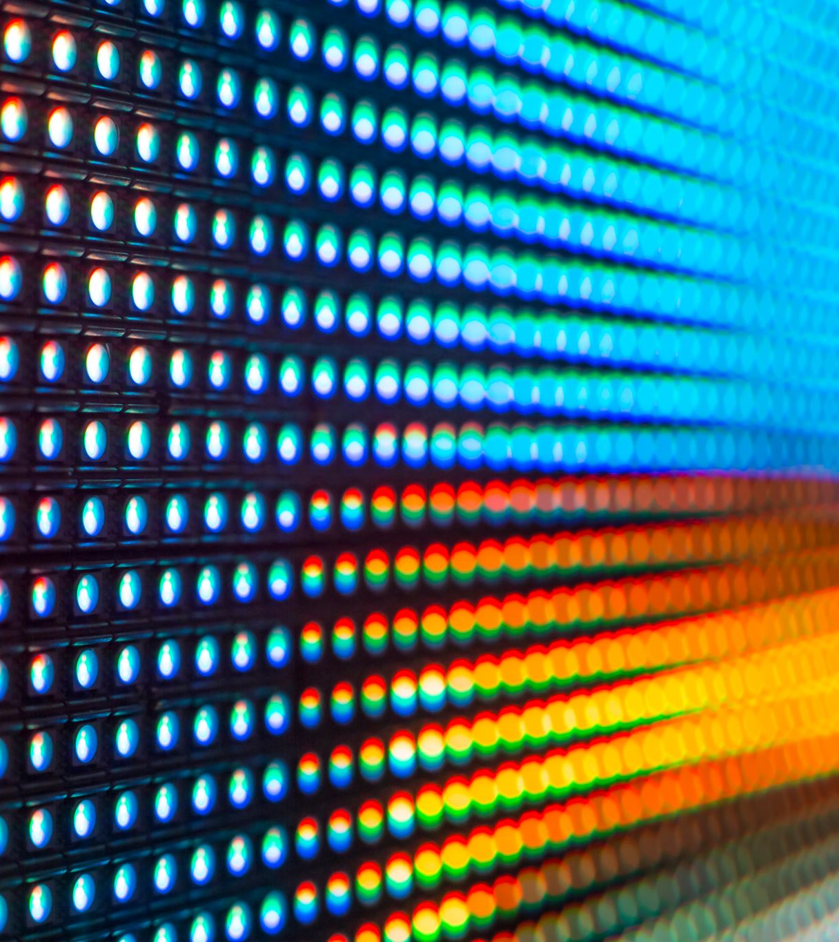
Specifications
Light source: Red, green, blue, and white LEDs
Frequency range: DC coupled
CMMR: >100 dB
Noise: <0.1 Î¼V
Sampling rate: 2 kHz
Flicker frequency: 28.3 Hz

Slide 11
Applications
The primary application of ERG is diagnosing various retinal diseases.
Ophthalmologists and optometrists use ERG to detect progressive retinal atrophy, a genetic condition causing gradual vision loss.
ERG is also widely used in eye research, providing unique insights into retinal function.

