Slide 1
Phonetics and Phonology
First Year
Diphthongs
And
Triphthongs
Dr. Hazim Al Dilaimy
(HOD)

Slide 2
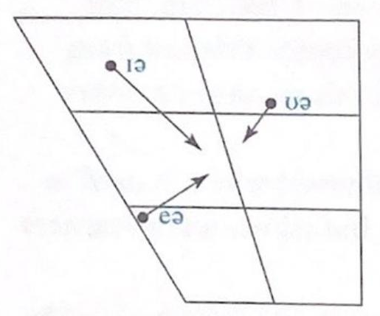
Centering Diphthongs

Slide 3
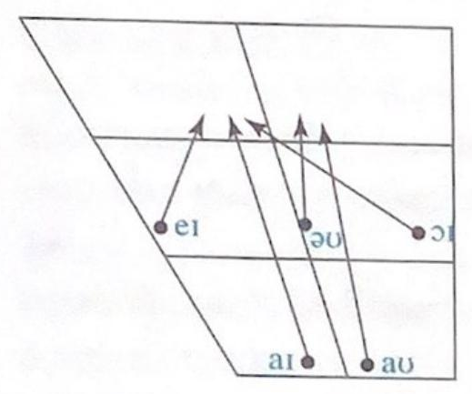
Closing Diphthongs

Slide 4
Q. Define a pure vowel:
A pure vowel is the vowel which remains constant and does not glide (move) to another vowel.
Q. Define the diphthong:
The diphthong is a combination of two vowels. The first vowel moves (glides) to a second vowel in the combination. The first vowel is longer than the second vowel.

Slide 5
Characteristics of Diphthongs:
They are combinations of two vowels.
There are 8 diphthongs in English.
They are difficult to be produced by non-native speakers.
The first element of the diphthong moves to the second element.
The first element of the diphthong is longer than the second element.
Diphthongs are classified into centering diphthongs and closing diphthongs.

Slide 6
Q. Define Centering Diphthongs:
They are diphthongs which glide to the center. They include the following diphthongs
Examples:

Slide 7
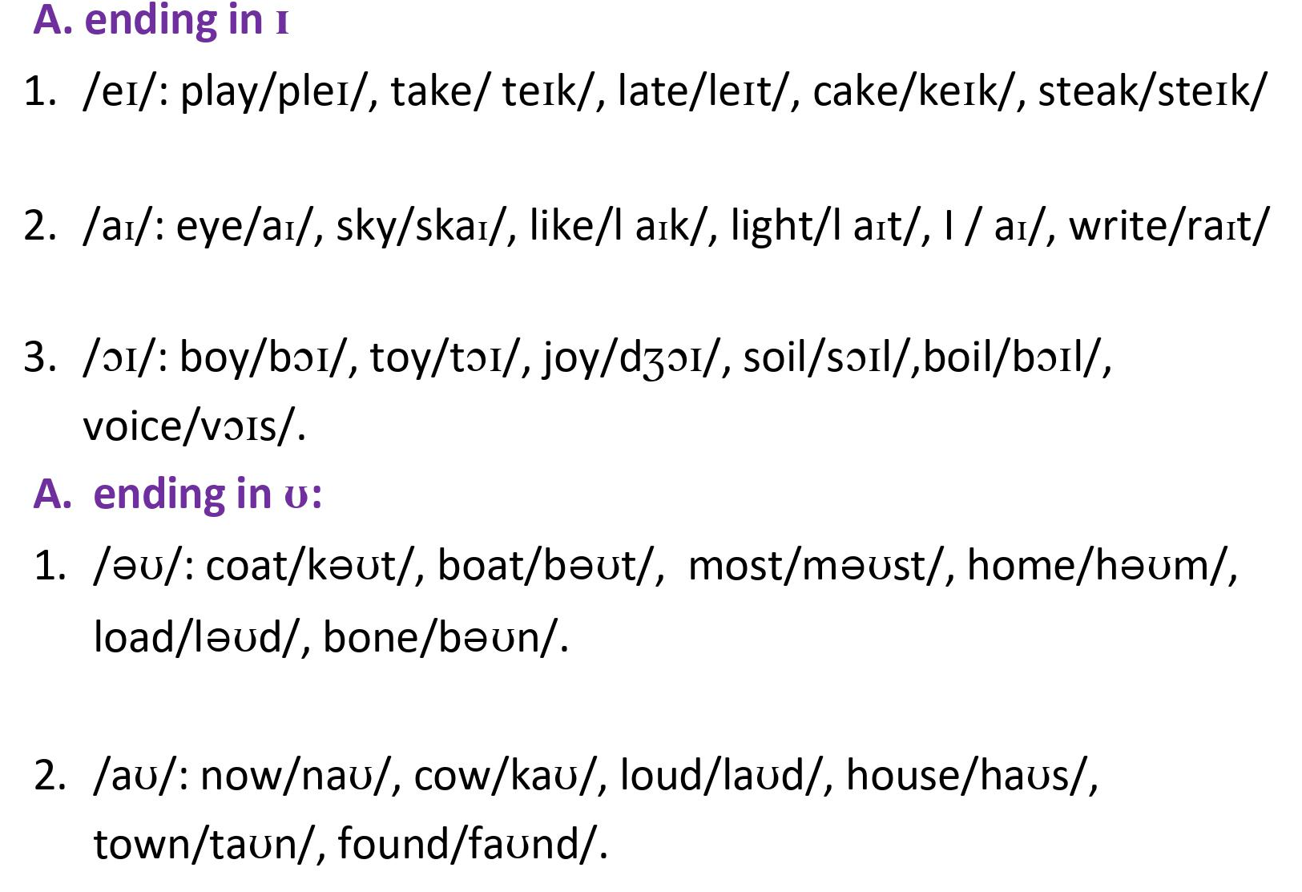
Q. Define closing Diphthongs:
They are the diphthongs that glide to the closing area. They include two types:

Slide 8
Q. Define The Triphthongs:
The triphthongs are combinations of three vowels :
Characteristics of Triphthongs:
They are made up of three vowels.
They are very difficult to be pronounced and recognized by non- native speakers.
A triphthong is a glide from one vowel to another and then to a third vowel.
They are produced rapidly without interruption.
There are five triphthongs in British English.

Slide 9
Characteristics of Triphthongs:

Slide 10
Note:
All students should practice on the transcription of words in full. For further practice, you can use the exercises found in O’Conner orange book where you can find a lot of examples that are phonemically transcribed.
To practice the correct pronunciation of diphthongs and triphthongs you may go back to the audio of short and long vowels, diphthongs and triphthongs. You may listen carefully and repeat until you master the pronunciation of all sounds outlined above.

