Slide 1
Echinococcus granulosus
Echinococcus causes hydatid disease in man.
There are four species of Echinococcus known to infect humans:
E. granulosus: Causes cystic hydatid disease
E. multilocularis: Causes alveolar hydatid disease
E. vogeli and E. oligarthrus: Cause polycystic hydatid disease.

Slide 2
Echinococcus granulosus
History: It is also called as dog tapeworm.
Hydatid cysts were recognized from the time of Hippocrates and Galen
Hartmann (1695) had demonstrated the adult form in dogs while Goeze (1782) had described the larval form (hydatid cyst).
Habitat:
The larval form (hydatid cyst) is found in liver and other viscera of man and other herbivores.
The adult worms reside in dog’s intestine.

Slide 3
:Morphology
:Adult Worm
It is much smaller than other cestodes.
It measures 3–6 mm long, consists of head, neck and strobila
Head/scolex: It is pyriform shaped (300 µm diameter), bears four suckers and a rostellum armed with two rows of hooklets
Neck: Short and thick
Strobila: Made up of only three proglottids/segments: one immature, one mature and one gravid segment.
The gravid segment is broader than others and is filled with 100­
1,500 eggs.
The structure of the proglottids is similar to other cyclophyllidean cestodes as described earlier.

Slide 4
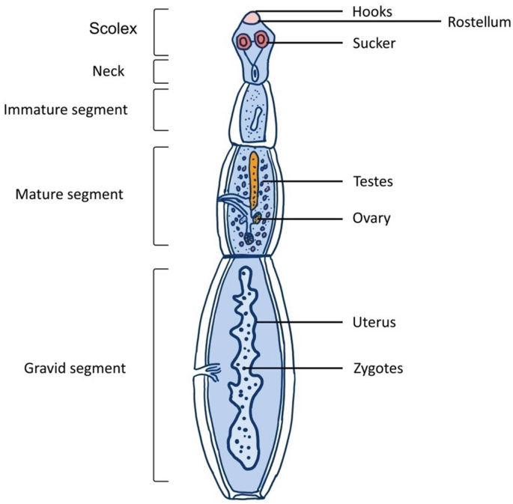
Eggs:
E. granulosus eggs are morphologically similar to Taenia eggs, consists of an oncosphere with six hooklets surrounded by an embryophore
Larva:
The larval form of E. granulosus is called as hydatid cyst.

Slide 5
Life Cycle:
Host: E. granulosus life cycle passes through two hosts:
1. Definitive host: Dogs and other canine animals
2. Intermediate host: Sheep and other herbivores
Man acts as an accidental intermediate host (dead end).
Mode of transmission: Men (and other intermediate hosts) acquire the infection by ingestion of food contaminated with dog’s feces containing E. granulosus eggs.
3.Rarely flies serve as a mechanical vector of
the eggs.

Slide 6
Development in man:
1.Eggs transform to larva (hydatid cyst): In duodenum, the oncosphere is released by the rupture of embryophore. It penetrates into the intestinal wall, enters the portal circulation and carries to the liver (60–70% of cases) or lungs or rarely to other organs.
2.Host­immune response tries to remove the parasite. Hence an inflammatory response takes place surrounding the sites where the
oncospheres are settled
3.Host­immune response may destroy many oncospheres, but few may escape destruction and develop into hydatid cyst
4. The oncospheres are encysted by the fibrous tissue (produced by fibroblasts) and transform into fluid filled bladder like cyst called
as hydatid cysts
5 The hydatid cyst undergoes maturation increases in size at a rate of 1 cm/month. Full development takes 10–18 months in sheep
6. This stage is infective to dog and other definitive hosts
Man is a dead end (as dogs don’t feed on human viscera).

Slide 7
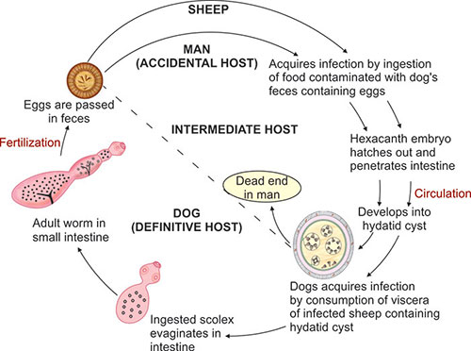

Slide 8
Pathogenicity:
Hydatid cyst
1. Fully developed hydatid cyst of E. granulosus
is unilocular, subspherical, shape and size varies from few milimeters to more than 30 cm .
2. It appears as fluid filled bladder like cyst
Cyst wall consists of three layers:
A) Pericyst (outer layer, host derived): Consists of fibrous tissue and blood vessels produced by the host cellular reaction

Slide 9
B) Ectocyst (middle layer, parasite derived): It is a tough elastic, glycan rich acellular hyaline layer of variable thickness (1 mm).
c) Endocyst (inner layer, parasite derived): Germinal layer, 22–25 µm
thickness. It consists of number of nuclei embedded in protoplasmic
mass. Its function is to form the ectocyst outside and on the inner side it forms brood capsule and secretes the hydatid fluid

Slide 10
Hydatid fluid:
1.It is clear, colorless to pale yellow
2. It has a pH of 6.7 and specific gravity of 1.005 to 1.010
3.Chemical composition: It contains sodium chloride, sodium sulfate,
sodium phosphate and succinates , It is antigenic, toxic and anaphylactic, Brood capsules arise from the inner side
of the endocyst and contains number of protoscolices (future head)
Hydatid sand:
Some of the brood capsules and protoscolices break off and gets
deposited at the bottom as granular deposit to form the hydatid sand

Slide 11
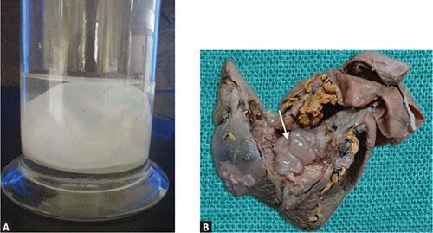
figs 10.21A and B: Hydatid cyst (A) macroscopic picture; (B) surgically resected from liver

Slide 12
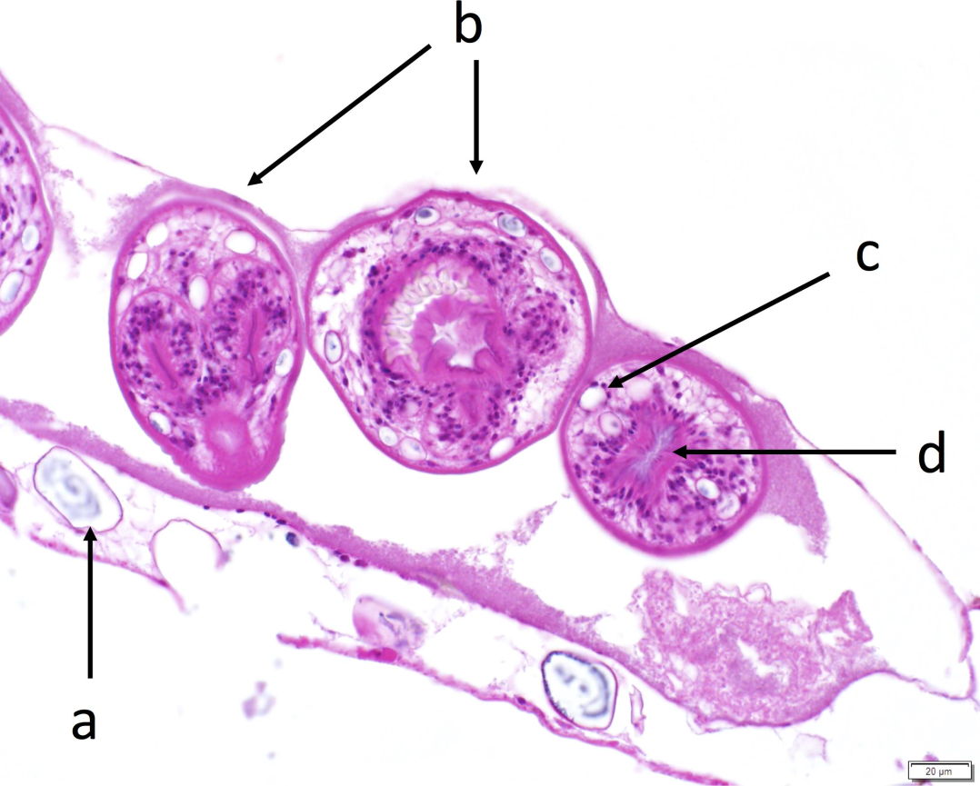
Clinical Features:
1.Infection usually occurs in childhood but gets manifested in adult life.
2.Site: Most common site of location of the cyst is liver (60–70%, right lobe) or lung (20–30%) but may be found in any organs
like spleen and kidney (3–5%), brain and
heart (1–1.5%) and rarely bones.
3.Pressure effect of the enlarging cyst: Leads to palpable abdominal mass, hepatomegaly, abdominal tenderness, portal hypertension and ascites
4. Obstruction: Daughter cyst may erode into the biliary tree or a bronchus and enter into the lumen to cause cholestasis and dyspnea
5. Secondary bacterial infection can cause pyogenic abscess formation in the hydatid cysts
6.Anaphylactic reactions: Cyst leakage or rupture may be associated with a severe allergic reaction to hydatid
fluid antigens; leading to hypotension, syncope and fever

Slide 13
Laboratory Diagnosis:
1.Hydatid fluid microscopy: Aspirated hydatid fluid is examined for brood capsules and protoscolices by direct microscopy or staining with acid fast stain.
2.Histological examination: Surgically removed cysts can be subjected to histopathological stains like Giemsa,
hematoxylin and eosin (H & E) and Periodic acid Schiff (PAS) stain to demonstrate the three layers of the cyst wall and attached
brood capsules
3.Immunodiffusion and electro immunodiffusion: Detecting antibody against antigen­5 (arc­5)

Slide 14
4. Western blot: Detecting antibody against antigen B fragment (produces 8–12kDa band). This test is 92% sensitive and 100%
specific. Antigen B fragment binds specifically to IgG4 antibodies
5.X­rays: It is simple, inexpensive, yet useful technique to detect hepatomegaly and calcified cysts and cysts in lungs.
6.Computed tomography (CT scan): It can detect 90–100% of cases.

Slide 15
Treatment:
:Antiparasitic agents
1.Albendazole is the drug of choice, given to
prevent recurrence and to reduce the size of
the cyst before surgery at 15 mg/kg daily in two divided doses 4
days before to 4 weeks after the procedure.
2.Praziquantel is given alternatively

