Slide 1
Taenia species cause two types of manifestations in humans—intestinal taeniasis and cysticercosis
z
Two important members are:
h
T. saginata (also called as beef tapeworm)
causes intestinal taeniasis in man
h
T. solium (also called as pork tape
worm) causes both intestinal taeniasis
and cysticercosis in man.

Slide 2
:habitat
The adult worms of T. saginata and T. solium
reside in the small intestine (jejunum and
ileum) of humans,
where as the larva of
T. solium (cysticercus cellulosae) reside and
form cystic lesions in the muscle, brain and
eyes.

Slide 3
Morphology
It exists in three forms—(1) adult worm,
(2) egg and (3) larva
:Eggs
Following fertilization eggs are released into
the uterus and fill the gravid proglottids.
Taenia eggs are round, 30–40 µm size, covered by two layers
Some time, eggs of T. solium are infective to
man (to cause cysticercosis).

Slide 4
Larva:
Cysticercus is the larval stage of Taenia.
It contains a muscular organ with bladder like sac.
It is called as:
Cysticercus cellulosae in T. solium
Cysticercus bovis in T. saginata
Larval stage of T. saginata and T. solium is
infective to man (to cause intestinal taeniasis).

Slide 5
:Adult Worm
The adult worm consists of head (scolex),
neck and strobila (body)
:Head/scolex
The scolex bears four cup like muscular suckers (or acetabula) which helps in attachment .
In T. solium, the scolex has a beak like apical
protrusion called as rostellum.
The rostellum is armed with two rows of hooklets (hence called as armed tapeworm).

Slide 6
:Neck
Situated next to the head. It is the narrow
growing region from which the proglottids
arise. Neck is longer in T. saginata.
:Strobila
Strobila is the trunk or body, consists of many
segments (or proglottids). Segments are of
three types—(1) immature, (2) mature and (3) gravid.
The mature segment contains the male and
the female reproductive organs .
Female organs consist of ovary, branched and
closed uterus, ootype, single mass of vitelline
gland and laterally situated genital pore.
Male organs consist of testes (follicles), vas deferens and cirrus

Slide 7
life Cycle of taenia saginata :
Host: Men act as the definitive and cattle serve as the intermediate host.
Infective stage: Cysticercus bovis (larval stage)
is the infective stage to men while eggs are infective to cattle.
:The Human Cycle
1.Mode of transmission: Man acquires the infection by ingestion of undercooked beef containing encysted larval stage (cysticercus bovis).
2.Larva transforms to adult: The larva hatch out in small intestine, the scolices exvaginate and anchor to the intestinal wall by suckers
and gradually develop into the adult worms.
3. Adult worms become sexually mature in 10–14 weeks, fertilization occurs (self or cross fertilization within the segments) and
eggs are formed & later released to the feces. Eggs are infective to cattle
4.Sometime, the older gravid segments break off and are released in the feces. They are quite mobile and migrate in the feces.

Slide 8
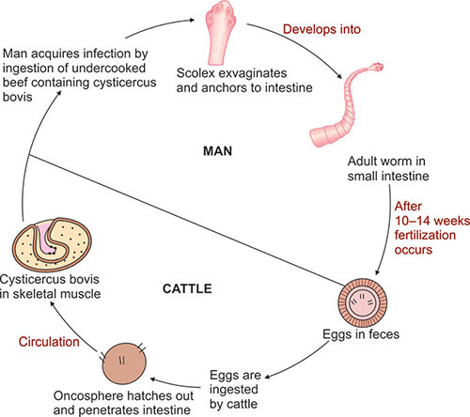
fig. 10.13: Life cycle of Taenia saginata

Slide 9
life Cycle of taenia solium
Life cycle of T. solium depends on the disease
it causes.
When it causes intestinal taeniasis, the life
cycle is exactly similar to that of T. saginata
except:
1.The intermediate host is pig (hence called as pork tapeworm)
2. Men harboring the adult worm excrete the eggs in feces which can infect the same individual by autoinfection
3. In pigs, the development time is shorter (7–9 weeks).But when it causes cysticercosis, the life cycle is different and given as below:
*Host: Man acts as both definitive and intemediate host.
* Infective stage: Eggs of T. solium.
* Mode of transmission: Firstly man acquirethe infection by
(1) ingestion of contaminated food or water with eggs of T. solium and (2) autoinfection.

Slide 10
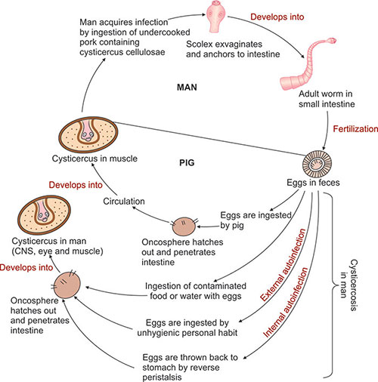

Slide 11
Autoinfection: Eggs excreted from men reinfect
the same individual.
Autoinfection can be of two types:
1. external autoinfection: Due to unhygienic
personal habit, e.g., contaminated finger
2.Internal autoinfection: Due to reverse peristaltic movements by which the gravid segments throw the eggs back into the stomach
(equivalent to swallowing of the eggs)

Slide 12
Pathogenecity
➢ Taeniasis (by adult Taenia) :
When the infection is symptomatic, vague abdominal discomfort, indigestion, nausea, diarrhea, and weight loss may be present. acute intestinal obstruction, acute appendicitis, and pancreatitis have also been reported.
➢ Cysticercosis (by larval stage) :
1. The cysticercus is surrounded by a fibrous capsule except in the eye and ventricles of the brain.
2. The larvae evoke a cellular reaction starting with infiltration of neutrophils, eosinophils, lymphocytes,
3. plasma cells, and at times, giant cells. This is followed by fibrosis and death of the larva with eventual calcification.
4. It may also affect the eyes, brain, and less often the heart, liver, lungs, abdominal cavity, and spinal cord.

Slide 13
Pathogenecity
➢ Neurocysticercosis :
1. It is the most common and most serious form of cysticercosis. About 70% of adult-onset epilepsy is due to neurocysticercosis.
2. The destruction of parasites induces an inflammatory response, granulomas and fibrous which may result in a sub acute encephalitis. 3. Other commonly associated clinical manifestations include headache, dizziness, involuntary muscle movement, intracranial hypertension and dementia.

Slide 14
Diagnosis :
1. MRI and CAT scans are considered to be the most sensitive methods of detection of neurocysticercosis and are useful in establishing diagnosis.
2. Serological methods of detection most often include the ELISA and involve the detection of antibodies against cysticerci.
3. Other methods of detection include complement fixation and indirect haemagglutination assay.
:Treatment
1. Praziquantel and Albendazole are the two anticysticercal drugs used to treat patients diagnosed with cysticercosis in the brain and skeletal muscles.
2. Niclosamide (2 g), single dose, is another effective drug.
3. For cysticercosis, excision is the best method, wherever possible.

