Slide 1
Department of Medical Laboratory Technology
University of Al-Maarif
Fourth Stage
Medical Parasitology
Lecture: 3
Second semester

Slide 2
GENERAL CHARATRISTICS
Helminths are elongated flat or round worm like parasites measuring few milimeters to meters.
They are eukaryotic multicellular and bilaterally symmetrical
Phylum Platyhelminths (flat worms)— it includes three classes:
Class: Cestoidea (tapeworms)
Class: Trematodea (flukes or digeneans)
Class: Monogenea (ectoparasite of fishes, don’t infect man)
2.Phylum: Nemathelminths.
The classification of all the medically important helminths according to their habitat in man .

Slide 3
Phylum Platyhelminths
Adult Form
Shape is tape like (in cestodes) or leaf like (in trematodes)
They have a definite head end called as suckers
They lack body cavity
Alimentary canal is absent in cestodes but incomplete (rudimentary) in trematodes
They are monoecious or hermaphrodite (i.e. both the sexes are present in the same worm), except in Schistosoma (diecious).
b) Larval form
There are various larval forms of helminths found in man and other hosts.
In cestodes: Cysticercus, hydatid cyst, coenurus, cysticercoid, coracidium, procercoid and plerocercoid forms
In trematodes: Cercaria, metacercaria, redia, miracidium and sporocyst.

Slide 4
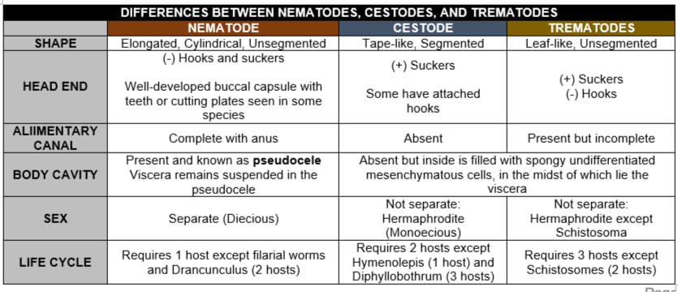
Table 9.1: Differences between cestodes, trematodes and nematodes

Slide 5
c)Eggs
Based on their reproduction, helminths can be classified into the following:
1.Oviparous: Most of the helminths (cestodes, trematodes and many nematodes) are oviparous, i.e. after fertilization, the adult worm lay eggs
2.Viviparous: Only few nematodes directly discharge the larval forms after fertilization (e.g. filarial worm, Dracunculus and Trichinella)
3.Ovoviviparous: They lay egg containing larva that immediately hatches out (e.g. Strongyloides).

Slide 6
d) LIFE CYCLE
1. Life cycle of helminths gets completed in one or more hosts.
2. Cestodes complete their life cycle in two hosts (definitive host and intermediate host) except Hymenolepis (requires only one host—man) and Diphyllobothrium requires three hosts (one definitive host— man, and two intermediate hosts—First, cyclops and second, fish)
3. Most of the trematodes require three hosts (one definitive host—man, and two intermediate hosts—first snail and second aquatic plant or fish) except schistosomes (need two hosts, definitive host—man and intermediate host—snail).

Slide 9
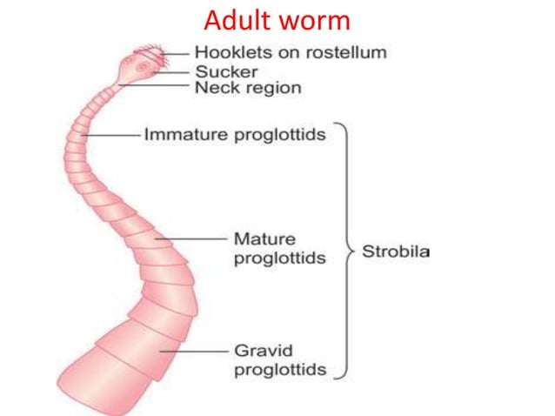

Slide 11
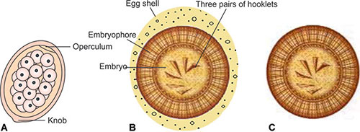
figs 10.3A to C: Eggs of Cestodes (A) Pseudophyllidean cestodes; (B) Cyclophyllidean cestodes; (C) Cyclophyllidean cestodes after the loss of egg shell

Slide 12
