Slide 1
FLATWORM PHYLUM : PLATYHELMINTHES GROUP
2. • Phylum Platyhelminthes includes the flatworms. Platy means “flat,” like a plate; helminth “worm”.
3. Characteristics feature • Invertebrate organism • Flatworm have soft and unsegmented body • No body cavity (no specialized respiratory and circulatory system) also called acoelomate • Other species have digestive system (incomplete or absent) • Most flatworm have gastro-vascular cavity. • Diffuse CO2 and O2 through the body wall
4. Characteristics feature • Primitive nervous system is present (can sense stimuli and coordinate movement) • Have excretory organ called nephridium formed by channels with terminal flame cell which control excretion and osmoregulation. (Excretetion of nitrogenous wastes through protonephridial pores or their mouth) • Can reproduce Sexually and Asexually • Most species are hermaphrodites

Slide 2
5. Characteristics/features • They are triploblastic, with three germ layers (multicellular) • 80 % are parasitic
6. Habitat Flatworm are mostly ecto or endoparasitic and a few are free- living (usually aquatic)
7. • Flatworms are bilateral symmetrical. It is different from radially symmetrical animals, like the anemones, which can be cut anywhere top to bottom to get two similar halves. • Non-parasitic flatworm respire through their body surface while parasitic worms are mostly anaerobes.

Slide 3
8. • In some flatworms, the process of cephalization has included the development in the head region of light- sensitive organ called ocelli.
• Have nervous system consists of a head ganglion connected to nerve cords which are interconnected across the body by transverse nerve connections Body Structure
9. . Diversity Divided into three classes: • Tubellaria, Trematoda and Cestoda •
Class Turbellaria includes non-parasitic and aquatic flatworm (marine flatworms and planarian).
• Class Trematoda, includes parasitic flatworm that live inside the host, this are commonly called as flukes (fasciola hepatica and sheep liver fluke). •
Class Cestoda also known as tapeworms. All tapeworms are internal parasites.

Slide 4
10. • Free-living flatworm usually are predators or scavenger • Have an extended tube-like pharynx out of their mouth which release digestive enzymes • In contrast, a parasitic flatworm have a hook or suckers that attaches to the host’s intestine, and then absorbs the host’s digested food through body wall.
11. Support and Movement • Flatworm have a hydrostatic skeleton • Some flatworms movement is controlled by longitudinal, circular and oblique layers of muscles. • Others move along slime trails by beating of epidermal cilia.
12. • Flatworms reproduce sexually by having both a male and female part. The majority of sexual reproduction is through cross- fertilization (where fusion of male and female gametes from different individual ).
• Asexually through: Fragmentation and regeneration or budding
13. Protection • A tough outer layer that protects parasitic flatworm against the host digestive and immune system
• Free-living forms secrete a protective mucus.
• Have cuticle which protects their body

Slide 5
19. Fluke • Class Trematode commonly knows as flukes or blood fluke. • Range in size from about 5 mm (0.2 in) • Commonly parasitize fish, frogs, and turtles; also invertebrates such as mollusks and crustacean • Some are external parasites (ectoparasites) and endoparasites • Most are flattened and leaflike or ribbonlike, some are stout and circular in cross section.
20. Fluke • the body is solid and filled with spongy connective tissue (mesenchyme) that surround all the body organs. • Occur in most types of vertebrates; three species attack humans: urinary blood fluke, the intestinal blood fluke, and the oriental blood fluke
21. Fluke • Almost flukes make both eggs and sperm. Blood flukes have separate sexes, and the adult females and males mate with each other. Flukes with a direct life cycle use only sexual reproduction. While indirect life cycle use asexual and sexual reproduction.

Slide 6
22. • Also called as class cesteda. They are distinctly different • There are two subclasses, Cestodaria and Eucestoda • They can grow to long 5 meters long
• They not only eat food by the hots; thye alos produce wastes and obstruct the alimentary canal.
• The common types of tapeworms are beef and pork tapeworms which proven to be dangerous to human beings.
23. Reproduction of Tapeworm • Tapeworms are also hermaphrodite, each proglottid includes both male and female gonads and generates both sperm and eggs.
• Can reproduce sexually, either through self-fertilization or cross- fertilization with another tapeworm • Can reproduce asexually, breaking off proglottid segments at the end of the trunk.
24. • Tapeworms generally do not move around much but they are capable of having muscular undulation.
• They use distinguishing feature, the scolex, which attaches firmly to the host’s intestine wall. The tip of scolex is equipped with a rectable hook-bearing rostellum which acts like disc with teeth to hold onto the intestinal wall.
• They will just hang on to the intestinal wall, absorbing food through their skin via diffusion Attachment

Slide 7
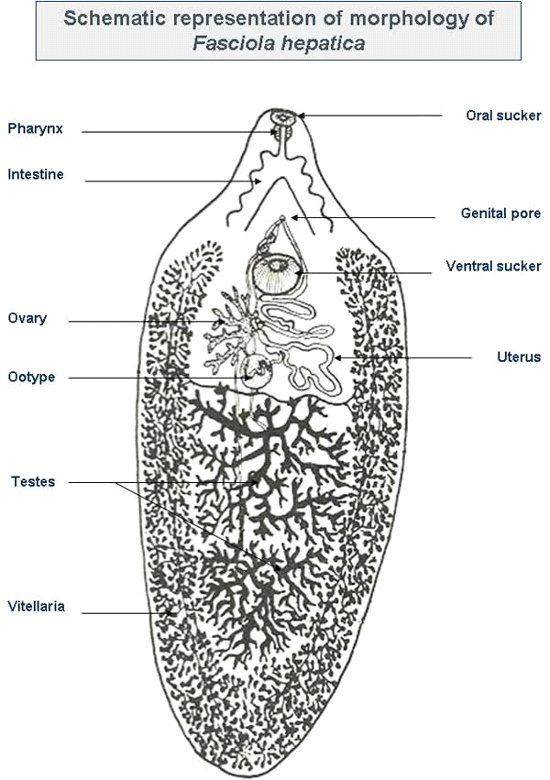
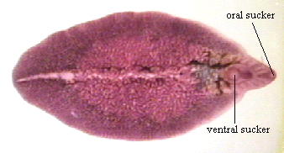
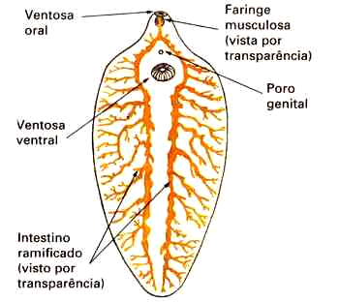

Slide 8
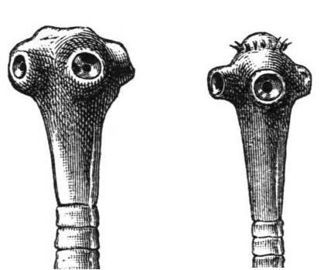
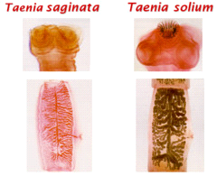

Slide 9
