Slide 1
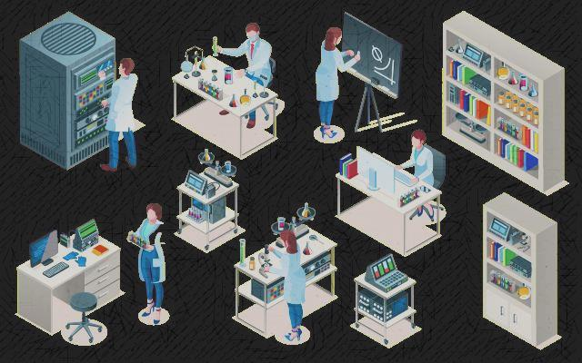
Pathology Laboratory Management
Lab 1
M.SC. FADHELA NAFAA ALRAWI

Slide 2
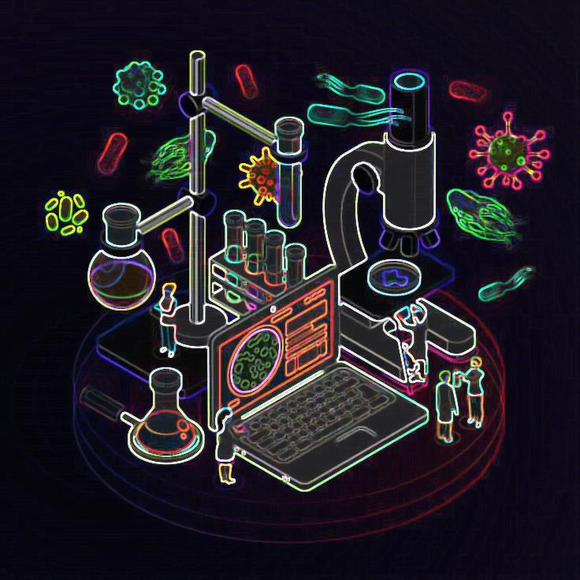
What Is Pathology Management?
is the web application used at the pathology laboratory to handle patient records. This pathology software is mobile-friendly, easy to use, and can save both time and increase quality.

Slide 3
Pathology Lab Management System
The Pathology Lab Management System module's thoughts and design are aimed at ensuring that it can satisfy the exacting standards that ideal software should to have in order to oversee today's hectic pathology labs.
Laboratory results and medical laboratory services are crucial to every facet of healthcare and should to be:
Precise
Timely
Reliable

Slide 4
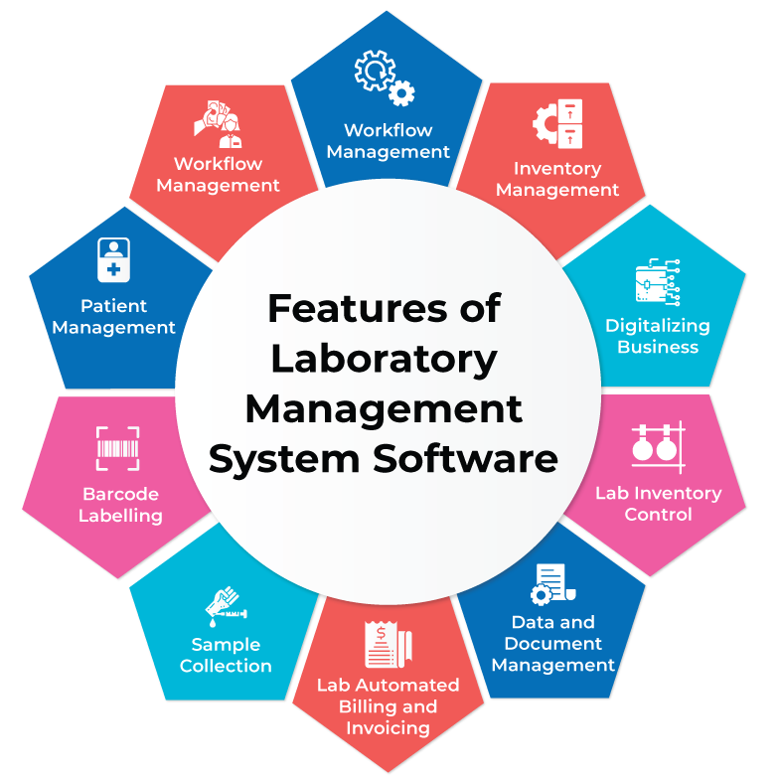

Slide 5
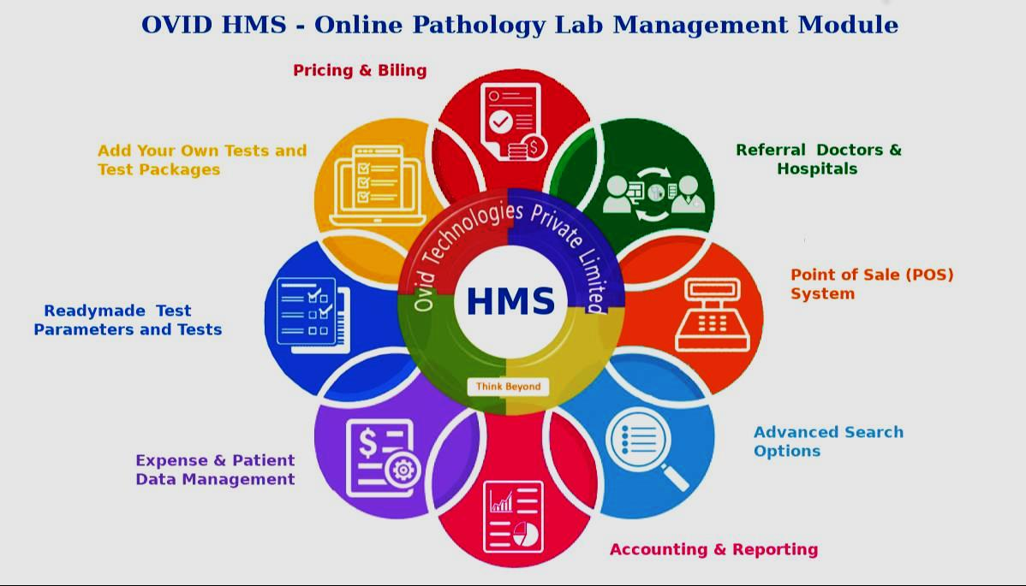

Slide 6
Leadership skills needed at various managerial levels
Management Levels
Skills needed
Laboratory director
Supervisory Technologist
Manager Chief Technologist
Conceptual
Interpersonal
Technical

Slide 7
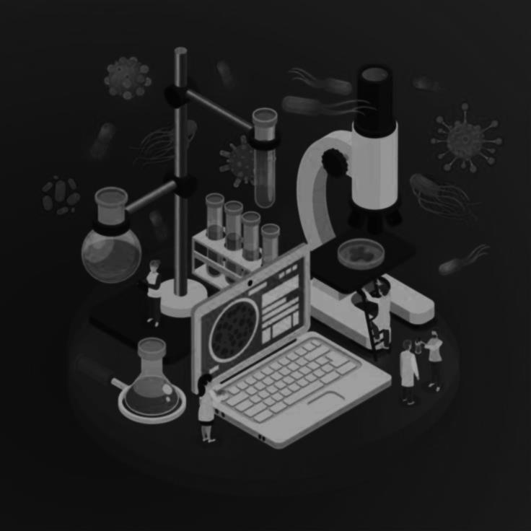
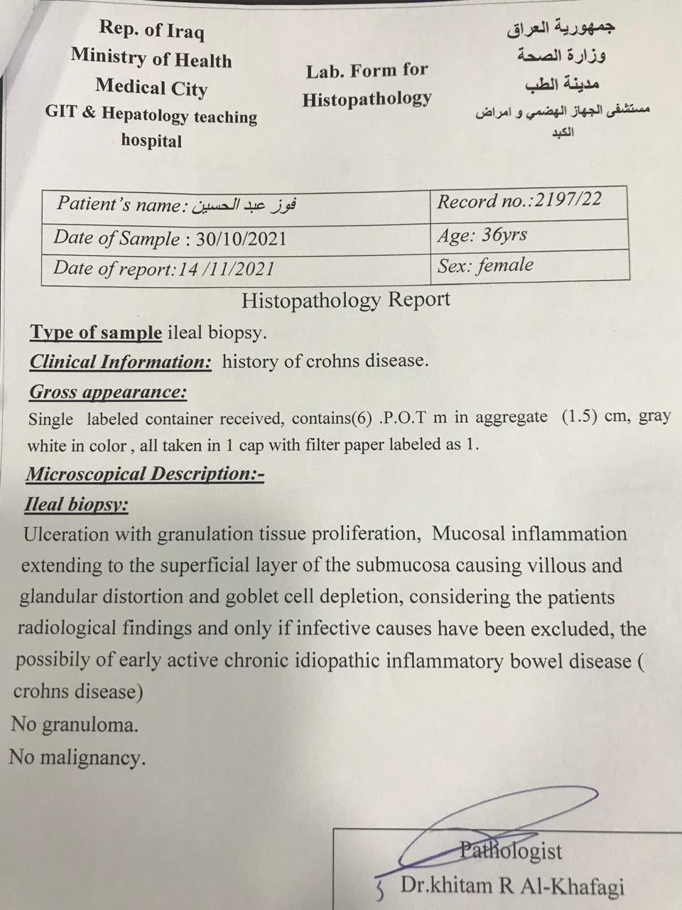
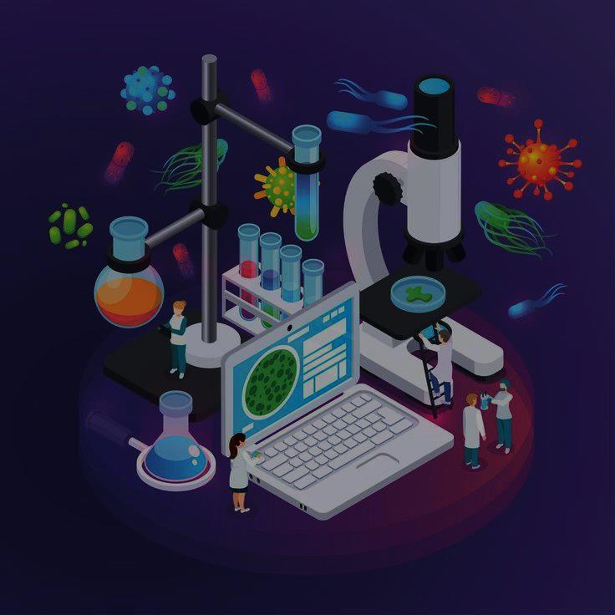

Slide 8


