Slide 1

Lab 6
Chromosome Banding
Human genetics
Medical Laboratories Techniques Department
MSc. Hussein Salim

Slide 2
What is the Chromosome banding
Chromosome banding refers to alternating light and dark regions along the length of a chromosome, produced after staining with a dye.
A band is defined as the part of a chromosome that is clearly distinguishable from its adjacent segments by appearing darker or lighter with the use of one or more banding techniques.
This process helps the researchers better understand and identify their structural composition.

Slide 3
Banding patterns are chromosomal patterns of bright and dark transverse bands.
These bands identify where genes are located on a chromosome. The bright and dark bands are visible when the chromosome is stained with a chemical solution and examined under a microscope.

Slide 4
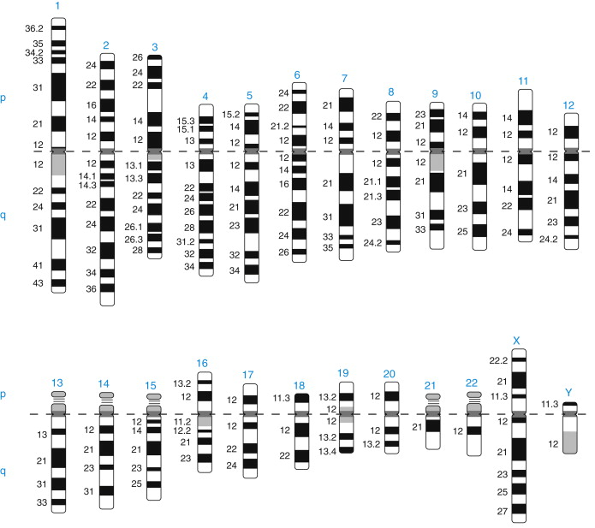

Slide 5
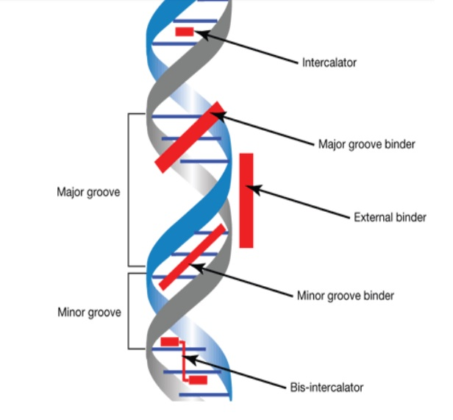
A stain can bind to the DNA through intercalation, minor groove or major groove binding, or external binding.
These modes of binding depend on the type of interaction the stain have with the DNA.

Slide 6
Chromosome Banding Pattern
G-banding or Giemsa Staining
cytogenetic procedure that produces a detectable karyotype by staining compressed or condensed chromosomes. This is the most basic chromosomal banding technique. Because the whole complement of chromosomes is photographed, it can be used to detect genetic disorders.
Giemsa, a visible light dye, binds DNA via intercalation. Giemsa stain is a combination of anionic eosin (like eosin Y) and cationic thiazine dyes.
The cells are frozen in metaphase and then fixed, dropped, and burst after becoming turgid and bloated. Before Giemsa staining, the chromosomal spreads are processed and air-dried.

Slide 7
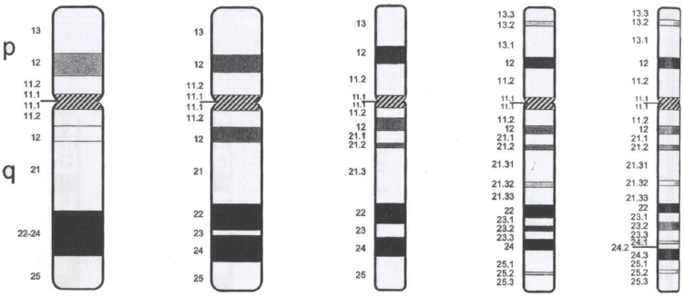
The bands (G bands) correlate approximately with the DNA sequence underlying it: AT-rich areas stain darkly,
GC-rich areas lightly
About 400 dark bands per haploid genome are seen in this way.

Slide 8
Positive G-bands
The darkly stained bands are positive G-bands. These areas are hydrophobic and facilitate the precipitation of the thiazine-eosin compound. The hydrophobic proteins are responsible for hydrophobicity. These proteins maintain the condensed areas. They are primarily AT-rich regions and formed the late replicating heterochromatin (is a cytologically dense material that is typically found at centromeres and telomeres. It mostly consists of repetitive DNA sequences and non-coding RNA transcripts and is relatively gene poor, most property is silence euchromatic gene expression.
Negative G-bands
Negative G-bands are light-stained bands. These are less condensed early replicating euchromatin. Base pairs from GC are abundant in these areas. These areas are less hydrophobic and less conducive to the precipitation of thiazine-eosin.

Slide 9
C-banding
Heterochromatin is recognised by the C-banding technique, which stains heterochromatin regions of centromeres. The centromere, located close to the centre of the chromosome at the attachment point of the two chromatids, plays an essential function in the DNA division during mitosis and meiosis.
Condensed DNA is called heterochromatin, which is crucial for gene expression.
Several plant and animal species, including humans, have had their chromosomes identified using the Giemsa-C-banding technique.

Slide 10
Q-banding
Quinacrine, a yellow fluorescent stain, is used in the chromosomal banding technique known as Q-banding.
A UV lamp is required to view the fluorescent bands after it has been stained. These bands will overlap with those that appear during G-banding. Q-banding can therefore identify similar chromosomal structural anomalies as G-banding. However, the fluorescent bands in Q-banding will disappear swiftly compared to the bands that develop in G-banding. The chromosomes must therefore be examined shortly after staining.
This method is used to identify mouse and human chromosomes

Slide 11
R-banding
The G-band staining technique is reversed by the cytogenetics process known as R-banding. R-banding is also known as Reverse chromosome banding.
This banding method produces a chromosomal band pattern that is the opposite of the G-band and Q-banding patterns. The dark band (AT-rich region) seen in the G-banding method appears light in the R-banding technique and vice versa.
Guanine-cytosine-rich R bands are darker in colour, and adenine-thymine-rich sections are more susceptible to heat denaturants. The method is beneficial for examining chromosomal translocations or deletions of genes involving telomeres.
Giemsa stain is also used in the R-banding procedure; however, the slide is heated in a buffer solution to 88°C before Giemsa staining. DNA denaturation results from heat.

Slide 12
Application of Chromosome Banding
Identifying chromosomal abnormalities and genetic diseases like Down syndrome depends greatly on chromosome banding. The additional 21st chromosome that results in Down syndrome can be found using chromosomal banding.
Visualising the evolutionary connections between chimpanzees and humans can also be accomplished with chromosome banding. Since chimpanzees and humans share many chromosomes, chromosomal banding can be used to establish the relationship between the two species and how each has evolved.

