Slide 1

Lab 5
CELL CULTURE
Human genetics
Medical Laboratories Techniques Department
MSc. Hussein Salim

Slide 2
animal cell culture
It is the process of cultivating animal cells in an artificial environment (in vitro) under control, we taking the cells from an animal organ, tissue in
a mechanical (Mincing, shearing, sieves)
enzymatic manner (Trypsin, pronase, collagenase, dispase)
Chemical
taking the cells from a previously manufactured strain in the laboratory and transplanting them into a selective environment inside glass or plastic vessels (a suitable culture medium containing all nutrients, growth factors and gases needed for cell growth).

Slide 3
Culture medium
It is the environment provided for the growth of the cells in the laboratory, similar to those conditions that the cells have been exposed to in vivo. Culture media consists of:
Physical media: a support or matrix
• Chemical media: appropriate nutrients, hormones and stromal factors. Serum is the most economical, easily available and most widely used culture medium for animal cell culture; Fetal bovine serum (FBS) is the preferred one.

Slide 4
Types of artificial culture media
There are three types of artificial culture media:
Serum –free culture medium
Protein- free culture medium
Chemically defined media
examples on artificial culture media.
Eagles minimal essential medium (EMEM)
Dulbecco's modified enriched medium(DMEM)
Roswell park memorial institute (RPMI)

Slide 5
Serum provides the following
Basic nutrients
Hormones and growth factors
Attachment and spreading factors
Binding proteins (albumin, vitronectin, transferrin).
hormones, vitamins, minerals, lipids
Protease inhibitors
Disadvantages of serum
Virus, fungi and bacteria may contaminate the serum easily
Some enzymes presents in serum can convert the cell secretions into toxic compounds

Slide 6
Component | Function
Carbon source (glucose/glutamine) | Source of energy
Amino acid | Building blocks of protein
Vitamins | Promote cell survival and growth
Balanced salt solution | An isotonic mixture of ions to maintain optimum osmotic pressure within the cells and provide essential metal ions to act as cofactors for enzymatic reactions, cell adhesion etc.
Phenol red dye | pH indicator. The color of phenol red changes from orange/red at pH 7–7.4 to yellow at acidic (lower) pH and purple at basic (higher) pH.
Bicarbonate /HEPES buffer | It is used to maintain a balanced pH in the media

Slide 7
Parameter
Temperature | 37 °C
Relative Humidity | 95%
Co₂ | 5%

Slide 8
Types of culture
A- Primary cell culture
The maintenance of growth of cells dissociated from the parental tissue in culture medium using suitable glass or plastic containers is called Primary Cell Culture. There are two types of it:
1- Monolayer cultures or Adherent cells; Cells shown to require the attachment for growth. They are usually derived from tissues of organs such as kidney.
2- Suspension Culture; Cells which do not require attachment for growth. They are derived from cells of the blood system.

Slide 9
B- Secondary cell cultures or cell line
When a primary culture is sub-cultured, it becomes known as secondary culture or cell line. Subculture (or passage); is the transfer of cells from one culture vessel to another culture vessel.

Slide 10
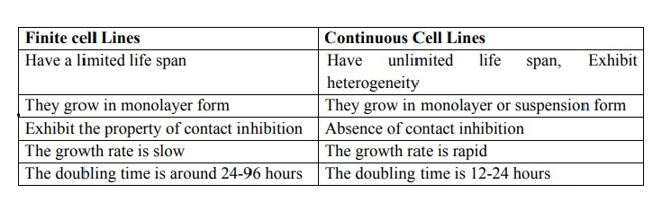
some cell lines become immortal through a process called transformation, which can occur spontaneously or can be chemically or virally induced. When a finite cell line undergoes transformation and acquires the ability to divide indefinitely, it becomes a continuous cell line.

Slide 11
Morphology of cells in culture
1. Fibroblastic (or fibroblast-like) cells: they are bipolar or multipolar, have elongated shapes, and grow attached to a substrate.
2. Epithelial-like cells: they are polygonal in shape with more regular dimensions, and grow attached to a substrate in discrete patches.
3. Lymphoblast-like cells: they are spherical in shape and usually grown in suspension without attaching to a surface

Slide 12
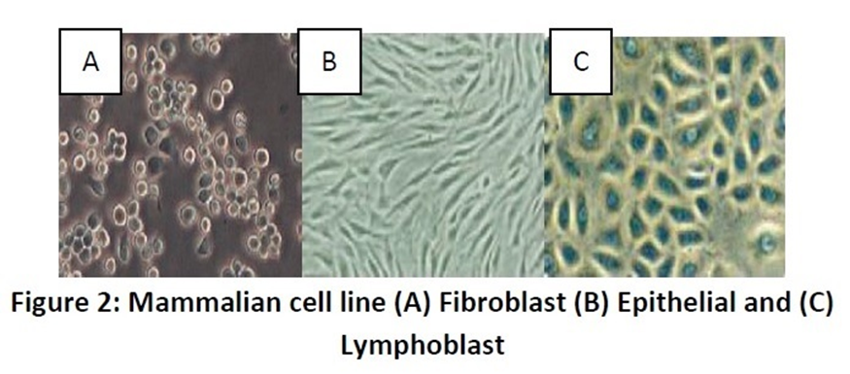
Morphology of cells in culture

Slide 13
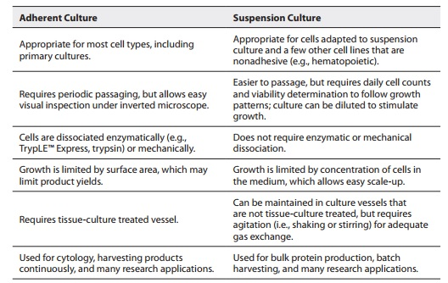
There are two basic systems for growing cells in culture, as monolayers on an artificial substrate (i.e., adherent culture) or free-floating in the culture medium (suspension culture).

Slide 14
What is the cell culture used for?
Model systems for Studying basic cell biology, interactions between disease causing agents and cells, effects of drugs on cells, process and triggering of aging & nutritional studies
Toxicity testing Study the effects of new drugs.
Virology Cultivation of virus for vaccine production, also used to study there infectious cycle.
Genetic Engineering Production of commercial proteins, large scale production of viruses for use in vaccine production e.g. polio, rabies, chicken pox, hepatitis B & measles
Cancer research Study the function of various chemicals, virus & radiation to convert normal cultured cells to cancerous cells.
Gene therapy Cells having a functional gene can be replaced to cells which are having non-functional gene.

Slide 15
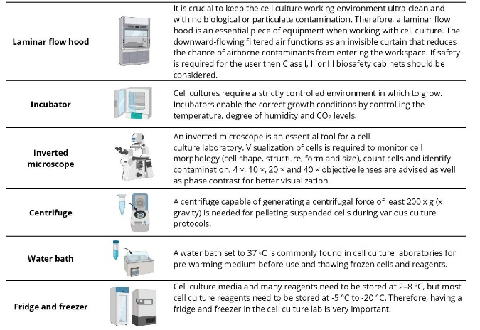

Slide 16
