Slide 1

Lab 3
Introduction to medical genetics
(detection of some inherited traits)
Human genetics
Medical Laboratories Techniques Department
MSc. Abdulqader Asaad
MSc. Hussein Salim

Slide 2
The human genome consists of 23 pairs of chromosomes (22 pairs of homologous chromosomes and one pair of sex chromosomes)
the set of chromosomes is called the karyotype. In humans there are 23 pairs of chromosomes. The reason the chromosomes are in pairs is because one set of chromosomes comes from the female parent via the egg and the other set of chromosomes comes from the male parent by way of the sperm. During fertilization when the sperm cell fuses with the egg cell the resulting cell is called a zygote and contains two sets of chromosomes.

Slide 3
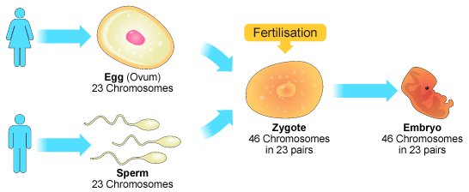

Slide 4
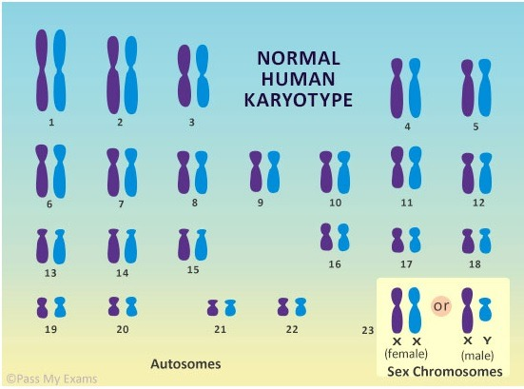

Slide 5
Gene:
A unit of heredity that controls the development of one trait
Made of DNA.
Allele:
Member of a paired gene
-one allele comes from each parents
Represented by a single letter

Slide 6
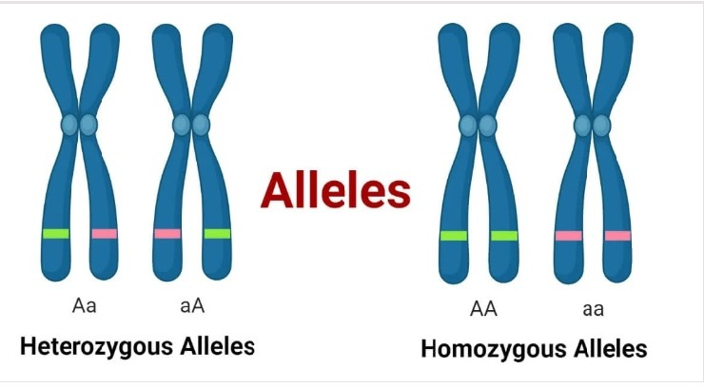
each person has two alleles for each gene, one from each parent

Slide 7
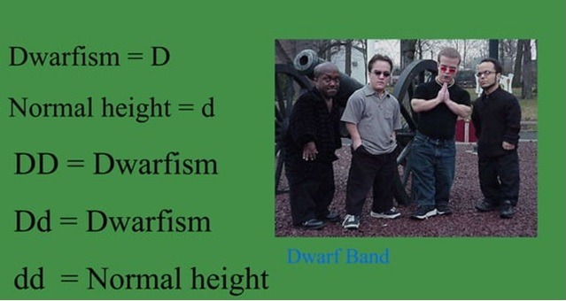
Examples of alleles

Slide 8
Dominant & Recessive Alleles
Dominant alleles are expressed
Recessive alleles are not expressed in the presence of a dominant allele
- Recessive alleles are only expressed if both recessive alleles are present

Slide 9
Incomplete dominance
Incomplete dominance is a pattern of inheritance in which neither allele is completely dominant over the other, resulting in an intermediate phenotype. This means that the phenotype of a heterozygous individual is different from both the homozygous dominant and homozygous recessive individuals.

Slide 10
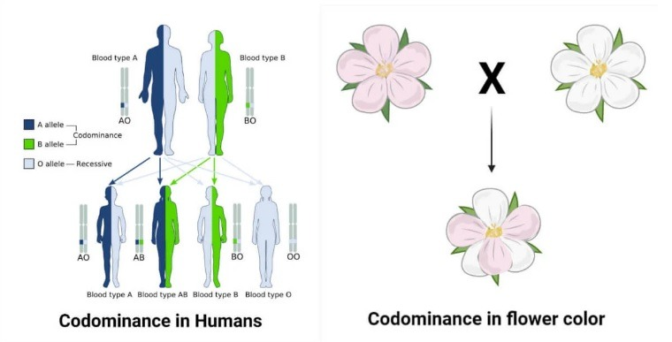
Codominane
Codominance is another pattern of inheritance in which both alleles are expressed equally in the phenotype of a heterozygous individual. This means that both traits associated with the alleles are observed in the individual.

Slide 11
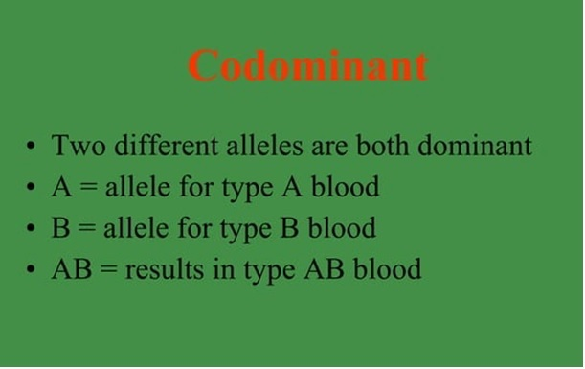

Slide 12
Homozygous
Both alleles alike
AA or aa
Heterozygous
Alleles are different
Aa

Slide 13
Genotype
• Genetic make up
Represented by alleles
• DD & Dd are genotypes for dwarfism
Phenotype
A trait
Genotype determines the phenotype
Dwarfism is a phenotype

Slide 14
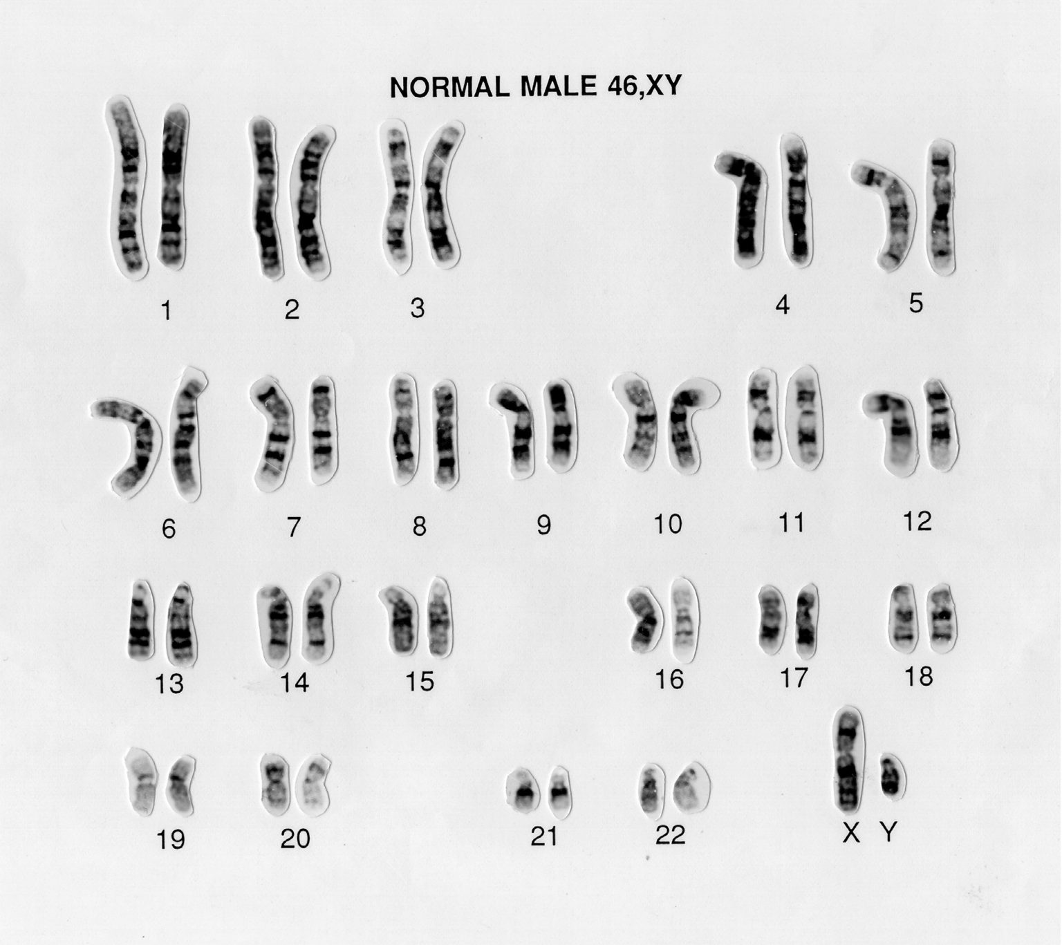
Karyotype
A karyotype is a visual representation of the number and structure of all the chromosomes

Slide 15
Mutation
Change in a gene or chromosome
Causes an abnormal traits
Mutagen
Agent that causes mutation
(smoking, pesticides, X ray, Nuclear radiation)

Slide 16
Autosomes (chromosome 1-22)
Sex chromosomes (chromosome 23)
- male (XY) gametes have either X and Y
- female(XX) gametes have X

Slide 17
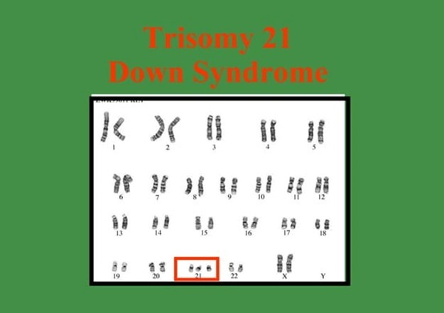

Slide 18
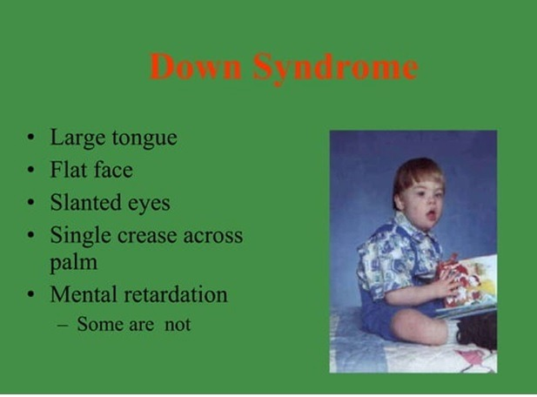

Slide 19
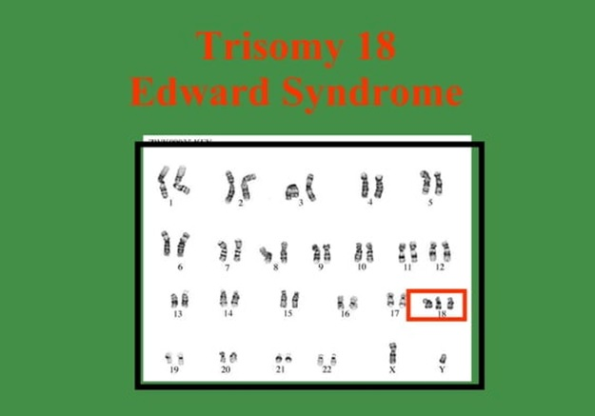

Slide 20
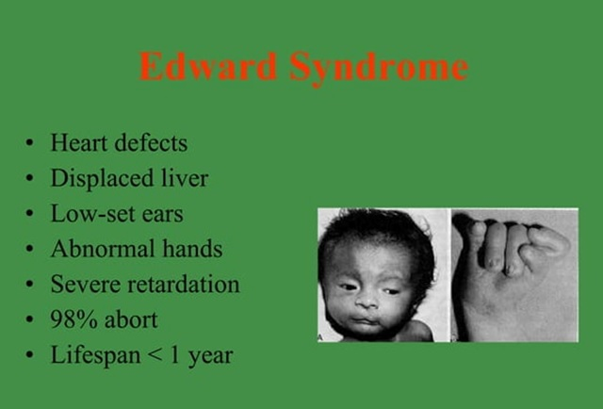

Slide 21
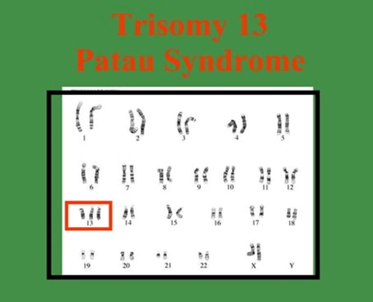

Slide 22
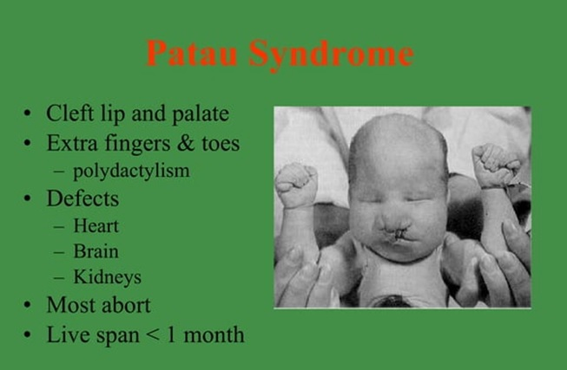

Slide 23
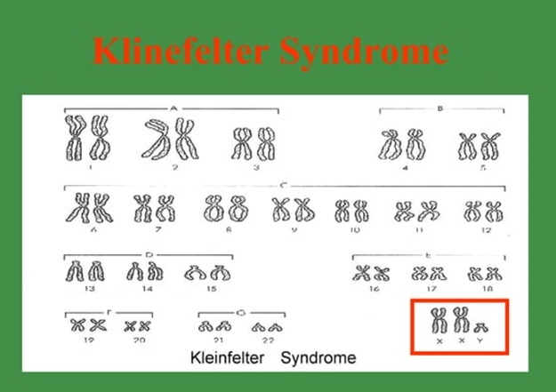

Slide 24
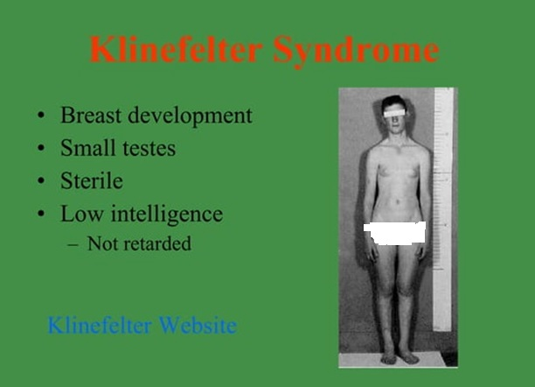

Slide 25
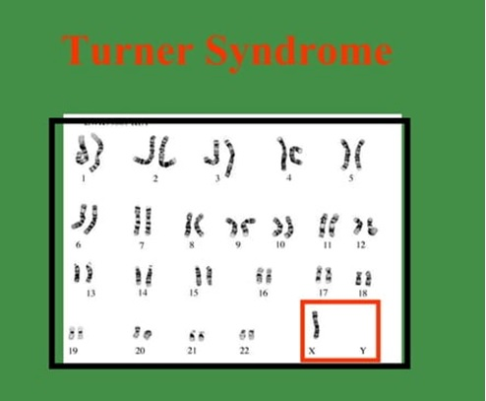

Slide 26
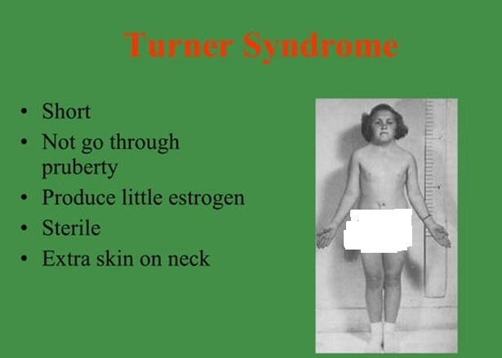

Slide 27
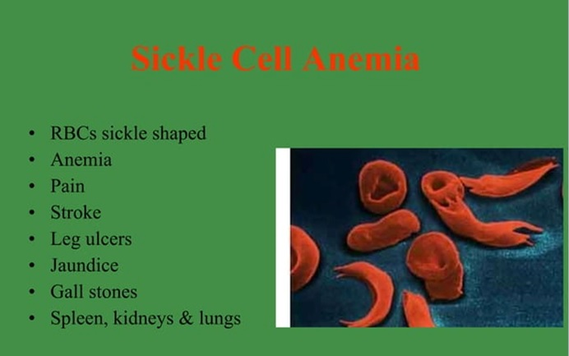

Slide 28
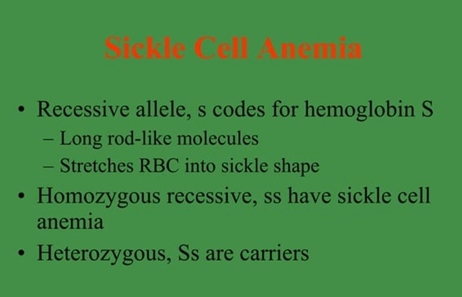

Slide 29
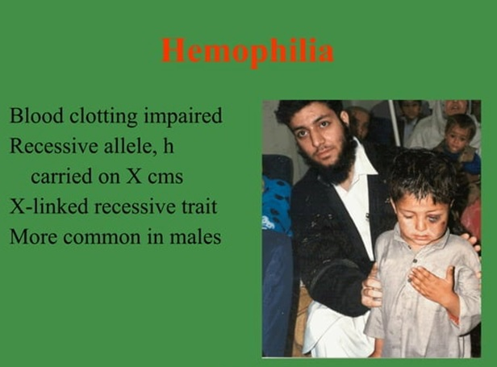

Slide 30
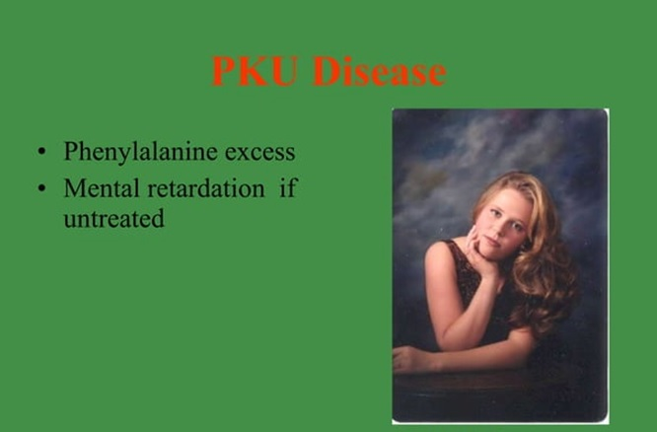

Slide 31
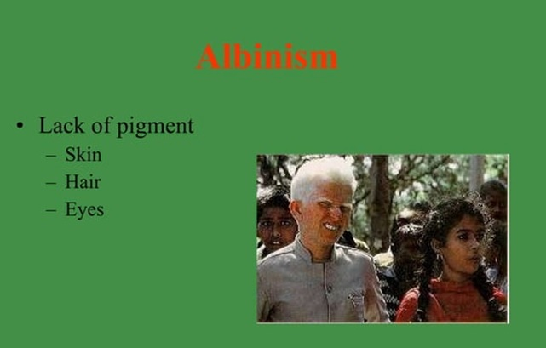
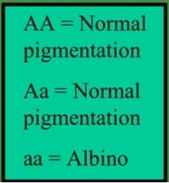

Slide 32
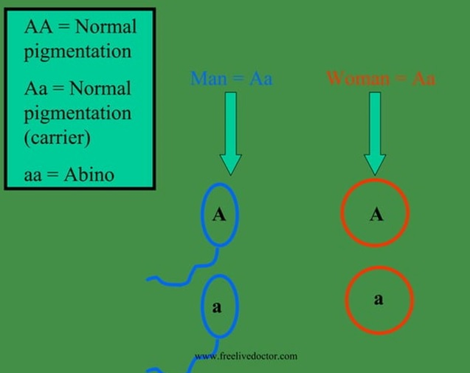

Slide 33
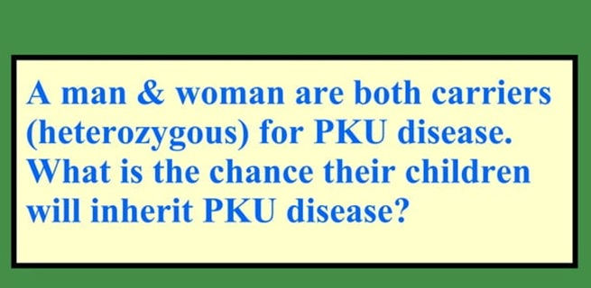
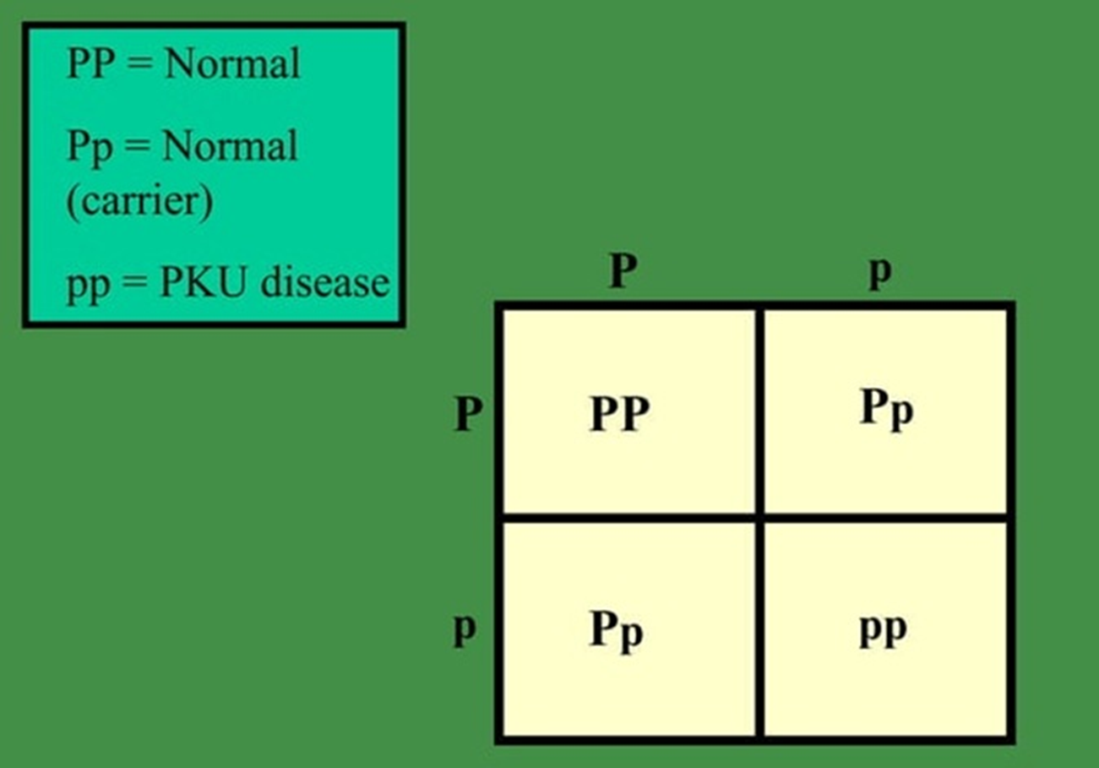

Slide 34
