Slide 1

Lab 10
Pedigree
Human genetics
Medical Laboratories Techniques Department
MSc. Hussein Salim

Slide 2
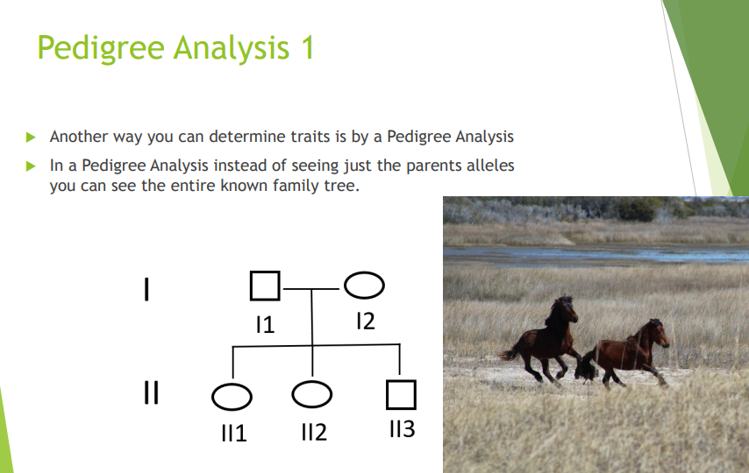

Slide 3
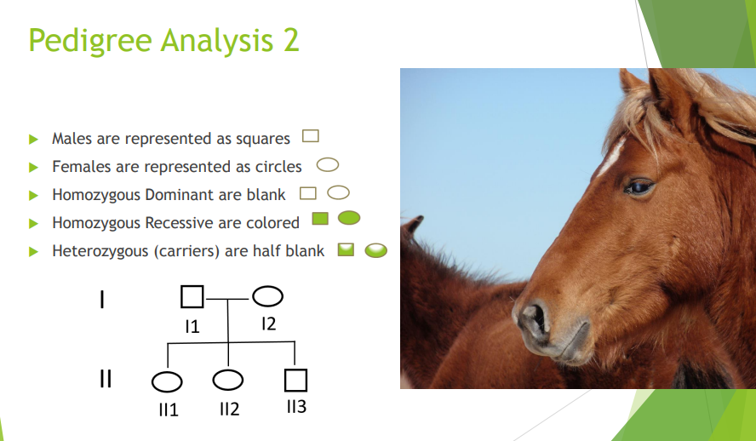

Slide 4
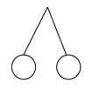


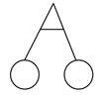
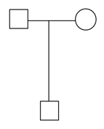

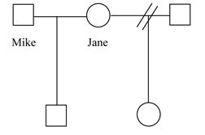
Marriage/Mating Line
Dizygotic Twins (non-identical)
Separated, Divorce
Monozygotic twins (identical)
Offspring Line
No children

Slide 5
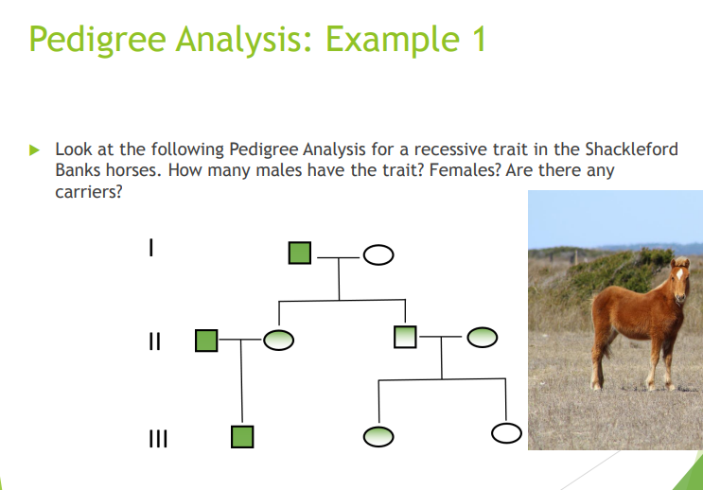

Slide 6
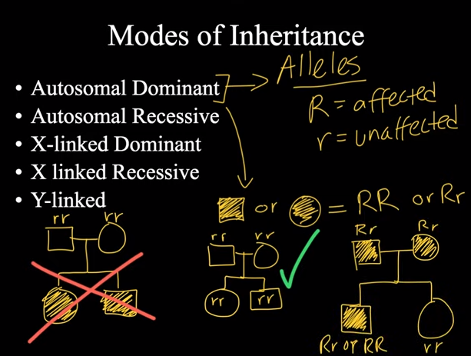

Slide 7
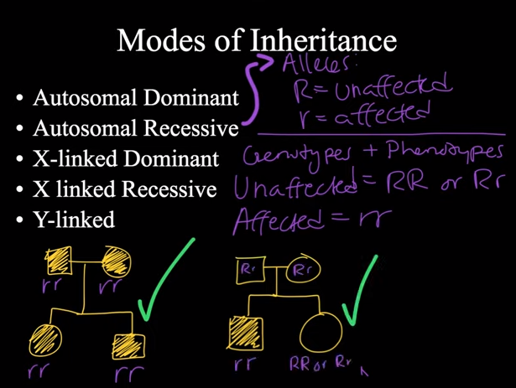

Slide 8
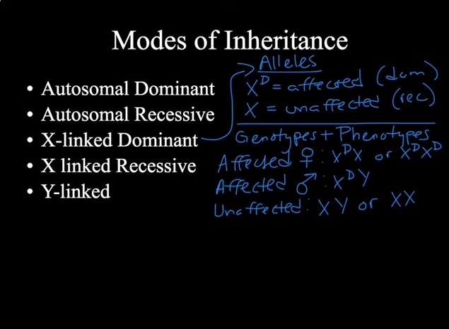

Slide 9
