Slide 1

instruments and materials used in genetics field
Lab one
Human genetics
Medical Laboratories Techniques Department
MSc. Hussein salim

Slide 2
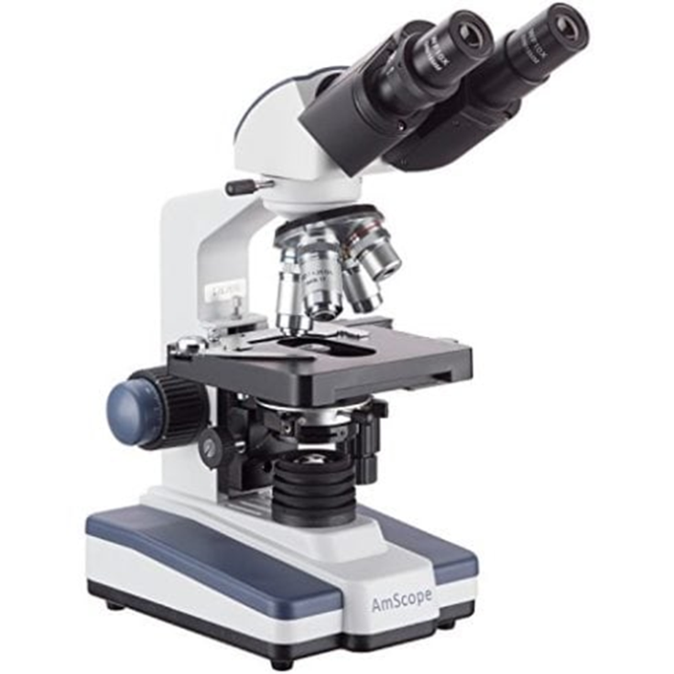
Genetics labs equipment
Microscope
is an instrument that can be used to observe small objects, even cells.

Slide 3
Genetics labs equipment
Biosafety cabinet
Personal Protection from harmful agents within the cabinet
Product Protection to avoid contamination of the samples.
Environmental Protection from contaminants contained within the cabinet.

Slide 4
Biosafety Cabinet Classes
Class I is the most basic biosafety cabinet that provides protection to the environment and the laboratory personnel.
Class II cabinets provide both kinds of protection (of the samples and the environment) since makeup air is also HEPA-filtered
Class III cabinets, totally enclosed but ventilated cabinets, where all air that either enters or leaves through the facility pass through a HEPA filter.

Slide 5
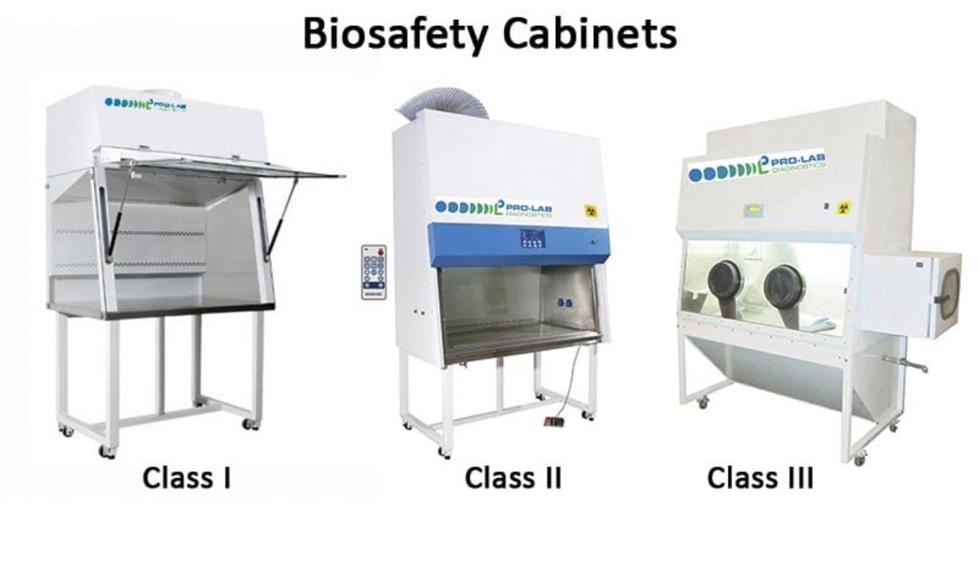

Slide 6
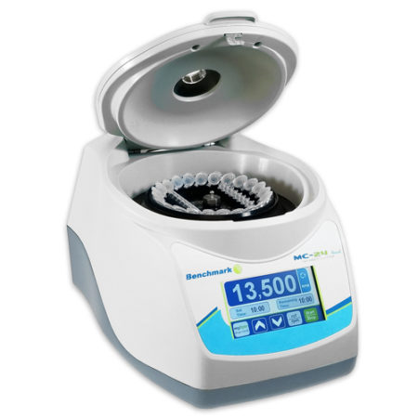
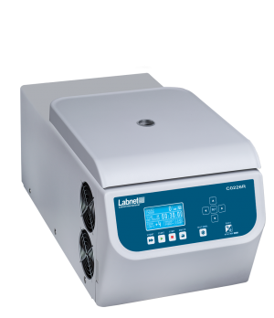
Micro centrifuge
Centerifuge eppendorf tubes to a maximum of 15000 RPM

Slide 7
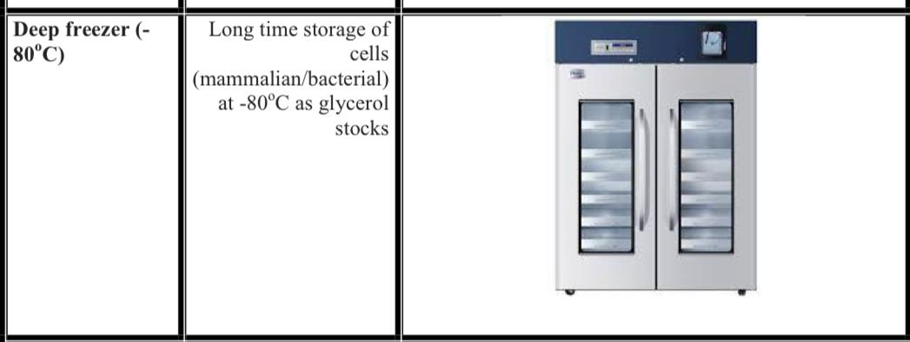
Deep freezer

Slide 8
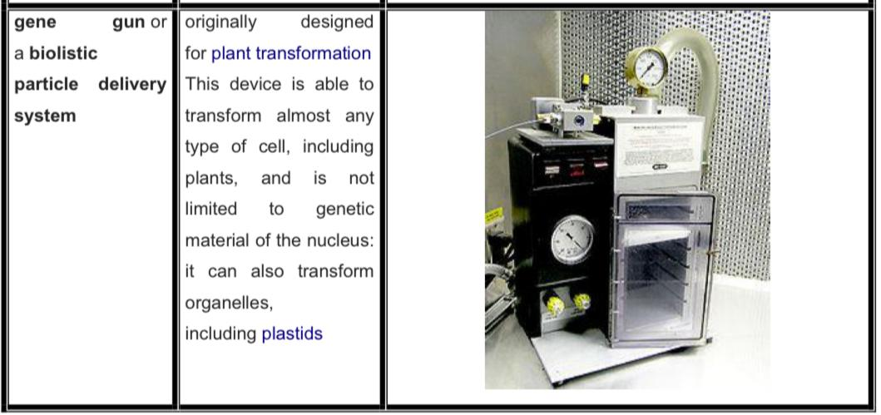
Gene gun

Slide 9
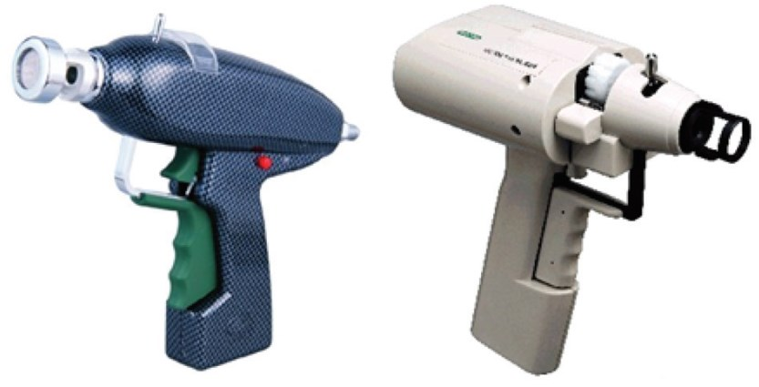

Slide 10
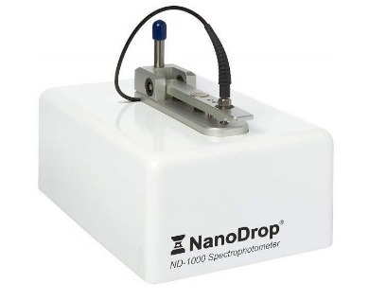
Nanodrop
Measuring nucleic acid concentration and purity

Slide 11
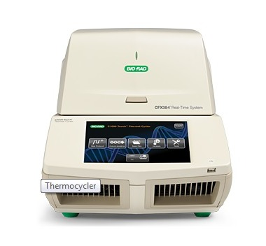
Thermal cycle
Quantitatively measure the amplification of DNA using fluorescent probes
allowing to look at gene expression

Slide 12
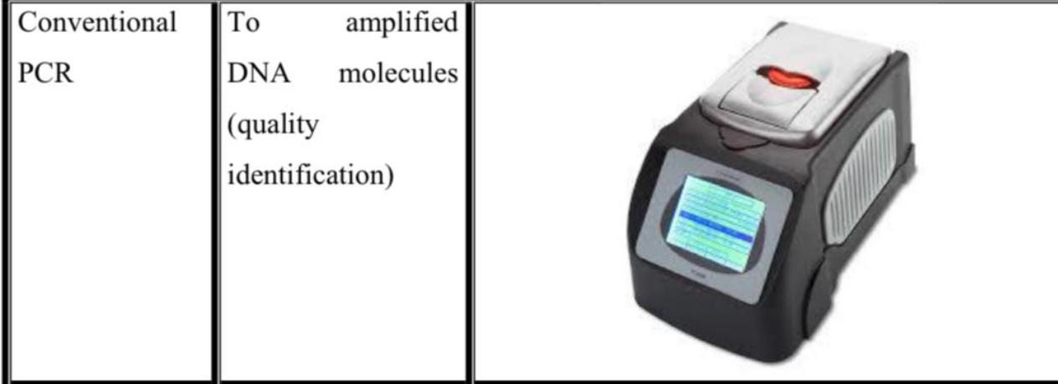
Conventional PCR

Slide 13
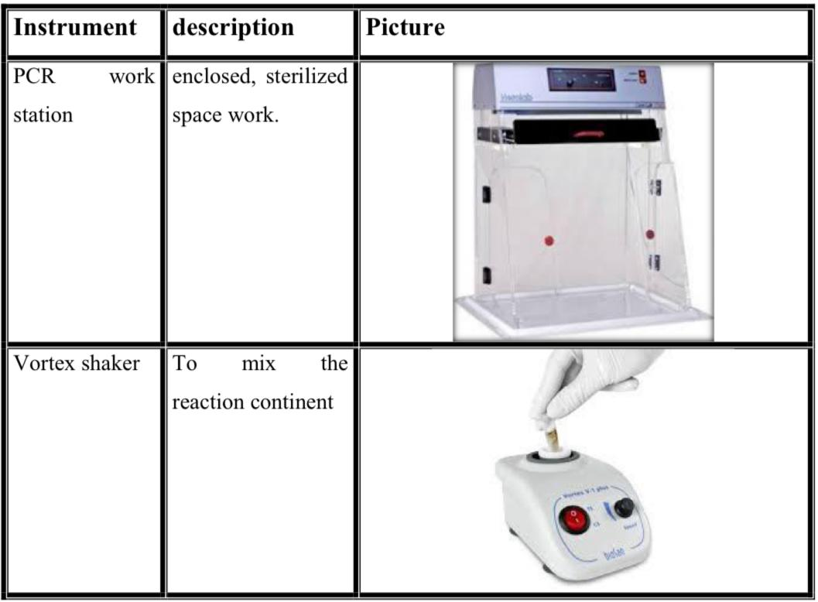

Slide 14
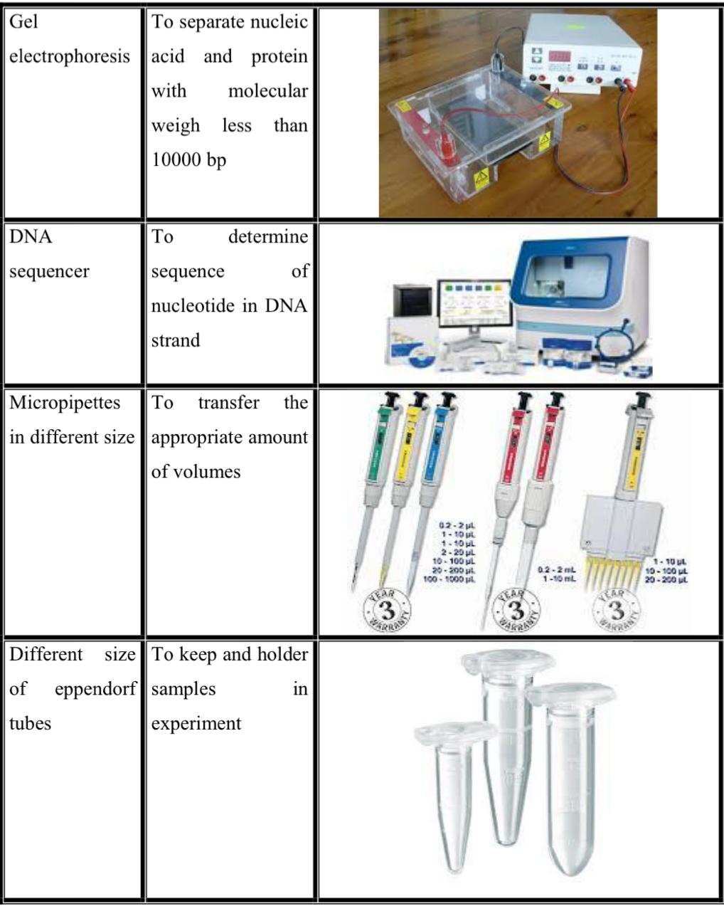

Slide 15
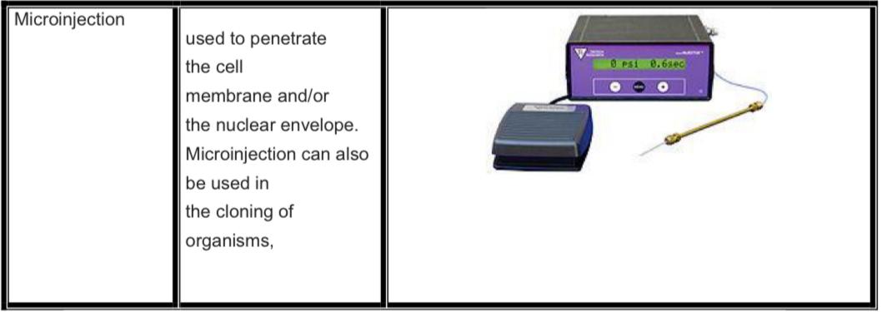
Microinjection

Slide 16
Software for Medical Laboratories
The above tools can handle a lot of work, but when it’s time to analyze and work with results, your DNA lab will need excellent software.
Ex: eLab \ Qmarks Pathology Lab \ Health Amaze

