Slide 1
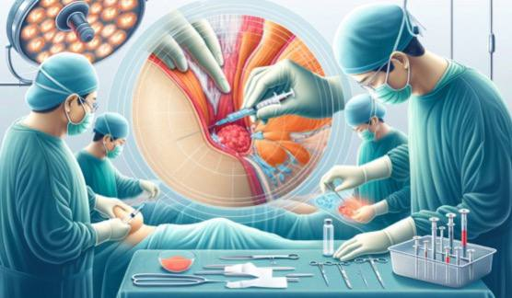
th
3 stage
Fixation of Tissues
Lab 5
Ms.c. Fadhela Nafi Alrawi

Slide 2
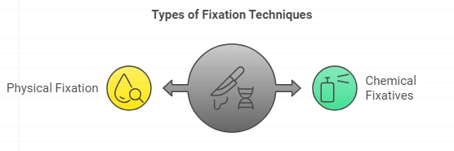
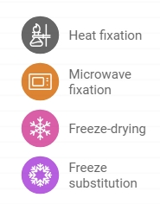
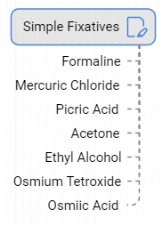
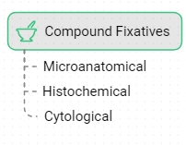

Slide 3
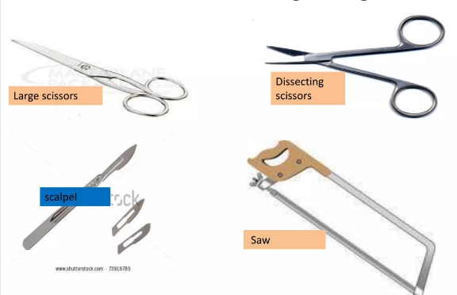
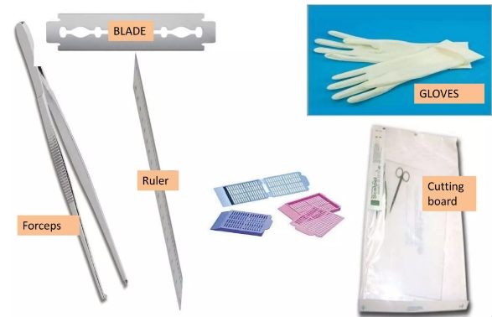
The gross room/surgical cut-up including sample handling
Instruments used in grossing

Slide 4
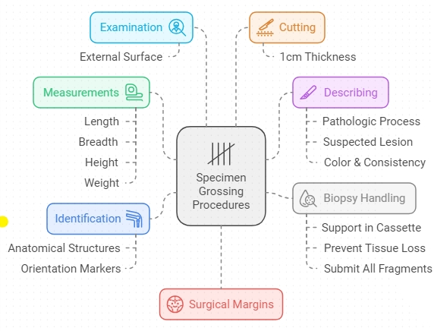
General principles of grossing

Slide 5
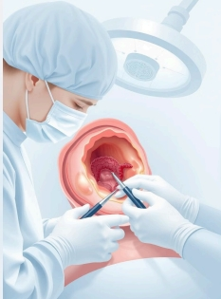
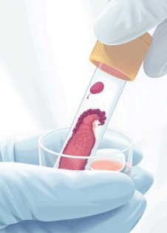
Type of tissues obtained in laboratory
The human tissue comes from the surgery (Biopsy) and/or from the dissection room (Autopsy). From surgery two types of biopsy could be obtained:
• Incisional Biopsy: A small piece of lesions or tumor is removed and sent for diagnosis before final removal of the lesion or tumor.
• Excisional Biopsy: whole tumor or lesion is removed for examination.

Slide 6
Specimen dissection plans
Small specimens need not to undergo any dissection and can be processed as they present ie whole ambedded.
Eyes
Eyes may be fixed in NBF usually for approximately 48 hours
Brain
this fixation takes 2-6 weeks.
Fixation may also be enhanced by the use of microwave technology.
Lungs
Lung biopsies are typically fixed in NBF.
Such fixed lungs can be cut within 2-6 hours
Muscle biopsies
The tissue for routine histological assessment is fixed in NBF and embedded so the fibers of the specimen are viewed in crosssection and longitudinally.

Slide 7
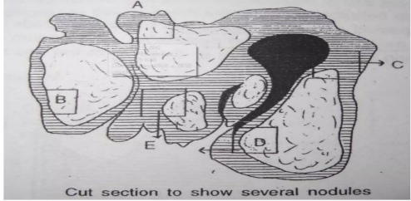
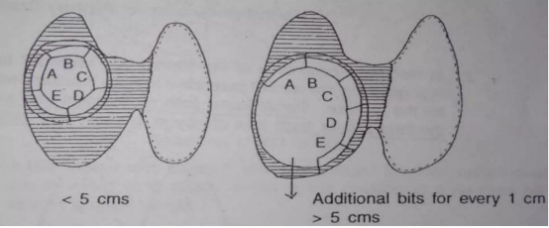
Specimen dissection plans
Thyroid gland-Thyroidectomy
Orient the specimen and cut parallel longitudinal slices 5 mm each
For multinodularThyroid gland
One section of each nodule (up to five nodules), including rim & adjacent normal gland.
More than one section for larger nodules
Solitary Encapsulated Lesion
For a solitary encapsulated nodule measuring up to 5cm.
take 1cm section for each additional centimeter

Slide 8
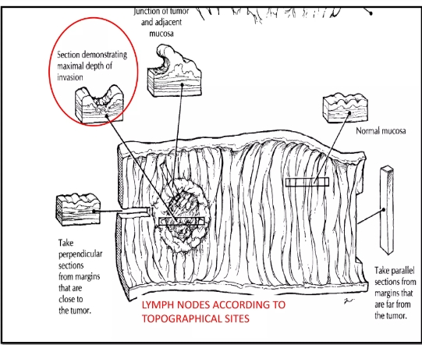
Specimen dissection plans
Stomach _gastrectomy for tumer and ulcer : use formalin fixtive for 24 h

Slide 9
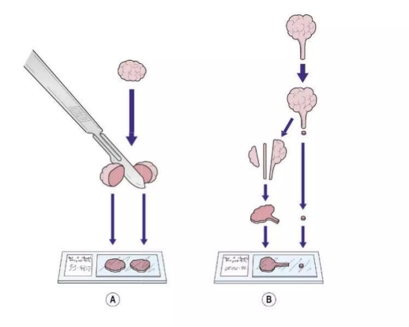
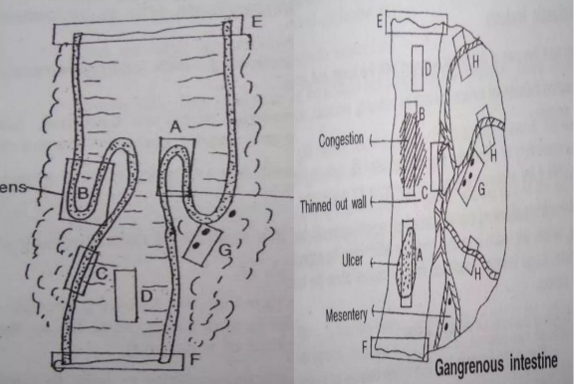
Specimen dissection plans
Polypectomy: use formalin fixtive for 24 h
Small bowel – excision:
use formalin or NBF fixtive for 24 h

Slide 10
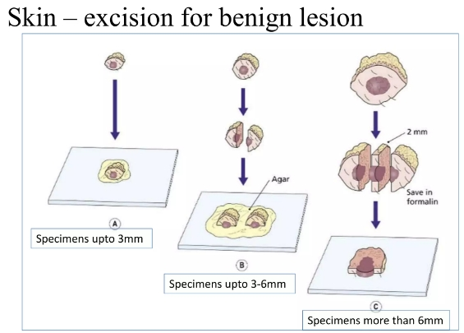
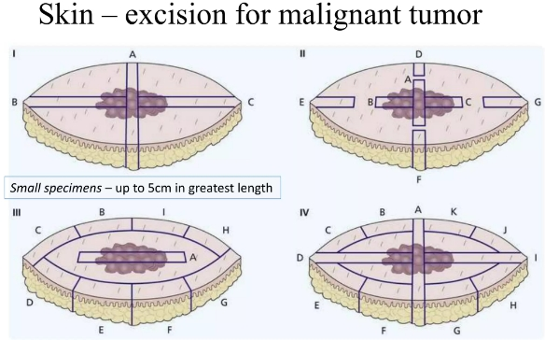
Specimen dissection plans

Slide 11
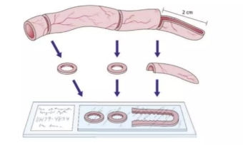
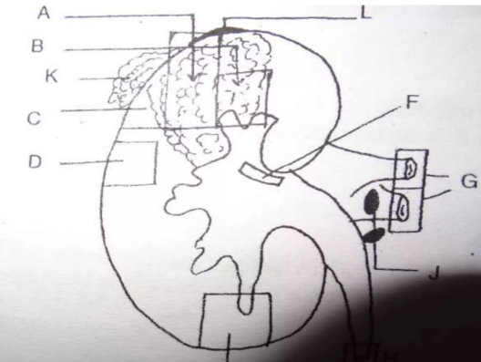
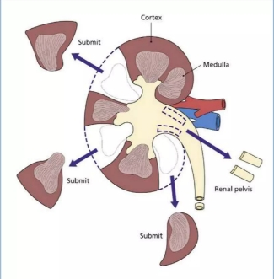
Specimen dissection plans
Appendix
Divide specimen in three by cutting a cross-section 2 cm from tip
Cut cross-sections of proximal fragment at 5 mm intervals
kidney
The sample is divided into three sections. It is taken from the affected area and from the lymph nodes, if any.
Kidney – nephrectomy for tumor

Slide 12
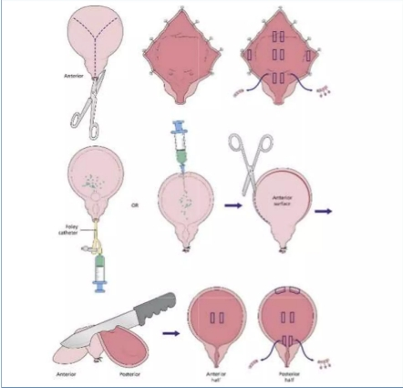
Specimen dissection plans
Bladder_ cystectomy
Two options are available for the dissection:
Open with scissors in a Y shape through the anterior wall and fix overnight in formalin
Fill with formalin, fix overnight and divide into anterior and posterior halves by first cutting the lateral bladder walls and then sectioning the prostate, beginning at the bladder neck and being careful to make the cut through the urethra.

Slide 13
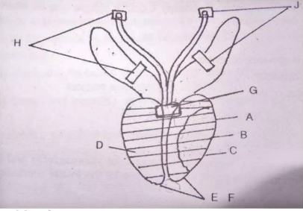
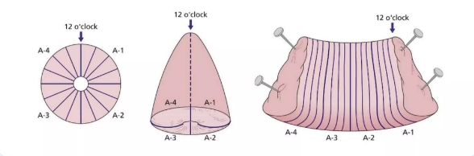
Specimen dissection plans
Prostate gland: Radical prostatectomy for tumor
Serially section the prostate at 2-3 mm intervals from apex to base Lay the individual slices sequentially and examine them carefully.
Uterus - cervical biopsy
Do not cut the specimen unless the individual pieces are ≥ 4 mm It is essential that all of the tissue received be preserved in formalin

Slide 14
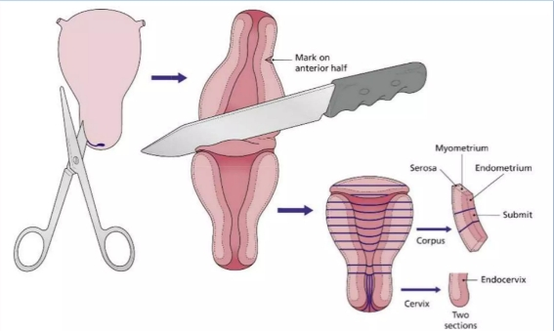
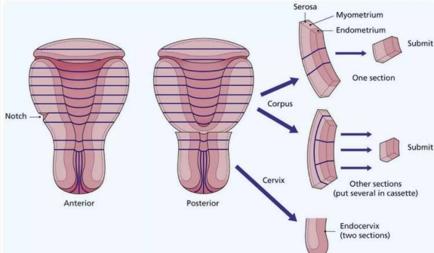
Specimen dissection plans
Uterus hysterectomy
Myomas: at least one section per myoma, up to three; sections from any grossly abnormal area (e.g. soft, fleshy, necrotic, cystic)
Cervix: one section from anterior half and one from posterior half
Cervical or endometrial polyps: to be submitted in entirety unless extremely large
Hysterectomy For Malignant Tumours
sample entire endometrium by making parallel sections, 2-3 mm apart,

Slide 15
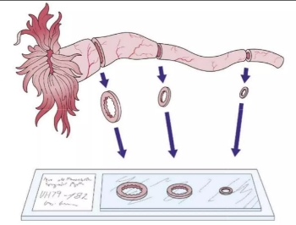
Specimen dissection plans
Fallopian tubes – salpingectomy
Submit three cross-sections of each tube, taken from the proximal, mid, and distal portions, submitted in the same cassette

Slide 16
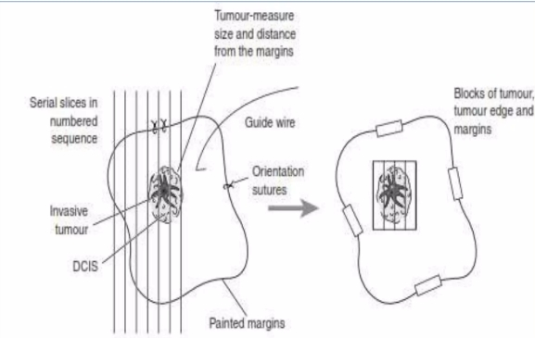
Specimen dissection plans
Breast: Lumpectomy / Excisional biopsy
Section specimen: if specimen is s 3cm, cut 3-4 mm slices;
if it is larger, bisect specimen transversely, place cut surface down, and take sagittal blocks through superior and inferior portions

Slide 17
GROSSING/SURGICAL CUT-UP
Specimen reception:
A separate room is required for specimen reception must be equipped with appropriate easily cleaned benching, adequate lighting, good ventilation, safety equipment, disinfectants, absorption granules and protective clothing.
The key point of this room is to receive samples safely and securely.
Any new specimen should have its identity confirmed and assigned a unique laboratory specimen identifier, usually a complex number.
Mapping of the specimen identifier against the clinical request form is mandatory, along with checking of appropriate clinical details mentioned against the specimen.
There must be facilities available that the pathologist can do the dissection either by standing or sitting way.

Slide 18
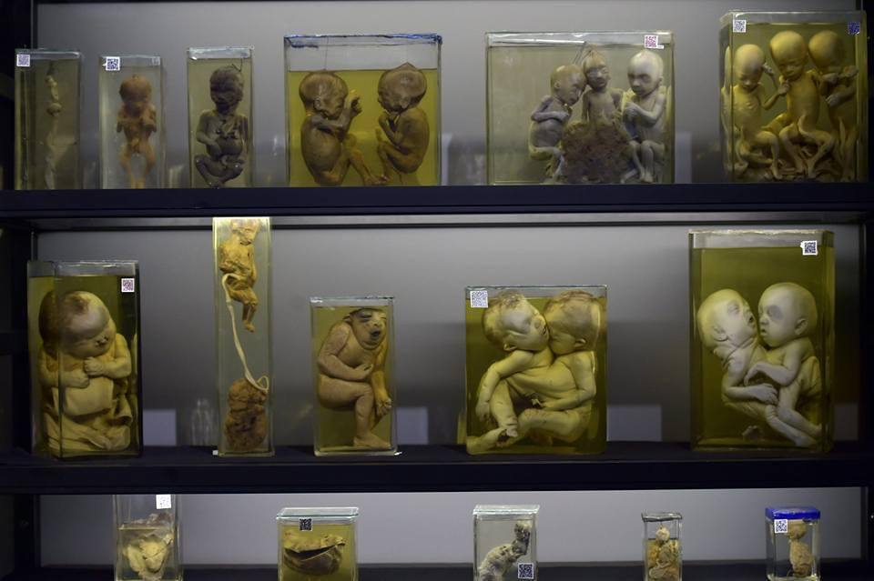
THANK YOU

