Slide 1

Light Microscopy
Lab3
M.SC. FADHELA NAFAA ALRAWI

Slide 2

What is microscopy ?
A microscopy : It is a tool used to see small things that can only be seen with the naked eye. Such as microorganisms.
The microscopy consists :
Light microscopy
Electron microscopy

Slide 3
Light microscopy
Light microscopes are compound microscopes, meaning they have at least two lenses.
Lenses are curved pieces of glass or plastic that bend light rays and can magnify objects, making them appear larger than they actually are.
Light is reflected from a mirror through the specimen or object to be viewed to a powerful objective lens, which produces the first magnification.
The image produced by the objective lens is then magnified again by the eyepiece lens, which acts as a simple magnifying glass.

Slide 4
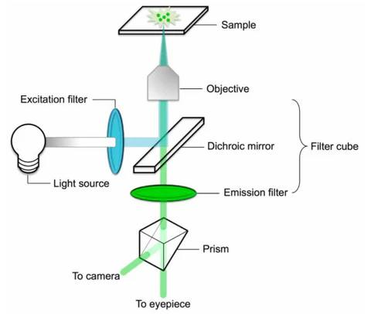

Slide 5

Light microscopy
The light microscope works according to important factors:
Magnification
Resolution
Contrast

Slide 6
Types of microscopy
Simple Light Microscope
Contain Single lens.
It has low magnification
Compound Light Microscope
Contain Two set of lens.
Has higher magnification.
Monocular Microscope
Contain one eye piece
Binocular Microscope
Contain two eye piece
Reduce eye strain

Slide 7
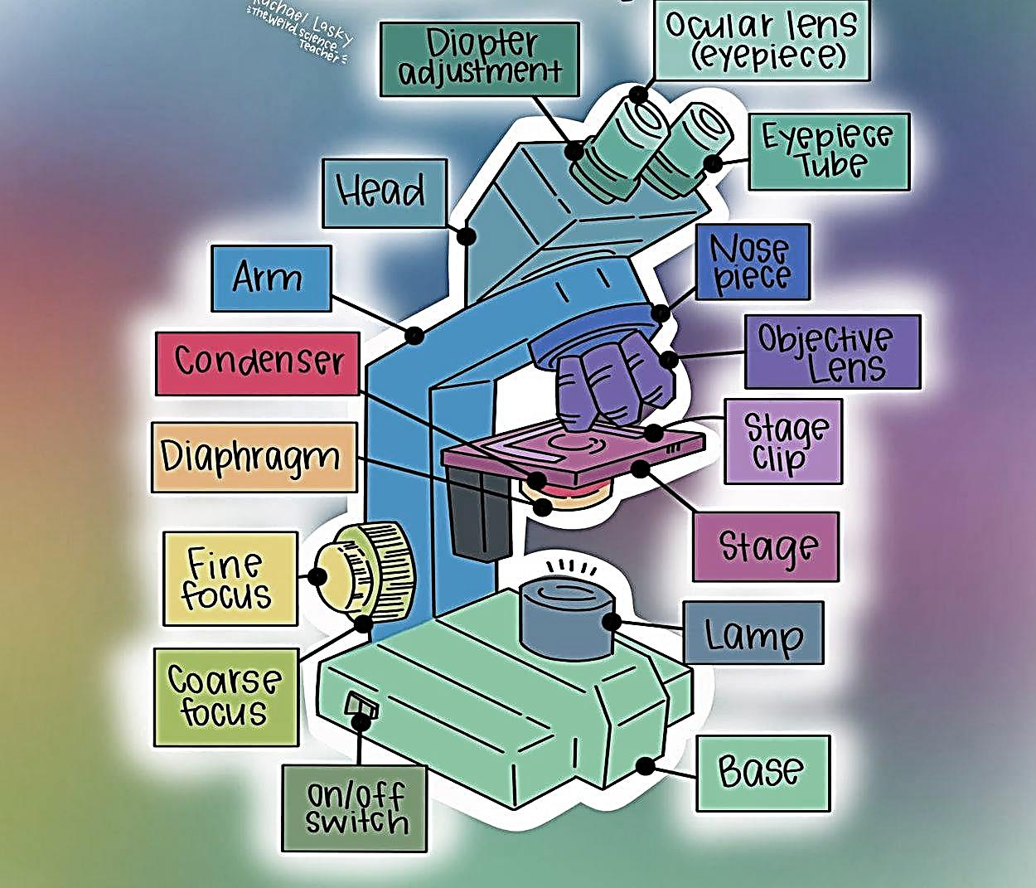
Parts of microscopy

Slide 8
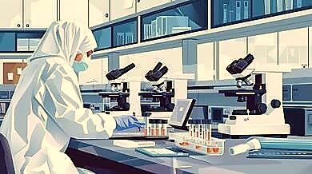
Types of Light microscope
Bright-field Microscopy
Dark-field Microscopy
Phase contrast Microscopy
Fluorescence Microscopy

Slide 9
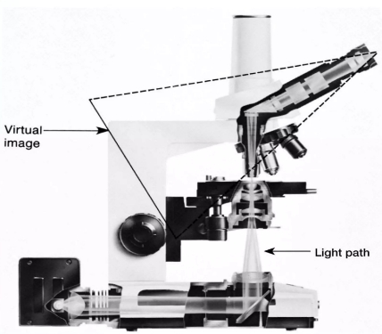
Bright-field Microscopy
produces a dark image against a brighter background
parfocal microscopes remain in focus when objectives are changed.

Slide 10
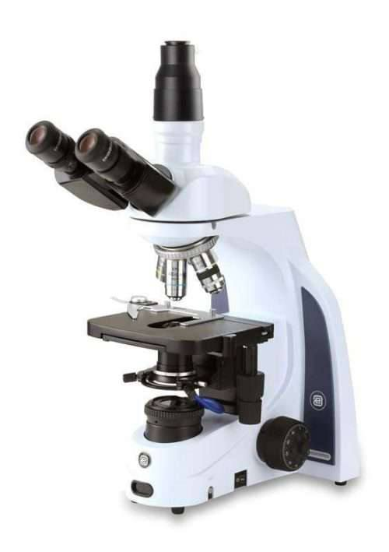
Dark-field Microscopy
produces a bright image of the object against a dark background
used to observe living, unstained

Slide 11
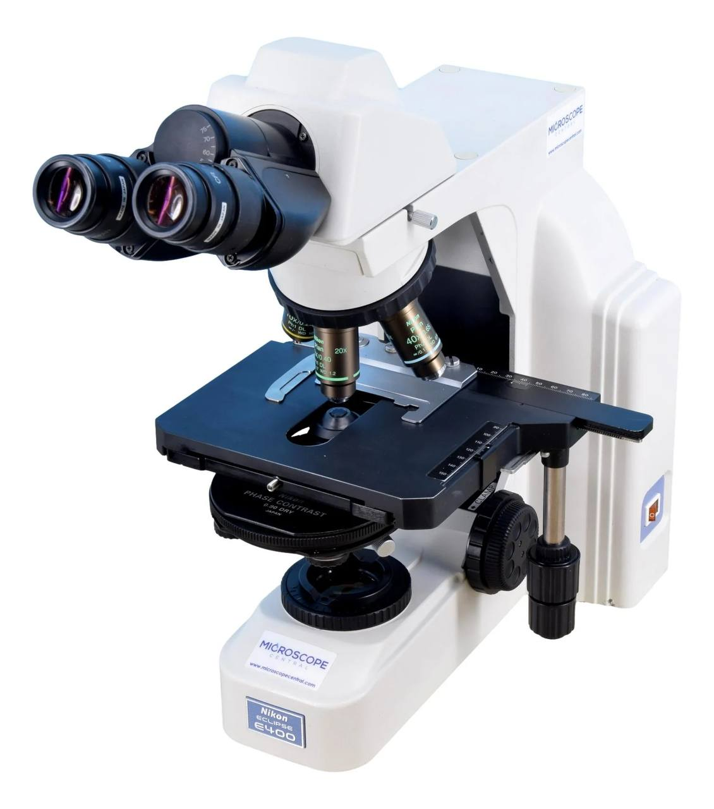
Phase contrast Microscopy
nhances the contrast between intracellular structures having slight differences in refractive index
excellent way to observe living cells

Slide 12
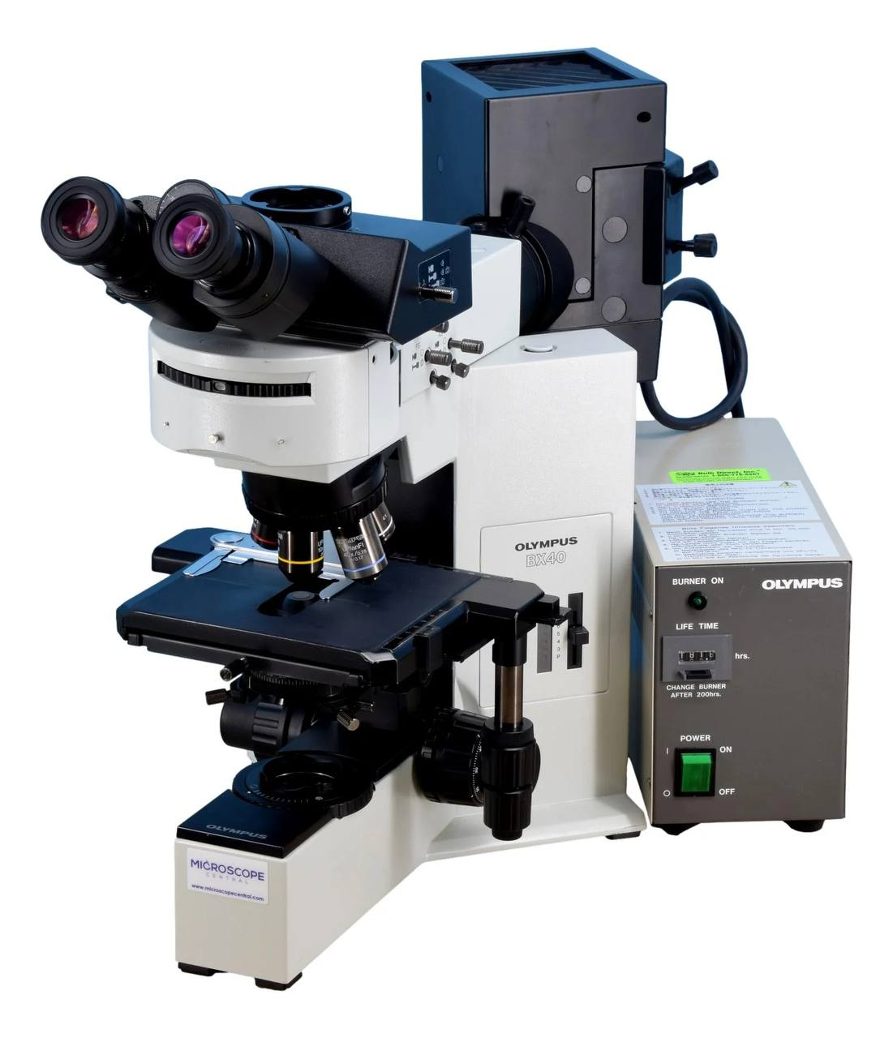
Fluorescence Microscopy
exposes specimen to ultraviolet, violet, or blue light
specimens usually stained with fluorochromes

Slide 13
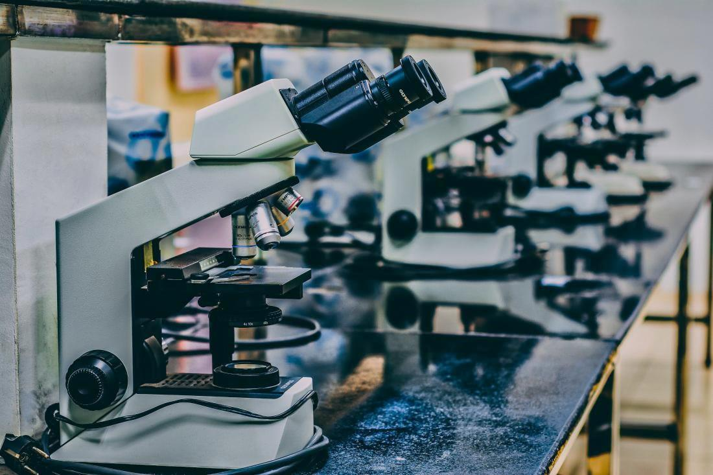
Thank you

