Slide 1


Al-Maarif University
Department of Dentistry
General Histology Lab
Stage -2-
Urinary system
Lec. 5
By :
Zaid Ahmad Hameed

Slide 2
Urinary system
Consists of :
Two kidneys . (urine formation)
Two ureters .
One urinary bladder and one urethra . (urine collection, storage, excretion)

Slide 3
kidneys
The kidney is an organ similar to a bean in shape located on both sides of the human spine.
The length of the kidney is 14-11 cm (extending over the height of three lumbar vertebrae).
The right kidney is usually several centimeters lower than the left kidney

Slide 4
Both kidneys rise and fall several centimeters during breathing , the kidney is divided into two parts, an external part, this part is called the renal cortex, and an inner part is the core of the kidney, Renal Medulla.

Slide 5
The kidneys functions
The kidneys perform several functions:
excretion of excess waste and foreign chemicals.
regulating water and balancing minerals.
regulating body fluid pressure and electrolyte concentrations, regulating arterial pressure , regulating acid and base balance.
secreting hormones and excreting metabolites, and the glycolysis process .
It is also the main source of the hormone erythropoietin, also works on the secretion of the hormone renin.
as well as its great role in converting vitamin D into the active form.

Slide 6
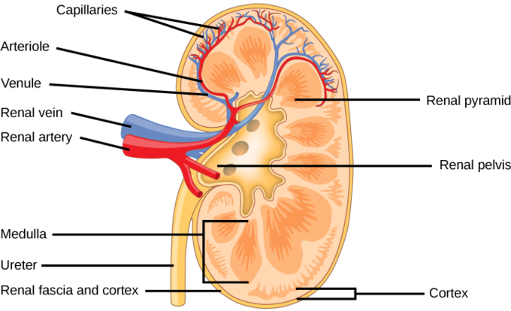
Kidney Anatomy
Kidney Anatomy

Slide 7
General organization
Renal Capsule outer membrane that surrounds the kidney; it is thin but tough and fibrous
Renal Pelvis basin-like area that collects urine from the nephrons, it narrows into the upper end of the ureter
Calyx extension of the renal pelvis; they channel urine from the pyramids to the renal pelvis
Cortex the outer region of the kidney; extensions of the cortical tissue, contains about one million blood filtering nephrons

Slide 8
Medulla inner region of the kidney contains 8-12 renal pyramids. The pyramids empty into the calyx.
Medullary pyramids formed by the collecting ducts, inner part of the kidney
Nephron these are the filtration units in the kidneys
Ureter collects filtrate and urine from renal pelvis and takes it to the bladder for urination
Renal Artery branches off of the aorta bringing waste-filled blood into the kidney for filtering in the nephrons; the renal artery is further subdivided into several branches inside the kidney. Each minute, the kidneys receive 20% of the blood pumped by the heart. Some arteries nourish the kidney cells themselves.

Slide 9
uriniferous tubule
Uriniferous tubule (anatomical unit for forming urine)
  1-Nephron Each KIDNEY consists of 1 million NEPHRONS
    Renal corpuscle (in cortex)
      Glomerulus (tuft of capillaries)
      Glomerular (Bowman’s) capsule
    Tubular section
      Proximal convoluted tubule
      Loop of Henle
      Distal convoluted tubule
  2- Collecting duct

Slide 10
1- Nephron
A nephron is the basic structural and functional unit of the kidneys that regulates water and soluble substances in the blood by filtering the blood, reabsorbing what is needed, and excreting the rest as urine. Its function is vital for homeostasis of blood volume, blood pressure, and plasma osmolality.
It is regulated by the neuroendocrine system by hormones such as antidiuretic hormone, aldosterone, and parathyroid hormone.

Slide 11
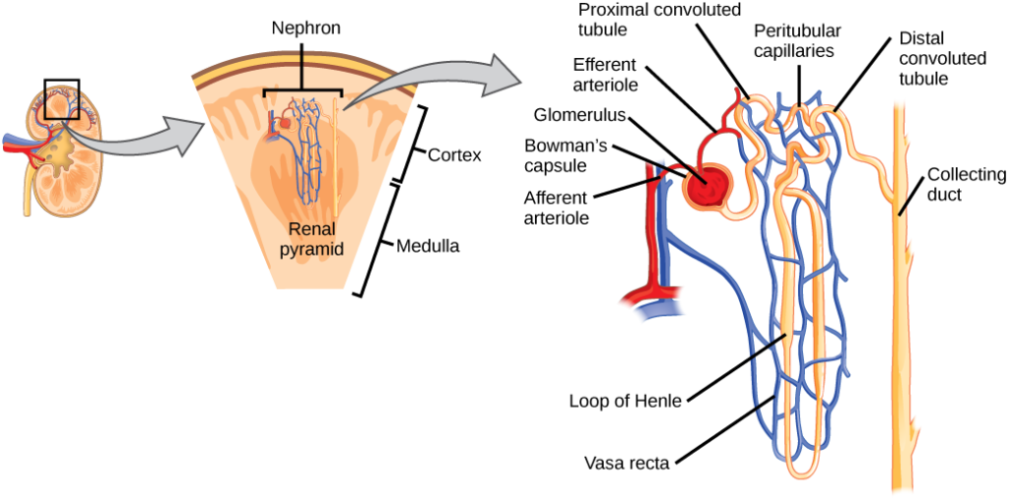
Nephron structure

Slide 12
Components of nephron
The Glomerulus
The glomerulus is a capillary tuft that receives its blood supply from an afferent arteriole of the renal circulation. Here, fluid and solutes are filtered out of the blood and into the space made by Bowman’s capsule.
The Bowman’s capsule (also called the glomerular capsule) surrounds the glomerulus. It is composed of visceral (simple squamous epithelial cells; inner) and parietal (simple squamous epithelial cells; outer) layers. The visceral layer lies just beneath the thickened glomerular basement membrane and only allows fluid and small molecules like glucose and ions like sodium to pass through into the nephron.

Slide 13
    Tubular section
    Proximal Convoluted Tubule
The proximal tubule is the first site of water reabsorption into the bloodstream, and the site where the majority of water and salt reabsorption takes place. Water reabsorption in the proximal convoluted tubule occurs due to both passive diffusion across the basolateral membrane, and active transport from Na+/K+/ATPase pumps that actively transports sodium across the basolateral membrane.
Water and glucose follow sodium through the basolateral membrane via an osmotic gradient, in a process called co-transport. Approximately 2/3rds of water in the nephron and 100% of the glucose in the nephron are reabsorbed by cotransport in the proximal convoluted tubule.

Slide 14
The Loop of Henle
The loop of Henle is a U-shaped tube that consists of a descending limb and ascending limb. It transfers fluid from the proximal to the distal tubule.
The descending limb is highly permeable to water but completely impermeable to ions, causing a large amount of water to be reabsorbed, which increases fluid osmolarity to about 1200 mOSm/L.
In contrast, the ascending limb of Henle’s loop is impermeable to water but highly permeable to ions.

Slide 15
Distal Convoluted Tubule and Collecting Duct
The distal convoluted tubule and collecting duct is the final site of reabsorption in the nephron. Unlike the other components of the nephron, its permeability to water is variable depending on a hormone stimulus to enable the complex regulation of blood osmolarity, volume, pressure, and pH .

Slide 16
2- The collecting tubules
The collecting duct is similar in function to the distal convoluted tubule and generally responds the same way to the same hormone stimuli. It is, however, different in terms of histology. The osmolarity of fluid through the distal tubule and collecting duct is highly variable depending on hormone stimulus. After passage through the collecting duct, the fluid is brought into the ureter, where it leaves the kidney as urine.
secretion of potassium and hydrogen ions to the lumen .

