Slide 1


Al-Maarif University
Department of Dentistry
General Histology Lab
Stage -2-
Connective tissue
Lec. 4
By :
Zaid Ahmad Hameed

Slide 2
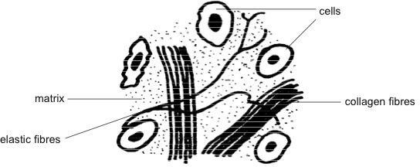

Connective tissue (CT)
CT is one of the four basic types of tissue in the body, its maintain the form of the body and its organs and provide internal support.
Connective tissue is found in between other tissues every where in the body, it is the widely distributed of the primary tissues but its amount in particular organs varies greatly
It develops from the mesoderm.
All connective tissue consists of three main components:
Fibers
Ground substance
Cells

Slide 3
Function of the CT:-
1)Binding and supporting ,like bones and cartilages 2)Protection like skin and adipose tissue
Insulation like adipose tissue
Storing reserve fuel
Transporting substances within the body like blood.

Slide 4
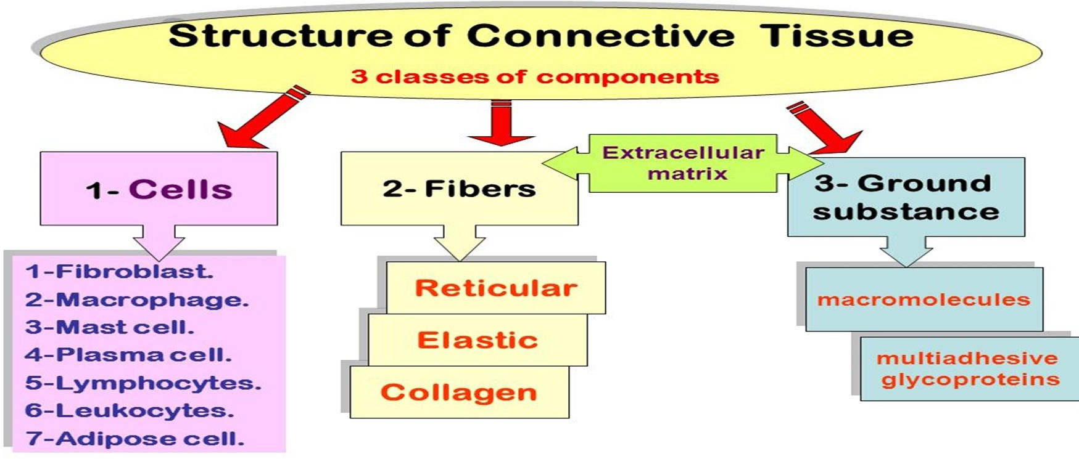

Slide 5
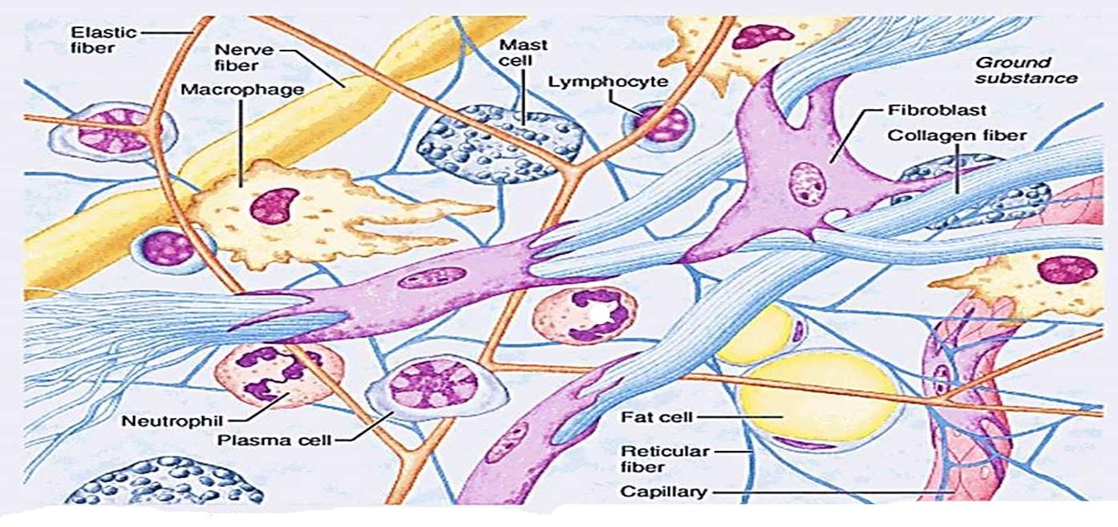
Ground substance
Is a clear, colorless, viscous ,unstructured material that fills the space between the cells and contains the fibers
It is composed of proteoglycans and cell adhesion proteins that allow the connective tissue to act as glue for the cells to attach to the matrix.
The ground substance functions as a molecular
sieve or
medium for substances to blood capillaries and
travel cells.
between
The fibers embedded in the ground substance impede diffusion somewhat and make it less pliable.

Slide 6
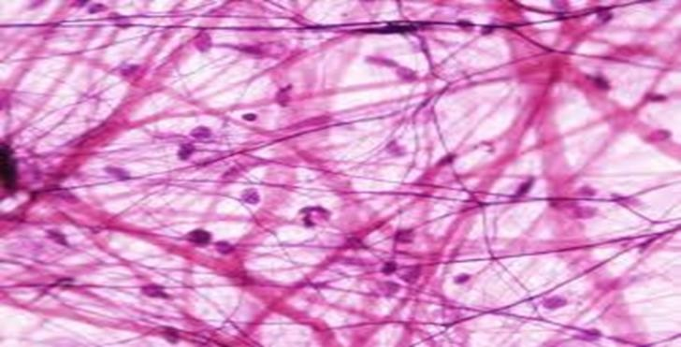
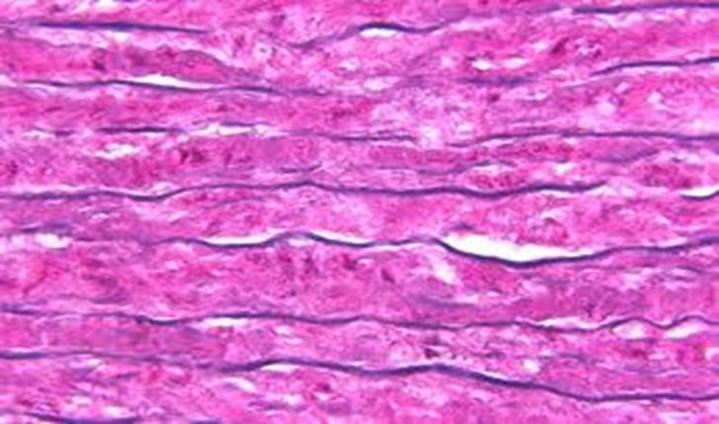
Fibers
Three main types of fibers are secreted by fibroblasts,
Collagen fibers
Are constructed primarily of the fibrous protein (collagen ) subunits linked together to form a long and straight fiber.
These fibers are extremely tough and provide high tensile strength ( that Is, the ability to resist longitudinal stress ) to the matrix .
when the fibers are fresh they have a glistening white appearance so they also called
(WHITE FIBERS )
Elastic fiber
Contains the protein elastin along with lesser amounts of other proteins and glycoproteins.
The main property of elastin is that after being stretched or compressed, it will return to its original shape. Elastic fibers are prominent in elastic tissues found in skin and the elastic ligaments of the vertebral column. .
Since fresh elastic fibers appear yellow, they are sometimes called (YELLOW FIBERS).
Reticular fiber
Are fine collagenous fibers, they branch extensively, forming delicate networks that surround small blood and support the soft tissue of organs .

Slide 7
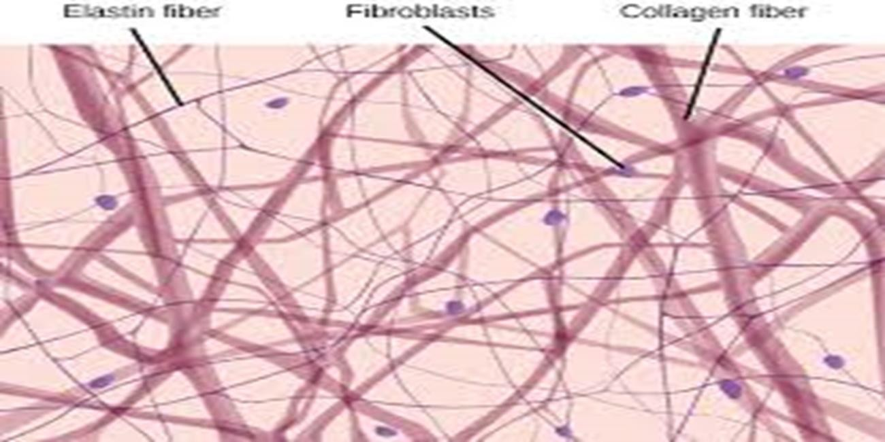

Slide 8
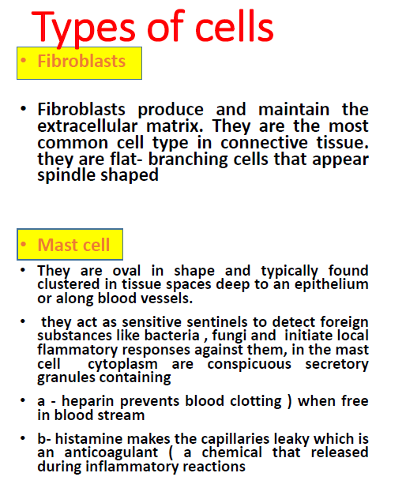
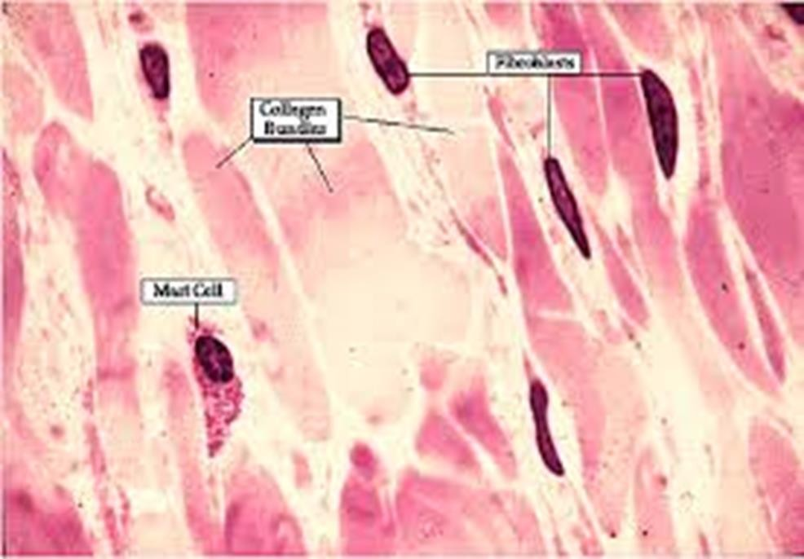
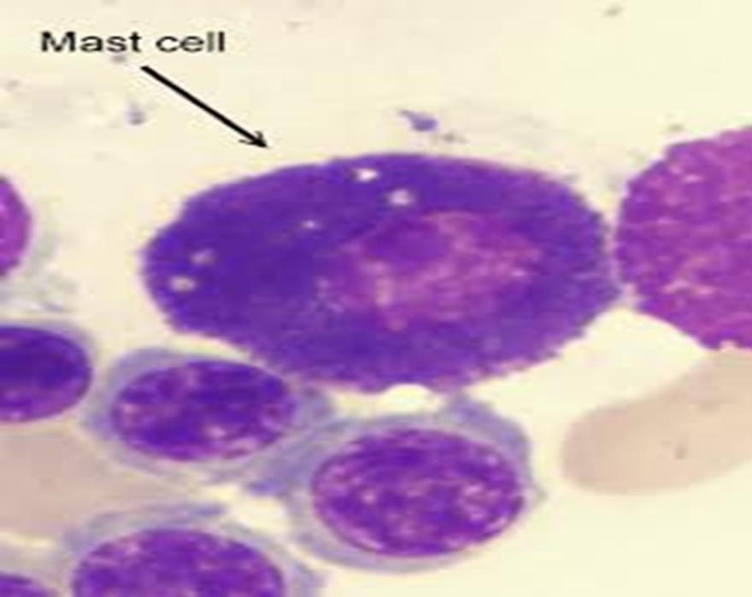

Slide 9

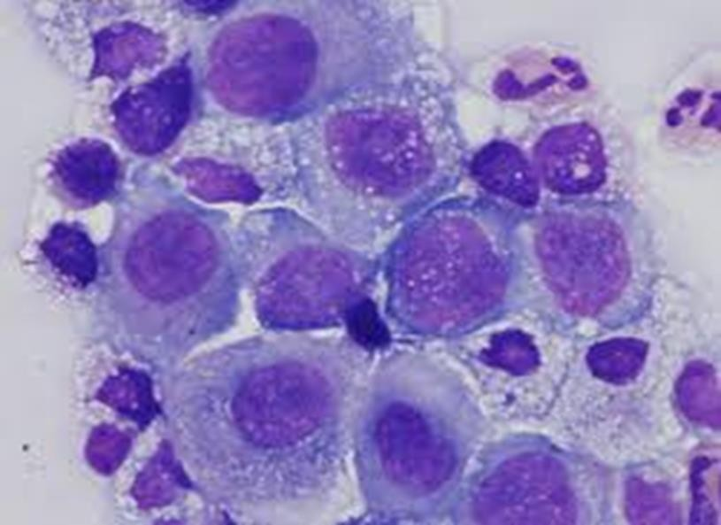
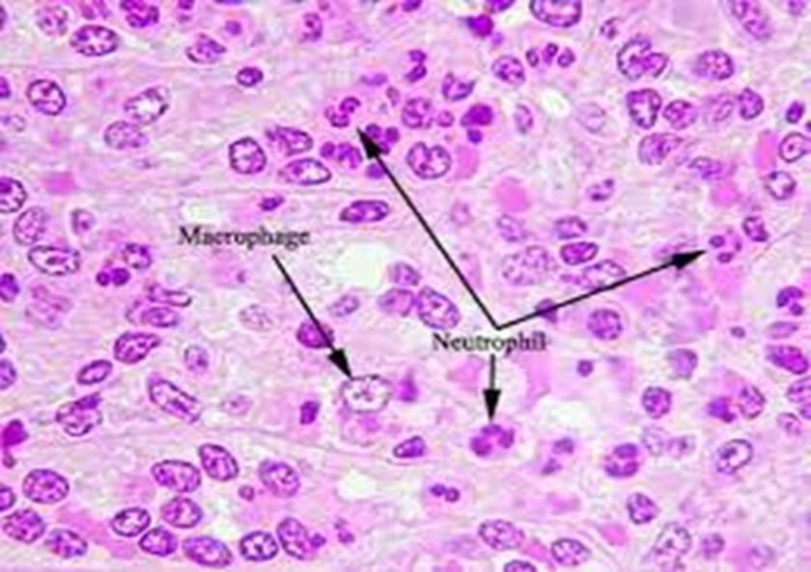
Macrophages
they are large irregularly shaped cells , remove and digest the by-products of both bacterial warfare and normal growth and degeneration.

Slide 10
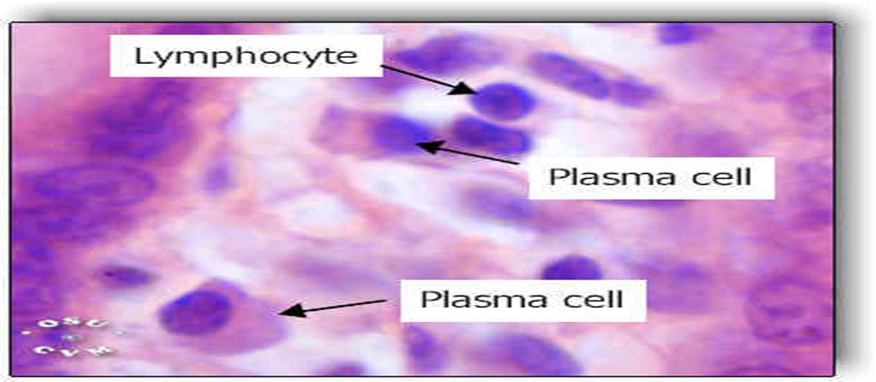
Plasma cells
Also called plasma B cells, are white blood cells that originate in the bone marrow and secrete large quantities of proteins called antibodies in response to being presented specific substances called antigens
Mobile cells
That migrate in to the connective tissue matrix from the blood stream they include white blood cells(Neutrophils ,Eosinophils , Lymphocytes)
Adipocytes
Are large connective tissue cells which contain a substantial amount of lipid stored in the form of conspicuous round droplets.

Slide 11
All classes of connective tissue consist of living cells surrounded by a matrix, their major differences reflect cell type, fiber type , and the proportion of the matrix contributed by fibers .Based on the cells present and the extracellular matrix structure, we differ two types of connective tissue:

Slide 12
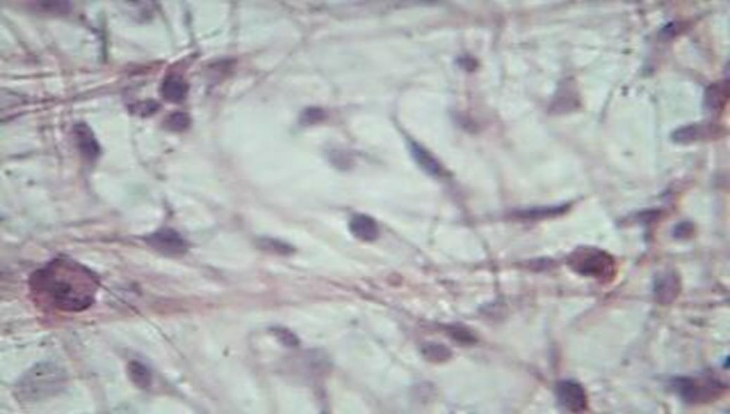
A-Loose connective tissue :-
1) Areolar connective tissue
Has a semi fluid or gelatinous ground substance, with the three types of fibers (white, yellow and reticular fibers ) also the cells (fibroblasts, numerous macrophages are also seen Fat cells appear singly or in small clusters, and the mast cells are identified easily by the large, darkly stained cytoplasmic granules that often obscure their nuclei, also some white blood cells are seem)
Location :-
1-Under epithelia of body like lamina preppie of mucous.
2-Packages organs. 3-Surrounds capillaries.
Function :-
A- Wraps and cushions organs
B- Role in inflammation
C- Holds and conveys tissue fluid

Slide 13
2-Adipose (fat) tissue :-
Is basically an areolar connective tissue in which the nutrient storing function is greatly increased Adipocytes commonly called adipose or fat cells
oil droplet occupies most of a fat cells volume and compresses the nucleus ,displacing it to one side only a thin rim of surrounding cytoplasm is seen
Adipocytes are among the largest cells in the body and are incapable of cell division
Location:-
1-under skin
2-Around kidneys and eyeball
3-in bones
4-within abdomen
Function:-
A-Provides reserve food fuel
B-Insulates against heat loss
C-Supports and protects organs

Slide 14
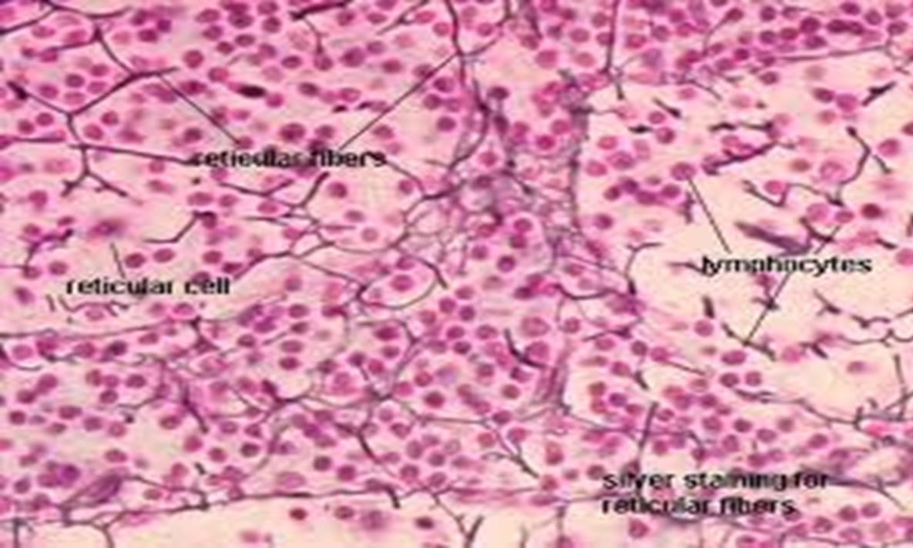
3- Reticular connective tissue :-
Resembles areolar connective tissue But the only fibers in its matrix are reticular fibers.
The reticular fibers form a delicate network along which fibroblasts called reticular cells lie scattered. although reticular fibers are widely distributed in the body, reticular tissue is limited to certain sites It forms a stroma, or internal framework that can support many free blood cells ( largely lymphocytes) in lymph nodes , the spleen, ( so it is a network of reticular fibers in a typical loose ground substance, reticular cells predominate)
Location:-
Lymphoid organs (lymph nodes ,bone marrow, and spleen)
Function:-
Fibers form a soft internal skeleton that supports other
Cell and bone marrow.

Slide 15
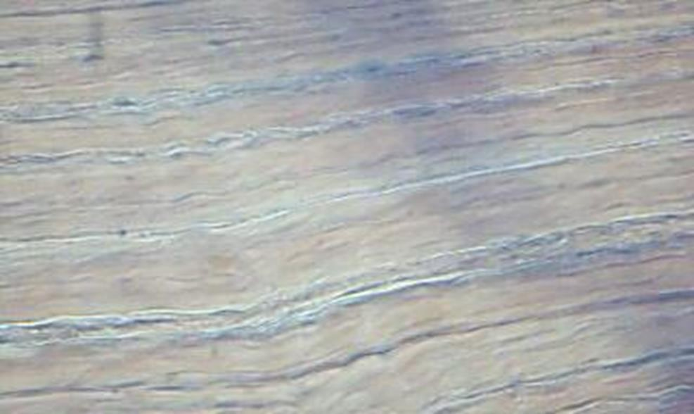
B-Dense connective tissue :-
•
1- Dense regular connective tissue :-
It is one of the dense connective tissues , all of which have fibers as their predominant element, so the dense connective tissues are often referred to as dense fibrous fibers running in the same direction, parallel to the direction of pull.
This results in a white, flexible tissue with great resistance to tension (pulling forces ) where the tension is exerted in a single direction. Among the collagen fibers are rows of fibroblasts that continuously manufacture fibers and scant ground substances collagen fibers are slightly wavy, which allows the tissue to stretch a little.
(so it is parallel collagen fibers, a few elastin fibers, major cell type is the fibroblast )
Location :-
1-Tendons 2-Most ligaments 3-Aponeuroses
Function :-
A-Attaches muscles to bones or to muscles
B- Attaches bones to bones
C-Withstands great tensile stress

Slide 16
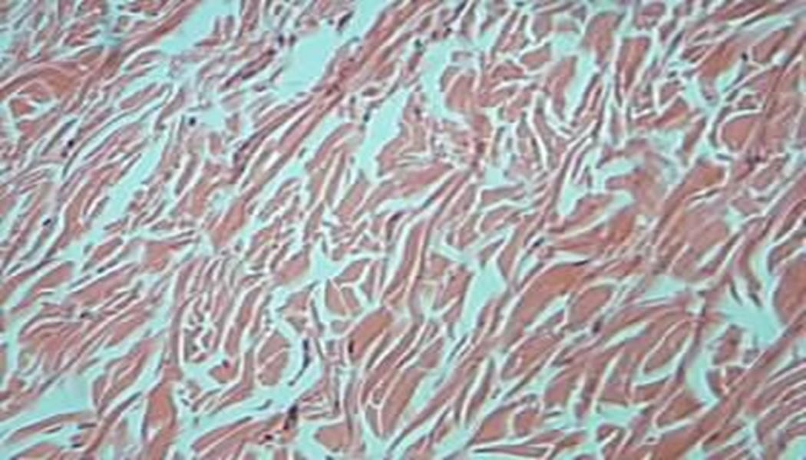
2- Dense irregular connective tissue :-
It has the same structural elements as the regular variety. the bundles of collagen fibers are much thicker and they are arranged irregularly. this type of tissue forms sheets in body areas where tension is exerted from many different directions.
(so it is irregularly arranged collagen fibers, some elastic fibers major cell type is the fibroblast )
Location :-
1-skin
2-forms fibrous joint capsule
3-fibrous covering some organs (testes,kidneys,bones)
4-submucosa of digestive tract
Function :-
able to withstand tension exerted in Provides structural strength many directions

