Slide 1


Al-Maarif University
Department of Dentistry
General Histology Lab
Stage -2-
EPITHELIAL TISSUE
Lec. 3
By :
Zaid Ahmad Hameed

Slide 2
EPITHELIAL TISSUE OR EPITHLIUM
Epithelium (plural, epithelia) is the tissue that covers and lines both the external and internal body surfaces, including vessels and small cavities. Epithelium not only serves as a protective covering or lining but is also involved in tissue absorption, secretion, sensory, and other specialized functions.
It serves to protect the more complex inner structures from physical, chemical, and pathogenic attack, as well as dehydration and heat loss by its formation as an epithelial barrier.

Slide 3
Epithelium Properties :
The basic tissue of the body.
Cells are arranged as continuous sheets.
Single or multiple layers.
Cells are held tightly together by cell junctions (desmosomes and hemi desmosomes), as is the case with its relationship to the basement membrane as well as the junctional epithelium of the gingival sulcular region that is attached to the tooth surface.
Basal surface adheres to basal lamina or basement membrane.
Avascular but supplied by nerves.
Has high capability to regenerate.

Slide 4
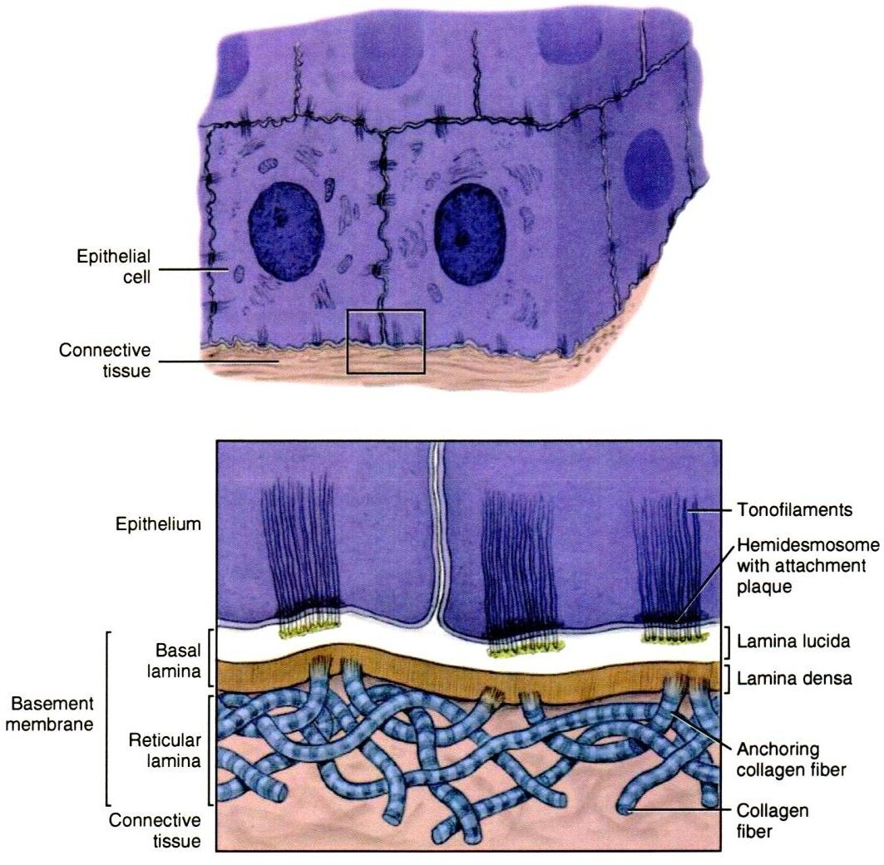
Epithelium Histology
Epithelium generally consists of closely grouped polyhedral cells surrounded by very little or no intercellular substance or tissue fluid .

Slide 5
Embryological aspect
  Epithelia are derived from all the 3 germ layers:
  Ectoderm- Epithelium of skin
  Endoderm- Epithelium of gut
  Mesoderm- Epithelium of pericardial, peritoneal and pleural cavities

Slide 6
Functions of EPITHELIAL TISSUE
    Protection
    Absorption
    Barrier
    Excretion
    Secretory
    Function as sensory surfaces

Slide 7
Classification
According to shape, arrangement and the specialization of their free surface:
  Simple
  Stratified
  Pseudostratified
  Transitional

Slide 8
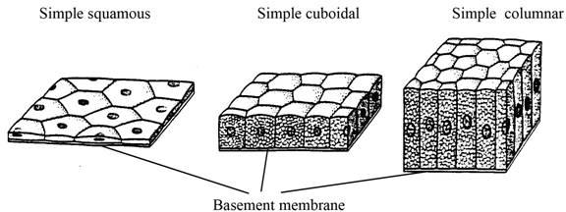
1- Simple epithelium

Slide 9
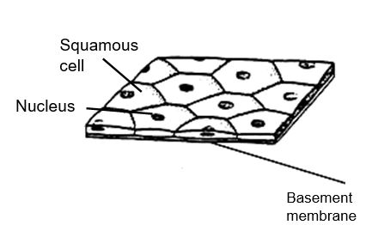
Simple Squamous Epithelium
Single layered
Flat cells
On surface view, like floor tiles
Elevated nuclei
Examples:
  Lung alveoli
  Parietal layer of
  Bowman’s capsule of kidney
  Inner aspect of tympanic membrane
  Function:
  Rapid transport of substances, secretion of fluid, diffusion of gases and osmosis

Slide 10
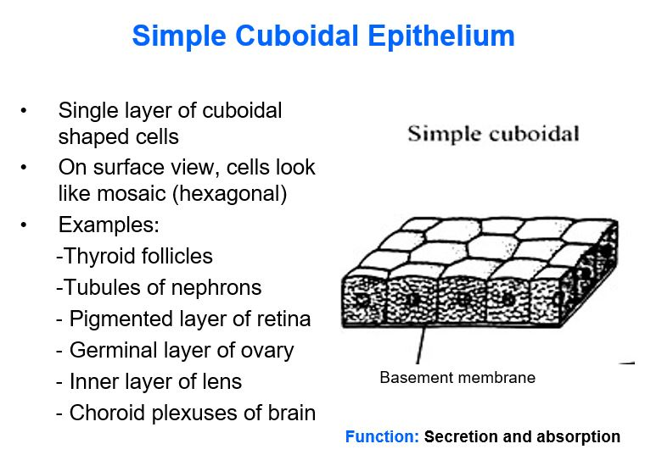

Slide 11
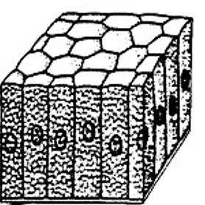
Simple Columnar Epithelium
Cells having more height than width
Nuclei are elongated, located in the lower half of cells
Cells may show some surface modifications
Examples:
  GIT(stomach to anus)
  Gall bladder
  Uterine tube & cavity Central canal of spinal
Function:
Secretion and absorption; Ciliary action

Slide 12
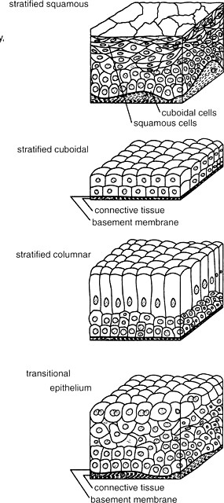
2- Stratified epithelium

Slide 13
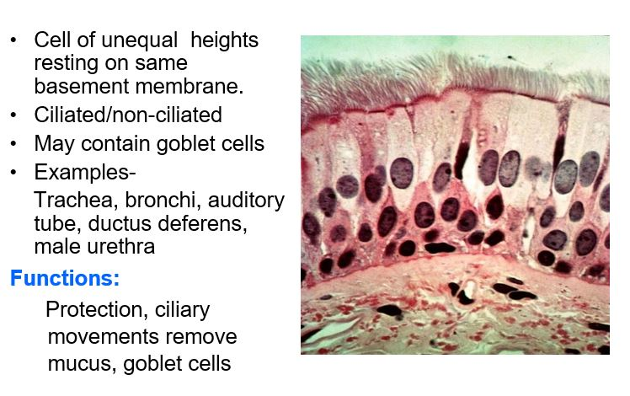
3- Pseudostratified epithelium

Slide 14
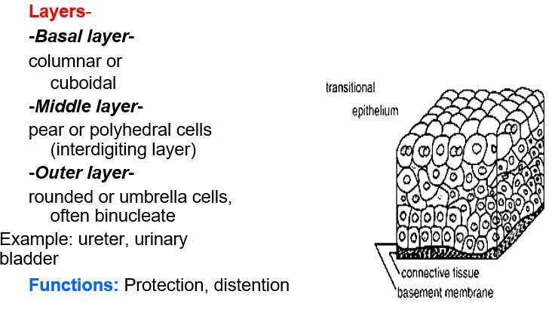
4- Transitional epithelium (urothelial)

Slide 15
Epithelium Regeneration, Turnover, and Repair
Turnover of both the epithelium in skin or oral mucosa occurs as a result of the cell division during the regeneration process. Cellular turnover of epithelium occurs as the newly formed deepest cells migrate superficially from their formation near the basement membrane.
Thus, the turnover time is the time needed for a cell to divide during mitosis and pass through the entire thickness of tissue. In order to migrate, the cells release and then regain their desmosomal connections at the intercellular junctions in the more superficial location.

Slide 16
The turnover time is faster for all types of epithelium, as compared to connective tissue. This faster turnover time is a result of the higher level of mitosis in those deepest dividing cells near the basement membrane.
Thus, the older, superficial epithelial cells are being shed or lost at the same rate as the deeper germinal cells are dividing into more cells during turnover time.
The epithelium of the oral mucosa generally has a faster turnover time than the epidermis of the skin (Table).

Slide 17
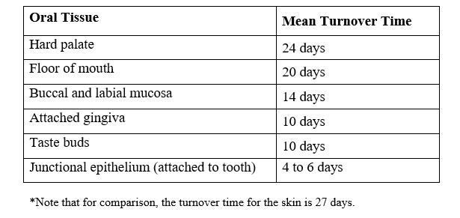
Oral Tissue Mean Turnover Time
More specifically within the oral cavity, the epithelium of the buccal mucosa that lines the cheek tissue has a faster turnover time (14 days) than the epithelium that covers the skin (27 days).

