Slide 1

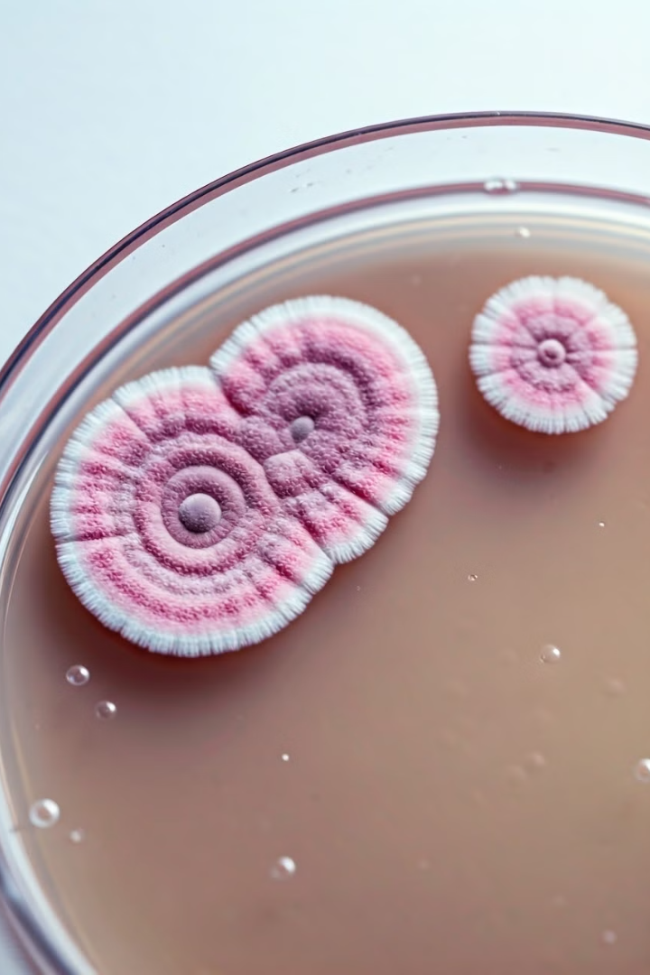

Lab 2: Preparation of Culture Media for Fungi
This lab will focus on the preparation of culture media specifically designed for fungal growth.
We will explore various types of media, including Sabouraud Dextrose Agar (SDA), Potato Dextrose Agar (PDA), and Malt Extract Agar (MEA).
by Mustafa Awad Mishaan Al-Koud /Medical

Slide 2
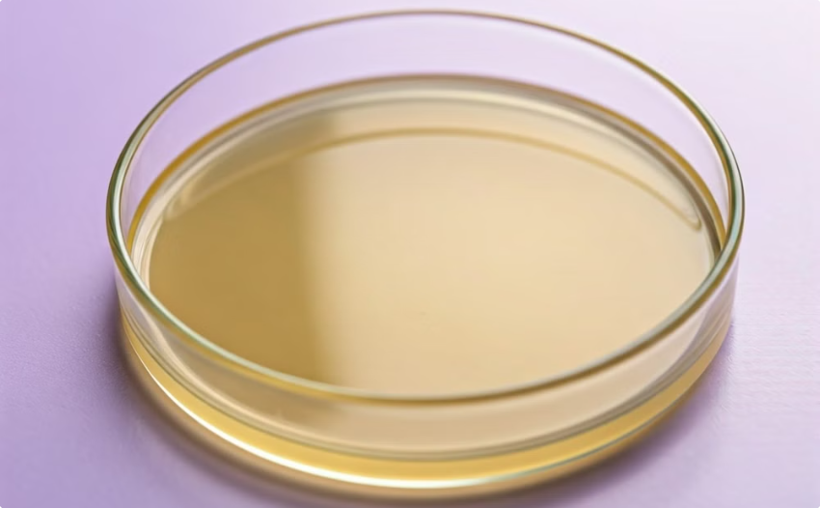
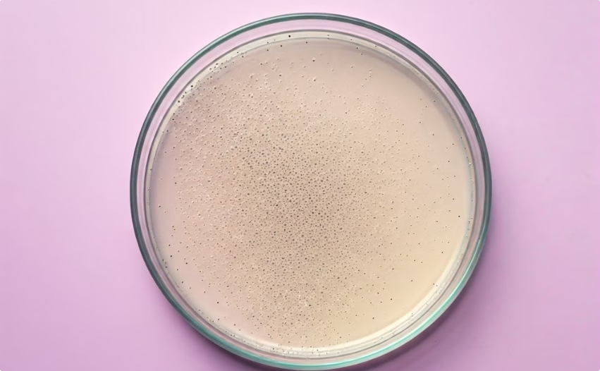
Types of Culture Media
Sabouraud's Dextrose Agar
Mycosel Agar
SDA is a common culture medium for fungi. It is often used for the isolation and identification of fungal species. This agar is rich in dextrose, a sugar that promotes fungal growth.
Mycosel agar is a selective culture medium designed to inhibit the growth of bacteria and saprophytic fungi. It is commonly used to cultivate pathogenic fungi. Mycosel agar contains chloramphenicol to inhibit bacterial growth and cycloheximide to inhibit saprophytic fungi and some yeasts, like Cryptococcus neoformans.

Slide 3
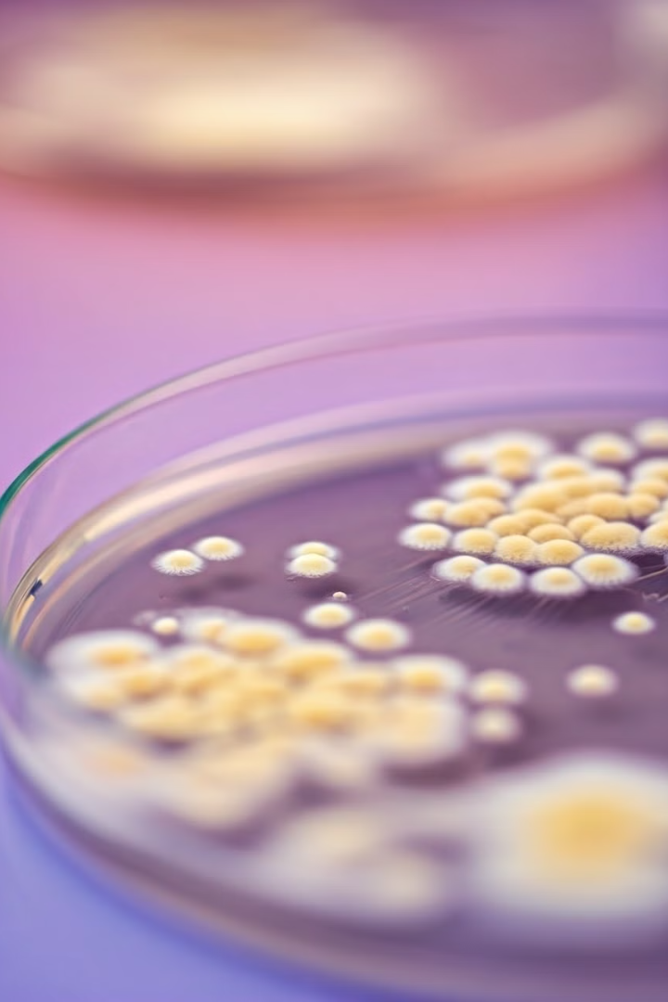
Sabouraud Dextrose Agar (SDA)
Selective Growth
Sabouraud Dextrose Agar (SDA) is a selective medium that promotes fungal growth while inhibiting bacterial growth.
Fungal Culture
It is commonly used for culturing yeasts and molds, including dermatophytes, which are fungi that cause skin infections.
Acidic pH
The acidic pH of SDA, around 5.6, is ideal for fungal growth and helps suppress bacterial growth.
Key Components
SDA contains dextrose (glucose) as a primary carbon source, peptone as a nitrogen source, and agar as a solidifying agent.

Slide 4
Preparation of Sabouraud Dextrose Agar (SDA)
Combine Ingredients
1
Combine all ingredients in 900 ml of deionized water.
Adjust pH
2
Adjust the pH to 5.6 with hydrochloric acid.
Heat and Dissolve
3
Heat to boiling to dissolve the medium completely.
Sterilize
4
Autoclave at 121°C for 15 minutes.
After sterilization, cool the medium to 45-50°C and pour it into petri dishes or tubes for slants. SDA is particularly effective for growing dermatophytes, which are fungi that cause skin infections. It is also used in clinical settings to isolate pathogenic fungi from clinical specimens and to determine microbial contamination in food, cosmetics, and clinical specimens.

Slide 5
Periodic Acid-Schiff (PAS) Staining
Purpose
Principle
PAS staining is a common technique in histology. It is useful for identifying fungal elements in tissue samples. This method highlights fungal cell walls by reacting with carbohydrates.
The reaction is particularly useful for visualizing fungal hyphae and spores. These structures contain abundant polysaccharides in their cell walls, making them readily visible under a microscope.

Slide 6




PAS Staining Procedure
Fixation
1
Tissue samples are fixed in formalin.
Oxidation
2
Samples are treated with periodic acid.
Staining
3
Schiff's reagent is applied.
Counterstaining
4
Hematoxylin or another counterstain is used.
PAS staining is a common technique used in microbiology for identifying fungal infections in clinical specimens and research studies.
The procedure involves a series of steps that sequentially expose the tissue sample to different reagents.
These steps enhance the visibility of fungal structures by staining the carbohydrates present in the fungal cell walls.

Slide 7
The PAS stain is a common histological stain, particularly used in mycology, to highlight fungi and other carbohydrates. This stain is useful in identifying fungal elements, such as yeasts, hyphae, and spores, which can be difficult to see with standard light microscopy.
The PAS stain is a valuable tool in clinical microbiology, aiding in the diagnosis of fungal infections, which are common in patients with weakened immune systems. Many different types of fungi can be differentiated based on their appearance with the PAS stain.

Slide 8
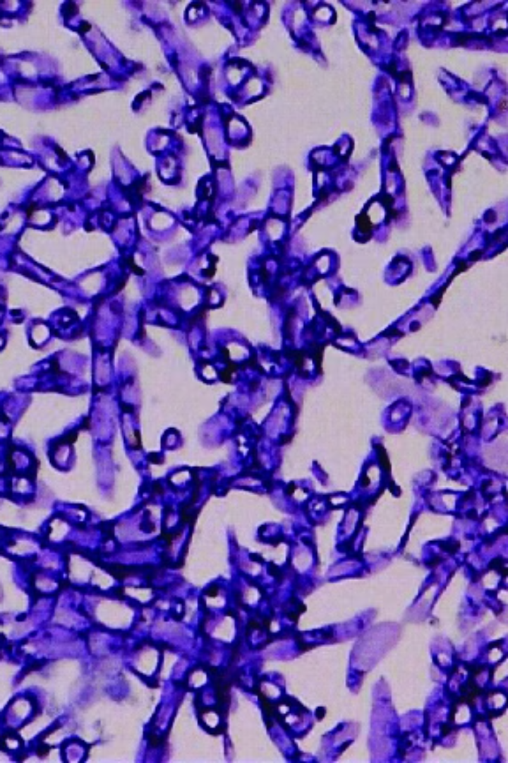
Fungal Hyphae (Magnification 40x)
The image shows fungal hyphae, which are thread-like structures that make up the fungal body. They are typically septate, meaning that they are divided by cross-walls called septa.
These septa allow for the movement of cytoplasm and organelles between the cells, but they also help to maintain the structural integrity of the hyphae. The presence of septa is a key feature used to differentiate between fungi and other types of organisms, such as bacteria.

Slide 9
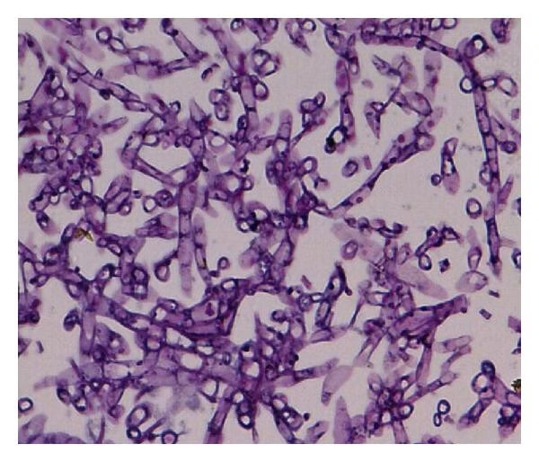
Schizophyllum Commune Case Report
Schizophyllum commune is a common saprophytic fungus that can cause opportunistic infections, especially in immunocompromised individuals.
In this case report, a patient presented with fungal sinusitis, a rare infection.
The patient was treated with antifungal medication and surgery, and made a full recovery.

