Slide 1
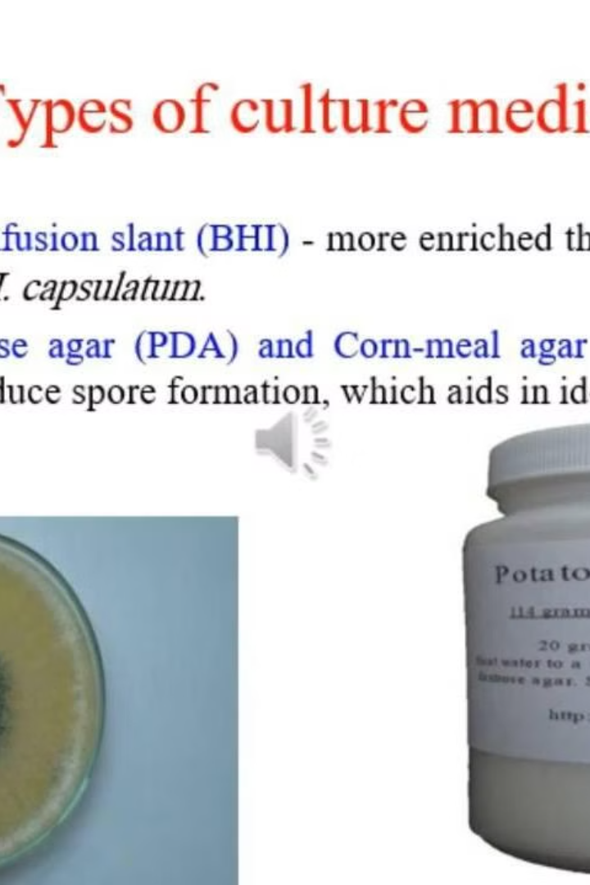

Slide 2
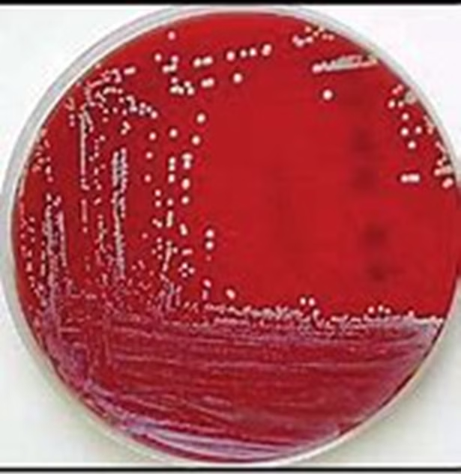
Gram Stain
Gram staining is a technique used to differentiate bacteria based on their cell wall structure. The staining process involves applying a series of dyes, including crystal violet, iodine, decolorizer, and safranin.

Slide 3
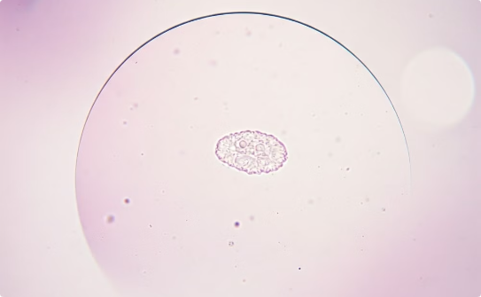
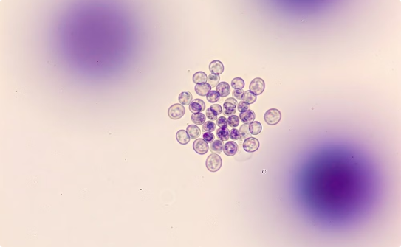
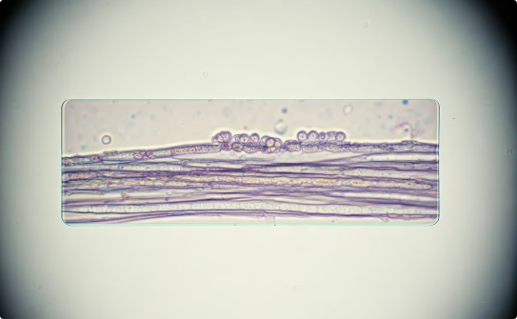
Image 11
Yeast Cell
Budding Yeast
Fungal Hyphae
This image displays a single yeast cell under the microscope. Yeasts are unicellular fungi that are important in a variety of fields, such as baking, brewing, and biotechnology. They are also a significant cause of infections in humans.
This image showcases a group of yeast cells undergoing budding. Budding is a form of asexual reproduction in which a new cell grows from a parent cell, eventually detaching to form a new individual.
The image demonstrates the branching and intertwining threads called hyphae. Hyphae are the main structural component of most filamentous fungi. They form networks called mycelia that extend through their environment, absorbing nutrients.

Slide 4
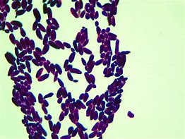
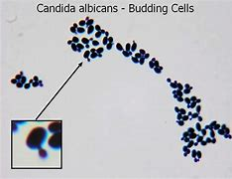

Slide 5
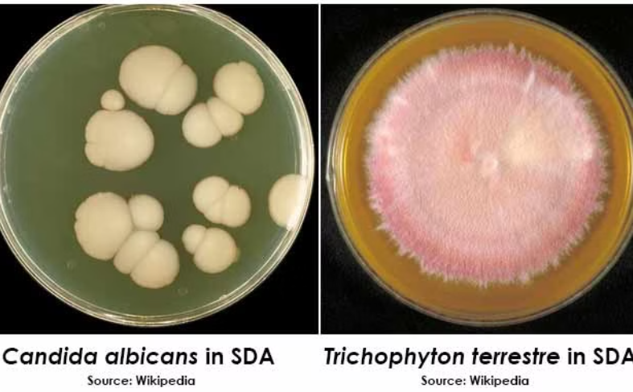
Image 12
Fungal Spores
This image showcases fungal spores, which are reproductive units responsible for the dispersal and propagation of fungi. Fungal spores can be dispersed by wind, water, or animals, contributing to the widespread distribution of fungi in various environments.

Slide 6
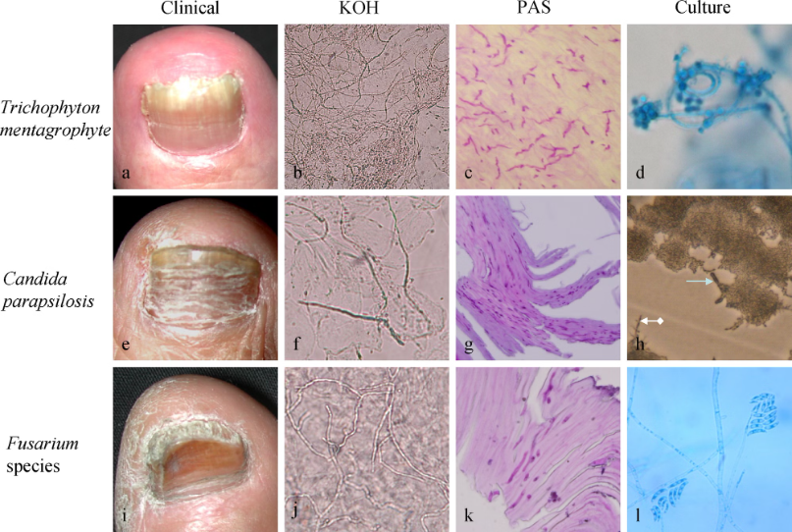
Image 13
Fungal hyphae are visible in the image. The image uses a light microscope with a 40x magnification.
Note the long, filamentous structures. This is the characteristic morphology of hyphae. They are responsible for the growth and spread of the fungus. They may branch to form a network called a mycelium.

