Slide 1

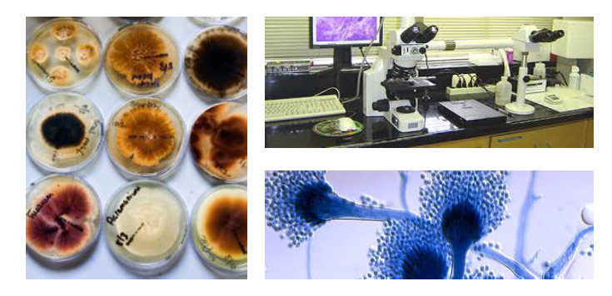
Lab 1 : collection and transport of fungal specimen

Slide 2
What is Fungi?
Fungi are eukaryotic organisms that include microorganisms such as yeasts, moulds and mushrooms. These organisms are classified under kingdom fungi.
The organisms found in Kingdom fungi contain a cell wall and are omnipresent. They are classified as heterotrophs among the living organisms

Slide 3
Characteristics of Fungi
Following are the important characteristics of fungi:
Fungi are eukaryotic, non-vascular, non-motile and heterotrophic organisms.
They may be unicellular or filamentous.
They reproduce by means of spores.
Fungi lack chlorophyll and hence cannot perform photosynthesis.
Fungi store their food in the form of starch.
Biosynthesis of chitin occurs in fungi.
The nuclei of the fungi are very small.
The fungi have no embryonic stage. They develop from the spores.
The mode of reproduction is sexual or asexual.
Some fungi are parasitic and can infect the host.
Examples include mushrooms, moulds and yeast

Slide 4
Specimens in mycology lab include
• Skin scraping • Urine
• Nail •Bone marrow
• Hair • Vaginal swap
• Biopsy tissue • Abscesses
• Blood • Bronchial brush
• CSF
• Body fluids
• Sputum

Slide 5
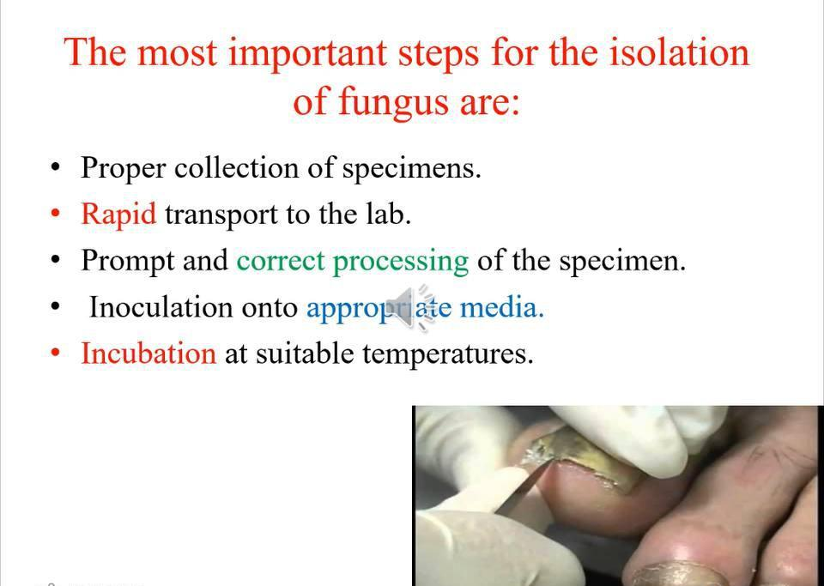

Slide 6
Processing of clinical specimens:
1- Macroscopic examination
2- Microscopic examination
3- Culture
4- Biochemical reactions
5- Serology

Slide 7
Macroscopic examination:
• Proper collection of specimen (proper
container and should be in plastic bag, no leaking, labeled)
• Good quantity of specimen
• Color of the specimen
• Consistency
• Presence of blood, mucus or pus

Slide 8
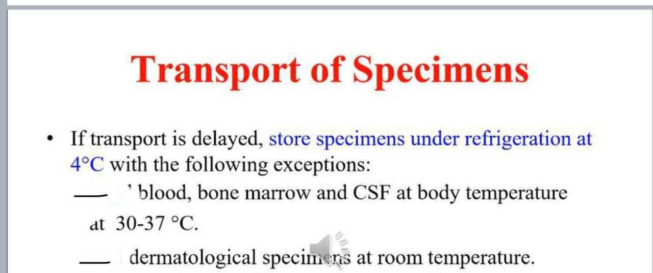

Slide 9
Direct microscopic examination (direct mount):
• 10% Potassium hydroxide (10% KOH) stain
• Periodic acid–Schiff (PAS) stain
• Giemsa stain
• Gram stain
• Ziehl–Neelsen (ZN) stain
• Hematoxylin and eosin (H & E) stain
• Silver stain(GMS stain)
• Negative stain (India ink stain, Nigrosin stain)

Slide 10
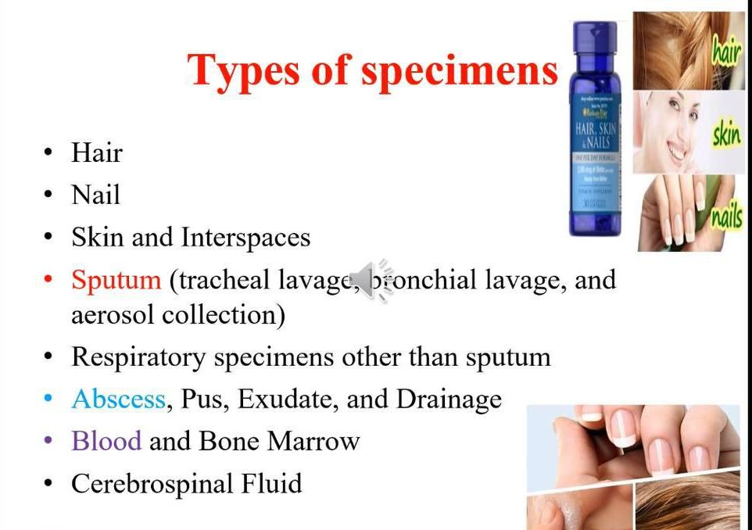

Slide 11
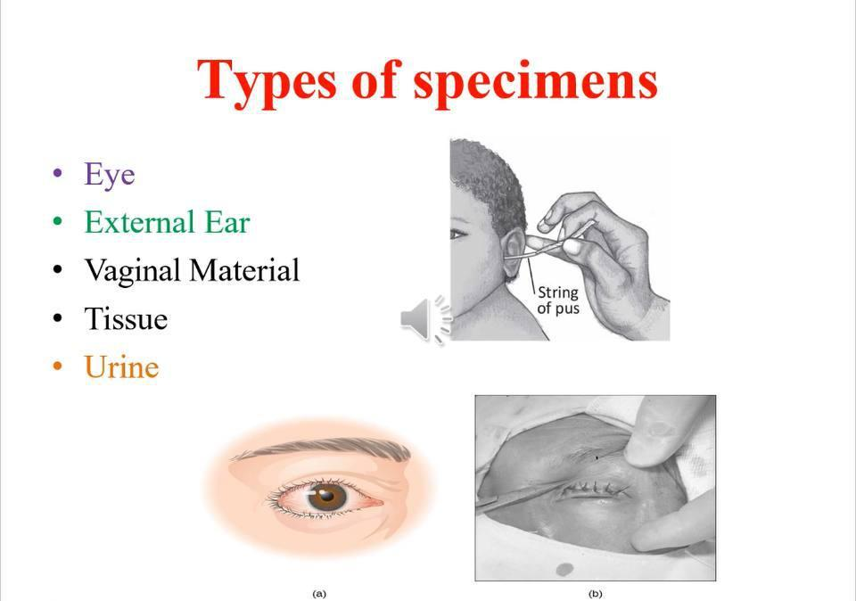

Slide 12
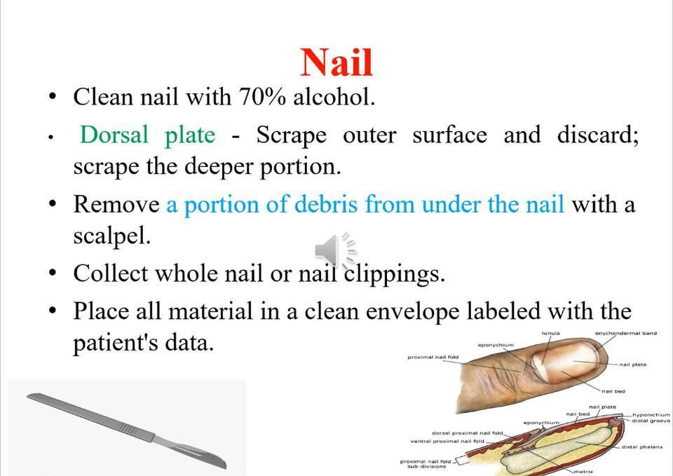

Slide 13
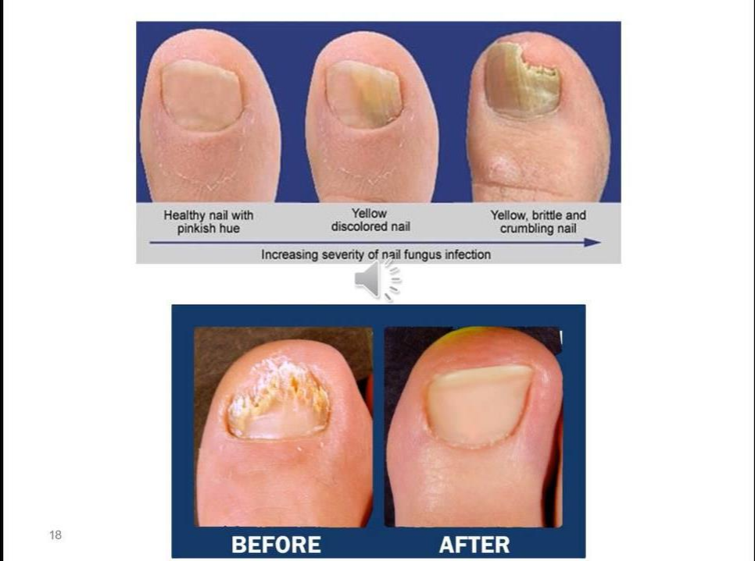

Slide 14
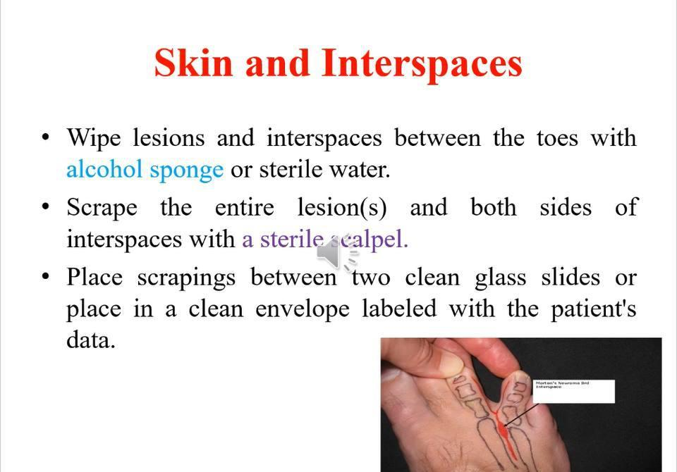

Slide 15
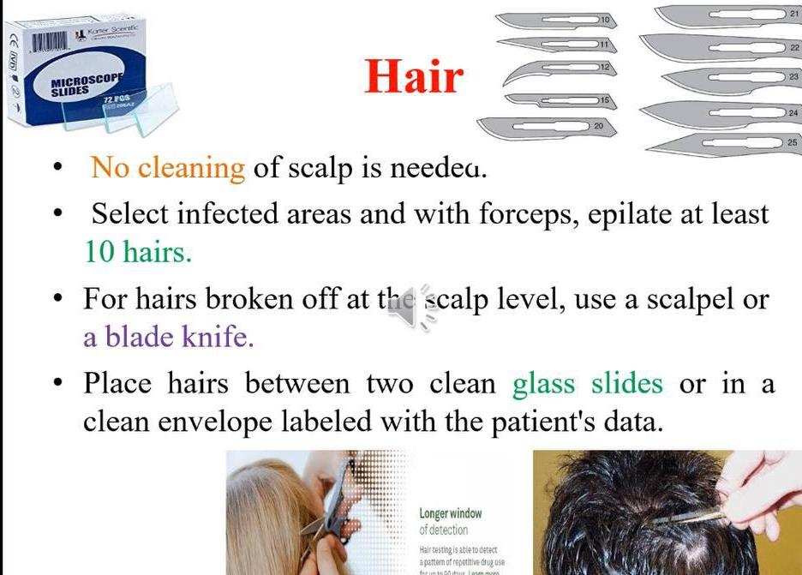

Slide 16
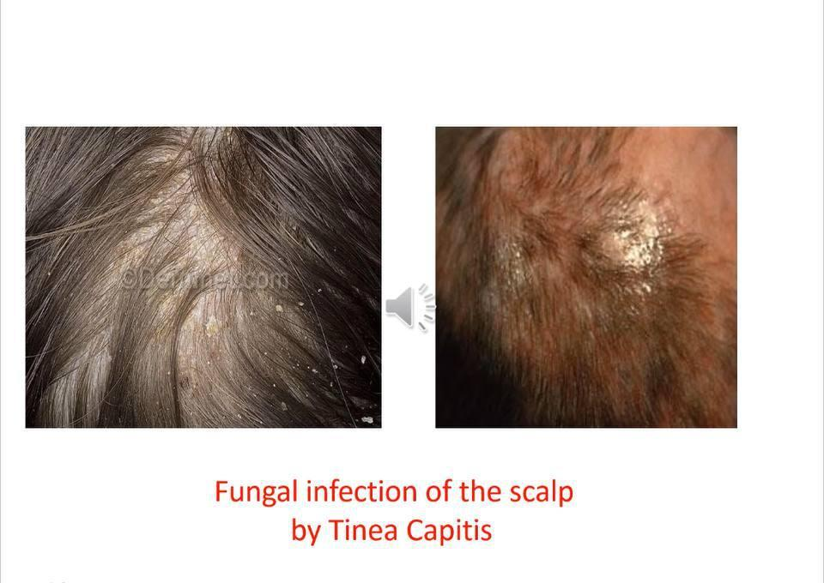

Slide 17
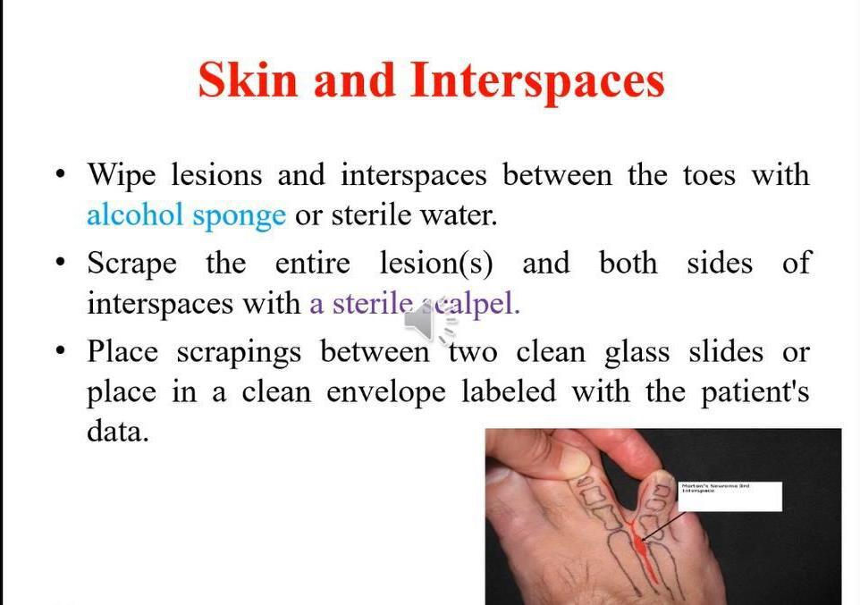

Slide 18
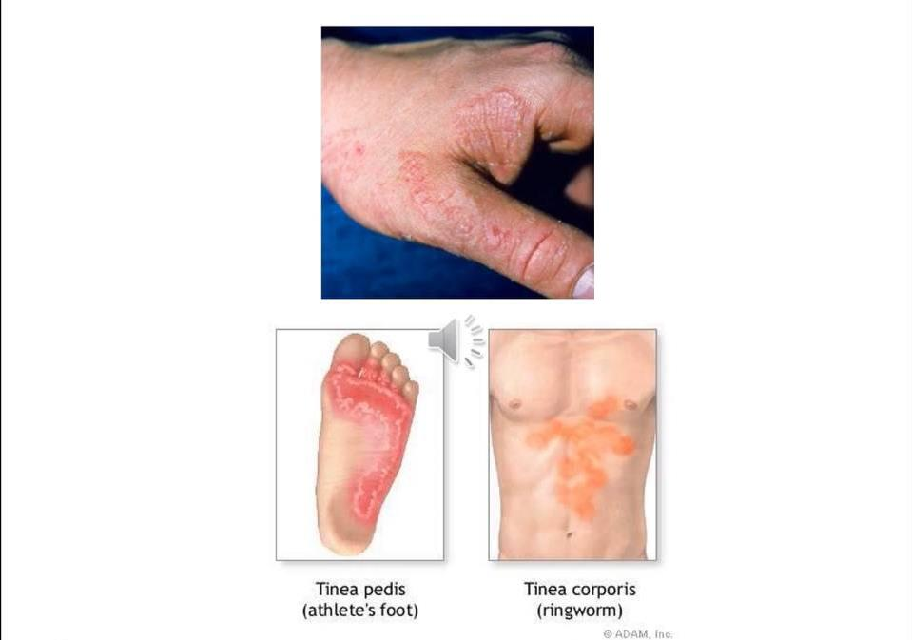

Slide 19
Skin scraping
1. DM examination: use 10% KOH or PAS stain
2. Culture: on SDA and SDA CC at 30°C
3. Microscopic ex. from culture: use LPCB
4. API 20C (if yeast)
Suspected fungi??

Slide 20
Hair Specimen
Collection:
• Take the infected hair shaft with its base
• The infected hair can be selected by using
Wood's lamp (UV light)>> green flourcens with
the infected hair
• Collect the specimen in sterile petri dish then
take it to the lab for processing.

Slide 21
Hair Specimen
1. Macroscopic ex.: see if there’s a􀅶y 􀅶odules
2. DM ex.: use 10% KOH or PAS stain
3. Culture: on SDA, SDA CC and BHI at 30°C
4. Microscopic ex. from culture: use LPCB
5. API 20C (if yeast)
Suspected fungi??

Slide 22
Nail Specimen
1. DM ex.: use 10% KOH or PAS stain
2. Culture: on SDA and SDA CC at 30°C
3. Microscopic ex. from culture: use LPCB
4. API 20C (if yeast)
Suspected fungi??

Slide 23
