Slide 1
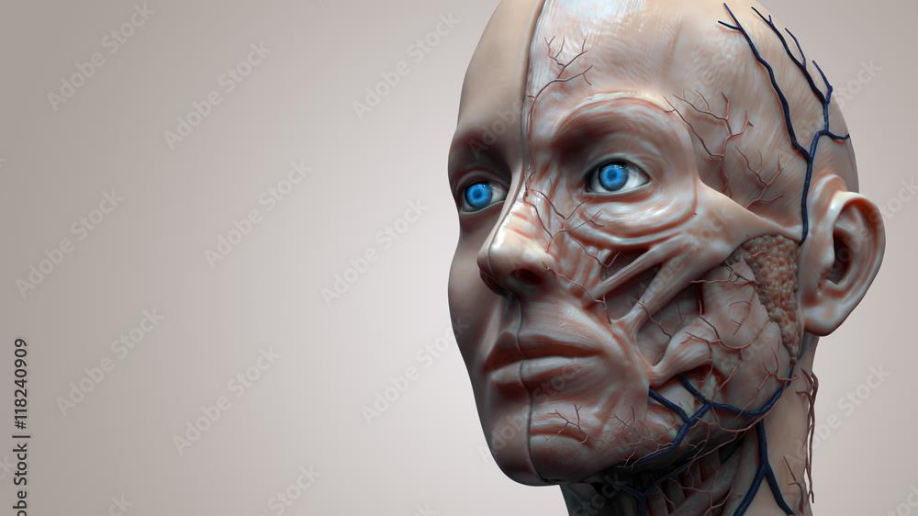
Human Anatomy
Second Year Dentistry
2024-2025
Lec1
The Scalp

Slide 2
Anatomy of the Scalp

Slide 3
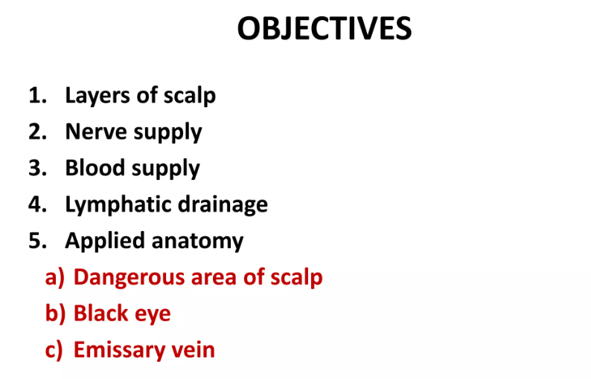
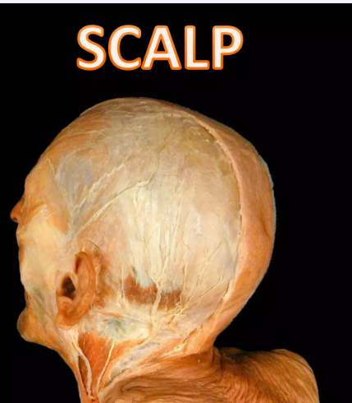

Slide 4
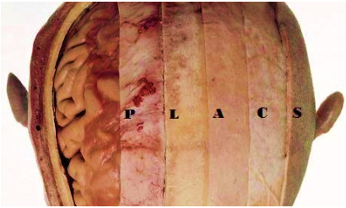
Layers of the Scalp

Slide 5
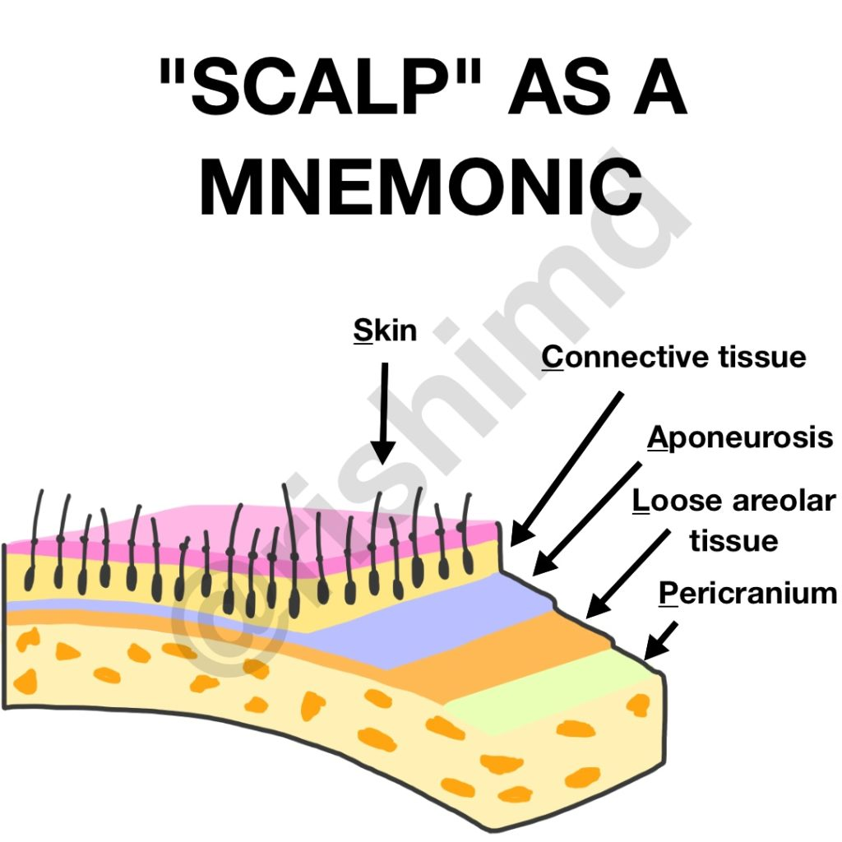

Slide 6
Structure
The scalp consists of 5 layers, the first
three of which are intimately bound
together and move as a unit.

Slide 7
Skin
which is thick and hair bearing and contains numerous sebaceous glands(thus a common site for sebaceous cysts).
the skin is made of 4 histologic layers;
1- epidermis, 2- dermis, 3- hypodermis,4- sebaceous layer.

Slide 8
Dense connective tissues; are formed of collagen fibers heavily condensed together arranged longitudinal and horizontally. –
connects the skin to the epicranial aponeurosis.
It is richly vascularised and innervated.
The blood vessels within the layer are highly adherent to the connective tissue. This renders them unable to constrict fully if lacerated – and so the scalp can be a site of profuse bleeding.
The arteries are branches of the external and internal carotid arteries, and a free anastomosis takes place between them.

Slide 9
Aponeurosis (epicranial),
a thin, tendon-like structure that connects the occipitalis and frontalis muscles .
The lateral margins of the aponeurosis are attached to the temporal fascia.
The subaponeurotic space is the potential space beneath the epicranial aponeurosis.
It is limited in front and behind by the origins of the occipitofrontalis muscle, and it extends laterally as far as the attachment of the aponeurosis to the temporal fascia
.
.

Slide 10
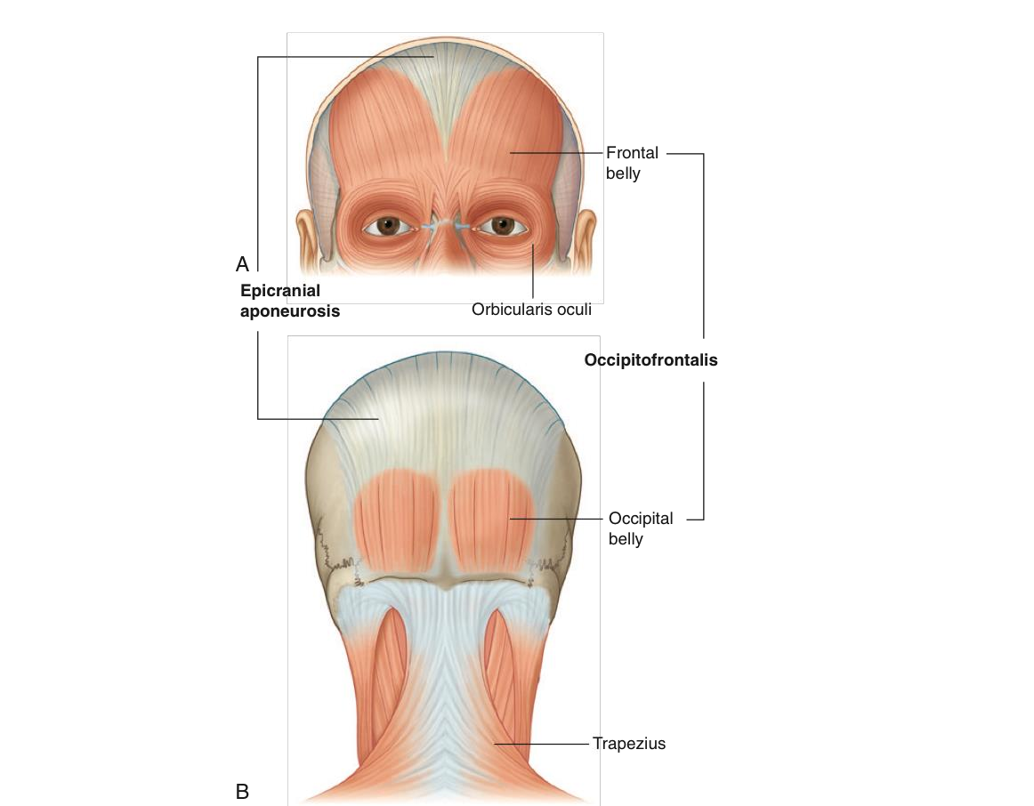

Slide 11
Loose areolar tissue,
which occupies the subaponeurotic space and loosely connects the epicranial aponeurosis to the periosteum of the skull (the pericranium).
The areolar tissue contains a few small arteries, but it also contains
some important emissary veins.
The emissary veins are valveless and connect the superficial veins of the scalp with the diploic veins of the skull bones and with the intracranial venous sinuses.

Slide 12
The loose connective tissue layer is considered the “danger area” of the scalp. This is because is contains the emissary veins – these are valve less veins which connect the extra cranial veins of the scalp to the intracranial Dural venous sinuses.
The emissary veins are a potential pathway for the spread of infection from the scalp to the intracranial space.

Slide 13
Pericranium,
which is the periosteum covering the outer surface of the skull bones. It is important to remember that at the sutures between individual skull bones, the periosteum on the outer surface of the bones becomes continuous with the periosteum on the inner surface of the skull bones

Slide 14
