Slide 1
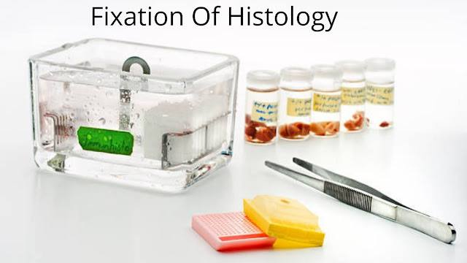
Fixation of tissues
Lab 4
Ms.c. Fadhela Nafi Alrawi

Slide 2
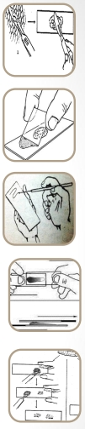
What is Fixation of Tissue?
Fixation is a complex series of chemical events which brings about changes in the various chemical constituents of cell like hardening, however the cell morphology and structural detail is preserved.
Unless a tissue is fixed soon after the removal from the body it will undergo degenerative changes due to autolysis and putrefaction so that the morphology of the individual cell will be lost.

Slide 3
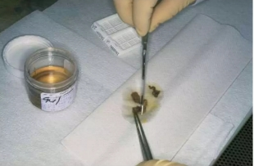
Properties of Fixation
To preserve the tissues as close to their living state as possible
To prevent autolysis and putrefaction.
To prevent tissues from changing their shape and size during processing
To harden the tissues
To allow clear staining of sections subsequently
To improve the optical differentiation of cells & tissues.

Slide 4
Types of Fixation
Coating/Spray fixation
Freeze drying
Microwave fixation/Stabilization
Immersion fixation (human and animal)
Perfusion fixation (only for animal)
Vapor fixation (osmiumte troxide solution)
Choice of fixative - The choice of fixative depends on the treatment a tissue is going
to receive after fixation e.g., what is the chemical structure that needs to be stained? If
fat is to be demonstrated the formalin fixed tissue is better. For demonstration of
glycogen formalin should never be used instead alcohol should be the choice of fixative.

Slide 5
:Sample collection and preservation
Take of small piece of tissue
Piece is removed with sharp knife in a particular orientation.
Size of 1 cm to achieve better penetration of fixative
Washing the specimen with normal saline to achieve maximum penetration of fixative.
At the time of tissue collection, it should be kept in mind that the representative tissue piece should include the part of lesion and a part of normal tissue.
Tissue pieces for histopathological exanination should be collected from all the organs.
Tissues should be collected directly in the fixative and not in any other pot or water.
The tissue pieces from hollow organs like intestines, oviduct etc should be cut transversely and placed on a hard paper.
The representative tissue should not be collected from such damaged portions.
The sample information sent to the laboratory must be recorded: number, name, date, and sample type.

Slide 6
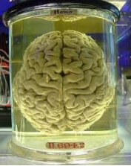
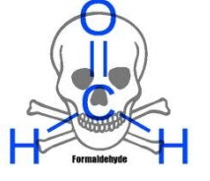
Commonly used Fixatives
Formalin solution 10 %
Buffered Formalin Neutral solution
Formalin Alcohol. (glyogen, good cytoplasmic fixation)
Bouin's Fluid. (embryological specimens, Purkinje cells)
Aceton
Ethyl Alcohol. (glycogen, pigments, amyloid, hylaine, elastic fibers and bacteria)
Glacial acetic acid. (rapid fixation, swelling of cells)
Potassium Dichromate.

Slide 7
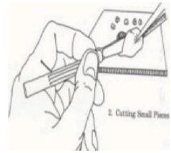
Fixation Steps
solution for 20-24 h:
Trimming of tissue: The tissue is cut and placed in special capsules and each capsule is numbered according to the record number attached to the register.
Washing of the Tissue: Washing of tissue under running tape water.
Dehydration: The purpose of dehydration to remove fixative and water from the tissue and replace them with dehydrating fluid.
Clearing : It involves removal of dehydrating agent and replacement by some fluid which is miscible with dehydrating agent.
10% Formalin Solution
37/40 C Formaldehyde 100 ml
Distilled water 900 ml
Types of dehydrating agents:
Ethanol
Methanol
Acetone

Slide 8
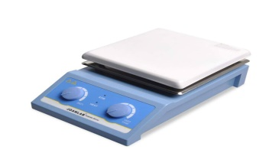
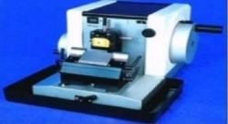
Fixation Steps
Wax Impregnation/ infiltration: The capsules are placed in the impregnation device after washing them with running water and the device takes approximately 20 hours and has several stages of alcohol (different concentrations from low to high to extract water molecules and replace them with alcohol to facilitate the penetration of wax into it later) - ethanol - and finally wax.
Blocking/Emebbing : At the time of transfer of tissuE blocks from Il, the paraffin wax must be kept (60-62'C) in liquid brm at a temp. 2 or 3 the melting point .
Hotplate device :The capsules are placed on the hotplate device (table heater) and the wax is melted and its surfaces are made as flat as possible and placed in other molds and then the wax is poured over them.
It is placed in the freezer for about 1 hour until it freezes
MICROTOMY:It is placed on the microtome device for trimming (slipping) at a temperature of 20 micro

Slide 9
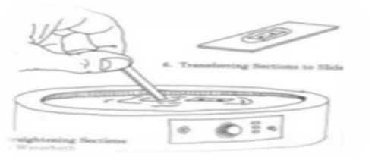
Fixation Steps
FLOATING &PICKING UP S CTIO: The ribbon is floated on the water surface heated at 45 C.
Drying section: The slides are placed in a special basket and in another container the xylene is placed and they are placed in the incubator separately at 70 degrees for 20 minutes.
The basket is placed in the xylene container for another 20 minutes
Pre staining preparation:
The basket is removed from the xylene package and is placed in a gradation of alcohols from 100 to 60 in each gradation for 2 minutes. The purpose of this is to extract alcohol molecules from inside the tissue and replace them with water molecules to facilitate the penetration of the dye into the tissue.
The basket is removed from the xylene package and is placed in a gradation of alcohols from 100 to 60 in each gradation for 2 minutes. The purpose of this is to extract alcohol molecules from inside the tissue and replace them with water molecules to facilitate the penetration of the dye into the tissue.
The albumin material is placed to fix on the slide and then the strips are carried on the slides

Slide 10
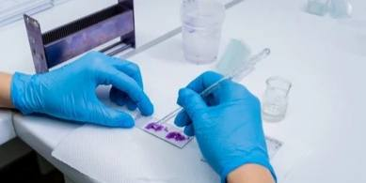
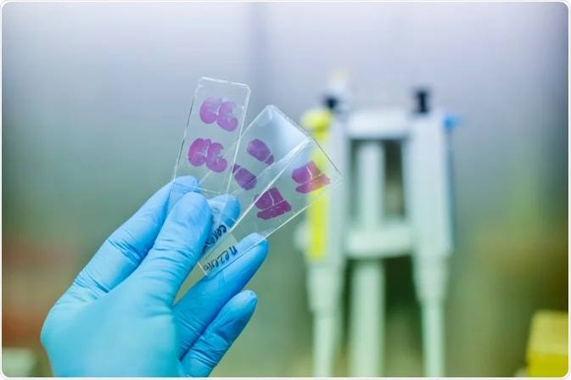
Fixation Steps
It is placed in eosin stain (an acidic stain that stains the acidic parts of tissue cells) for 2 minutes.
- It is washed with running water.
- It is washed with distilled water.
- It is repeated in alcohol in sequence from lowest to highest 60 to 100 in each concentration for 15 seconds.
This completes the staining process.
- The DBX material is placed on the slides, which gives them a shiny and glossy appearance under the microscope, and then the cover slide is placed.
- It is left to dry and then it is ready for examination and storage.

Slide 11
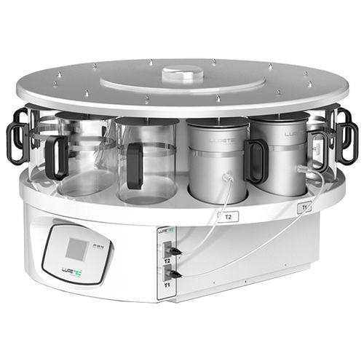
NOTE
•To minimize tissue distortion from diffusion currents, delicate specimens are
dehydrated in a graded ethanol series from water through 10%-20%-50%-95%-
100% ethanol.
Factors affecting fixation
1. Temperature
2. Volume of tissue.
3. Exposure time and duration
Automatic tissue processor

Slide 12
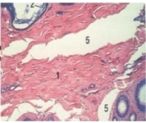
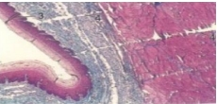
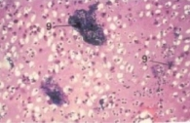
Helpful hints
Tissue may be subjected t excessive pressure, tensi01t or shrinkage during processing resulting in separations of tissue
Knife marks Caused by defects in the microtome knife or by accumulation of debris on the knife edg
Occasionally , solution accumulate precipitate that may stick to the surface tissue section during staining procedure

Slide 13
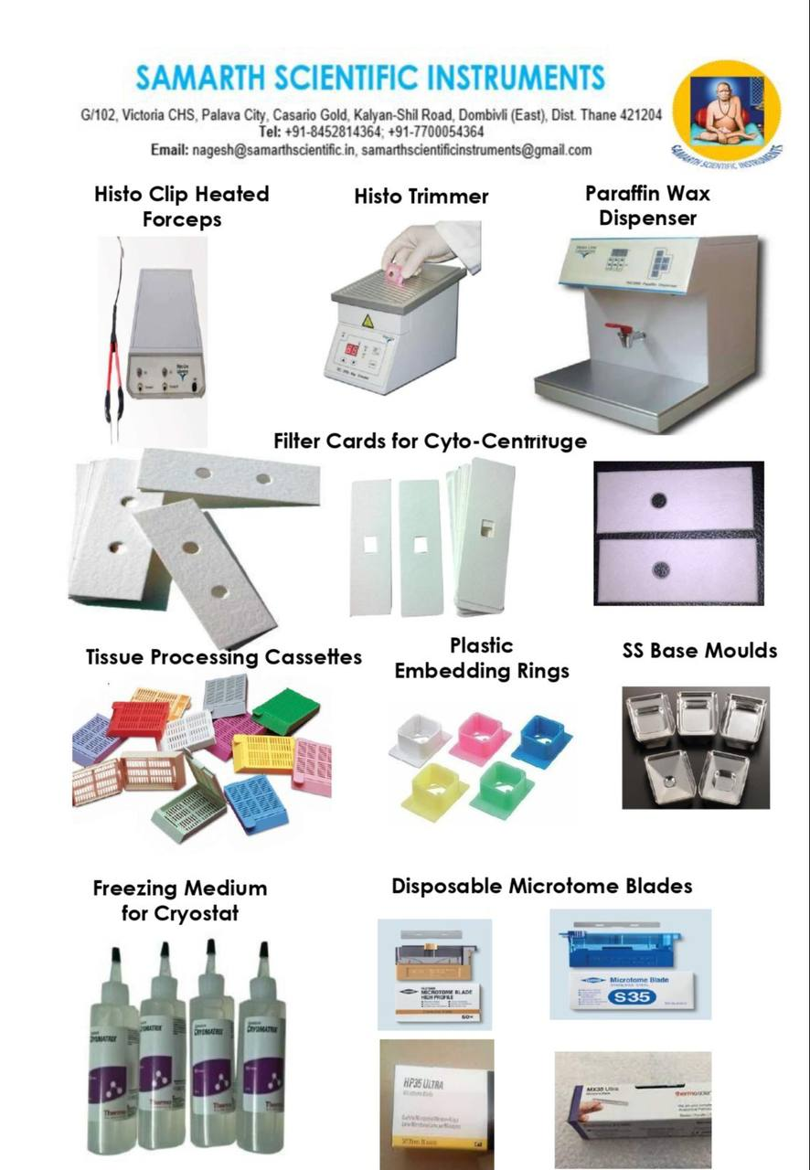

Slide 14
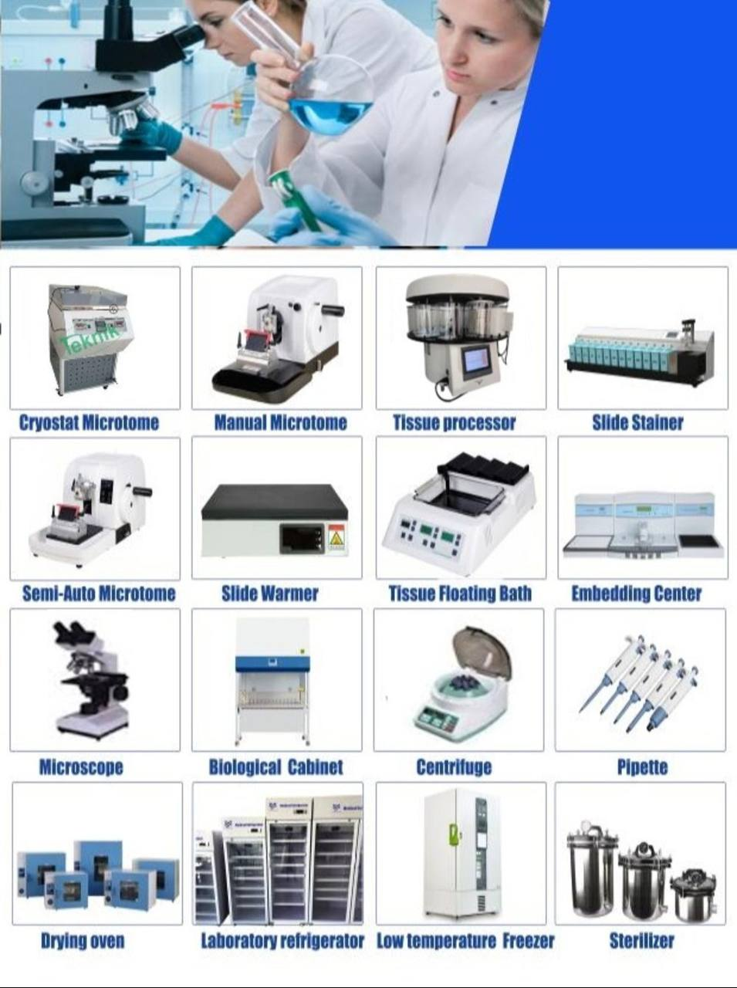

Slide 15
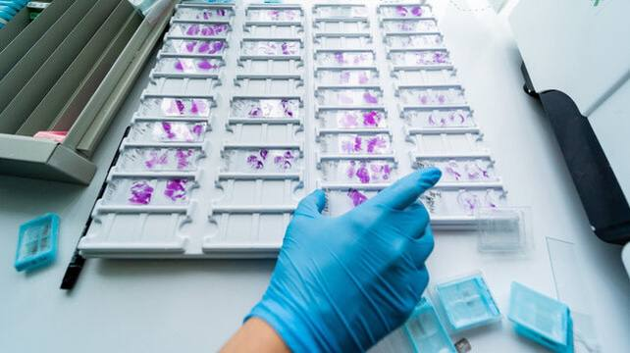
Thank you

