Slide 1
Object Oriented Programming
Almaarif University-College of Science
Computer Science Department

Slide 2
C++ Classes and Objects
The main purpose of C++ programming is to add object orientation to the C programming language and classes are the central feature of C++ that supports object-oriented programming and often called user-defined types.
A class is used to specify the form of an object and it combines data representation and methods for manipulating that data into one neat package. The data and functions within a class are called members of the class.

Slide 3
A Class definition
A class definition starts with the keyword class followed by the class name; and the class body, enclosed by a pair of curly braces. A class definition must be followed either by a semicolon or by a list of declarations.
Example:
Class Student {
public:
string name;
int age;
string college;
};

Slide 4
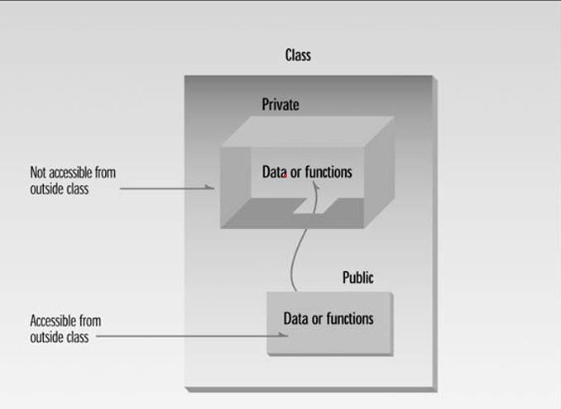

Slide 5
Define C++ Objects
A class provides the blueprints for objects, so basically an object is created from a class. We declare objects of a class with exactly the same sort of declaration that we declare variables of basic types. Following statements declare two objects of class Student:
student obj1;
student obj2;
It is important to note that private and protected members can not be accessed directly using direct member access operator (.). We will learn how private and protected members can be accessed.

Slide 6
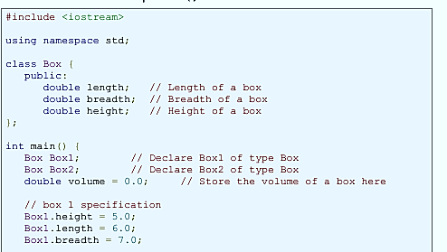

Slide 7
