Slide 1
Chapter 1
HTML & CSS Integration
Dr. Ahmad Al-Sabhany

Slide 2
Outline
Introduction
Common HTML Tags
Common CSS Properties
HTML & CSS Integration
CSS Overlap
HTML ID Attribute with a tag & css
CSS Selectors
Showcases & Try yourself!

Slide 3

Introduction
HyperText Markup Language (HTML) tags are the main components of the web page.
They represent the elements that all the page content are based in.
The cascading style sheets (CSS) represents the styling factors that are attached to elements.
HTML tags
<div>
CSS
Color: white;
Background-color: blue;
…

Slide 4
Common HTML Tags
HTML
It is used as
<html></html>
It is the building tag for HTML. If you are creating an HTML file you have to use incorporate all your content inside HTML tag.
HEAD
Once you open the HTML tag, the head tag should be the first thing to come. It is the tag which does not contain any text but encompasses all the other tags. Tittle, style, Meta etc. all the tags are written inside it. It is used to describe the content on the website.
Syntax:
<head></head>

Slide 5
Common HTML Tags
TITLE
This tag is used when you want to give a title to your content. The title tag also comes under the head tag. It does not include any other tag inside it. Only text can be written inside this tag.
Example:
<title> this is WEB PAGE TITLE<\title>
BODY
Anything which you see on the website is written under this tag. So the content which you want should be visible to people, has to be incorporated into body tag. One thing to remember is this comes after the head tag.
An example to use it is:
<Body>this is the body</body>

Slide 6
Common HTML Tags
DIV
The div tag, also known as the division tag, is used to define the division of the content in the file. It often acts as a container for the other elements or tags in the file. This is usually used for styling the content in the file. It is used as
<div></div>
P
Paragraph Hitting a return in the HTML file will not make a new paragraph when the file is viewed. You need to use this tag to make a new paragraph.
<P> This is a new paragraph...</P>
SPAN
It is used to wrap the entire text in the file. It is basically used to group the inline content of the file. It is used as:
<span>Ahmad AlSabhany</span>

Slide 7
Common HTML Tags
A
This is the hyperlink tag. In this tag, you can pass a link of page or website where you will like to direct the viewer. It consists of “href” attribute which is very important as the destination is passed into this attribute.
Example:
<a href="https://www.google.com">go to google</a>.
BR
It is the line break command which is used to break the lines inside the file. All it does is to add spacing in the paragraph and ensure that the line following it appears in the new line. There is no closing tag for <br>
Syntax:
<br>

Slide 8
Common HTML Tags
Heading Tags
<H1> . . . </H1> First-level heading large text size
<H2> . . . </H2> Second-level heading
<H3> . . . </H3> Third-level heading
<H4> . . . </H4> Fourth-level heading
<H5> . . . </H5> Fifth-level heading
<H6> . . . </H6> Sixth-level heading small text size
STRONG
<strong> tag is used to declare the important text in the file. All it does is that it put the text into bold. This is done so that important text can easily be read by the viewer.
Example:
<strong> this is strong text</strong>
<B>Bold text . . . </B> Bold Makes text bold
<I> Italic Text. . . </I> Italic Makes text italic

Slide 9
Common HTML Tags
UL
Ul tag is used to define the unordered list in the file. It posts the limits with bullets on the website. This is a block-level element in which List Items are placed.
Syntax:
  <ul>
  <li> Item 1
  <li> Item 2
  </ul>

Slide 10
Common HTML Tags
OL
Ol tag is used to define an ordered list in the file.
Syntax:
  <ol>
    <li>fictional</li>
    <li>classic</li>
    <li>mystery</li>
  </ol>

Slide 11
Common HTML Tags
LI
Li tag is used along with the tag to pass the hierarchy of list in the file. When you want to pass a list inside a list we make use of li tag.
Example:
  <ul>
    <li>fictional</li>
    <li>classic</li>
    <li>mystery</li>
  </ul>

Slide 12
Common HTML Tags
TABLE
It is the table tag which is declared as
<table></table>
Although this tag won’t make any difference unless some content is passed into it. There are many other tags which are passed along with it to provide the layout.
THEAD
It is another one of the table tags which is used to group the header content of the table in a file. It represents the top row of table which provides the heading for the columns.
<thead></thead>

Slide 13
Common HTML Tags
TBODY
It is another one of the table tags which is used to group the body content of the table in a file. Used within the table tags and is used to show actual table data (it’s used after “<thead>” tag (if any).
Syntax:
  <table>
  <tbody>
  <tr><td>Site</td><td>URL</td></tr>
  <tr><td>Facebook</td><td>https://facebook.com</td></tr>
  <tr><td>google</td><td>https://www.google.com</td></tr>
  </tbody>
  </table>

Slide 14
Common HTML Tags
TR
This tag is passed inside the table tag. It is used to declare the table row. Even this tag is void until tags which pass the content are passed into it. It is written as <tr></tr>. It contains at least one <td> or <th> element into it.
TD
This tag is passed inside the <tr> tag. It can contain any content inside itself. It is used to define the content which should be passed in the table row. Content inside <td></td> is equivalent of one cell. <tr> is the beginning of a new row. The syntax for this tag is:
<tr><td>Value1</td><td>Value2</td></tr>
Above example has one row with two columns.

Slide 15
Common HTML Tags
SCRIPT
When you want to define the client-side script inside your file, you use script tag. It usually contains the scripting statement inside it or may direct towards any other using src attribute. It also might contain javascript and plugin files to make the webpages interactive.
Syntax:
  <script>
  <!-- javascript code -->
  </script>

Slide 16
Common HTML Tags
IMG
If you wish to put any image in the HTML files, you can do the same using img tag. You can define the height and width of the image using other attributes inside it and thus, can customize image according to yourself.
Syntax:
<img src=https://bitarray.io/images.logo.png alt="bitarray logo">
<img> tag has no closing tag.

Slide 17
Common HTML Tags
HR
This tag is used to depict the change of themes within the content of the file. When there is any change between the content we use <hr> tag. It separated the content into two so that changes are easily visible to the viewer. It inserts a horizontal line. till HTML 4.01 it used to represent the horizontal rule.
Example:
<h1> heading 1</h1>
//line 1
//line 2
//line 3
<hr>
<h2>heading 2</h2>

Slide 18
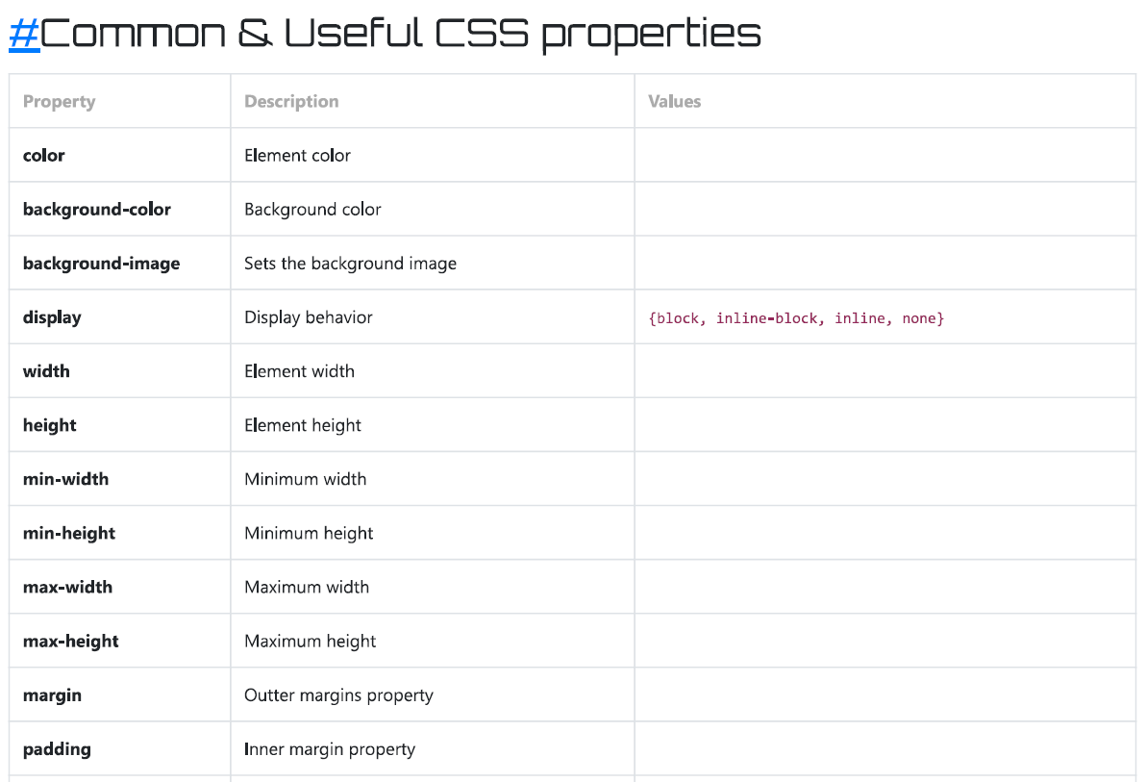
Common CSS Properties

Slide 19
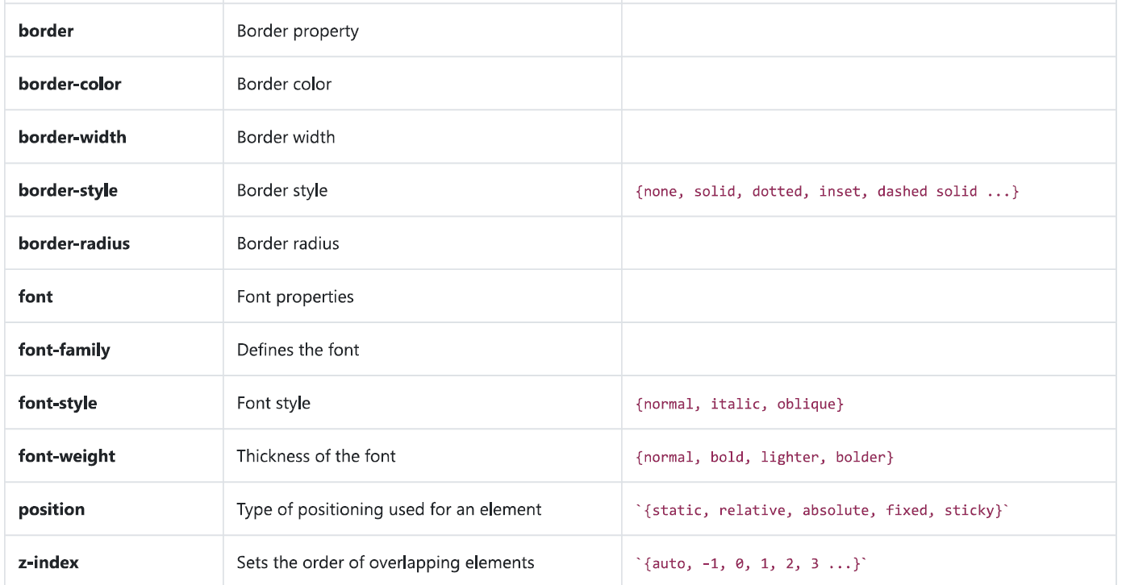
Common CSS Properties

Slide 20
HTML & CSS Integration
Three Ways to Insert CSS
  External CSS (Pro)
  Internal CSS (Useless)
  Inline CSS (Fast)

Slide 21
Inline CSS (Fast)
An inline style may be used to apply a unique style for a single element.
To use inline styles, add the style attribute to the relevant element. The style attribute can contain any CSS property.
<!DOCTYPE html>
<html>
<body>
<h1 style="color:blue;text-align:center;">This is a heading</h1>
<p style="color:red;">This is a paragraph.</p>
</body>
</html>

Slide 22
Internal CSS (Useless)
An internal style sheet may be used if one single HTML page has a unique style.
The internal style is defined inside the <style> element, inside the head section.
<!DOCTYPE html>
<html>
<head>
<style>
body {
background-color: linen;
}
h1 {
color: maroon;
margin-left: 40px;
}
</style>
</head>
<body>
<h1>This is a heading</h1>
<p>This is a paragraph.</p>
</body>
</html>

Slide 23
External CSS (Pro)
With an external style sheet, you can change the look of an entire website by changing just one file!
Each HTML page must include a reference to the external style sheet file inside the <link> element, inside the head section.
<!DOCTYPE html>
<html>
<head>
<link rel="stylesheet" href="mystyle.css">
</head>
<body>
<h1>This is a heading</h1>
<p>This is a paragraph.</p>
</body>
</html>
body {
background-color: lightblue;
}
h1 {
color: navy;
margin-left: 20px;
}
HTML file
mystyle.css

Slide 24
HTML ID Attribute
The HTML id attribute is used to specify a unique id for an HTML element.
You cannot have more than one element with the same id in an HTML document.
Using The id Attribute
The id attribute specifies a unique id for an HTML element. The value of the id attribute must be unique within the HTML document.
The id attribute is used to point to a specific style declaration in a style sheet. It is also used by JavaScript to access and manipulate the element with the specific id.
The syntax for id is: write a hash character (#), followed by an id name. Then, define the CSS properties within curly braces {}.
In the following example we have an <h1> element that points to the id name "myHeader". This <h1> element will be styled according to the #myHeader style definition in the head section:

Slide 25
HTML ID Attribute – Example with CSS
<!DOCTYPE html>
<html>
<head>
<style>
#myHeader {
background-color: lightblue;
color: black;
padding: 40px;
text-align: center;}
</style>
</head>
<body>
<h1 id="myHeader">My Header</h1>
</body>
</html>

Slide 26
HTML ID Attribute – Example with a tag
<!DOCTYPE html>
<html>
<body>
  <p><a href="#C4">Jump to Chapter 4</a></p>
  <p><a href="#C10">Jump to Chapter 10</a></p>
<h2>Chapter 1</h2>
<p>This chapter explains ba bla bla</p>
<h2>Chapter 2</h2>
<p>This chapter explains ba bla bla</p>
<h2 id="C4">Chapter 4</h2>
<p>This chapter explains ba bla bla</p>
<h2 id="C10">Chapter 10</h2>
<p>This chapter explains ba bla bla</p>
</body>
</html>
Full Source
https://www.w3schools.com/html/tryit.asp?filename=tryhtml_id_bookmark

Slide 27
CSS Selectors
* all elements
div all div tags
div,p all divs and paragraphs
div p paragraphs inside divs
div > p all p tags, one level deep in div
div + p p tags immediately after div
div ~ p p tags preceded by div
.classname all elements with class
#idname element with ID
div.classname divs with certain classname
div#idname div with certain ID
#idname *all elements inside #idname

Slide 28
Show Case
Try it Yourself !
If you need help contact me at
alsabhany@uoa.edu.iq

